Slide 1


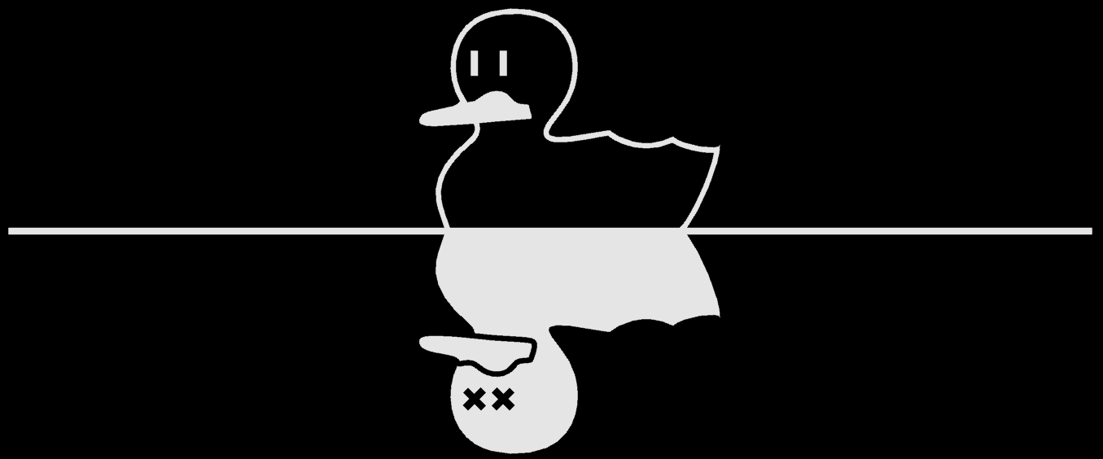
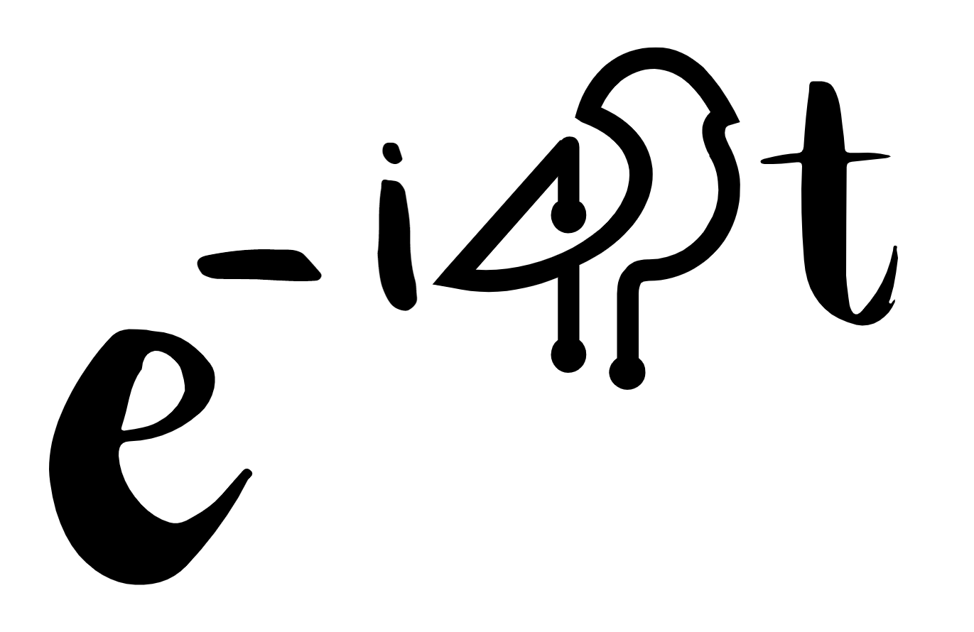
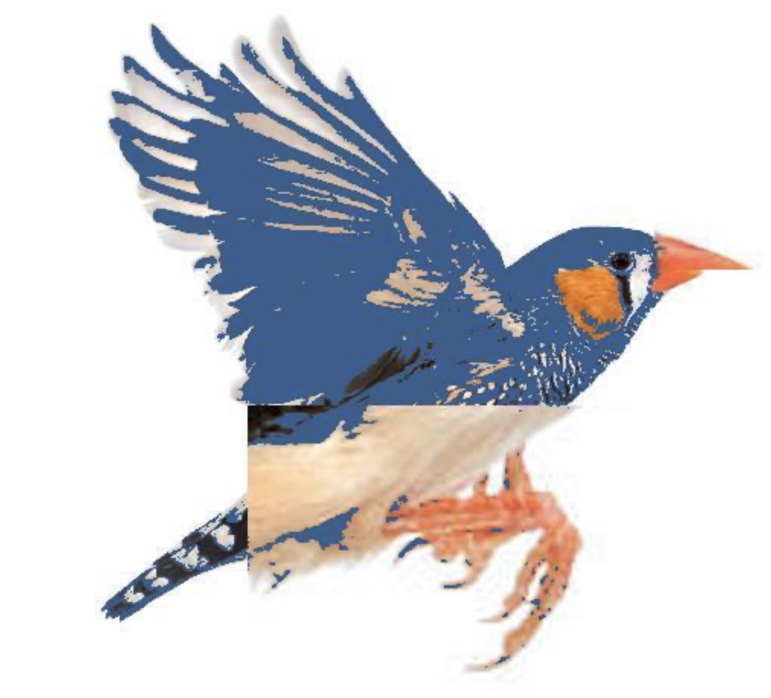


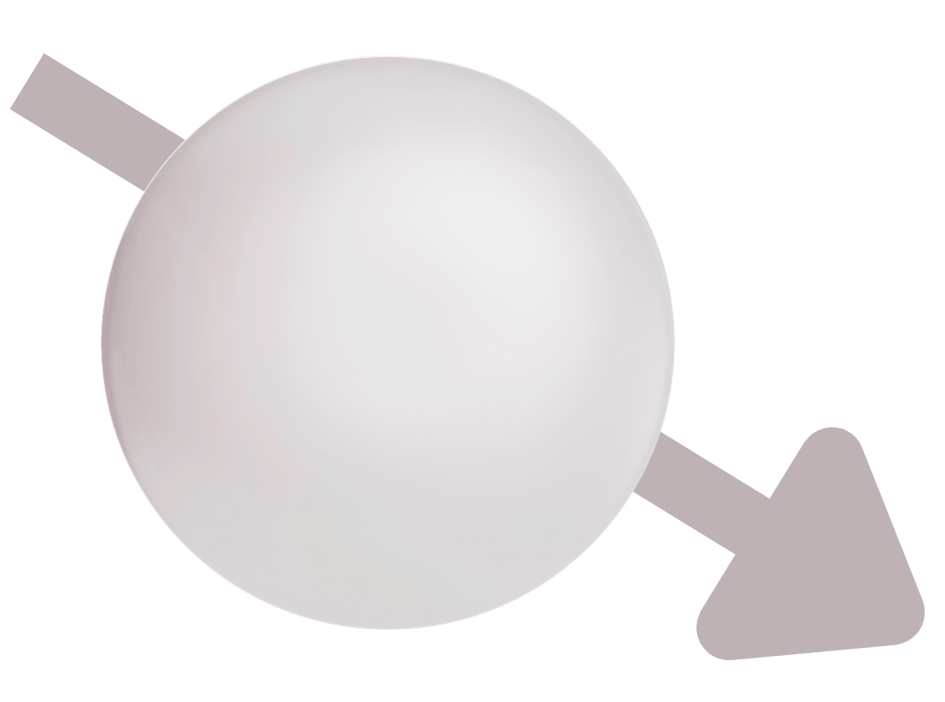

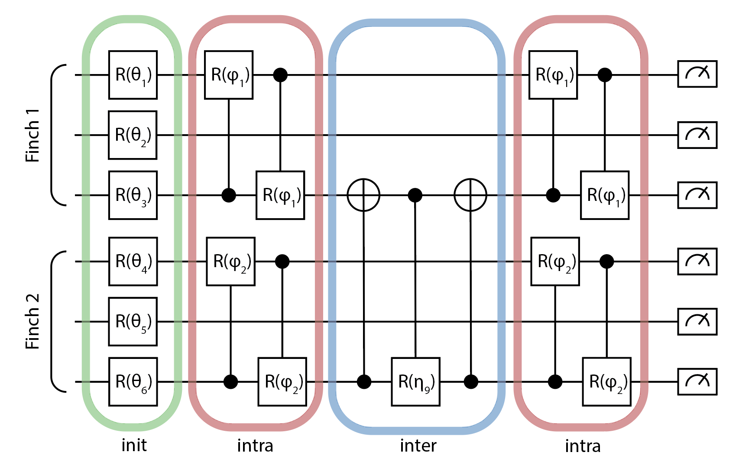
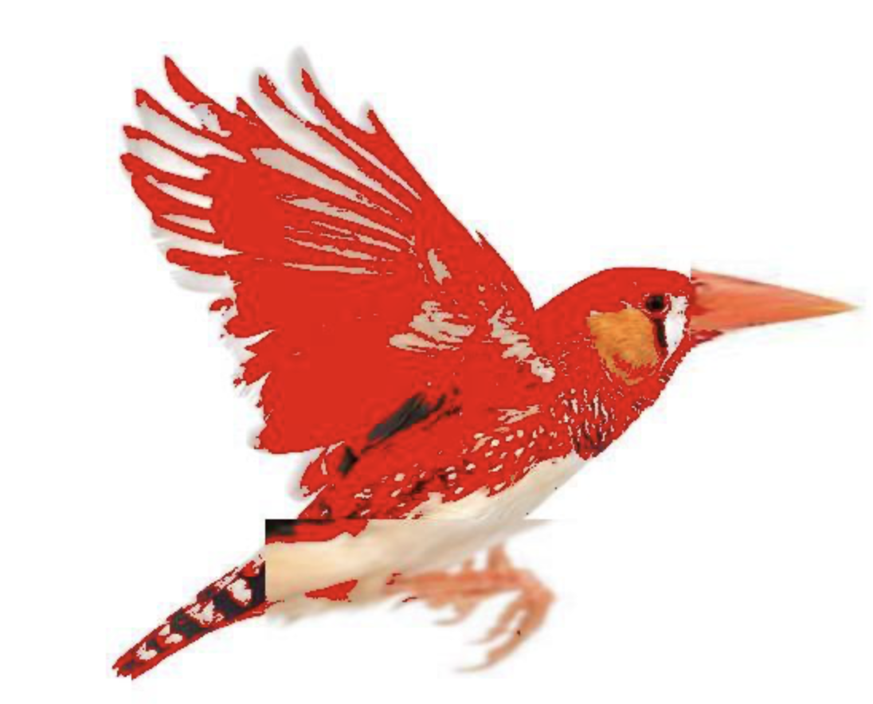
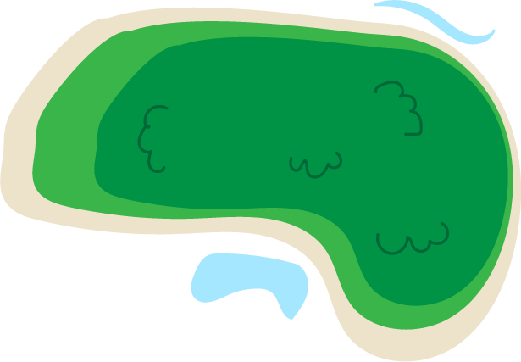


Game of Finches
Entanglement5
Single qubit gates: environmental constraints
Two qubit gates: genetic mixing of finch populations
Beagle
Interactive modelling of biological evolution on a trapped ion quantum computer

Slide 2
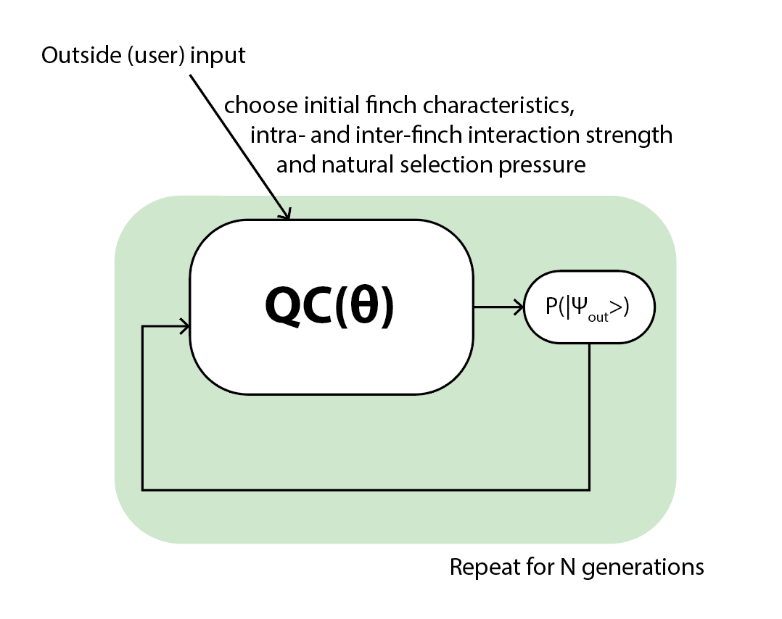
The approach

Slide 3
The quantum circuit

Slide 4
The quantum circuit

Slide 5
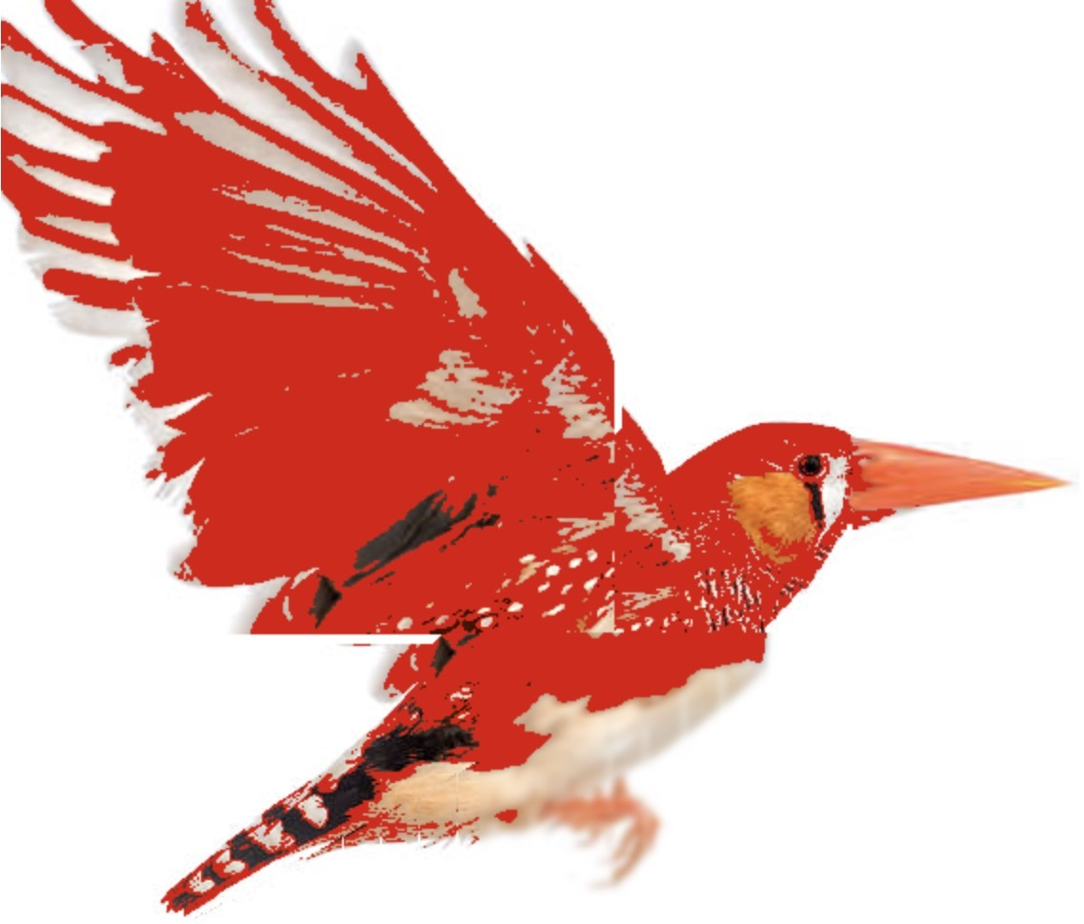
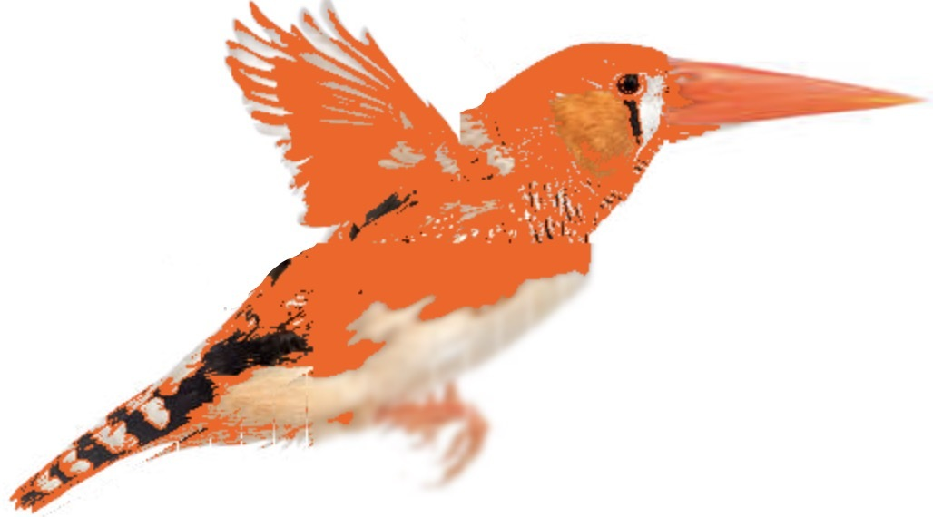
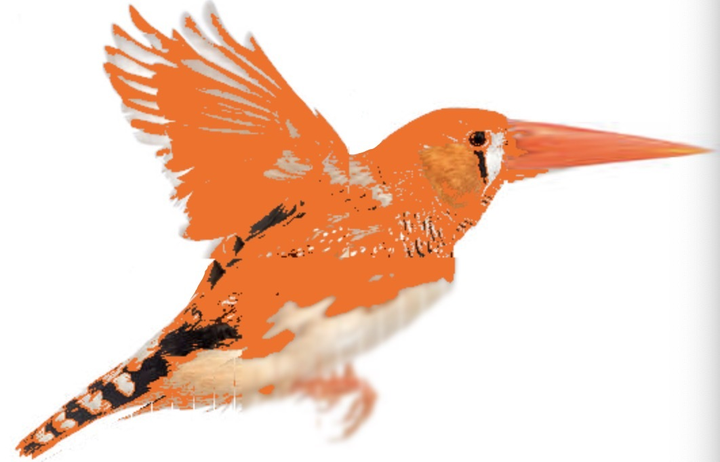

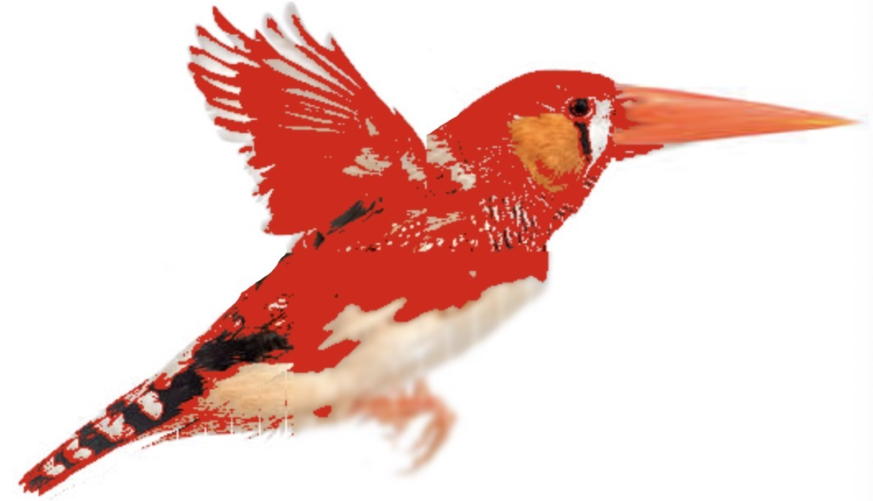
Finch evolution on Harmony
Finch 1
Finch 2
Gen 0
Gen 1
Gen 2

Slide 6
Finch Hall of Fame

