Slide 1
MASTER OF COMPUTER APPLICATIONS
Department of Computer Science and Engineering | University of Kalyani
Kalyani, India | June 2026
Diagonal Gradient Extension and
Otsu-Based Evaluation for
Lackadaisical Quantum Walk
Edge Detection
Presented by
Anish Chattopadhyay
Roll No. 90/MCA No. 240003
Under the supervision of Mr. Shambo Chatterjee

Slide 2
What is Edge Detection?
Original Image
Edge detection finds boundaries between regions of different pixel intensities in an image.
These boundaries correspond to object outlines, transitions in depth, and surface changes.
It is a fundamental step in computer vision pipelines — applied before recognition, segmentation, or compression.
Example: detecting the boundary of a car in an image before tracking it in a video.
🟫🟫⬛⬛⬛
🟫🟫⬛⬛⬛
🟫🟫⬛⬛⬛
▼
Edge Map Output
⬜⬜🔲⬜⬜
⬜⬜🔲⬜⬜
⬜⬜🔲⬜⬜
Edge = sharp change in pixel intensity

Slide 3
Why Do We Need Edge Detection?
Medical Imaging
Autonomous Vehicles
Remote Sensing
In medical imaging, doctors need to detect the boundary of tumors, organs, or tissues in MRI and CT scans. A small error in boundary detection can lead to incorrect diagnosis.
In autonomous vehicles, the car's computer must detect road lane boundaries, pedestrians, and obstacles in real time. If it misses an edge, it may not detect a person standing on the road.
In remote sensing, satellites take images of earth from space. Scientists use edge detection to identify rivers, coastlines, forests, and agricultural zones from these images.
Forensic Analysis
Image Compression
Object Recognition
In forensic analysis, edge detection helps identify tampered or forged digital photographs by finding unnatural boundaries.
In image compression, algorithms like JPEG remove non-edge regions first because they carry less information — but edges must be preserved.
In object recognition, the shape of an object is defined by its edges. A neural network uses edge features to classify whether an image contains a cat, a car, or a building.

Slide 4
Classical Edge Detection — Methods & Limitations
Classical Methods
Key Limitations
Sobel (1968) : uses two 3×3 convolution kernels — one for horizontal gradients and one for vertical gradients. Wherever the gradient is large, there is likely an edge.
Prewitt (1970) : similar to Sobel but uses uniform weights in the kernel.
Kirsch (1971) : compute gradients in all 8 compass directions and take the maximum, giving better directional sensitivity.
Canny (1986) : It has four steps — first it applies Gaussian smoothing to remove noise, then computes gradient magnitude and direction, then applies non-maximum suppression to thin the edges to single pixel width, and finally applies double thresholding with hysteresis to decide which edges are real and which are noise.
Time complexity O(N) — slow for high-resolution images
Noise sensitivity — require careful Gaussian sigma tuning
Fixed thresholds — cannot adapt to varying lighting
Sequential per-pixel processing — no parallelism
No quantum speedup — fundamentally classical
All classical methods scale linearly with image size — a fundamental bottleneck.

Slide 5
Why Quantum Computing for Edge Detection?
⚛ Superposition
🔗 Entanglement
A qubit can be 0 AND 1 simultaneously. A quantum circuit processes all N pixels in parallel — not one by one.
Qubits can share correlated states. Operations on one qubit instantly affect its partner — enabling global image operations.
📐 Quantum Parallelism
🎯 Amplitude Amplification
Grover's search finds a marked item in O(√N) steps vs O(N) classically — a quadratic speedup for edge search.
the probability of measuring a particular outcome is related to the square of the amplitude of that state. Quantum algorithms can deliberately increase the amplitude at desired states

Slide 6
Existing Quantum Edge Detection — The Core Problem
Method | Approach | Success Probability | Problem
QSobel | It encodes pixel intensities into a quantum representation called FRQI and applies quantum circuits to compute gradients. | pq ≈ 0.0095 | Extremely low — dominated by background noise
HED | Uses a Hadamard gate on pixel amplitudes to compute differences between adjacent pixels. | ph ≤ 0.0031 | Discards >50% probability mass on non-edges
Giri et al. 2025 ✓ | They proposed a completely different approach — treating edge detection as a quantum search problem using a lackadaisical discrete-time quantum walk | ps ≈ 0.98 | High — but oracle & post-processing undefined
⚠ Key gaps in Giri et al.: (1) Only 4-direction gradient oracle — misses diagonal edges. (2) Post-processing threshold never specified — not reproducible.

Slide 7
Baseline: Lackadaisical DTQWS (Giri et al. 2025)
Place each pixel at a vertex of an N₁ × N₂ lattice with 4 directed edges + 1 self-loop (weight s).
Mark edge pixels: pixels where gradient ≥ threshold ath form the set T_M.
Start quantum walk from uniform superposition |ψ_in⟩ over all N vertices.
Apply evolution U = S · C_G repeatedly: C_G flips the self-loop phase at marked vertices; S moves the walker.
After T iterations, measure — probability concentrates at edge pixels: p_s ≈ 0.98.
Image
Pixels
▼
Mark
Edges
(T_M)
▼
Initial
State
|ψ_in⟩
▼
Apply U
t times
▼
Measure
Edges
ps ≈ 0.98 | beats QSobel (0.0095) and HED (0.0031) dramatically

Slide 8
Contribution 1: Six-Direction Diagonal Gradient Extension
The Problem with 4 Directions:
Gradient Direction Diagram
↑
Original oracle checks only: right, left, up, down.
Diagonal edges (45° or 135°) produce ZERO horizontal or vertical gradient.
Such pixels are never marked → never detected.
P
←
→
Our Fix — Extended Oracle (Eq. 3*):
Add ↘ (lower-right): I(x,y) − I(x+1, y+1)
Add ↙ (lower-left): I(x,y) − I(x+1, y−1)
G_max = max over 6 directions.
T_M⁽⁶⁾ ⊇ T_M⁽⁴⁾ — more edges marked, recall increases.
↙
(NEW)
↘
(NEW)
↓
Blue = original 4 directions
Gold = our 2 new diagonal directions

Slide 9
Ablation Study: Which Diagonal Direction is Best?
We tested 3 variants against the paper's baseline on 20 BSDS500 images:
Configuration | Raw Oracle F1 | Otsu Oracle F1 | Otsu Quantum F1
Paper baseline (4-dir) | 0.2571 | 0.2554 | 0.2572
Upward diagonals (↑→ + ↑←) | 0.2480 ↓ | 0.2510 ↓ | 0.2484 ↓
Full 8-direction (all diag.) | 0.2525 ↓ | 0.2632 ↑ | 0.2537 ↓
✓ Downward diag. (Ours ↘ + ↙) | 0.2598 ↑ | 0.2664 ↑ | 0.2602 ↑
Only downward diagonals improve ALL 3 metrics simultaneously — due to alignment with BSDS500 ground-truth annotation conventions.

Slide 10
Contribution 2: Otsu-Based Probability Map Thresholding
The Problem
Dual Evaluation Protocol
After the quantum walk, we get a continuous probability map P(x,y) ∈ [0,1].
Giri et al. mention a threshold but never specify how to choose it.
Top-K selection (uses ground truth count) leaks evaluation data.
Otsu Oracle F1
Apply Otsu to gradient map BEFORE quantum walk.
→ Measures quality of gradient oracle alone.
Our Solution — Otsu's Method
▼
Finds threshold t* that maximizes between-class variance.
Splits P(x,y) into background (non-edge) and foreground (edge).
Entirely data-driven — needs NO ground truth at inference time.
Raises Quantum F1 from 0.2572 → 0.2777 on paper's own method.
Otsu Quantum F1 ← Primary Metric
Apply Otsu to probability map AFTER quantum walk.
→ Measures full pipeline quality.

Slide 11
Qiskit Circuit Implementation
Full 2D circuit is infeasible on NISQ hardware — we use 2×2 block decomposition (Giri et al.).
Each 2×2 block → 4-qubit circuit: 2 vertex qubits (q₀, q₁) + 2 coin qubits (q₂, q₃).
Key insight: only 2⁴ = 16 possible marking patterns per block → precompute lookup table.
16 circuits built once on AerSimulator (~15 sec). Then each image: table lookup only (<0.4 sec).
q₀ (vertex LSB)
H
C_G
16×16
S
16×16
Meas
q₁ (vertex MSB)
H
Meas
q₂ (coin LSB)
Init
|cv⟩
Meas
q₃ (coin MSB)
Meas
Circuit validated against exact statevector for all 16 patterns ✓
Repeat t times (t = 1…5)

Slide 12
Experimental Results — 20 BSDS500 Images
Evaluated on 20 images from BSDS500 dataset | Parameters: s=0.0001, threshold=30, T=1000
Raw Oracle F1
Otsu Oracle F1
Otsu Quantum F1
0.2571
0.2598
0.2554
0.2664
0.2572
0.2602
Paper
Ours
Paper
Ours
Paper
Ours
+1.05%
+4.31%
+1.17%
Proposed method wins Otsu Oracle F1 on 18/20 images, Otsu Quantum F1 on 12/20 images
Showcase Image | Raw Oracle F1 Δ | Otsu Oracle F1 Δ | Otsu Quantum F1 Δ
29030 (Ferrari Car) | +0.0079 | +0.0140 | +0.0080
8068 (Swan) | +0.0072 | +0.0239 | +0.0071

Slide 13
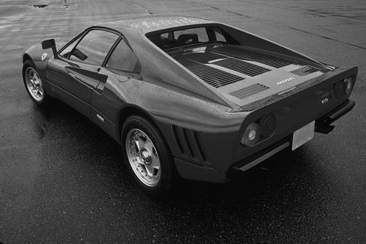
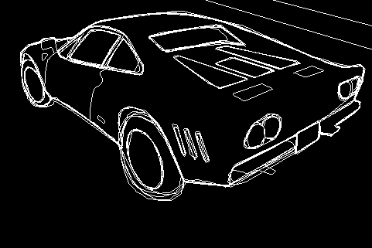
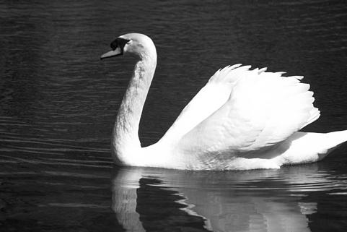
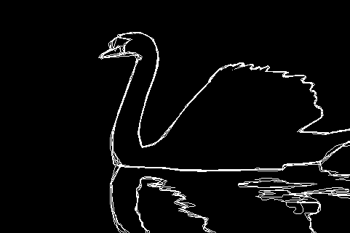
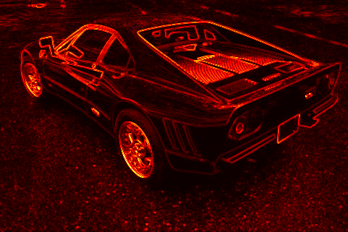
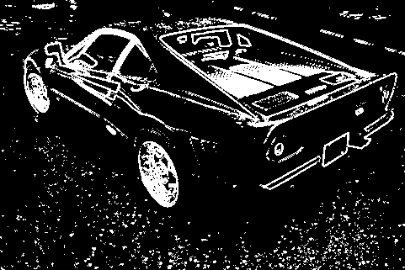
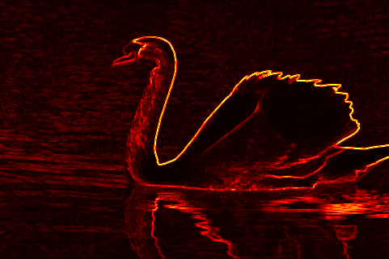
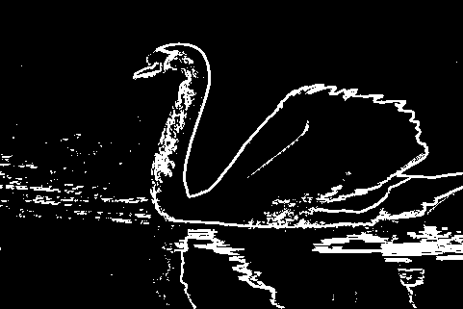
Showcase: Image 29030 (Ferrari Car) & 8068 (Swan)
Ferrari Car — dominant diagonal body panel, wheel arch, and spoiler edges
Swan — almost entirely diagonal neck and body contour against smooth water background
[ Image
Here ]
[ Image
Here ]
[ Image
Here ]
[ Image
Here ]
(a) Original
(b) Ground Truth
(a) Original
(b) Ground Truth
[ Image
Here ]
[ Image
Here ]
[ Image
Here ]
[ Image
Here ]
(c) Gradient (6-dir)
(d) Otsu Quantum
(c) Gradient (6-dir)
(d) Otsu Quantum
→ Replace placeholder boxes with your saved thesis images from the images/ folder

Slide 14
Qiskit Results & Summary
AerSimulator — Otsu Quantum F1 vs iteration depth t :
Summary
Method | t=1 | t=2 | t=3 | t=4 | t=5
Paper (4-dir) | 0.1451 | 0.1614 | 0.1350 | 0.0480 | 0.0496
Proposed (6-dir) | 0.1041 | 0.1569 | 0.1315 | 0.0662 | 0.0494
Δ | −0.0411 | −0.0046 | −0.0035 | +0.0182 | −0.0002
✓Diagonal oracle: all 3 metrics improved
✓ Otsu: fairer, ground-truth-free eval
✓ Lookup table: 1.5 hrs → 30 sec
✓ Circuit verified vs statevector
Future Work :
• Full 2D Qiskit circuit (MPS)
• Adaptive self-loop weight s
• Full BSDS500 (200 images)
• Colour image extension
Block circuit peaks at t=2. Diagonal advantage not visible here
due to block isolation — 2×2 circuit is a proof of concept.

Slide 15
References
[1] Giri, Sato, Saito. Quantum Walk Search Based Edge Detection. arXiv:2510.04420, 2025.
[6] Martin et al. A Database of Human Segmented Natural Images. ICCV, 2001.
[2] Canny, J. A Computational Approach to Edge Detection. IEEE TPAMI, 8(6):679–698, 1986.
[7] Le, Dong, Hirota. FRQI: Flexible Representation of Quantum Images. QIP, 10(1), 2011.
[3] Zhang, Lu, Gao. QSobel: A Novel Quantum Image Edge Extraction. Science China, 2015.
[8] Portugal, R. Quantum Walks and Search Algorithms. Springer, 2013.
[4] Yao et al. Quantum Image Processing and Edge Detection. Physical Review X, 7(3), 2017.
[9] Giri, P.R. Spatial Search on Graphs using Lackadaisical QW. Eur. Phys. J. D, 2023.
[5] Otsu, N. A Threshold Selection Method from Gray-Level Histograms. IEEE SMC, 9(1), 1979.
[10] Wong, T.G. Equivalence of Szegedy's and Coined Quantum Walks. QIP, 14(9), 2015.

Slide 16
Thank You
Diagonal Gradient Extension and Otsu-Based Evaluation
for Lackadaisical Quantum Walk Edge Detection
Anish Chattopadhyay | Roll 90/MCA No. 240003
Under the supervision of Mr. Shambo Chatterjee
Department of Computer Science and Engineering | University of Kalyani

