Slide 1

An Energy Efficient Whale Swarm-based Routing Algorithm for Underwater Wireless Sensor Network
Presented by Anish Gupta, under the guidance of
Dr. Prasenjit Chanak
Assistant Professor, Department of Computer Science and Engineering
Indian Institute of Technology (BHU) , Varanasi
Anish Gupta
Page : 1

Slide 2
INTRODUCTION
A Wireless Sensor Network (WSN) is a wireless distributed network that is used to monitor physical and environmental conditions of a region such as temperature, pressure, sound, motion and so on.
It consists of numerous micro-sensor nodes deployed in the monitoring region that collect and process information in real time and forward it to a centralized base station via wireless communication.
The base station then transmits the data to users via internet, satellite or mobile network.
One of the key uses of WSN is in underwater applications such as oceanographic monitoring, disaster management, offshore data collection, surveillance, pollution monitoring and control.
Such networks, where WSN is employed in underwater environment are popularly referred as Underwater Wireless Sensor Network (UWSN).
The communication in UWSN takes place using acoustic waves which are more suitable for underwater communication.
Anish Gupta
Page : 2

Slide 3
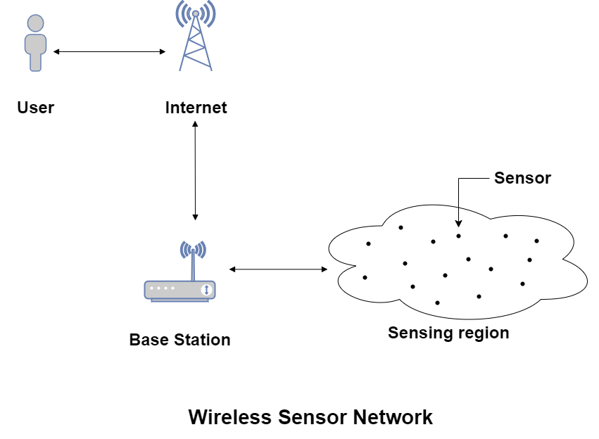
The routing algorithm in WSN are used to identify the most optimal path for transfer of data packets from source node to base station.
The most common issue in WSN research is the energy supply of sensor nodes, which often acts as a bottleneck.
This paper addresses the energy constraint issue of sensors.
Anish Gupta
Page : 3

Slide 4
LITREATURE REVIEW
Author | Contribution | Limitation
Okdem et al. [1] | In this protocol, the path between source nodes and sink node are constructed by forwarding ants which select next hop based on amount pheromone trail left by other. | The algorithm only considers path length not the energy levels of nodes while calculating the amount of pheromone trail an ant deposits on its path.
Saleem et al. [2] | It is an event-driven, reactive and on-demand multipath routing protocol inspired by the foraging principles of honey bees | The algorithm becomes computationally expensive for larger number of nodes
Anish Gupta
Page : 4

Slide 5
LITREATURE REVIEW
Author | Contribution | Limitation
Liu et al. [3] | This is based on particle swarm optimization(PSO). The objective function consist of bandwidth, delay and packet loss to find optimal path and enhance performance. | Storing global information in each sensor nodes is not suitable for large scale WSN.
Heinzelman et al. [4] | The LEACH protocol is a clustering based hierarchical routing protocol that aims to extend the network's lifetime by reducing energy consumption. | The protocol fails if the distance between CH and sink is more than a certain threshold since the energy dissipation of CH becomes proportional to the fourth power of the distance between CH and sink.
Anish Gupta
Page : 5

Slide 6
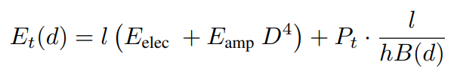
SYSTEM MODEL AND DEFINITIONS
Energy Model
The energy consumption of sensor nodes mainly includes three parts:
Sensing energy consumption due to sensors.
Data processing energy consumption by microprocessor.
Communication energy consumption due to wireless module
The major energy consumption is due to wireless communication module that uses acoustic signals to transfer data. The
research paper solely focuses on this energy.
The energy consumption for transmitting l bits of data over D meters of distance is given as
where,
E_{elec} : energy required by electronics circuit B(d) : Bandwidth of signal
E_{amp} : energy required by amplifier Pt : Transmitting Power
Anish Gupta
Page : 6

Slide 7


The energy consumption for receiving l bits of data is given as
E_{DA} : Data aggregation energy Pr : Receiving Power
h : bandwidth efficiency of modulation given in bits/s/ Hz
The signal to noise ratio (SNR) is represented as
SNR=SL – NL – TL + DI
The hydrophone modem is considered to be omnipresent, thus the directive index (DI) is 0.
Anish Gupta
Page : 7

Slide 8



The source level depends on transmission power intensity, I_{t} as
d : depth
k : 2π or 4π for shallow and deep water respectively
The noise loss is resultant of shipping, turbulence, thermal and wave loss as expressed by the equation
Anish Gupta
Page : 8

Slide 9
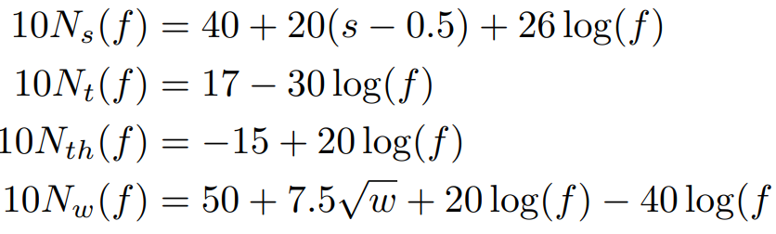



These are expressed by following equations :
where
f : frequency s : shipping factor
w : wind speed
The transmission loss (TL) incurred between transmitter and module can be modelled as
Anish Gupta
Page : 9

Slide 10
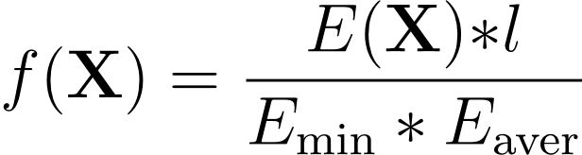
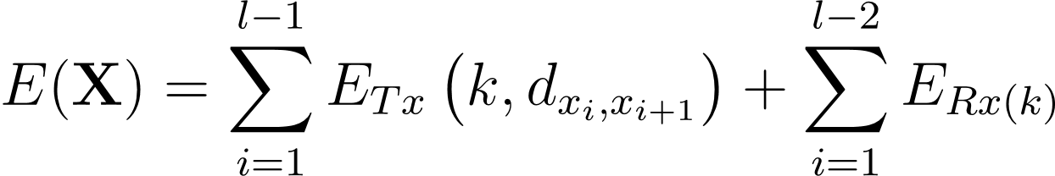
Objective Function
The objective function (fitness function) is given by
where
E_{min} : least residual energy of node l : number of nodes
E_{aver} : average residual energy of all the nodes in path X
E(X) : the sum of energy consumption of all nodes
In this paper E_{min}, E _{aver} are required to be as large as possible while E(X) and l are required to be as less as possible. Therefore, the fitness function is a minimization problem.
Anish Gupta
Page : 10

Slide 11
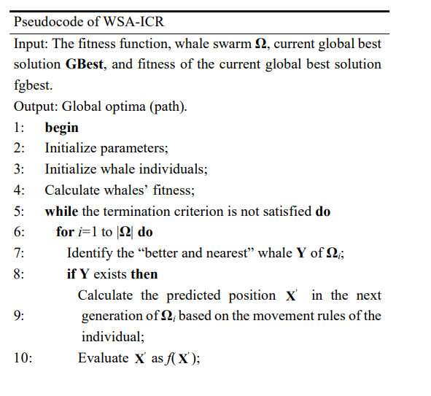
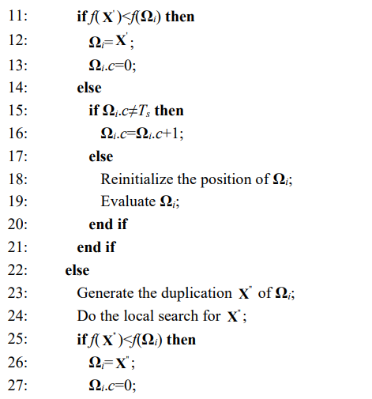
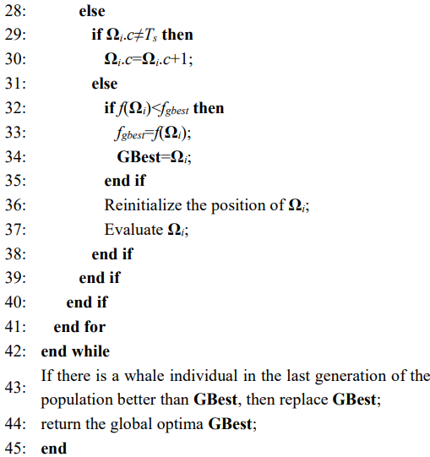
PROPOSED WORK
WSA-ICR
Inspired by the hunting nature of humpback whales, our proposed methodology uses Whale Swarm Algorithm for iterative counter based routing to address optimization problem.
Anish Gupta
Page : 11

Slide 12
The paper improves the existing algorithm in 5 key aspects :
1. Individual encoding
The solution of this energy efficient routing problem is an optimal path from source to sink node. This solution is a discrete sequence containing number of nodes as
X= {s, ,74, 61, 3, 26, 39, 4, d}
2. Distance calculation between individuals
In the whale swarm algorithm , each whale is guided by better and nearest whale. The Levenshtein algorithm is used to calculate distance between two whale individuals.
The algorithm is :
if i = 0 and j = 0 then dist(i,j) = 0 if i = j cost (i,j) = 1, else cost (i,j) = 0
if i = 0 and j > 0 then dist(i,j) = j
if i > 0 and j = 0 then dist(i,j) = i
if i > 1 and j > 1 then dist(i,j) = min{dist(i-1,j)+1,dist(i,j-1)+1,dist(i-1,j-1)+cost(i,j)}
dist(i, j) denotes the Levenshtein distance between the first substring whose length is i and the second substring whose length is j.
Anish Gupta
Page : 12

Slide 13
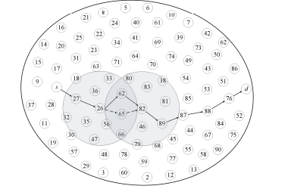
3. Individual Movement
In whale swarm algorithm each whale moves under the guidance of better and nearest whale. The model improves individual movement, to ensure optimal path is selected. A new parameter λ is introduced whose value is set to 0.5.
4. Local Search Strategy
When there is no better or nearest whale individual in current population, then it does not perform any searches but directly checks the iteration counter. It is implemented as follows:
A node is selected from the path represented by best individual.
If the individual finds a better solution then original solution is replaced.
Otherwise, the solution is kept and IC is checked.
A sketch map of local search is shown in the figure.
Anish Gupta
Page : 13

Slide 14
RESULTS AND SIMULATIONS
The proposed algorithm is implemented in Python 3 language.
The parameters settings are shown in the table
Table : Simulation Parameters Table : Energy Parameters
Parameter | Value
Area | 200 m x 200 m x 200 m
Number of nodes | 100
Base Station | (100,100,200)
Packet size | 800 bits
Initial Energy | 1 J
Communication Range | 50 m
Number of Evaluations | 100
λ | 0.5
|Ω| | 10
Parameter | Value
E_{Elec} | 50 nJ / bit
E_{Amp} | 0.0013 pJ / bit
E_{DA} | 5 nJ/ bit
Frequency | 10 KHz
Transmitting Power | 70 mW
Receiver Power | 16 mW
Shipping factor | 0.5
wind speed | 6 m/s
Anish Gupta
Page : 14

Slide 15
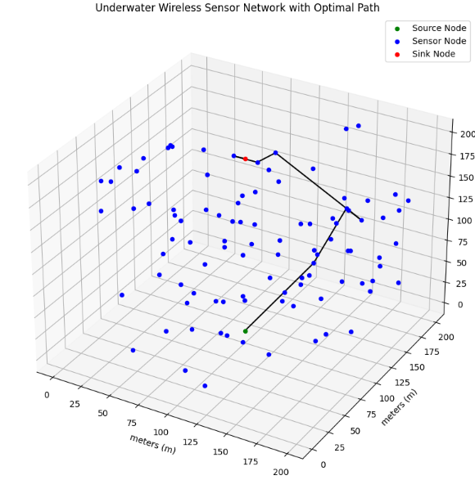
A wireless sensor network (WSN) with 100 sensor nodes deployed in a sensing region of 200 x 200 m² .
The base station is positioned at the surface of water body.
regular sensor nodes
source node
sink node
Best path : [0, 74, 61, 3, 26, 39, 4, 99]
Best fitness : 0.00003173
Anish Gupta
Page : 15

Slide 16
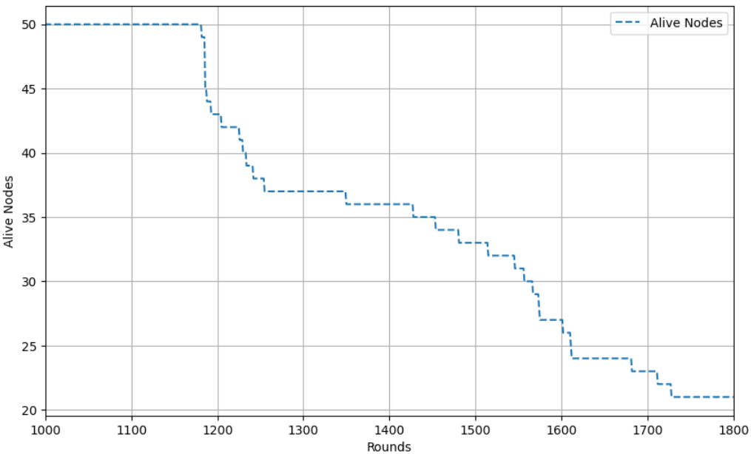
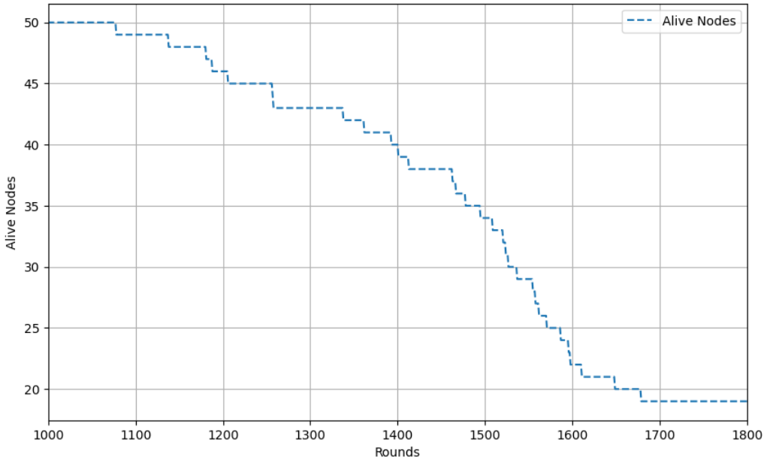
Alive nodes in every round for homogeneous (a) Shallow and (b) Deep UWSN
(a)
(b)
Anish Gupta
Page : 16

Slide 17
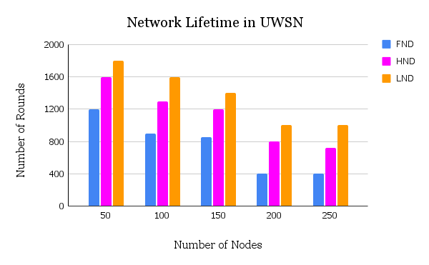
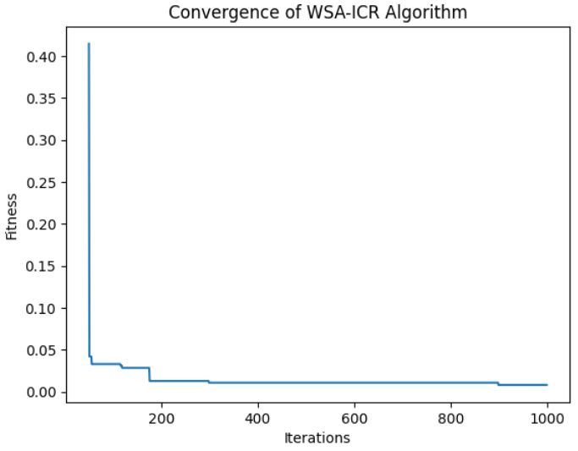
Anish Gupta
Page : 17

Slide 18
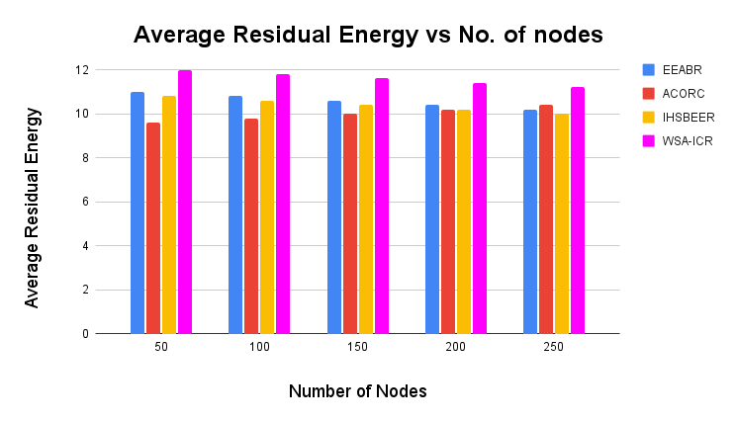
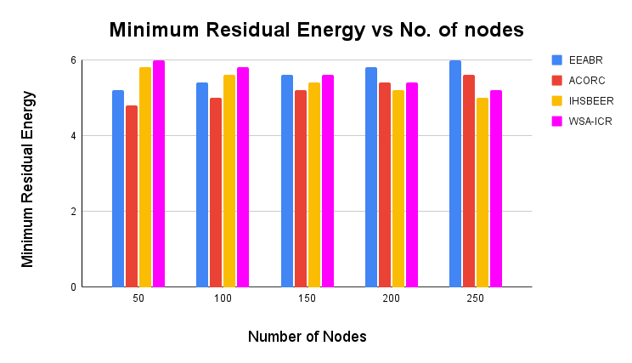
For 10 instances, the initial energy of all nodes is randomly selected from 6 J, 12 J and 18 J, and the nodes in each scenario periodically send packets to the sink node.
Anish Gupta
Page : 18

Slide 19
CONCLUSION
The simulations results show that the WSA-ICR algorithm effectively finds the most optimal path for transfer of data from source to sink node.
The model shows exceptional performance in maximizing the lifetime of network in both shallow and deep waters.
It also balances the energy consumption of the whole network, prolonging the network life cycle and convergence speed.
The model outperforms various state of the art algorithms like LEACH, IHSBEER, ACORC etc.
Anish Gupta
Page : 19

Slide 20
REFERENCES
S. Okdem, D. Karaboga, Routing in wireless sensor networks using an ant colony optimization (ACO) router chip, Sensors 9 (2)
M. Saleem, I. Ulla, M. Farooq, Bee Sensor energy-efficient and scalable routing protocol for wireless sensor networks, Inf. Sci. 200
M. Liu, S. Xu, S. Sun, An agent-assisted QoS-based routing algorithm for wireless sensor networks, J. Network Computing . Appl. 35
W. R. Heinzelman, A. Chandrakasan and H. Balakrishnan, "Energy-efficient communication protocol for wireless micro sensor networks.
Zeng B , Deng J , Dong Y , Ying X , Huang L , Xiao Z Whale swarm based energy efficient routing algorithm for wireless sensor networks IEEE Sensors
Zeng B , Gao L , Li X (2017) Whale Swarm Algorithm for Function Optimization.
AV Jha , B Appasani , MS Khan , HH Song A novel clustering protocol for network lifetime maximization in underwater wireless sensor networks, IEEE Transactions on Green Communications and Networking
Anish Gupta
Page : 20

Slide 21
THANK YOU
Anish Gupta
Page : 21

