Slide 1
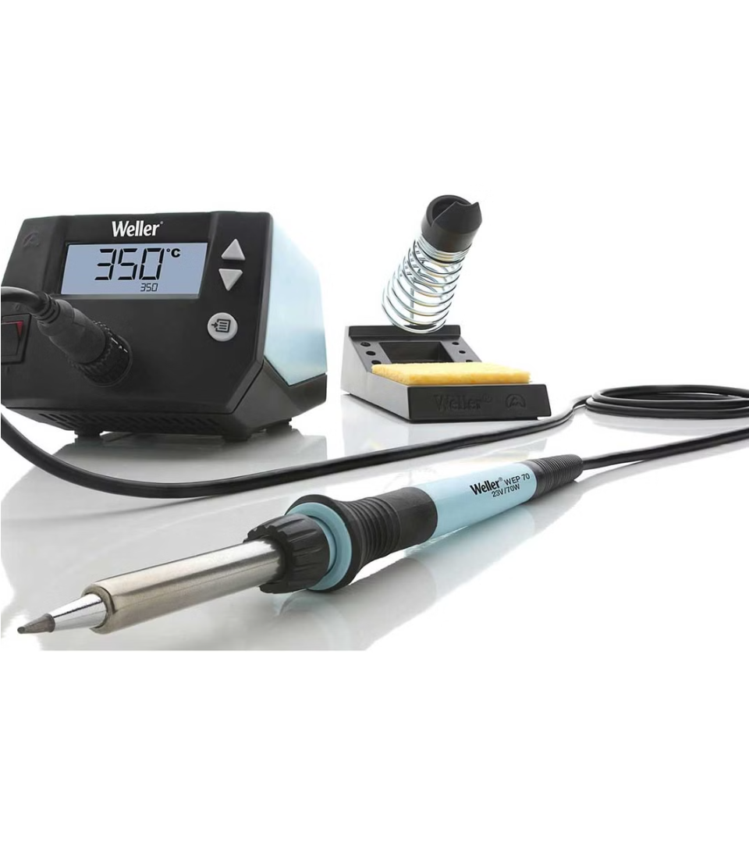
By: Anish
SolderingStation

Slide 2
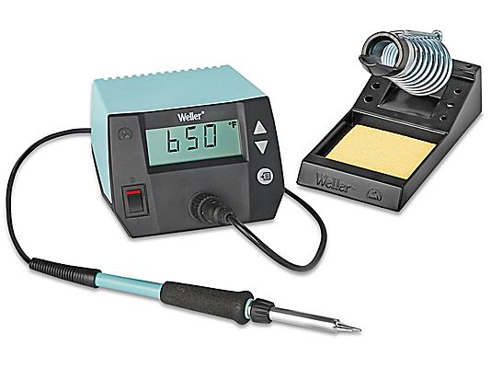
Introduction.
1
Problem
2
Solution
3
Features
4
Design

Slide 3
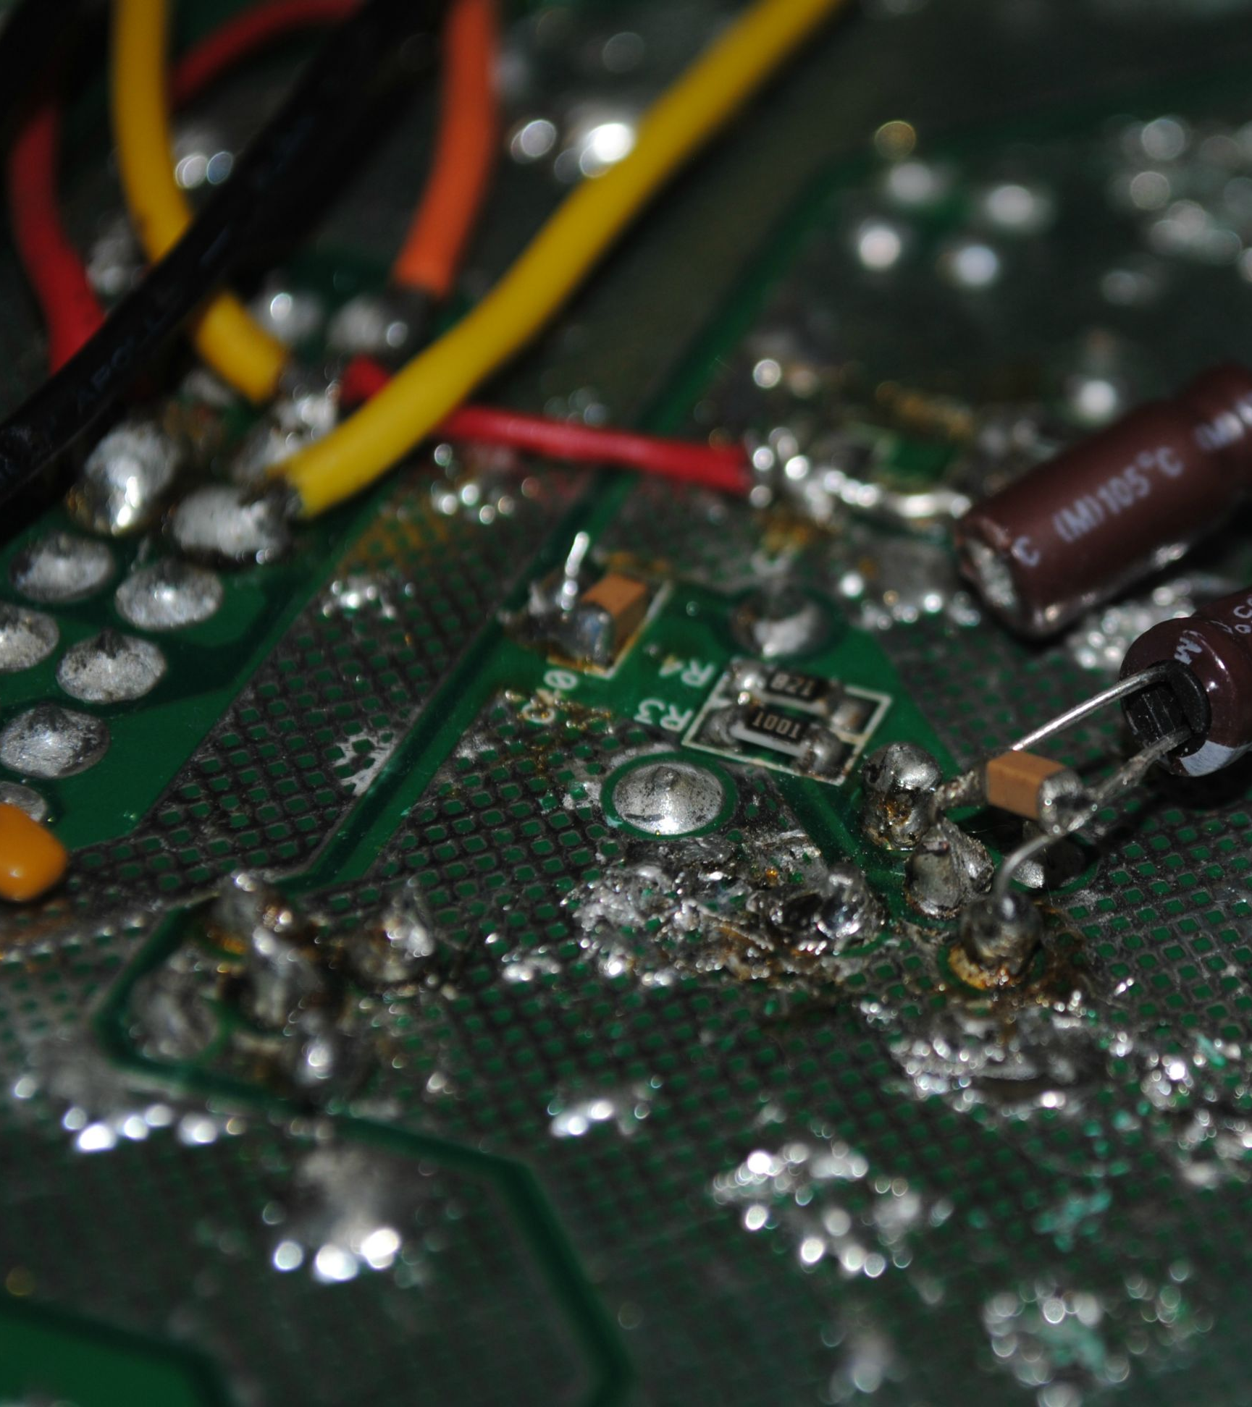
Problem:
1
Bad Equipment.
Not being able to access to high quality soldering equipment.
Lacking flexibility.
Hindering project progress.

Slide 4
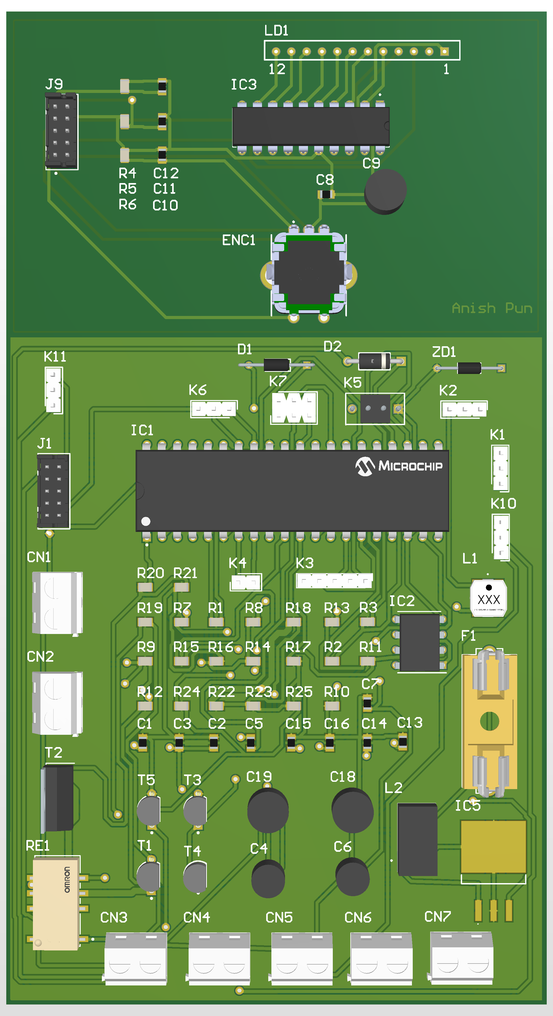
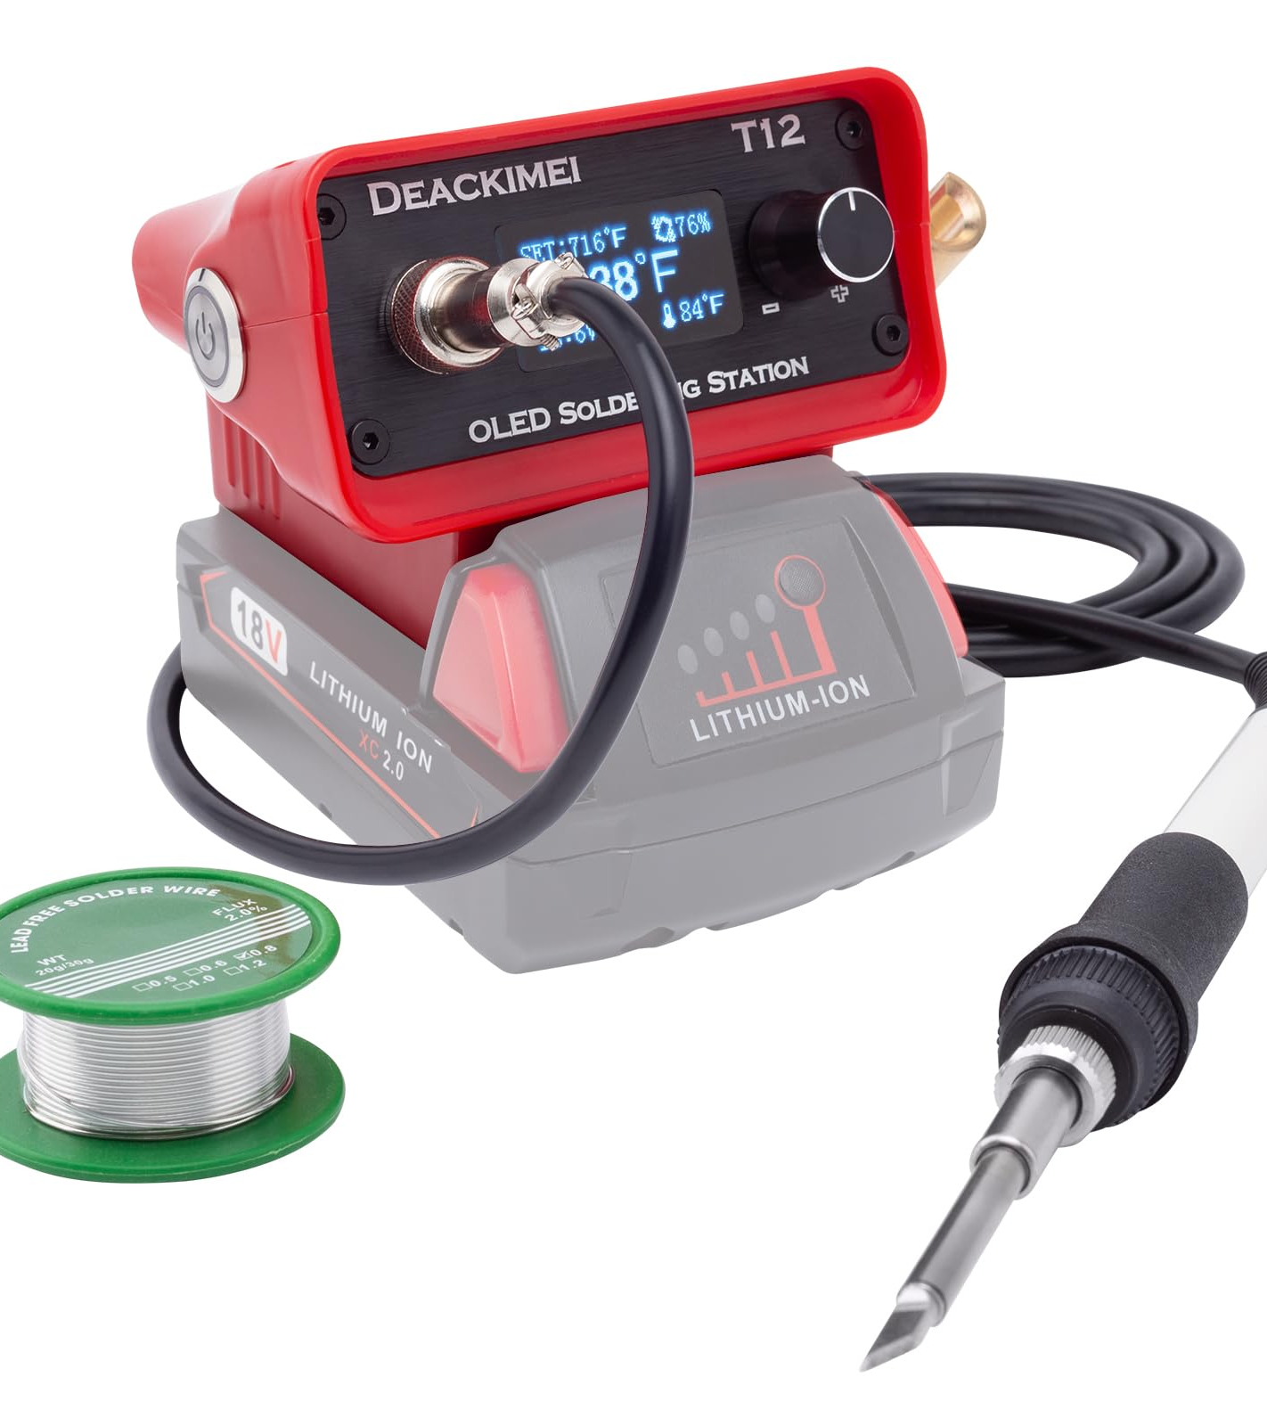
Solution: Portable SolderingStation.
2
Precise Temperature control
Design
Flexibility Functionality
Works with battery

Slide 5
Features:
3
Temperature control:
Precise temperature control for accurate and consistent soldering.
Digital Display:
Provides clear and readable temperature information
Safety Mechanisms:
Safety feature ensuring a safe and secure soldering experience.
Compatibility
Compatible for variety of soldering tools and accessories
Design:
Its light so you can use the soldering station without fatigue.

Slide 6
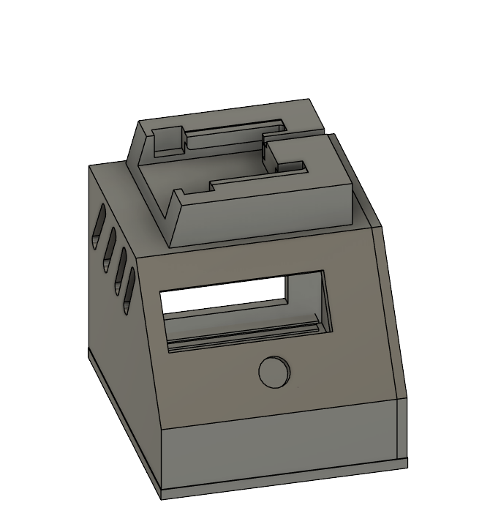
Design:
4
The lightweight design allows for fatigue-free use of the soldering station.

