Slide 1
Higher discounts may not boost Eniac’s revenue
21.06.2024

Slide 2
Background
timeframe: 2017-01-01 to 2018-03-14 i.e. 15 months. ca. 20% valid data was used in this analysis
Dataset information: product_quantity, unit_price, total price, description, and so on
Products were categorized for analysis purpose
Analysis was based on total revenue and discount %

Slide 3
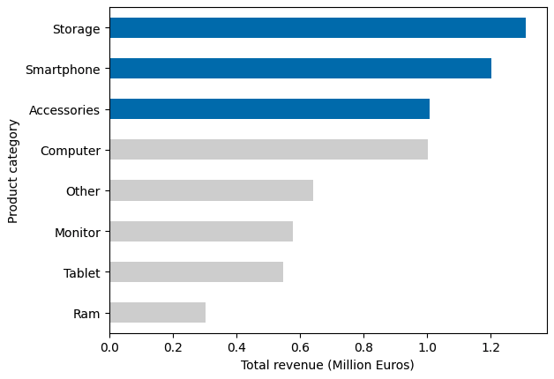
Storage, smartphone and accessories bring the highest revenue

Slide 4
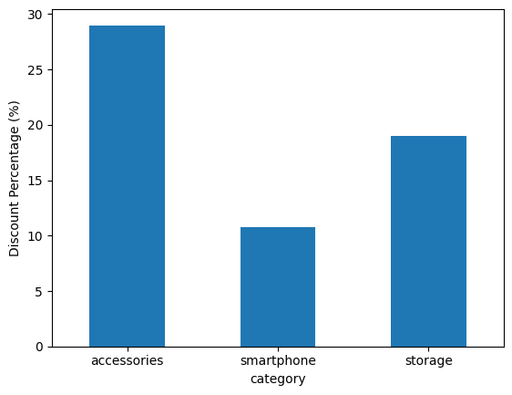
The average discount was between 10-30%

Slide 5
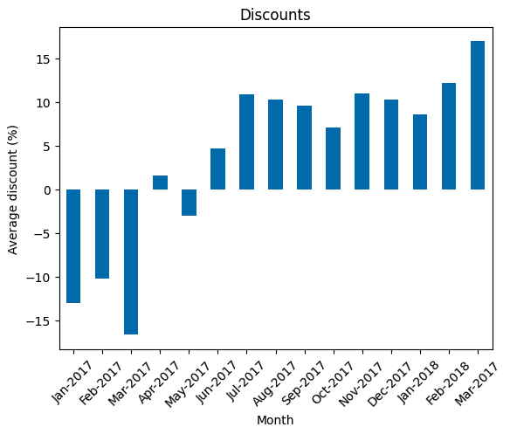
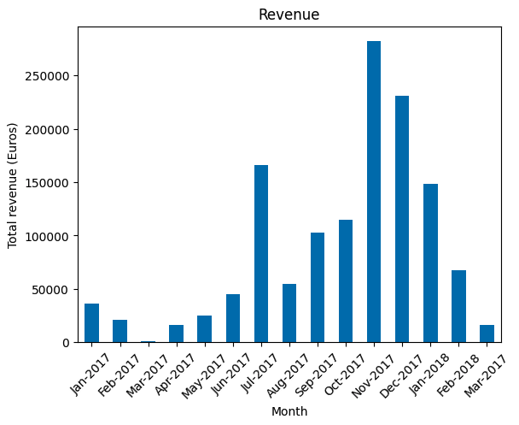
Periods with high negative discounts reflected very low sales
Smartphones

Slide 6
Negative discounts represent
less than 2%
of the sales
and will be ignored from further analysis

Slide 7
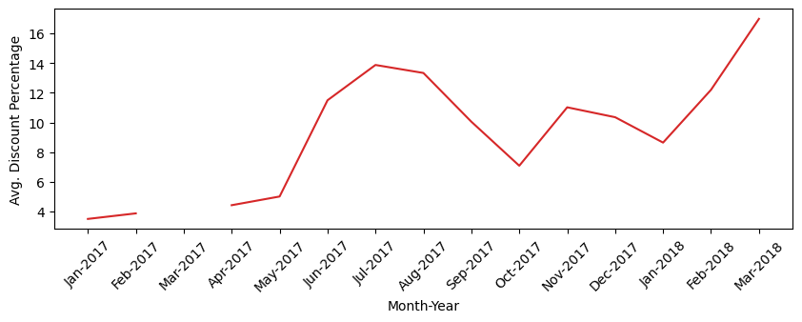
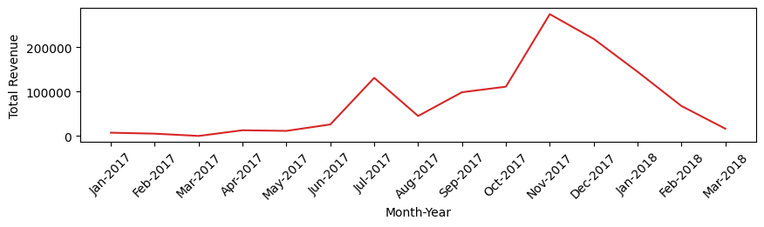
Avg. discount percentage vs revenue (smartphone)
– dry spell –

Slide 8
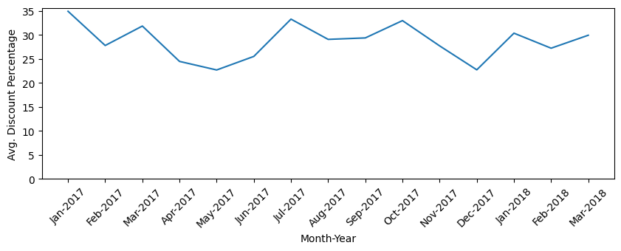
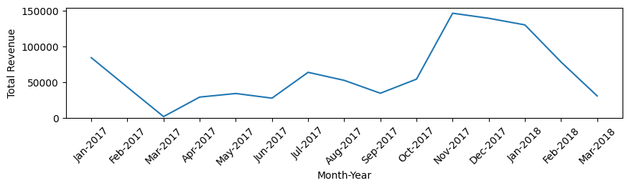
Avg. discount percentage vs revenue (accessories)
Compare Discounts with Revenue per month.
No clear correlation between them.

Slide 9
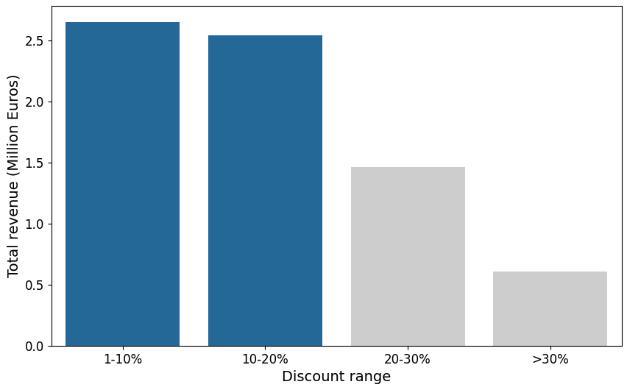
Most of the revenue comes from discounts smaller than 20%

Slide 10
Conclusion
A larger dataset is necessary – at least 2 years (and with more quality)
There is no clear correlation between higher discounts and higher revenue
Discounts should be at maximum 20% – at least for expensive products
Eniac should continue to focus on quality and marketing segments

Slide 11
Thank you

