Slide 1
Movie Recommendation System
Anish Man Shrestha (985078)
Bishal Nepal (985040)

Slide 2
Introduction
System to provide recommended movies based on user rating.
To filter, prioritize and efficiently deliver relevant information.
Solve the problem of searching large volume of data dynamically.
Our system uses Collaborative Filtering based on ratings.
we utilize machine learning technique to predict movie preference for a user based on his or her previous ratings.

Slide 3
Feature
To recommend movie for the user based on the user rating history.
Analysis of the data and its accuracy.
Reduce the transaction costs of finding and selecting movies from the server.

Slide 4
Dataset
Here our Machine Learning model utilized to conduct analysis upon data sets, to equip it with intelligence, with the data that has already been collected.
In our system, we utilize dataset to conduct analysis between the users personal particulars and their movie preferences.
Data set: IMDB Data set from movielens
Volume: 20 million records
Attributes:
Movie(movieId,title,genres)

Slide 5
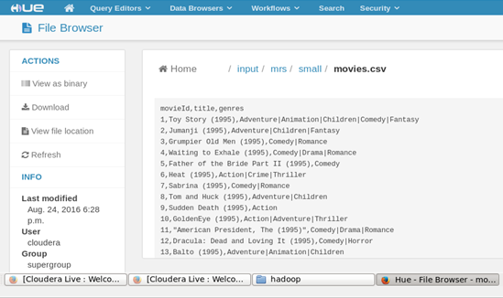

Slide 6
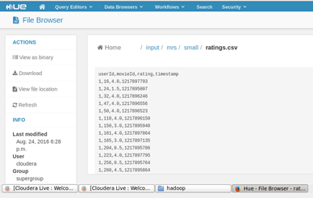
Rating(userId,movieId,rating,timestamp)
Source: http://grouplens.org/datasets/movielens/20m/

Slide 7
Implementation
Model/Algorithm
ETL: For data clean
ALS(Alternating Least Squares):
able to handle large sparse data sets and its better prediction performance.
For predicting the missing entries
Matrix Factorization Model:
Discover the interaction between entities
To split the training set.
Root Mean Square Error: To validate

Slide 8
Model/Algorithm continue…
Collaborative filtering aim to fill in the missing entries of user-movie rating matrix.
MLlib supports model-based collaborative filtering, in which users and products are described by a small set of latent factors that can be used to predict missing entries.
In particular, we implement the alternating least squares (ALS) algorithm to learn these latent factors.
To make recommendation for user, we are going to take user history ratings.

Slide 9
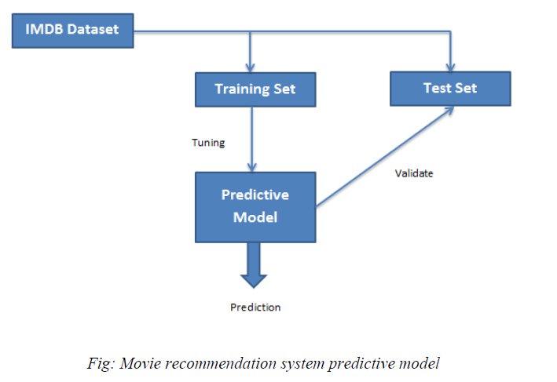
Model/Algorithm continue…
To determine a good combination of the training parameters, we split the data into three non-overlapping subsets, named training, test, and validation.
We trained multiple models based on the training set, select the best model on the validation set based on RMSE (Root Mean Squared Error), and finally evaluate the best model on the test set

Slide 10
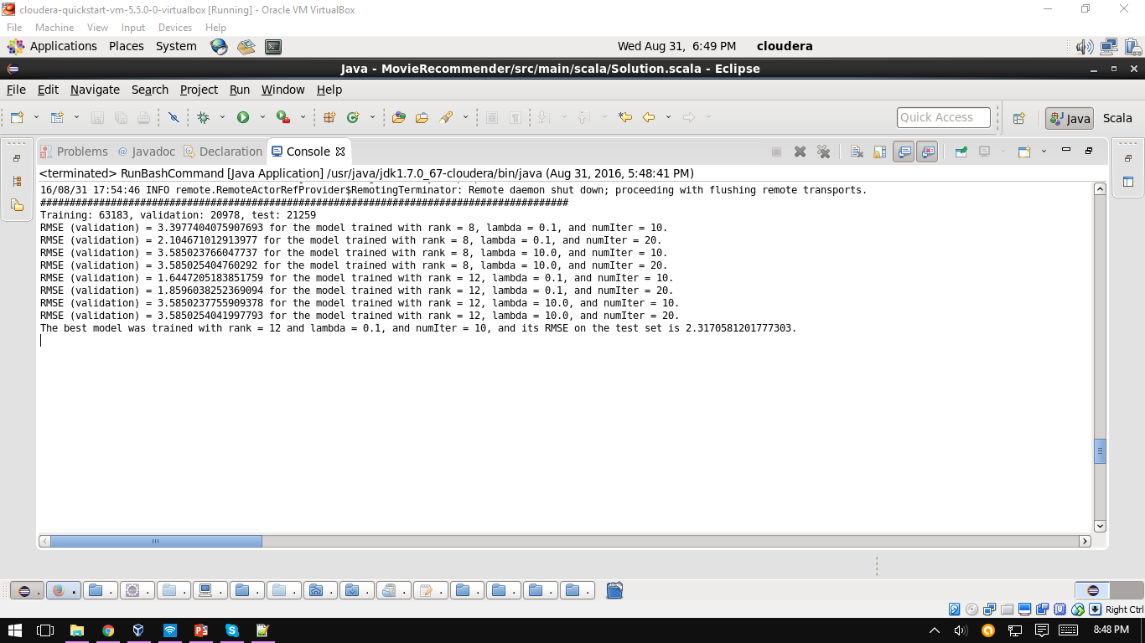
Model/Algorithm continue…
we tested 8 combinations resulting from the cross product of 2 different ranks (8 and 12), 2 different lambdas (1.0 and 10.0), and two different numbers of iterations (10 and 20).
The model with the smallest RMSE on the validation set becomes the one selected and its RMSE on the test set is used as the final metric

Slide 11
Implementation
Tools
Hadoop: For storing and running application
Scala: Used for functional programming
Spark: For data processing tool that operates on distributed data collection.
Java: For application

Slide 12
Demo

Slide 13
Thank You !

