Slide 1
Software Engineering · Fall 2026 · Group 13
Campus Marketplace
A student-only place to buy, sell and trade used items at Rutgers
Midterm · November 6, 2026
Anish · Krisha · Anuj · Aryan · Kunal · Santanu · Anand
Notes:
Santanu: welcome, introduce the team and the project in one sentence.

Slide 2
Recap: what we are building
Rutgers students already trade textbooks, furniture and dorm gear in scattered group chats. We give them one searchable, students-only marketplace.
7
3
100+
team members, each owning one feature end to end
steps in the midterm goal: log in, post with a photo, see it in the feed
automated server tests running in CI on every pull request
Midterm goal
1 Log in
→
2 Post a listing with a photo
→
3 See it in the feed
Notes:
Santanu: recap the problem, the team structure, and the midterm goal. Then hand over to Anand for stack and architecture.

Slide 3
Stack and architecture
Web client
API and chat
Database
Next.js, React, TypeScript, Material UI. Hosted on Vercel.
→
Express and Socket.IO: REST routes, validation and real-time messages. Hosted on Render.
→
MongoDB Atlas, accessed with Mongoose models.
Cloudinary
Rutgers CAS
GitHub Actions
Listing photos: images only, 5 MB each, up to 5 per listing
NetID sign-in; a test login is used until access is approved
Lint, build and tests on every pull request; 1 approval to merge
Every tool is on a free tier. Keys live in environment variables, never in Git.
Notes:
Anand presents. Confirm deployment status on the day before saying the site is live.

Slide 4
Database schema
User
Listing
Flag
Favorite
netId, name, email
role: student or admin
suspended flag
createdAt
title, description, price
category, condition, photos
seller → User
status: active, sold, removed
target: listing or user
reporter → User
reason, note
status: open, dismissed, actioned
user → User
listing → Listing
createdAt
unique per user and listing
Conversation
Message
Notification
How to read this
An arrow (→) points to the model a field refers to.
Every model also stores its own id and timestamps.
listing → Listing
buyer → User, seller → User
one per listing per buyer
conversation → Conversation
sender → User
text, time sent
user → User
type: new message, flagged, removed
link, read flag
Notes:
Kunal presents the final schema diagram. Cards here follow the task plan; update them if the models changed.

Slide 5
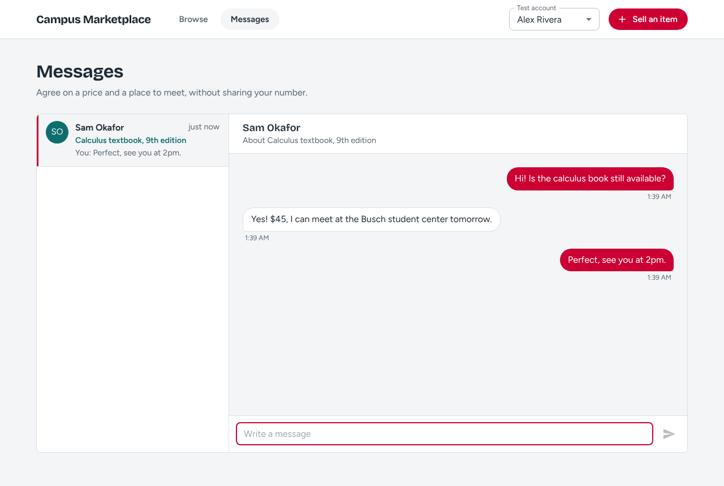
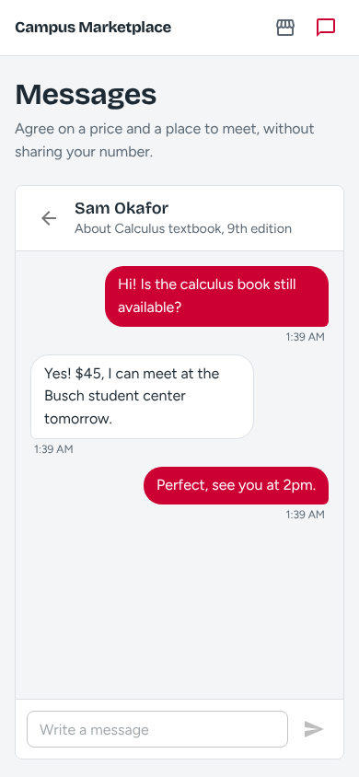
Wireframes and shared UI
One set of components
Rutgers scarlet theme and shared tokens
ListingCard and ListingGrid on every list
EmptyState, LoadingGrid and error messages
One navbar and page container
Responsive from phone to desktop
Chat: desktop and phone
Every page is built from the same parts, so new features look consistent without extra design work.
Notes:
Anish presents. Add the feed, listing detail, new listing, admin queue and profile wireframes if they are exported to docs/wireframes.

Slide 6
Roles and progress
Member | Owns | Status
Anish | Repo, UI foundation, chat prototype | On main
Anuj | Listings and photo upload | On main
Aryan | Feed, search, filters, sample data | On main
Krisha | Accounts, test login, sessions | Branch, in review
Kunal | Flag model, admin queue wireframe | Branch, in review
Santanu | Profile page and public profile API | Branch, in review
Anand | Deployment, keys, test plan, notifications | In progress
Status as of November 5. Update before presenting.
Notes:
Krisha and Aryan present. Refresh statuses from GitHub right before the midterm.

Slide 7
Live demo
1
2
3
4
5
Log in
Sell an item
See it in the feed
Open the listing
View the seller
Pick a test account from the header
Fill the form and add a photo
Newest first, with the photo
Photo, price, condition, seller
Profile with active listings
If time allows: open the chat in two browser windows and send a message in real time.
Presented by Anuj and Anish
Notes:
Run the seed scripts first: npm run seed:profiles and npm run seed:listings in server/. Keep a screenshot of each step as a fallback.

Slide 8
Next steps after the midterm
Sign-in
Listings
Search
Rutgers NetID through CAS, log out, block suspended users
Edit, delete and mark as sold, clear error messages
Keyword search, filters, sorting and pagination in the URL
Moderation
Messaging and alerts
Profile and favorites
Report button, admin queue, dismiss, remove, suspend
Real-time inbox, notification bell with unread count
My listings, saved listings and a Saved page
Features land by Nov 27, then testing, the final report and the final demo (week of Nov 30).
Notes:
Krisha presents.

