Slide 1

Dynamo AI
🇮🇳 MADE IN INDIA
● INCUBATOR PITCH · 2026
Dynamo
AI
The Research Operating System for Academia.
RESEARCH · WRITE · CITE · PRESENT — ALL IN ONE PLACE.
Built for researchers, scholars and educators.
FOUNDER: ANISH KRISNA S · MS DATA SCIENCE
APP.DYNAMOAI.IN

Slide 2
Dynamo AI
THE PROBLEM
02 / 17
● THE PROBLEM
Academic work is broken.
Today's researchers juggle a dozen disconnected tools just to complete a single piece of academic work.
💬 ChatGPT
🔎 Google Scholar
📚 Research DBs
THE RESULT
General AI chat
Paper search
JSTOR · Scopus
✗ Context switching across 6+ tools
📋 Citation Tools
📝 Word
📊 PowerPoint
✗ Lost productivity & wasted time
Zotero · Mendeley
Writing & drafts
Presentations
✗ Repeated effort & duplicate work
✗ Fragmented, disconnected workflow
DYNAMO AI · CONFIDENTIAL
app.dynamoai.in

Slide 3
Dynamo AI
THE COST
03 / 17
● THE COST OF FRAGMENTATION
The hidden tax on every researcher.
Fragmented tools don't just slow researchers down — they steal focus from the actual work that matters.
🔄
📋
🗂️
⏱️
🔁
Context Switching
Manual Formatting
Fragmented Notes
Lost Time, Lost Focus
Duplicated Effort
Constantly jumping between 6+ tools breaks flow and deep thinking.
Citation rules, paper formatting, and references rewritten by hand.
Findings scattered across tabs, docs, and offline notebooks.
Time spent stitching tools together — instead of producing insight.
Same searches, same summaries, same formatting — across every project.
⚡ The real cost isn't just hours — it's the insight, ideas and research output lost to busywork.
DYNAMO AI · CONFIDENTIAL
app.dynamoai.in

Slide 4
Dynamo AI
THE SOLUTION
04 / 17
● INTRODUCING
One platform. One continuous academic workflow.
Every step of your research — from discovery to final presentation — happens in one place.
🔬 Discover relevant papers and evidence instantly
📖 Identify insights, patterns and research gaps
✍️ Draft academic content with structured assistance
Search across web + Semantic Scholar in seconds — no tab switching
Analyse and summarise papers automatically, surface what matters
Write with DeepThink AI — built for academic rigour and depth
📋 Generate publication-ready citations automatically
📊 Convert research into presentations, mind maps and flowcharts
🧠 Preserve research context across documents and sessions
APA, MLA, IEEE, Chicago, Harvard, Vancouver — formatted on demand
Go from notes to polished deck or visual in minutes
AI Memory + Document Library keep your work accessible — always
20+ AI capabilities · 3 AI model tiers · 6 citation formats · Built for researchers
DYNAMO AI · CONFIDENTIAL
app.dynamoai.in

Slide 5
Dynamo AI
THE WORKFLOW
05 / 17
● THE DYNAMO AI WORKFLOW
One continuous workflow — start to finish.
No more tab-switching. From research question to final deck — every step in one platform.
01
02
03
04
05
06
07
🎯
🔍
🧠
✍️
📋
📊
📂
Define Topic
›
Search
›
Analyse
›
Write
›
Cite
›
Present
›
Store
⚡ Each step removes friction. The full workflow lives inside a single workspace.
DYNAMO AI · CONFIDENTIAL
app.dynamoai.in

Slide 6
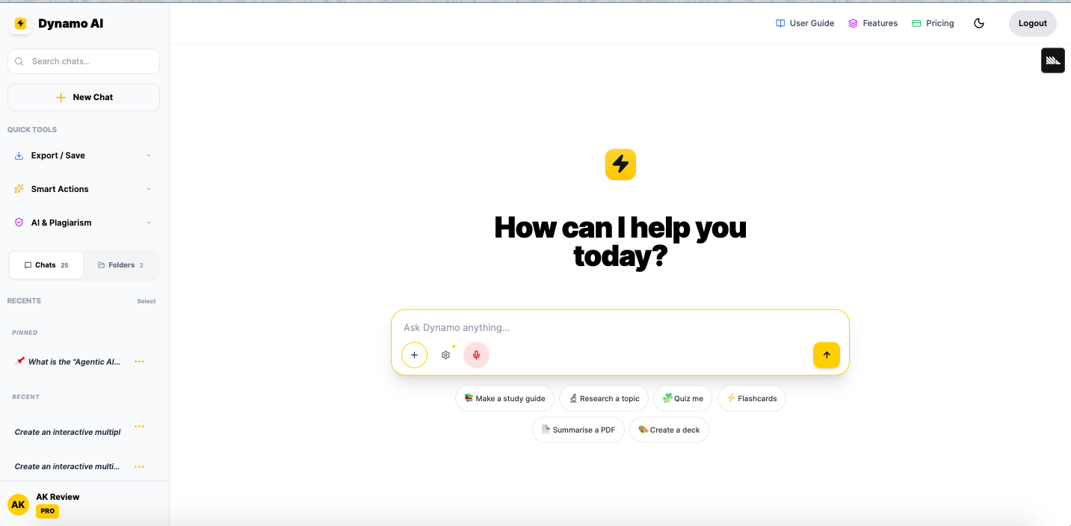
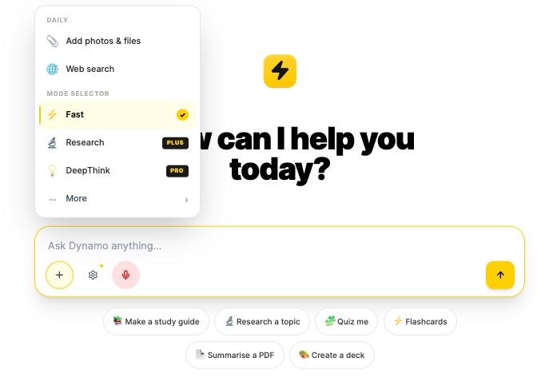
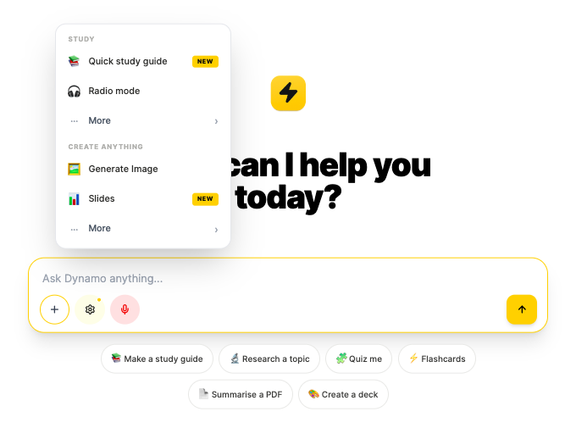
Dynamo AI
PRODUCT · PART 1
06 / 17
● PRODUCT · THE WORKSPACE
● LIVE IN PRODUCTION
A workspace built for thinking.
Clean, chat-first interface. Modes for every research task. Built and live today at app.dynamoai.in
● ● ● app.dynamoai.in
● ● ● app.dynamoai.in
Mode Selector
Fast · Research (Plus) · DeepThink (Pro)
● ● ● app.dynamoai.in
Main Workspace
Tools Menu
Chat-first interface · Recents · Quick Tools · Persistent memory across sessions
Study guides · Radio mode · Image, Slides, Mindmaps
Try it live · app.dynamoai.in
DYNAMO AI · CONFIDENTIAL
app.dynamoai.in

Slide 7
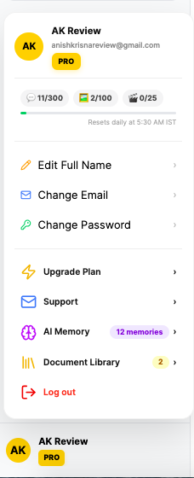
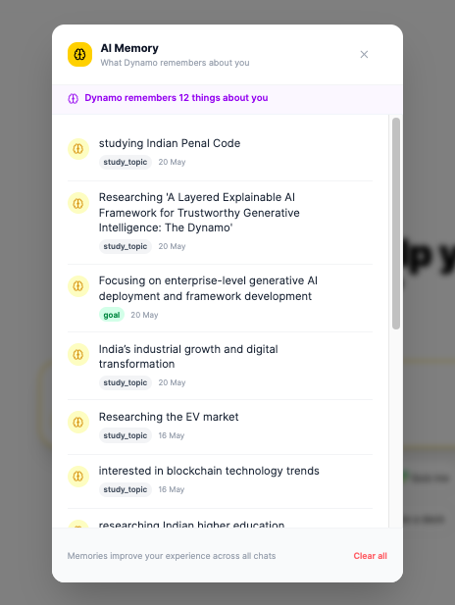
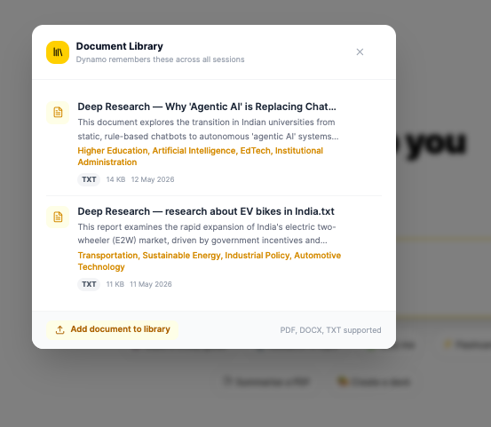
Dynamo AI
PRODUCT · PART 2
07 / 17
● PRODUCT · PERSISTENT INTELLIGENCE
It remembers. So you don't have to.
Your research context persists across sessions, documents and projects.
● ● ● app.dynamoai.in
● ● ● app.dynamoai.in
● ● ● app.dynamoai.in
User Profile & Quotas
AI Memory — Research Context Retention
Document Library
Plan tier · Chat / Image / Video quotas · One-click upgrade
Dynamo remembers your topics, goals & interests across every session
Access all research materials in one place — summaries injected into every chat
Your research context remains available across sessions, projects and uploaded documents — automatically.
DYNAMO AI · CONFIDENTIAL
app.dynamoai.in

Slide 8
Dynamo AI
THE JOURNEY
08 / 17
● THE RESEARCHER JOURNEY
The same workflow. A completely different experience.
Dynamo AI doesn't add another tool. It replaces the entire fragmented workflow with one.
✗ WITHOUT DYNAMO AI
✓ WITH DYNAMO AI
Multiple tools. Fragmented workflow.
Single platform. Single workflow.
→ Search Papers
✓ Discover evidence-backed papers
Google Scholar, databases
Evidence-backed research assistance
↕ switch app
→ Take Notes
✓ Analyse & take smart notes
Word, Notion, sticky notes
Insights, gaps and summaries — instant
↕ switch app
⟹
→ Write Draft
✓ Draft academic content
MS Word / Docs
Structured assistance with DeepThink AI
↕ switch app
→ Generate Citations
✓ Generate citations automatically
Zotero / Mendeley
6 formats — APA, MLA, IEEE and more
↕ switch app
→ Create Slides
✓ Convert research to a deck
PowerPoint / Canva
Slides, mindmaps, flowcharts — in seconds
↕ switch app
→ Store Documents
✓ Store in Document Library
Drive / email to self
Access all research materials in one place
DYNAMO AI · CONFIDENTIAL
app.dynamoai.in
Dynamo AI is not another AI chatbot. It is the academic workflow platform where researchers do all their work.

Slide 9
Dynamo AI
WHY RESEARCHERS CHOOSE DYNAMO AI
09 / 17
● WHY RESEARCHERS CHOOSE DYNAMO AI
Why researchers choose Dynamo AI.
Dynamo AI is not another AI chatbot. It is the academic workflow platform where researchers do all their work.
🎓
Built for Academic Workflows
🔗
Research → Write → Cite → Present
Not a generic AI chat. Every feature — modes, citation engine, study guides — is shaped around how researchers actually work.
The full academic pipeline lives inside a single workspace. Switching tools is the problem we exist to remove.
🧠
Academic Memory Layer
📋
Generate publication-ready citations automatically
👨‍🔬
Built by Someone Who Lived It
Research context remains available across sessions, projects and uploaded documents — automatically, without any manual effort.
6 academic citation formats, structured assistance, and evidence-backed research in one place.
Founder is a data scientist who built Dynamo to solve a workflow problem he experienced first-hand.
We don't compete on AI capability. We compete on workflow ownership.
DYNAMO AI · CONFIDENTIAL
app.dynamoai.in

Slide 10
Dynamo AI
COMPETITION
10 / 17
● COMPETITIVE LANDSCAPE
One workflow. Everyone else is a slice.
Other tools each solve a single piece of the research workflow. Dynamo AI brings them together in a single workspace.
Researcher Outcome
ChatGPT
Consensus
Jenni
⚡ Dynamo AI
Find evidence from research papers
~
✓
✗
✓
Write academic research papers
✓
✗
✓
✓
Manage research knowledge & memory
✗
✗
✗
✓
Generate formatted citations
~
✓
✓
✓
Create presentations & visuals
✗
✗
✗
✓
Complete research workflow end-to-end
✗
✗
✗
✓
💡 Dynamo AI is the only platform where a researcher can complete their entire workflow — without switching tools.
DYNAMO AI · CONFIDENTIAL
app.dynamoai.in

Slide 11
Dynamo AI
WHY NOW
11 / 17
● WHY NOW
Three forces. One window.
Academia is at an inflection point. Researchers need integrated AI tools — and they need them now.
📈
01
🤖
02
⚡
03
Research Output is Exploding
AI Adoption is Mainstream
Workflow Tools are Demanded
Exponential growth
Already in workflows
Integration is the gap
Global research volume is growing exponentially. Manual literature reviews don't scale to the pace of modern science.
AI tools are now part of daily academic life. But most are generic — none are designed around how researchers actually work.
Researchers are vocally tired of stitching 6+ tools together. The next winner won't add another chatbot — it'll consolidate the workflow.
The market is ready. Researchers want integrated, intelligent tools — built for them, in India.
DYNAMO AI · CONFIDENTIAL
app.dynamoai.in

Slide 12
Dynamo AI
MARKET
12 / 17
● TARGET MARKET · TAM / SAM / SOM
Big market. Sharp entry point.
Start with the highest-pain users. Expand outward to institutions.
TAM
SAM
SOM
Total Addressable Market
Serviceable Available Market
Serviceable Obtainable Market
Researchers, educators and institutions across India using digital academic tools.
India's 200K+ PhD scholars + 1.5M professors & academic researchers.
First wedge: 10,000 paying scholars & researchers in 24 months.
India-wide
1.7M+
10K
academic research & education sector
active researchers & faculty (India)
users · ₹4–10 Cr ARR target by Year 2
Wedge strategy: dominate PhD scholars first → expand to professors → institutional contracts.
DYNAMO AI · CONFIDENTIAL
app.dynamoai.in

Slide 13
Dynamo AI
BUSINESS MODEL
13 / 17
● BUSINESS MODEL
Predictable revenue. Scalable margins.
Subscription SaaS today. Institutional licensing tomorrow. INR-priced for the Indian market.
MOST POPULAR
Free Forever
Plus
Pro
₹0
₹399
₹999
/mo
/mo
/mo
Acquisition layer
For scholars & researchers
Power users & professors
10 AI chats / day
✓ Unlimited AI chats
• Everything in Plus
Fast Mode (Gemini Flash)
✓ Research Mode (3 models)
• DeepThink Mode
Web search + voice input
✓ 6-Format Citation Engine
• Deep Research Agent
AI Detector & Plagiarism
✓ Document Library
• Unlimited PDF uploads
Mindmaps & Flowcharts
✓ Find Research Gaps
• Advanced academic workflows
🏛️ FUTURE · YEAR 2 — Institutional Licensing: ₹5L–50L / year per university
🤝 FUTURE · YEAR 2 — University Partnerships: Embedded into curriculum
DYNAMO AI · CONFIDENTIAL
app.dynamoai.in

Slide 14
Dynamo AI
VALIDATION
14 / 17
● EARLY VALIDATION
Real users. Real traction.
We're live. We have users. They're using it. Here's where we are and where we're heading.
● TODAY · LIVE
● NEXT 90 DAYS
[X]
100%
50
Beta users onboarded
Scaling from launch to active researchers
Beta users
MVP shipped
20+
[X]
5+
Video testimonials
Professor + PhD scholar validation videos
AI features live
Professor endorsements
100
Paid users target
"[ Add real user testimonial here ]"
First ₹1L+ MRR from organic conversion
— [ Add attribution ]
3
University pilots
Initial institutional conversations
DYNAMO AI · CONFIDENTIAL
app.dynamoai.in

Slide 15
Dynamo AI
ROADMAP
15 / 17
● THE ROADMAP
From MVP to market leader — in 18 months.
A focused, milestone-driven plan from where we are today to a category-defining position.
Phase 1
Q2–Q3 2026
Phase 2
Q4 2026 – Q1 2027
Phase 3
Q2–Q4 2027
Validate & Refine
Scale & Expand
Institutional Play
› 100 paid users (₹1L+ MRR)
› Mobile apps (iOS + Android)
› 10,000+ active users
› 5+ video testimonials
› First 3 university pilots
› 10+ institutional contracts
› Product-market fit signals
› 1,000 paid users (₹10L+ MRR)
› Team scale to 15
› Feature prioritisation
› Hindi language support
› National Academic Adoption
DYNAMO AI · CONFIDENTIAL
app.dynamoai.in

Slide 16
Dynamo AI
FOUNDER
16 / 17
● WHO'S BUILDING THIS
Built by someone who lived the problem.
📊
📣
🛠️
AK
Analytics
Marketing
Product
Data-driven product decisions
Brand, growth & demand gen
End-to-end product building
Anish Krisna S
MISSION
"Build the operating system for academic work — so India's brightest minds spend their time on insight, not on busywork."
Founder & CEO
EDUCATION: MS in Data Science
EXPERIENCE: 11 Years cross-functional
WHY I BUILT DYNAMO AI
I experienced how fragmented academic workflows force researchers to spend more time managing tools than producing insight. Dynamo AI was created to unify research, writing, citations and knowledge management into a single academic workspace — so scholars can focus on what actually matters.
DYNAMO AI · CONFIDENTIAL
app.dynamoai.in

Slide 17
Dynamo AI
THE ASK
17 / 17
● WHAT WE NEED FROM YOU
Let's build India's academic operating system — together.
We have the product, the vision, and early traction. We're looking for the right partners to scale.
🎓
🚀
🏛️
🧪
🧭
Mentorship
Incubation
Academic Partnerships
Pilot Institutions
Strategic Guidance
Strategic guidance from founders who've scaled SaaS in India
Workspace, infrastructure, and ecosystem support
Warm intros to universities & research institutions
3–5 partner institutions for institutional MVP
Go-to-market, hiring, and fundraising playbooks
LET'S TALK
Demo: app.dynamoai.in
Try it live · See the product · Then decide.
Email: anish@dynamoai.in
⚡ THANK YOU ⚡

