Slide 1

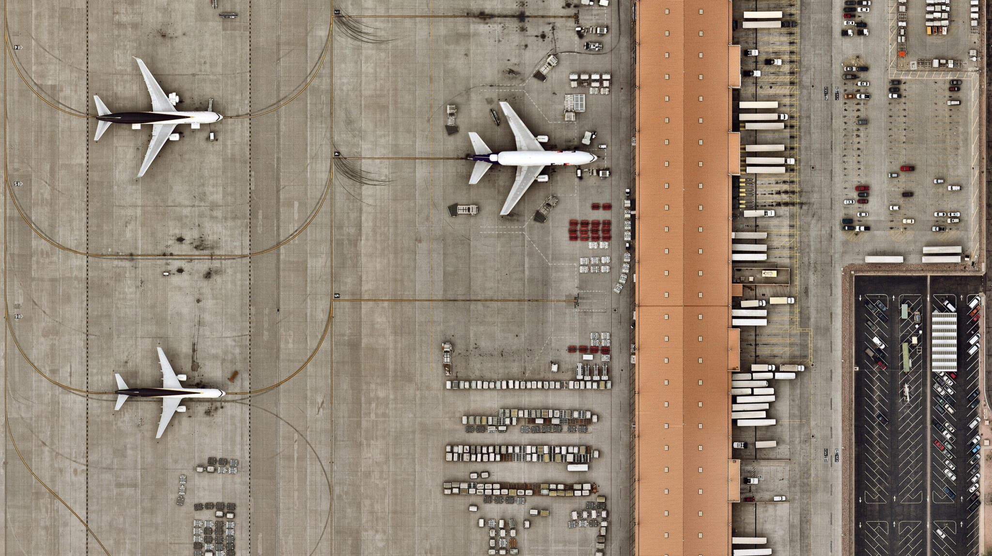
Air Lines Reservation System
AIRLINE RESERVATION SYSTEM

Slide 2
Introduction
This project aims to create an Airline Reservation System to streamline and improve the reservation process, making it easier and more efficient for both passengers and administrators. Its primary objective is to simplify flight and passenger management while offering robust administrative tools for handling flight details.

Slide 3
Collection Details
Collection 1 – Admin :
AdminID
name
contactNumber
Collection 2 – Users :
passengerID
name
contactNumber
email

Slide 4
Collection 3 – Flights :
departureAirport
arrivalAirport
departureDate
arrivalDate
duration
availableSeats
aircraftNumber
ﬂightID
Collection 4- Aircraft
aircraftID
aircraftType
registrationNumber
seatingConfiguration
lastMaintenance

Slide 5
Collection 5- Airport
airportCode
location
Collection 6 – Booking
bookingID
ﬂightID
bookingStatus

Slide 6
Collection 7 – payments
bookingID
paidBy
amount
Collection 8 – Tickets
passengerID
seatNumber
bookingID

Slide 7
Collection 9 – passengers
passengerID
passportNumber
name
contactNumber
email

Slide 8
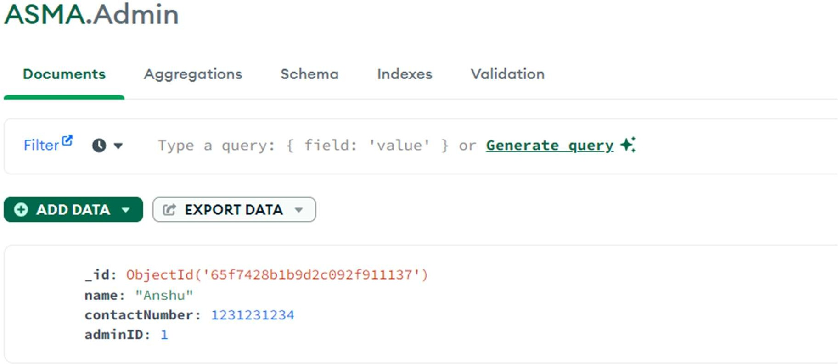
Sample Collections collection 1: Admin

Slide 9
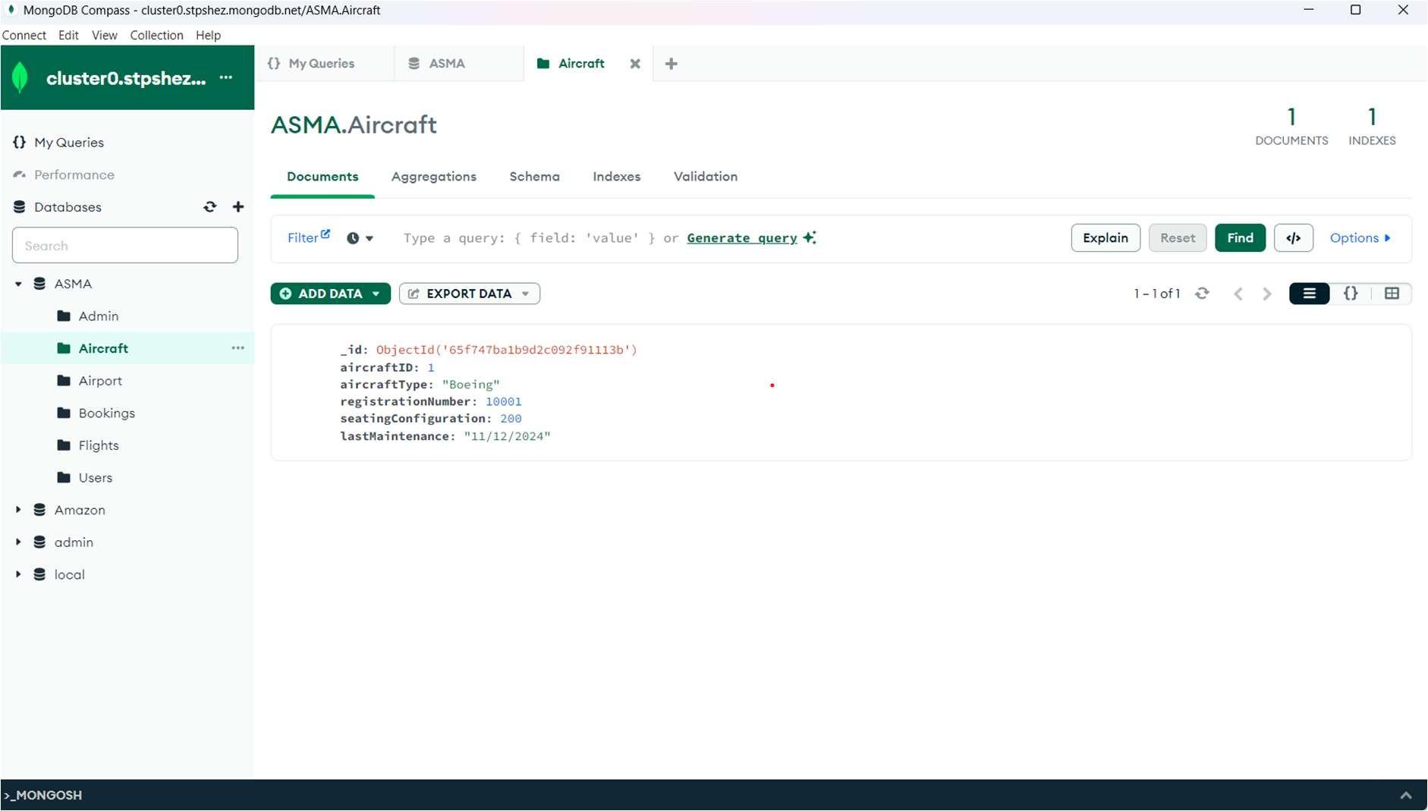
Collection 2: Aircraft

Slide 10
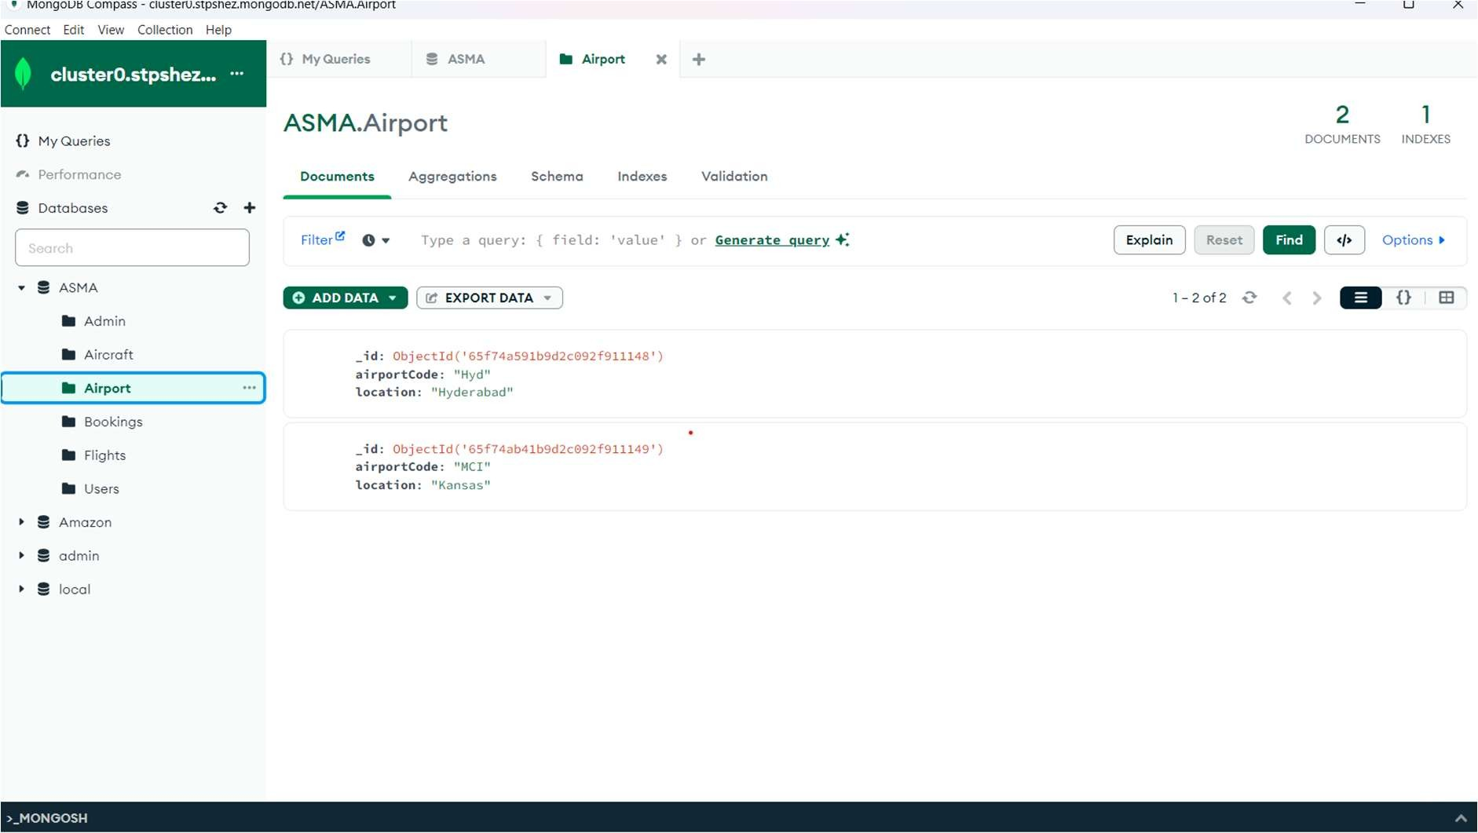
Collection 3: Airport

Slide 11
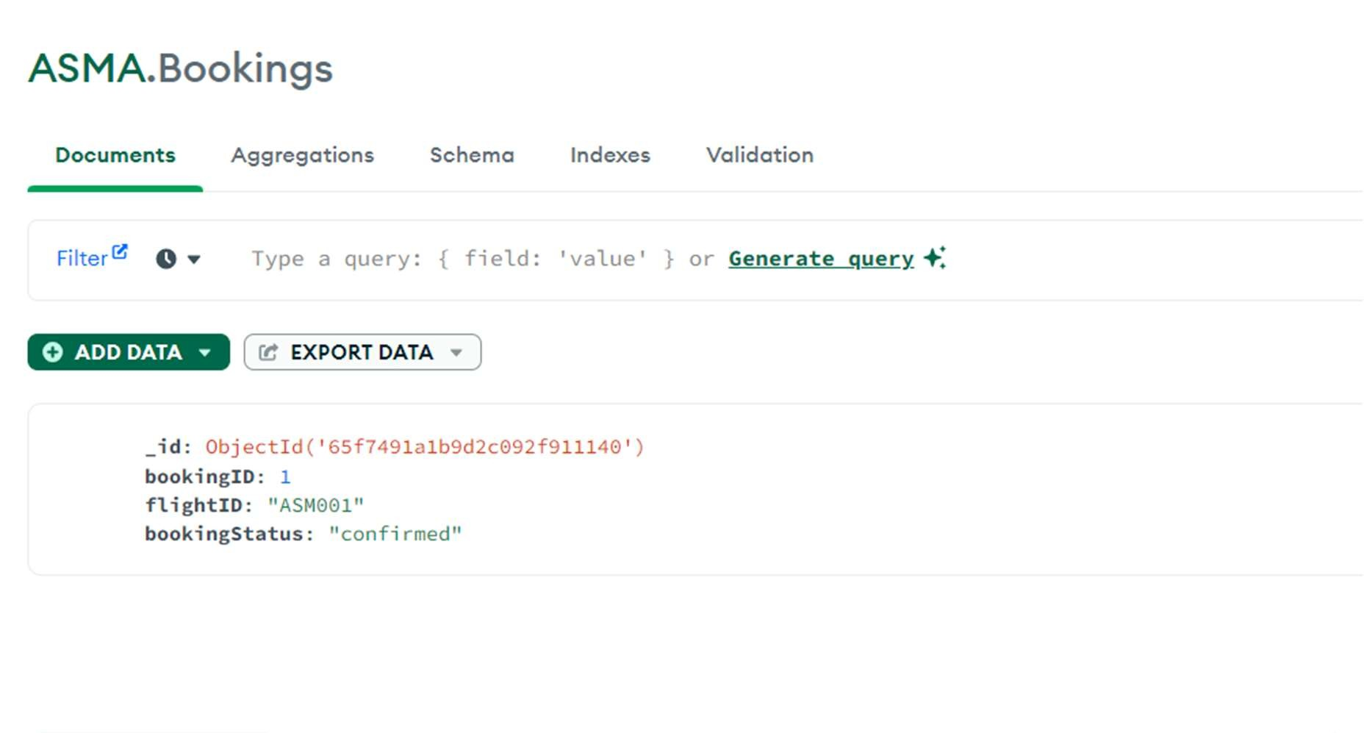
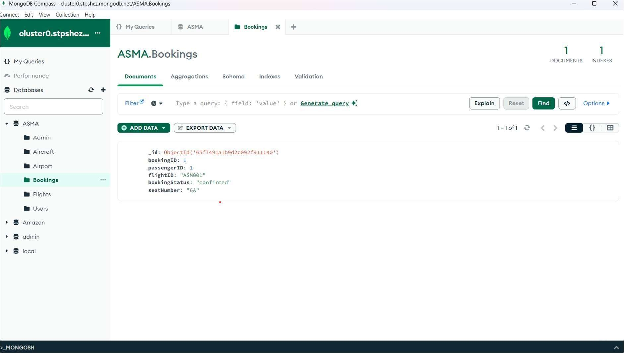
Collection 4: Booking

Slide 12
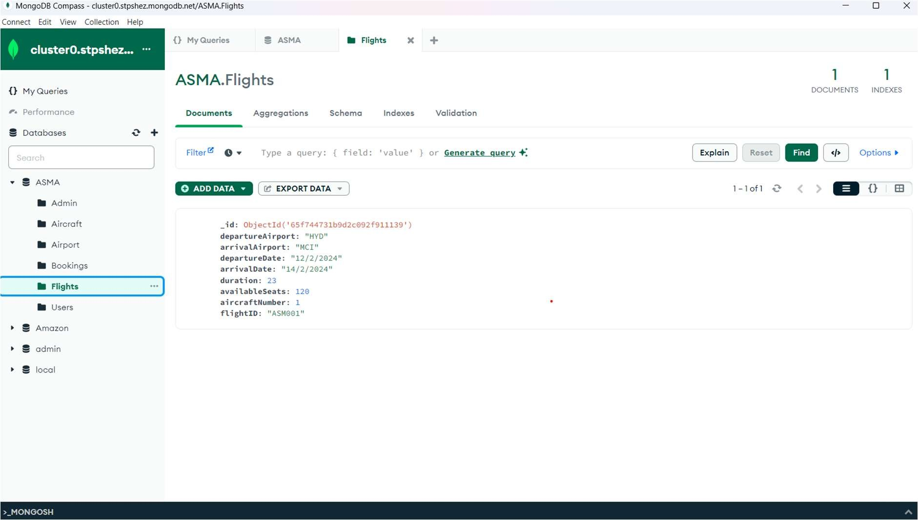
Collection5: Flight

Slide 13
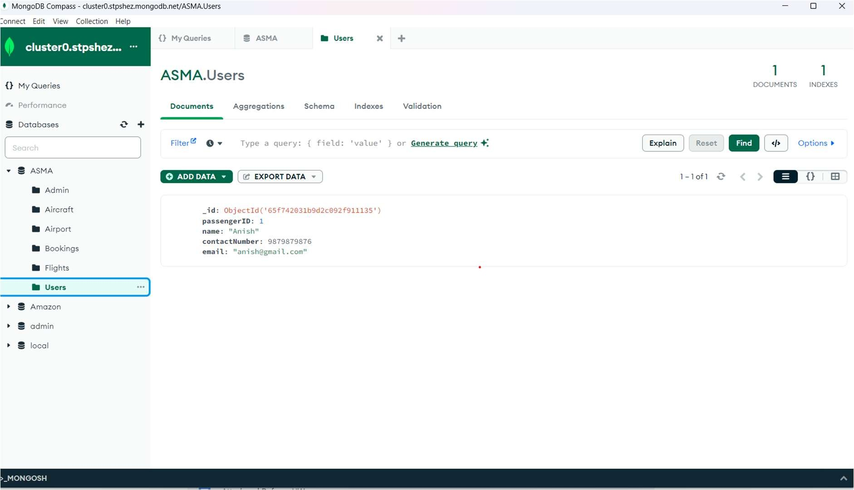
Collection 6: Users

Slide 14
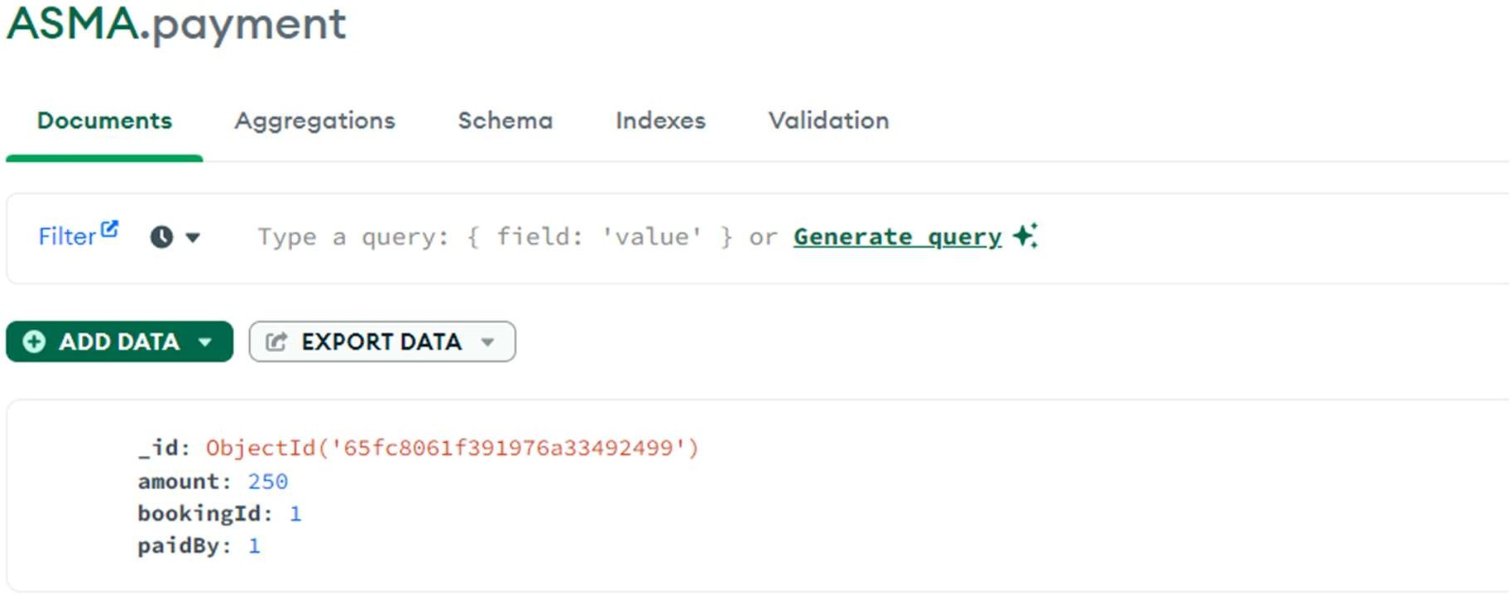
Collection7: Payment

Slide 15
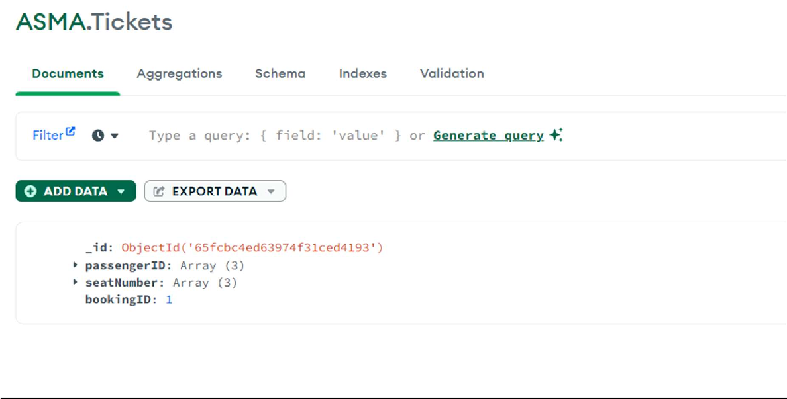
Collection8: Tickets

Slide 16
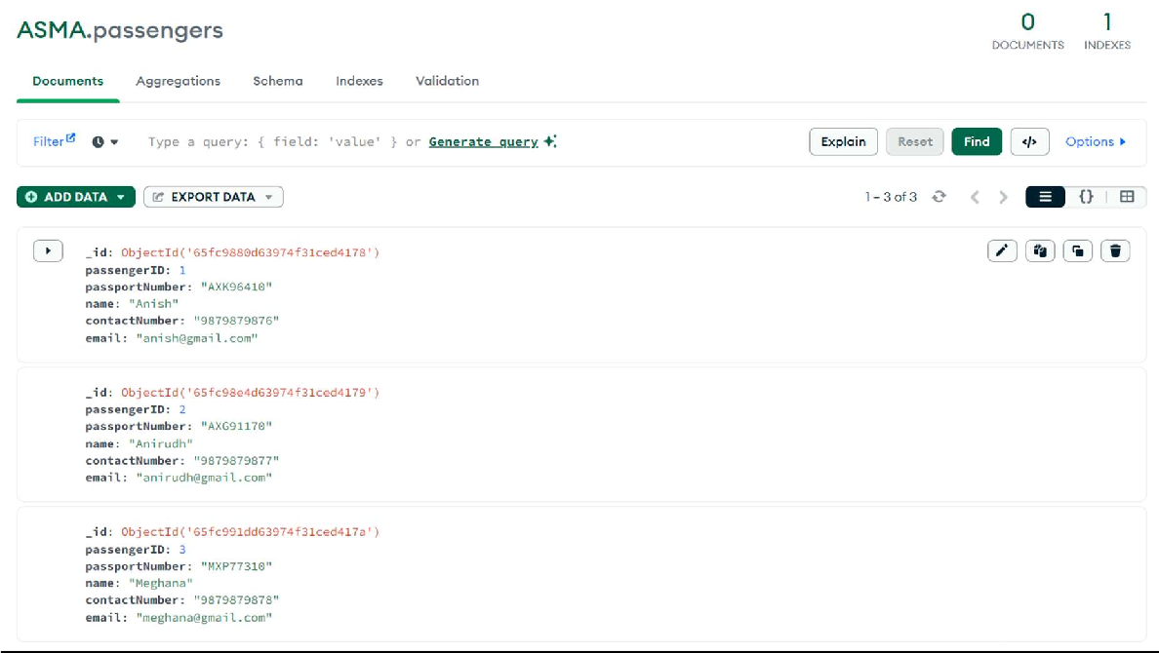
Collection9: Passengers

Slide 17
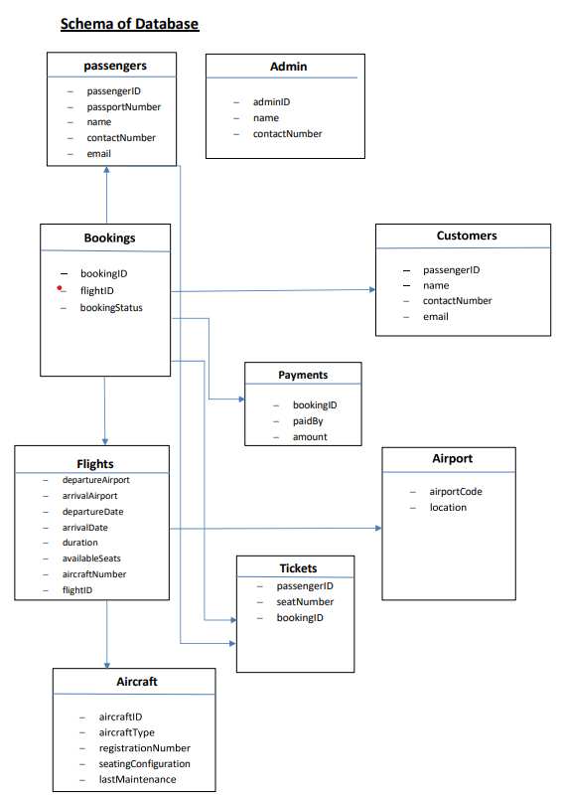

Slide 18
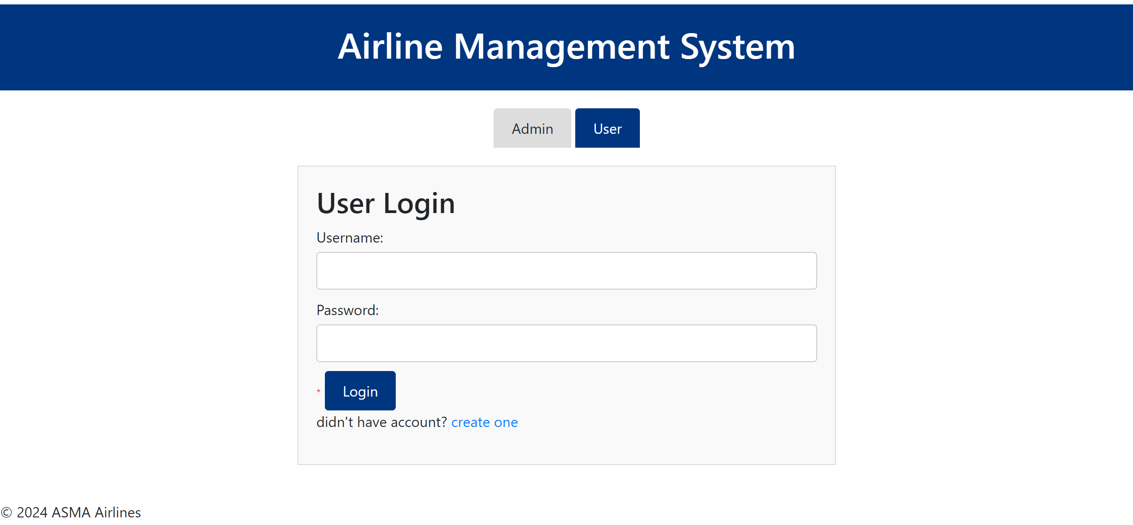
User Login Page

Slide 19
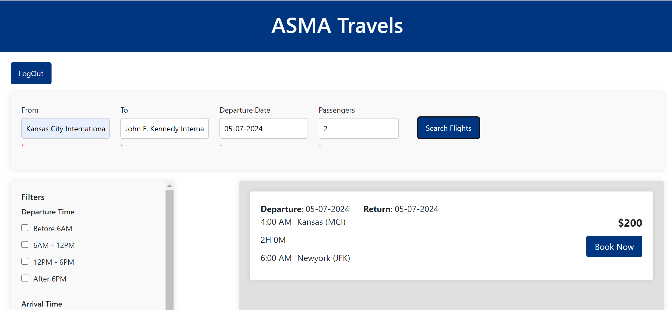
Flights Search Page

Slide 20
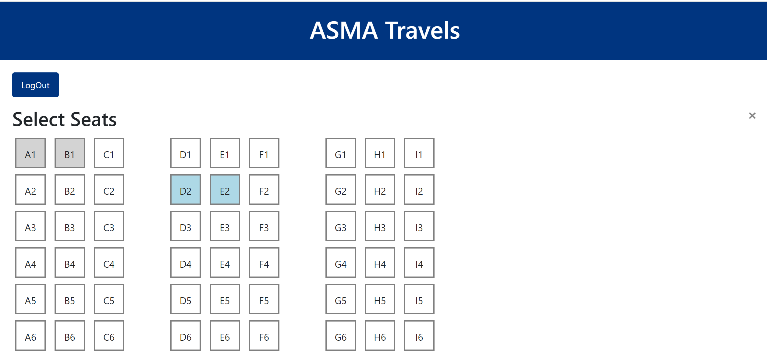
Seat Selection Page

Slide 21
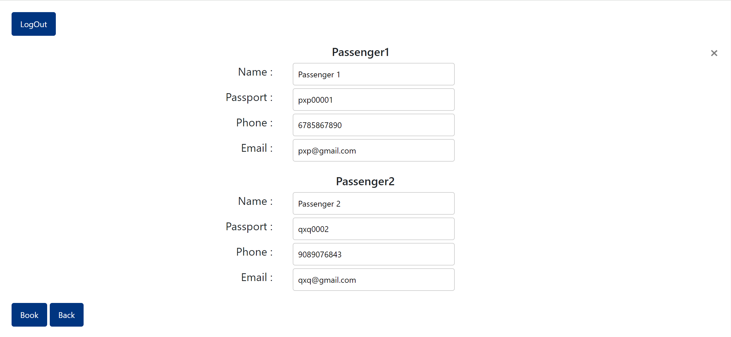
Passengers Information Page

Slide 22
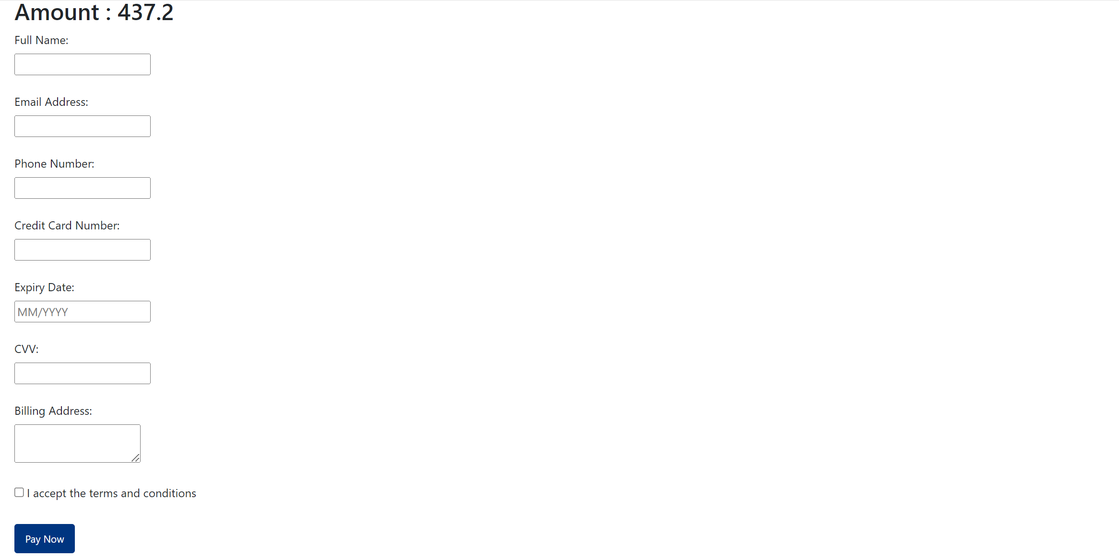
Billing Information

Slide 23
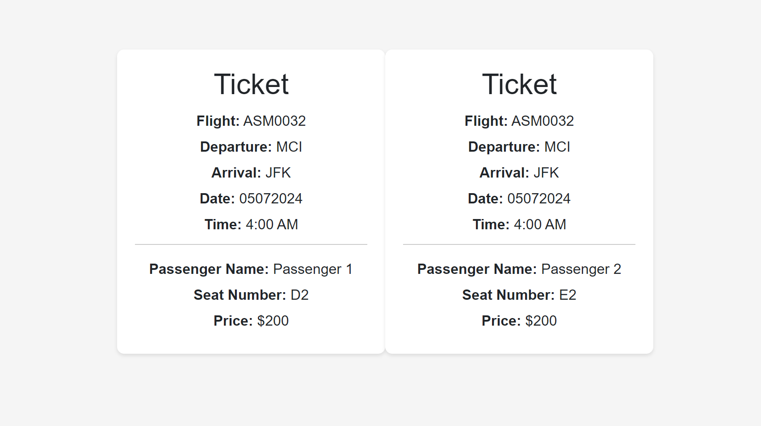
Tickets

Slide 24
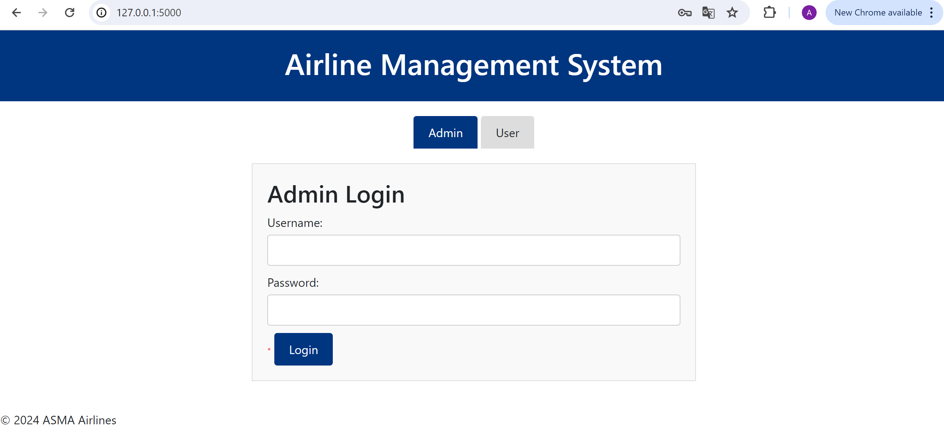
Admin Login

Slide 25
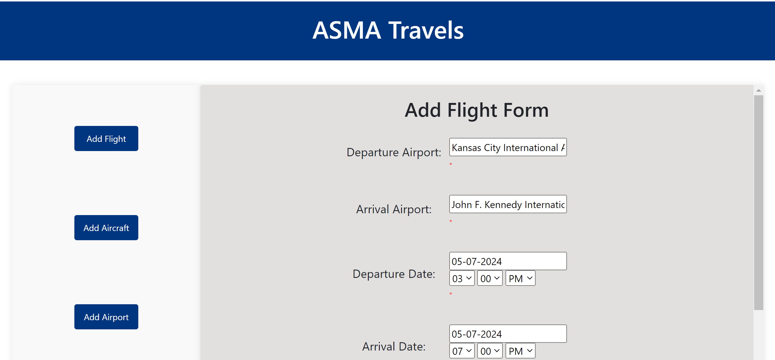
Add Flight Page

Slide 26
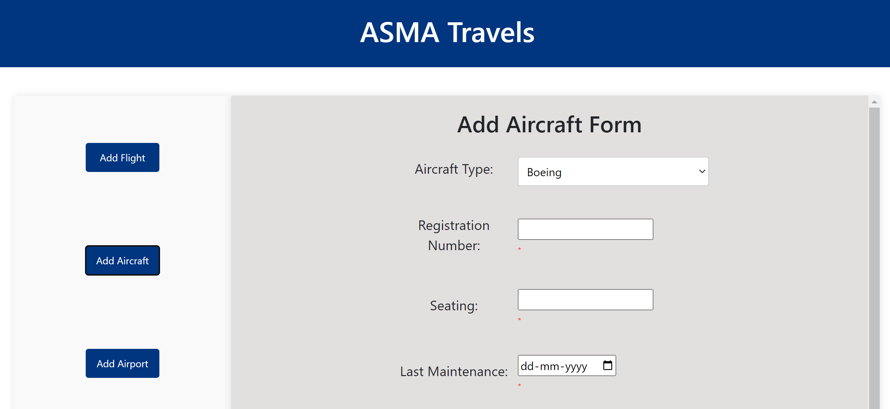
Add Aircraft Page

Slide 27
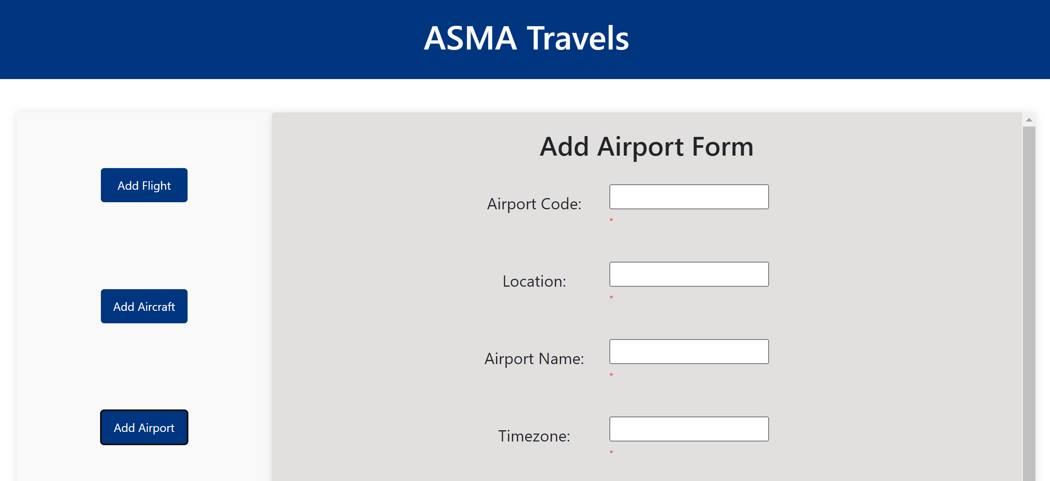
Add Airport

Slide 28
THANK YOU

