Slide 1



k6 Load Testing
By Anish Jain
k6 is an open-source tool for performance testing APIs, websites, and backend services using JavaScript.

Slide 2

Agenda
k6 offerings
xK6 Installation
Myths about load testing
Load Testing Type
Purpose of Load Testing
Introduction to K6
Options In K6
Check
Threshold
Build-in Metrics
Custom Metrics
Test lifecycle
Groups
Demo
k6 Load Test Results
Notes:
https://www.slideshare.net/slideshow/laravel-load-testing-strategies-and-tools/251763963
https://www.slideshare.net/slideshow/running-distributed-tests-with-k6pdf/254078520

Slide 3

Myths about load testing
Performance testing == load testing
It is only for large companies
Is expensive to do
Should only be in production
Unnecessary if you have Observability

Slide 4
Introduction to K6
k6 is an open-source load testing tool for testing the performance of APIs, microservices, and websites.
Load Testing is primarily concerned with assessing the current performance of your system in terms of concurrent users or requests per second.
This tool is scriptable and support the Javascript language.
k6 was initially released on GitHub in 2017 by Load Impact as an open-source.
It’s written in Go Language.

Slide 5
k6 offerings
k6 Open Source
Features:
Scripting: Write tests in JavaScript.
Local Execution: Run tests locally on your machine.
Integrations: Integrate with CI/CD pipelines.
Visualization: Basic result visualization in the terminal.
k6 Cloud
Features:
Distributed Testing: Run tests from multiple cloud locations.
Scalability: Easily scale tests to thousands of virtual users.
Test Builder: Create tests using a graphical interface.
Result Storage: Store and analyse test results in the cloud.
Dashboards: Rich, interactive dashboards for visualizing results.
Collaboration: Share test results and collaborate with team members.
Integrations: Seamless integration with Grafana and other tools.
Support: Premium support and enterprise-grade security.

Slide 6
xK6 Installation
Step 1: Install Go
1. Download and Install Go: Visit the [Go official website](https://golang.org/dl/) and download the installer for Windows. Follow the installation instructions.
Step 2: Set Up Your Environment
1. Set GOPATH: Ensure your `GOPATH` environment variable is set. You can do this by adding the following to your system environment variables:
```powershell
setx GOPATH "C:\Users\YourUsername\go"
```
Replace `YourUsername` with your actual username.
Step 3: Install xk6
1. Open PowerShell: Run PowerShell as an administrator.
2. Install xk6:
```powershell
go install go.k6.io/xk6/cmd/xk6@latest
```
Step 4: Build k6 with Visualization Extensions
1. Build k6 with Extensions: Use the following command to build k6 with the desired visualization extensions:
```powershell
xk6 build --with github.com/grafana/xk6-dashboard@latest
```
This will create a `k6.exe` file in your current directory with the specified extensions.
Step 5: Verify Installation
1. Check the Directory: Ensure that `k6.exe` is present in your current directory.
2. Run k6: Open a new PowerShell window and run:
```powershell
.\k6.exe version
```
This should display the version of k6, confirming the installation.
./k6.exe run --out web-dashboard=port=5666 '.\exporttokafka copy.js'

Slide 7
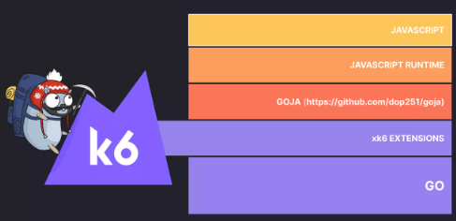
K6 Build Upon

Slide 8
K6 vs Jmeter
Parameter | k6 | JMeter
Release Year | 2017 | 1998
Scripting Language | JavaScript | Java, Groovy
User Interface | Command-line, Code-based | GUI, Code-based
Ease of Use | High (developer-friendly) | Moderate (GUI-based, but can be complex)
Performance | High (efficient resource usage) | Moderate (can be resource-intensive)
Integration | CI/CD pipelines, Grafana, InfluxDB | CI/CD pipelines, Jenkins, Grafana
Reporting | JSON, InfluxDB, Grafana | HTML, CSV, XML, Grafana
Protocol Support | HTTP/1.1, HTTP/2, WebSocket | HTTP, HTTPS, FTP, JDBC, JMS, LDAP, SOAP
Community Support | Growing, active community | Large, established community
Extensibility | High (via xk6 extensions) | High (via plugins and scripting)
License | Open-source (Apache 2.0) | Open-source (Apache 2.0)
Scalability | High (efficient handling of VUs) | High (supports distributed testing)
Resource Efficiency | High (written in Go) | Moderate (written in Java)
Learning Curve | Moderate (requires coding knowledge) | Low to Moderate (GUI-based)
Error Handling | Detailed error messages and logs | Detailed error messages and logs
Key Differences:
Scripting: k6 uses JavaScript, making it more appealing to developers familiar with modern web development. JMeter uses Java and Groovy, which might be more familiar to testers with a background in enterprise environments.
User Interface: k6 is primarily command-line based, which can be more efficient for automated testing and CI/CD integration. JMeter offers a GUI, which can be easier for beginners but might become cumbersome for complex tests.
Performance and Resource Usage: k6 is known for its efficient resource usage, making it suitable for high-load scenarios. JMeter can be more resource-intensive, especially for large-scale tests.
Integration and Extensibility: Both tools offer extensive integration options, but k6’s modern approach and support for extensions via xk6 make it highly flexible.

Slide 9
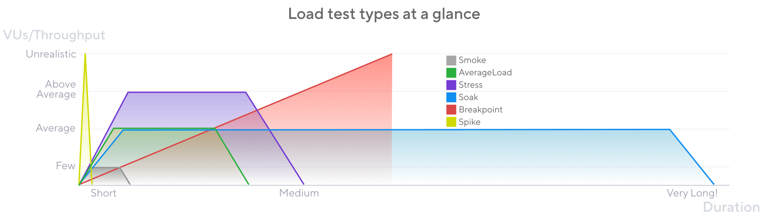
LOAD TESTING TYPE

Slide 10
Purpose of Load Testing
1. Identify Performance Bottlenecks
- Uncover areas where the system may slow down or fail under heavy load.
Example: During load testing, you might find that the database queries are taking too long to execute under heavy load. This can help you optimize the queries or improve the database indexing to enhance performance.
2. Validate System Capacity
- Ensure the system can handle expected user loads without compromising functionality or user experience.
Example: If your e-commerce website expects a surge in traffic during a sale, load testing can ensure that the site can handle thousands of simultaneous users without crashing or slowing down significantly.
3. Evaluate Behaviour Under Load
- Assess how the software performs under both high and normal user loads.
Example: A social media platform might perform well with 1,000 users but start to lag or show errors when the user count reaches 10,000. Load testing helps identify these issues so they can be addressed before they affect real users.
4. Measure Key Metrics
- Track response times, throughput rates, and resource utilization levels.
Example: By measuring response times, you might discover that the average page load time increases from 2 seconds to 10 seconds under heavy load. This information is crucial for making performance improvements.
5. Determine Breaking Points
- Identify the maximum load the application can handle before it breaks down.
Example: Load testing might reveal that your application can handle up to 5,000 concurrent users before it starts to fail. Knowing this breaking point allows you to plan for scaling up resources or optimizing the application to handle more users.

Slide 11

K6 Essentials

Slide 12
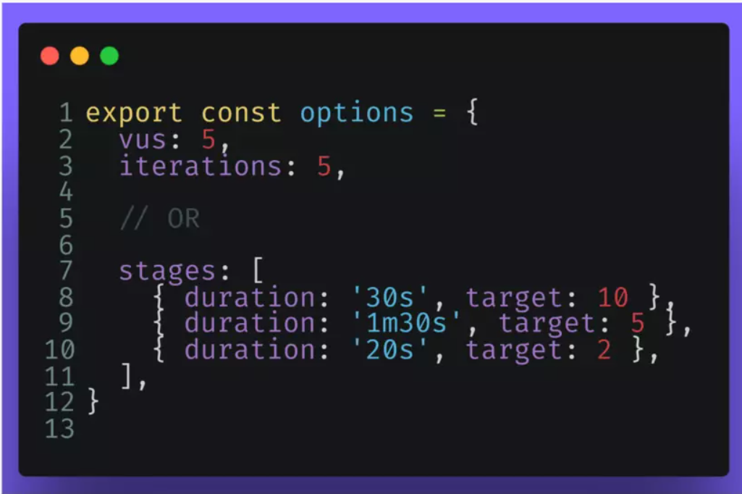
Options In K6
VUs
Duration
A fixed number of VUs execute as many iterations as possible for a specified amount of time.
A string specifying
the total duration a
test run should be
run for.
Stages
Array of objects that
specify the target
number of VUs to
ramp up or down to.
Options in K6

Slide 13
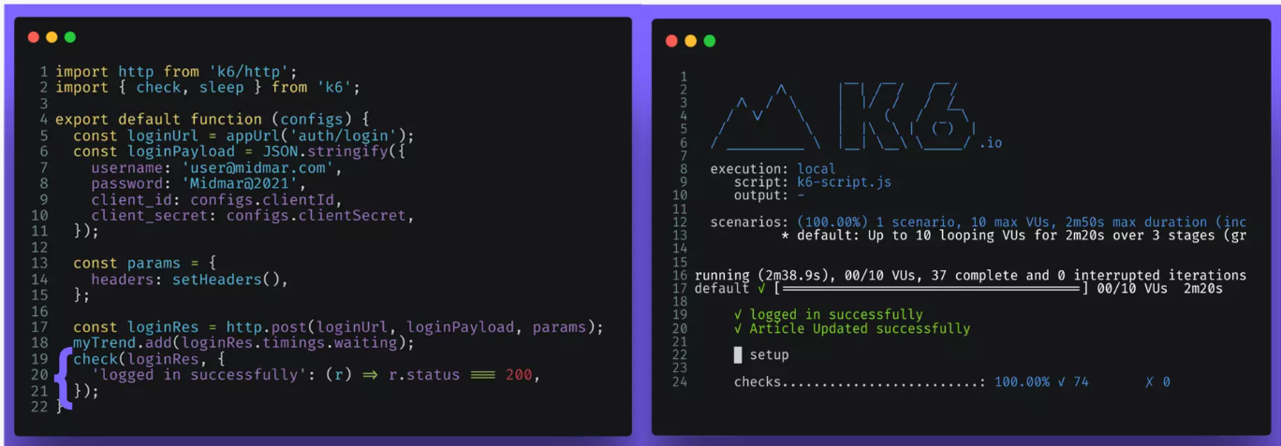
CHECKS
Checks are asserts but differ in that they don't halt the execution. Instead, they store the result of the check, pass or fail, and let the script execution continue.
Checks are great for codifying assertions relating to HTTP requests/responses, such as making sure the response code is an HTTP.

Slide 14
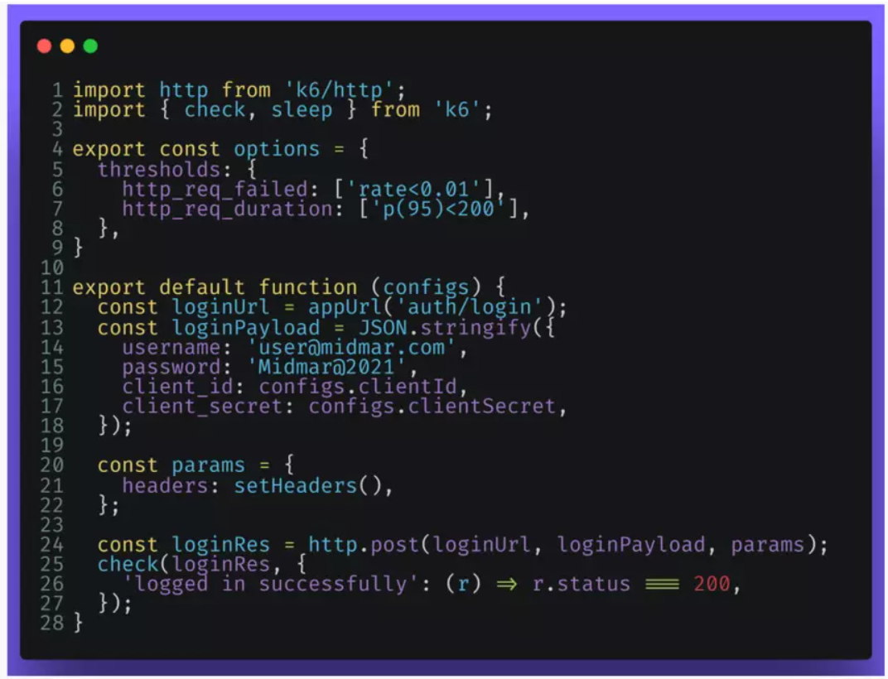
Threshold
Thresholds are a pass/fail criteria used to specify the performance expectations of the system under test.
Thresholds analyze the performance metrics and determine the final test result (pass/fail).

Slide 15
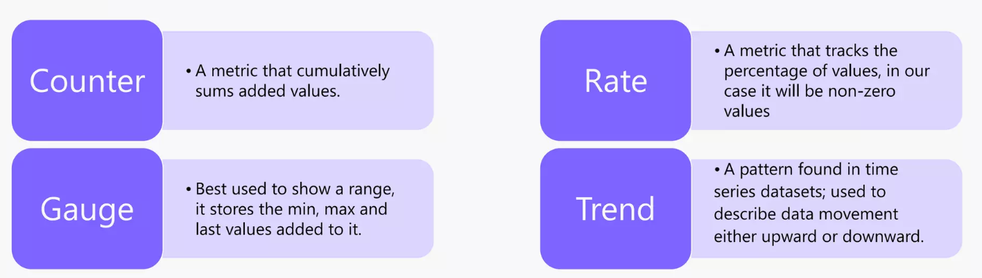
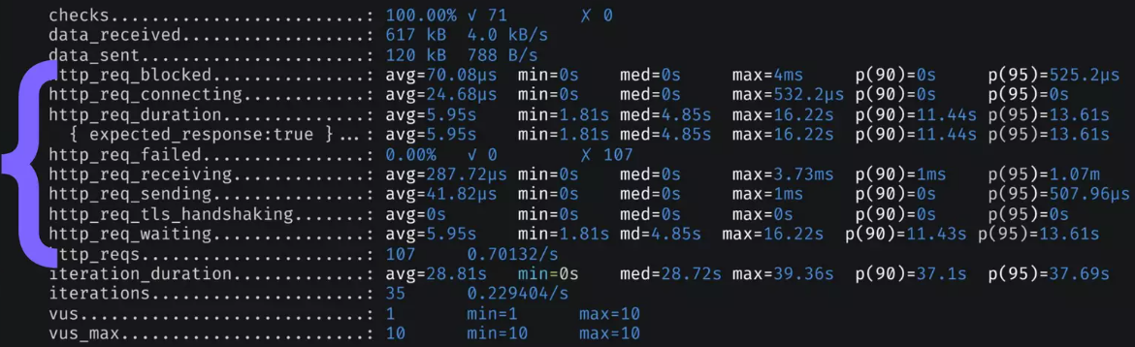
Build-in Metrics

Slide 16
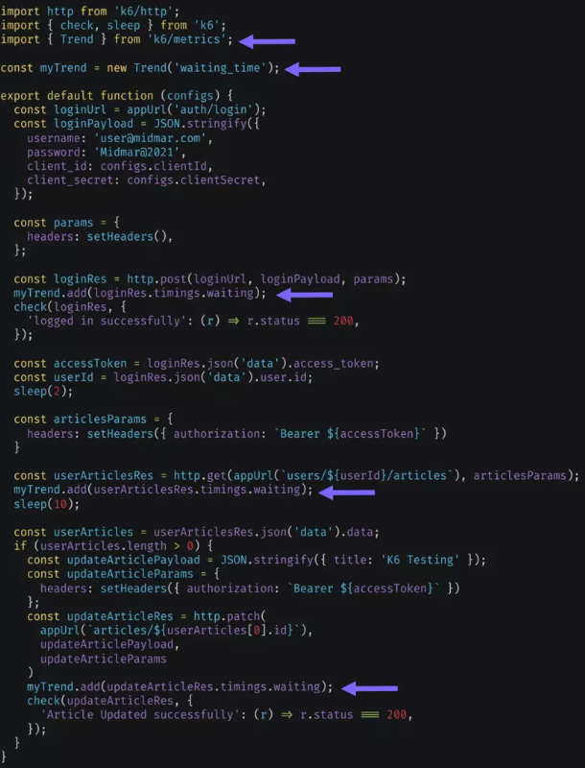
Custom Metrics
K6 allows you to create custom metrics of any type.
Custom Metrics are reported at the end of the test.

Slide 17
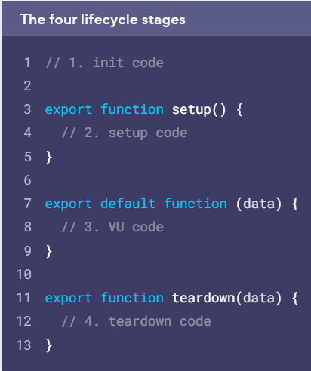
Test lifecycle
Test stage | Purpose | Example | Called
1. init | Load local files, import modules, declare lifecycle functions | Open JSON file, Import module | Once per VU
2. Setup | Set up data for processing, share data among VUs | Call API to start test environment | Once
3. VU code | Run the test function, usually default | Make https requests, validate responses | Once per iteration, as many times as the test options require
4. Teardown | Process result of setup code, stop test environment | Validate that setup had a certain result, send webhook notifying that test has finished | Once
Notes:
Test lifecycle (k6.io)

Slide 18
Modules
Module Type | Description | Example
Built-in Modules | Core functionalities provided by k6. These are included by default. | import http from 'k6/http'; - for making HTTP requests.
Local Modules | Modules stored on the local filesystem, accessed via relative or absolute paths. | import { someHelper } from './helpers.js'; - importing a helper function from a local file.
Remote Modules | Modules accessed over HTTP(S) from a web server or repository. | import { randomItem } from 'https://jslib.k6.io/k6-utils/1.2.0/index.js'; - importing from a remote URL.
Extension Modules | Custom modules that extend k6 functionality, often written in Go. | xk6 build --with github.com/grafana/xk6-dashboard@latest - building k6 with a dashboard extension.
Notes:
https://grafana.com/docs/k6/latest/using-k6/modules/

Slide 19
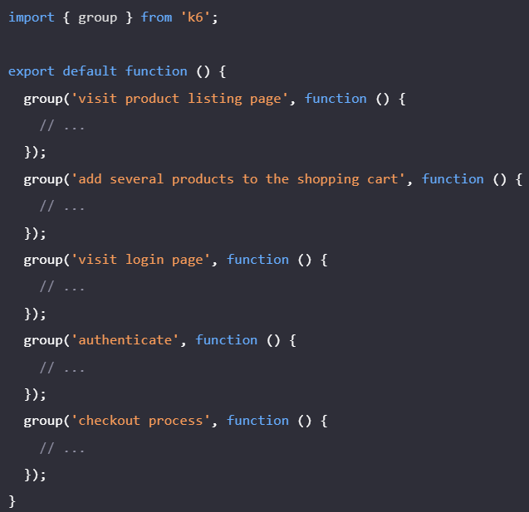
Groups
What are Groups?
Definition: Groups in k6 are used to organize and structure your load test scripts.
Purpose: They help in categorizing and isolating different parts of your test, making it easier to analyse results.
Benefits of Using Groups
Organized Results: Groups help in organizing the results, making it easier to identify which part of the test is causing issues.
Improved Readability: Scripts are more readable and maintainable.
Detailed Analysis: Allows for detailed analysis of specific parts of the test.
Best Practices
Meaningful Names: Use meaningful names for groups to clearly indicate what part of the test they represent.
Avoid Async Code: Avoid using asynchronous code within groups to ensure reliable tagging and results.

Slide 20
DEMO

Slide 21
k6 Load Test Results
1. Overview
- Test Duration: 10 minutes
- Total Requests: 10,000
- Concurrent Users: 100
2. Key Metrics
- Response Time:
- Average: 200 ms
- 95th Percentile: 350 ms
- Max: 500 ms
- Throughput:
- Requests per Second: 16.67
- Error Rate:
- Total Errors: 50
- Error Percentage: 0.5%
3. Resource Utilization
- CPU Usage: 70%
- Memory Usage: 60%
4. Performance Insights
- Bottlenecks Identified:
- High response times during peak load
- Increased error rate when concurrent users exceeded 90
- Recommendations:
- Optimize database queries
- Scale server resources during peak times
5. Detailed Metrics Breakdown
- HTTP Request Duration:
- Min: 150 ms
- Median: 200 ms
- 90th Percentile: 300 ms
- HTTP Response Codes:
- 200 OK: 9,950
- 500 Internal Server Error: 50
6. Visualizations
- Response Time Distribution: Graph showing the distribution of response times.
- Error Rate Over Time: Graph showing error rates throughout the test duration.
- Resource Utilization Trends: Graphs showing CPU and memory usage over time.

Slide 22

Any Questions?

Slide 23

Thank You

