Slide 1

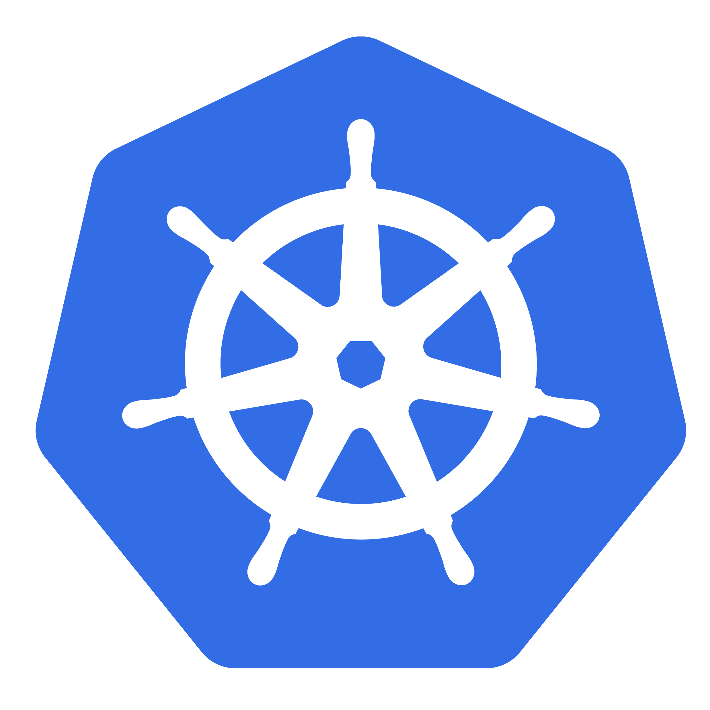
KUBERNETES
By Anish Jain
Orchestrating containers, scaling workloads, and securing applications.

Slide 2
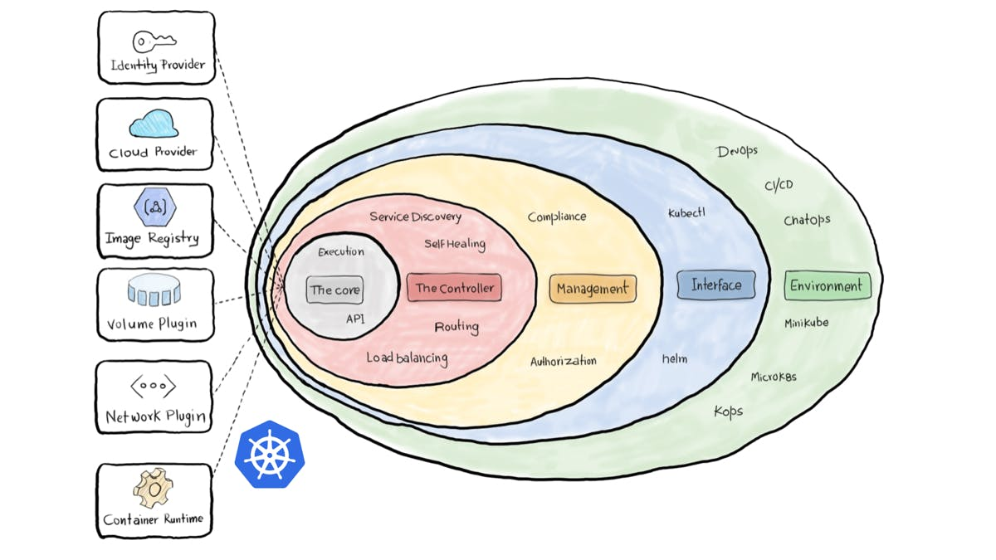
Agenda
Upcoming sessions
Architecture of Kubernetes
- Control Plane Components
- NODE Components
CORE OBJECTS AND APIS
- POD
- Labels
- Selectors
- Services
- Namespace
Configuration
- Config map
- Config Secret
Probes
- Startup
- Liveness
- Readiness
Container Patterns
- Side car
- Ambassador
- Adapter
Getting started with Open shift in Microlise
- Creation of repo
- Create namespace in Gryphon.OpenShift.Projects
- Create entry in Gryphon.Quay.Config.registry
- Open shift UI etc.
- Check-in to deployment process
- Get Help and Contribution

Slide 3
Upcoming sessions
HELM CHART
- Introduction to Helm and Kubernetes:
- Helm Chart Structure
- Values Files
- Templates
- Labels and Annotations
- Dependencies and Subcharts
- Helm CLI Commands
- Security
- Hooks and Tests
- Best Practices
Deployment
- Introduction to Deployments
- Deployment Object Structure
- Creating and Managing Deployments
- ReplicaSets
- Rolling Updates and Rollbacks
- Scaling Applications
- Deployment Strategies
Resource Quota Allocation
- Introduction to Resource Quotas
- Setting Resource Quotas
- Resource Requests and Limits
- Namespace Isolation
Networking
- Introduction to Kubernetes Networking
- Cluster Networking
- Network Policies
- Service Types
- Route
- Container-to-Container Networking
- Pod-to-Service Networking
- External-to-Service Networking
Volume
- Introduction to Kubernetes Volumes
- Volume Types
- Persistent Volumes (PV) and Persistent Volume Claims (PVC)
- Storage Classes
- VolumeMounts
- Data Persistence and Sharing
- Configuring Volumes in Pod Specifications
- Security Considerations
Issue investigation
- Deployment issue
- Resources quota issue etc.

Slide 4

Architecture of Kubernetes

Slide 5
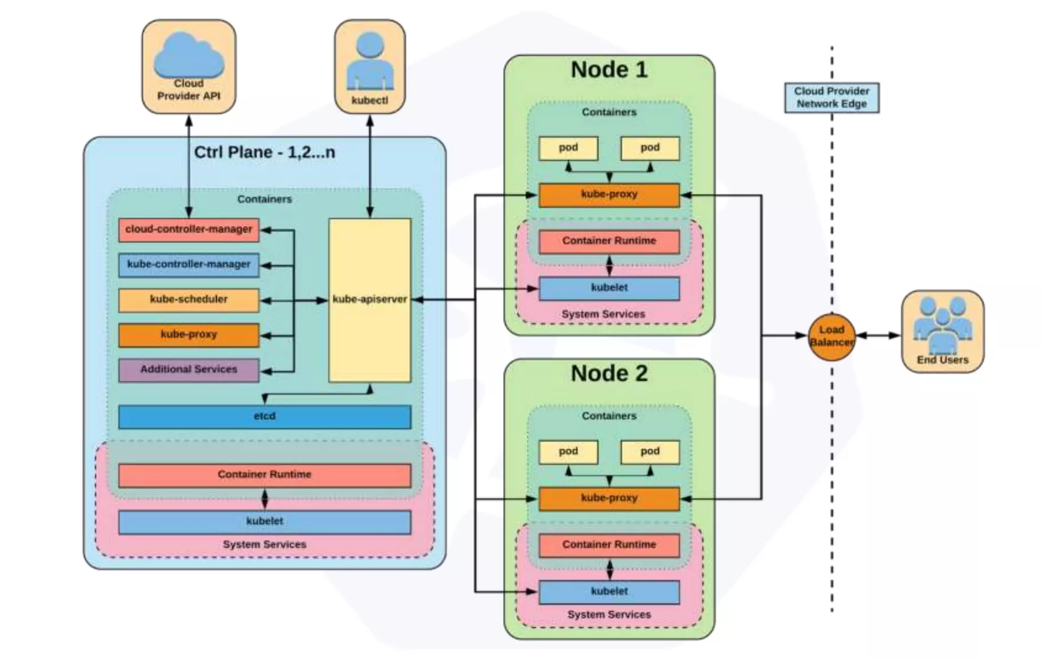

Slide 6
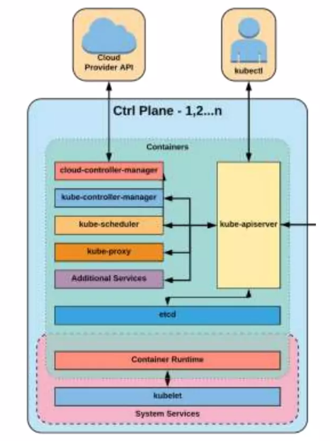
Control Plane Components
kube-apiserver
- Provide REST interface.
- Strictly all client communicate via API server.
- Act as gatekeeper to handle authentication, request validation etc.
Etcd
- Act as cluster data store.
- key-value store for persisting cluster state.
kube-controller-manager
- Steers the cluster towards the desire state
- Node controller, Replication controller, endpoint controller, Service account and token controller
kube-scheduler
- Assigning node for newly created pod
- Scheduling decision: resources required, constraints etc.
cloud-controller-manager
- Node, Route, Service, Volume Controllers

Slide 7
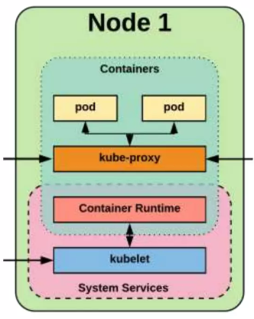
NODE Components
Kubelet
- An agent that runs on each node in the cluster. It makes sure that containers are running in a pod.
- The kubelet takes a set of PodSpecs that are provided through various mechanisms and ensures that the containers described in those PodSpecs are running and healthy.
kube-proxy
- Manages the network rules on each node.
- Performs connection forwarding or load balancing for Kubernetes cluster services.
Container Runtime Engine
- A container runtime is a CRI (Container Runtime Interface) compatible application that executes and manages containers. Containerd (docker), Cri-o, Rkt

Slide 8
Developer Use Case
Ensure Config/secrets are working properly
Performance testing scenarios
Ensure Application scales
Workload scenarios CI/CD

Slide 9
CORE OBJECTS AND APIS

Slide 10
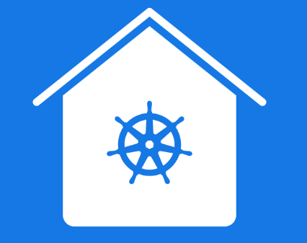
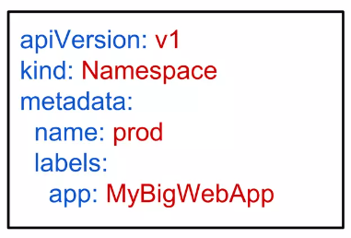
Core objects and APIs
Namespaces
- Namespaces are a logical cluster or environment and are the primary method of partitioning a cluster or scoping access.
Pods
Labels
Selectors
Services

Slide 11

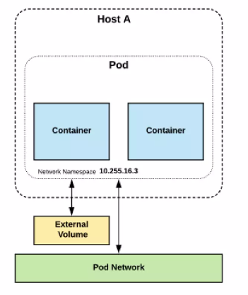
PODs
Atomic unit or smallest “unit of work” of Kubernetes.
Pods are one or MORE containers that share volumes and namespace.
They are also ephemeral!
Pod containers share the same network namespace (Share IP)
Container processes need to bind to different ports within a pod
Notes:
Edit Pods
A Note on Editing Existing Pods
In any of the practical quizzes, if you are asked to edit an existing POD, please note the following:
If you are given a pod definition file, edit that file and use it to create a new pod.
If you are not given a pod definition file, you may extract the definition to a file using the below command:
kubectl get pod <pod-name> -o yaml > pod-definition.yaml
Then edit the file to make the necessary changes, delete, and re-create the pod.
To modify the properties of the pod, you can utilize the kubectl edit pod <pod-name> command. Please note that only the properties listed below are editable.
spec.containers[*].image
spec.initContainers[*].image
spec.activeDeadlineSeconds
spec.tolerations
spec.terminationGracePeriodSeconds

Slide 12
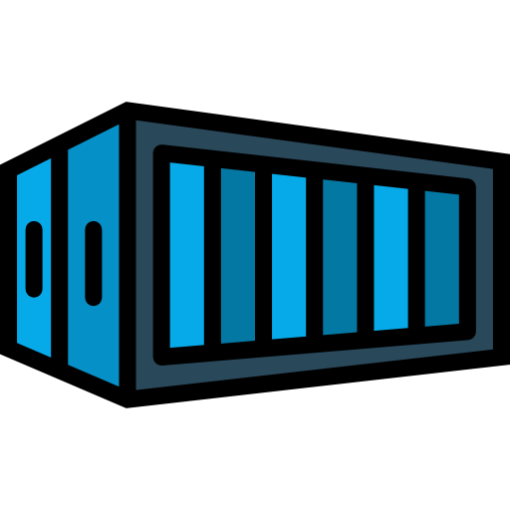
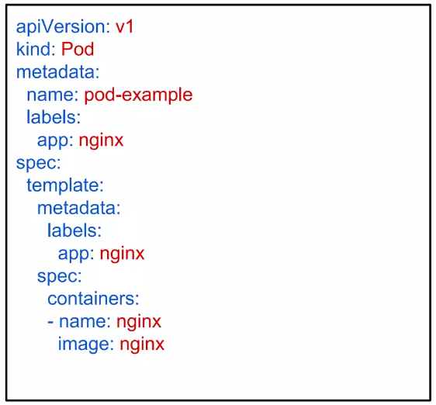
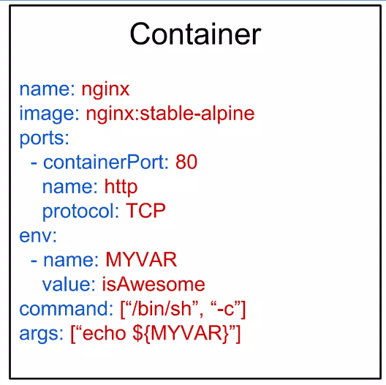
Key Pod Container Attributes
name - The name of the container
image - The container image
ports - array of ports to expose. Can be granted a friendly name and protocol may be specified
env - array of environment variables
command - Entrypoint array (equiv to Docker ENTRYPOINT)
args - Arguments to pass to the command (equiv to Docker CMD)

Slide 13

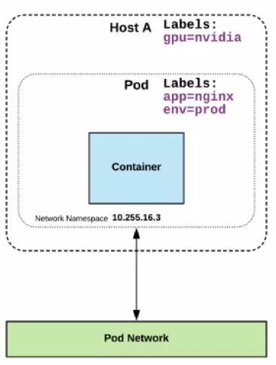
Labels
key-value pairs that are used to identify, describe and group together related sets of objects or resources.
NOT characteristic of uniqueness.
Have a strict syntax with a slightly limited character set*.
* https://kubernetes.io/docs/concepts/overview/working-with-objects/labels/#syntax-and-character-set

Slide 14

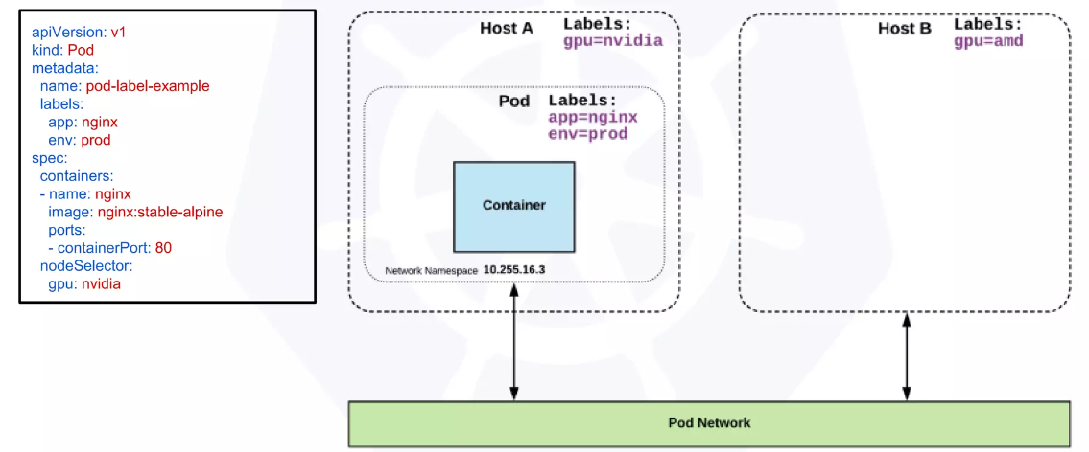
Selector
Selectors use labels to filter or select objects, and are used throughout Kubernetes.

Slide 15
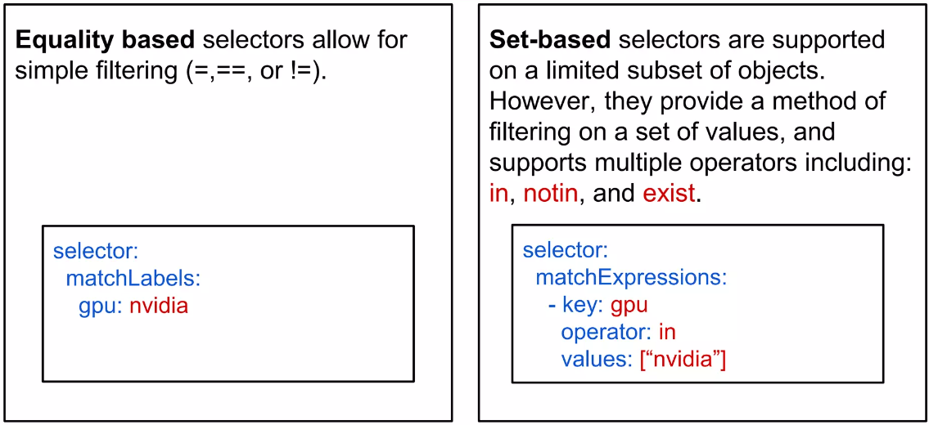
Selector Type

Slide 16

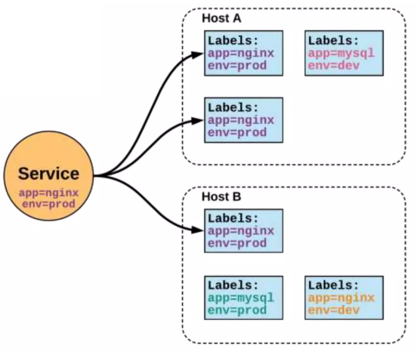
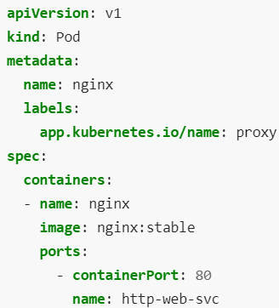
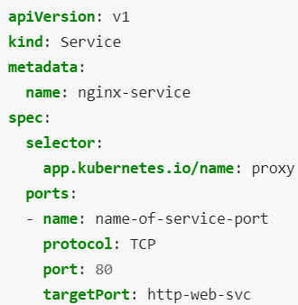
SERVICES
Unified method of accessing: the exposed workloads of Pods.
Durable resource
static cluster IP
static namespaced DNS name
Notes:
Kubernetes Services (kerno.io)
Implementing and Working With Kubernetes Services | by Vladimir Romanov | Medium

Slide 17
Configuration

Slide 18
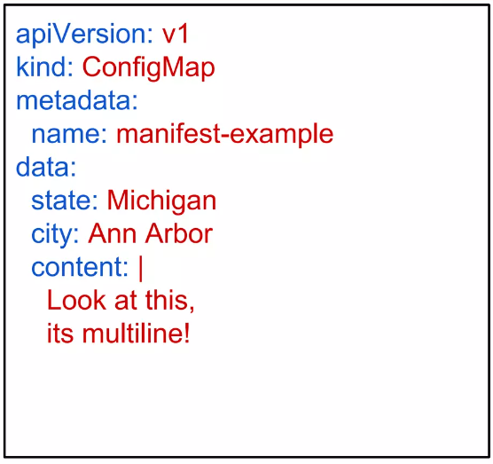
Configuration: Config Maps
Config maps provide a way to store configuration information and provide it to containers.
Kubernetes has an integrated pattern for decoupling configuration from application or container.
This pattern makes use of two Kubernetes components: ConfigMaps and Secrets.
ConfigMaps
Externalized data stored within Kubernetes.
Can be referenced through several different means:
environment variable
a command line argument (via env var)
injected as a file into a volume mount
Can be created from a manifest, literals, directories, or files directly.

Slide 19
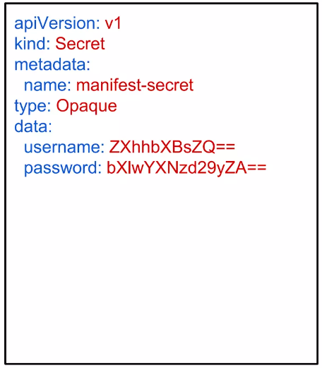
Configuration: Secret
Functionally identical to a ConfigMap.
Stored as base64 encoded content.
Encrypted at rest within etcd (if configured!).
Stored on each worker node in tmpfs directory.
Ideal for username/passwords, certificates or other sensitive information that should not be stored in a container.
Example:
type: There are three different types of secrets within Kubernetes:
docker-registry - credentials used to authenticate to a container registry
generic/Opaque - literal values from different sources
tls - a certificate based secret
data: Contains key-value pairs of base64

Slide 20
K8s Probes
Notes:
Kubernetes — Probes (Liveness, Readiness, and Startup) Overview | by Ashish Patel | DevOps Mojo | Medium

Slide 21
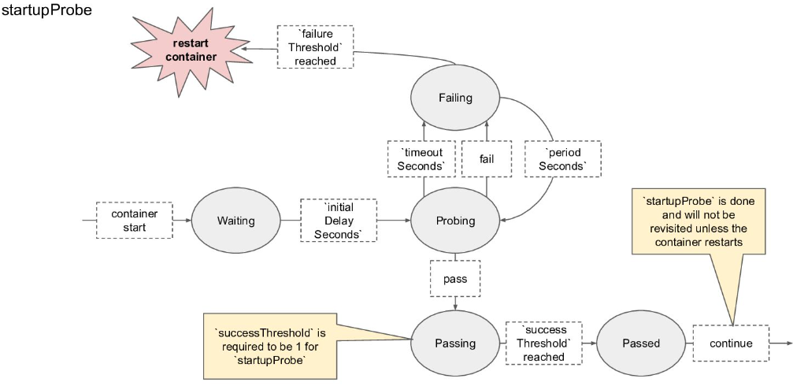
Start-Up Probe

Slide 22
Start-up probe
To know when a container application has started
It disables liveness and readiness checks until it succeeds
Can be used to adopt liveness checks on slow starting containers

Slide 23
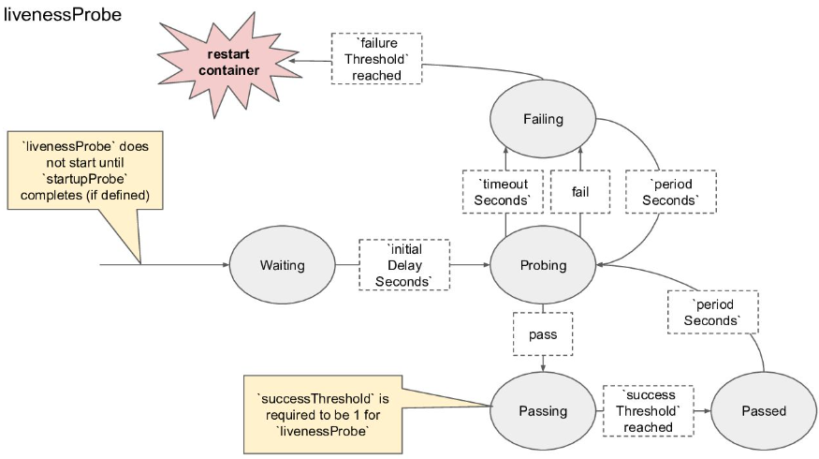
Liveness Probe

Slide 24
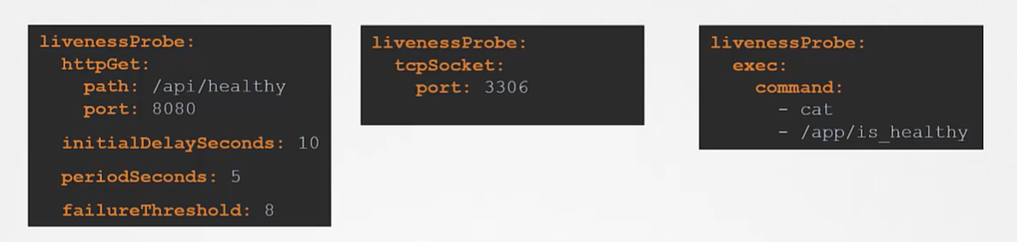
Liveness Probe
Used by Kubelet
To know when to restart the container
Catching a Deadlock
Despite App’s Bugs

Slide 25
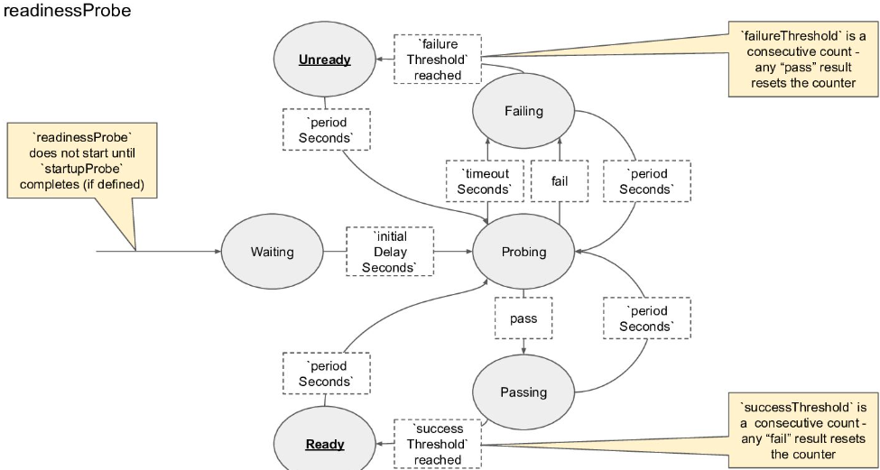
Readiness Probe

Slide 26
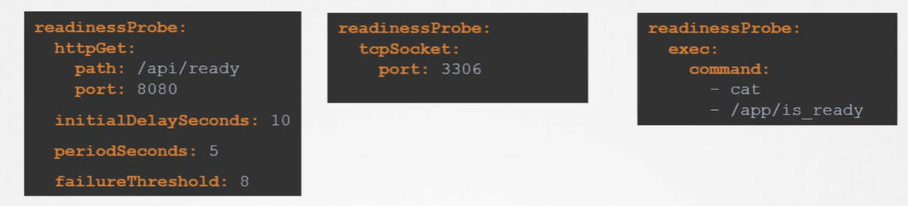
Readiness Probe
Used by Kubelet
To know when a container is ready to start accepting traffic
When all of its containers are ready
Unlike a liveness probe, a readiness probe doesn’t kill the container. If the readiness probe fails, Kubernetes simply hides the container’s Pod from corresponding Services, so that no traffic is redirected to it.
Liveness probes do not wait for readiness probes to succeed. If you want to wait before executing a liveness probe you should use initialDelaySeconds or startupProbe.
A side-effect of using Readiness Probes is that they can increase the time it takes to update Deployments.

Slide 27
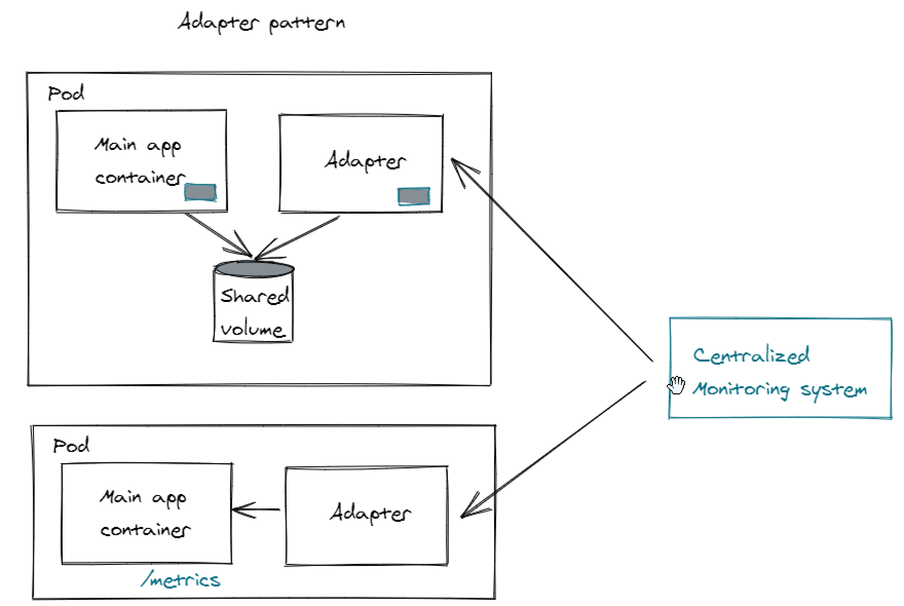
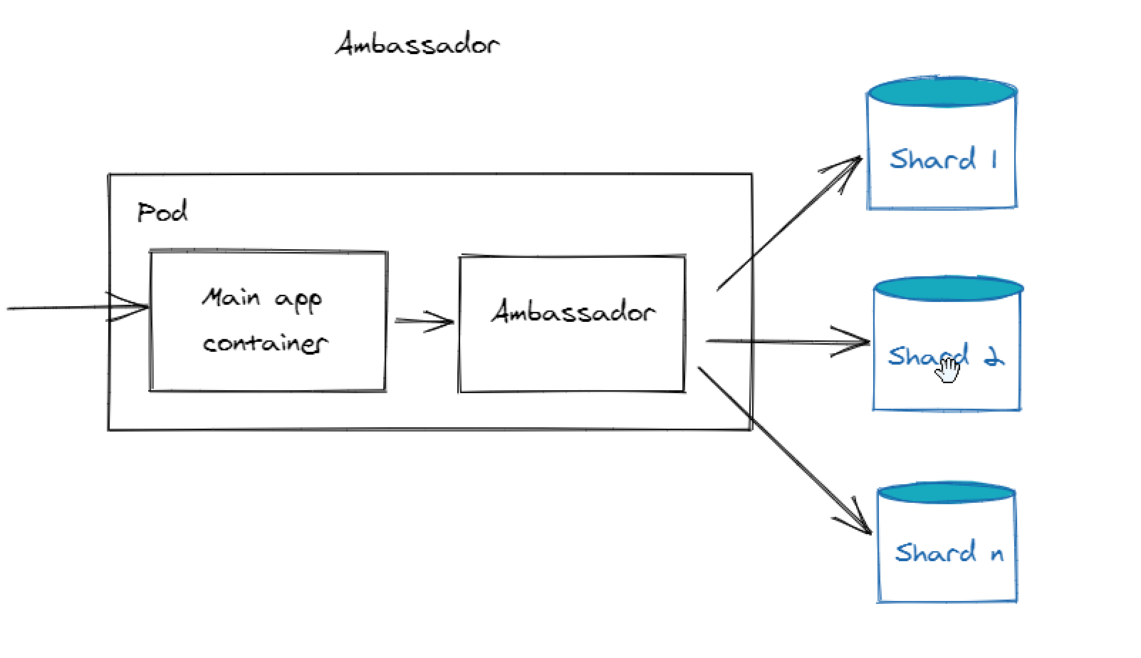
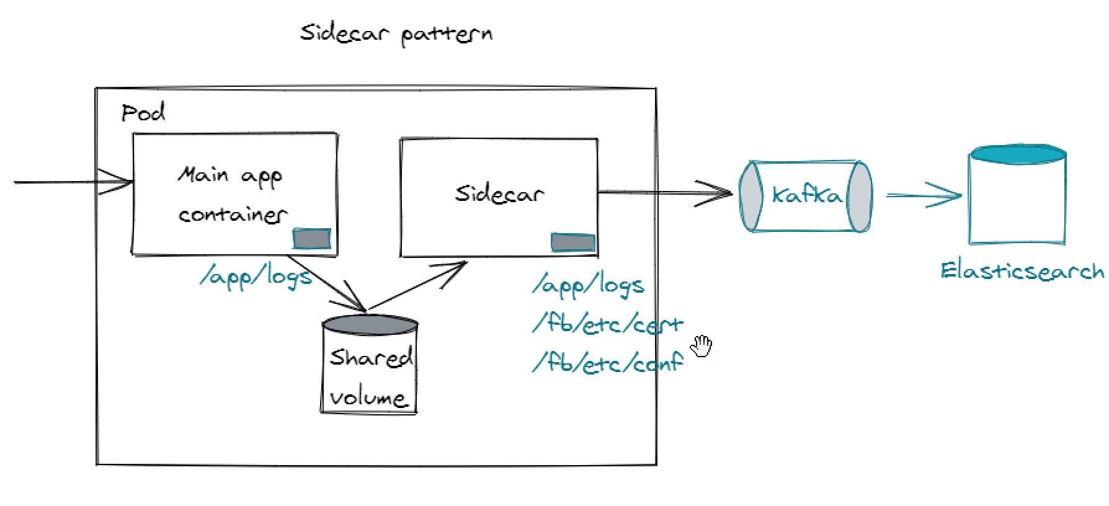
Container patterns
Pattern | Description
Sidecar | An additional container in the same pod that enhances or extends the functionality of the main container. For example, a logging agent alongside the main application container.
Ambassador | A container that acts as a proxy to other parts of the system. It handles network connections for the main container. Common use cases include authentication to external services or proxying to a Redis caching cluster.
Adapter | A container that transforms the output of the main container. It modifies or adapts data before it’s sent out.
Notes:
Patterns: Sidecars, Ambassadors, and Adapters Containers | by Vittorio Nardone | The Startup | Medium
Talk: Kubernetes multi-container patterns | Raghav Ramesh

Slide 28
Getting started with Open shift in Microlise
Notes:
Kubernetes — Probes (Liveness, Readiness, and Startup) Overview | by Ashish Patel | DevOps Mojo | Medium

Slide 29
Getting started with Open shift in Microlise
- Creation of repo
- Create namespace in Gryphon.OpenShift.Projects
- Create entry in Gryphon.Quay.Config.registry
- Open shift UI etc.

Slide 30
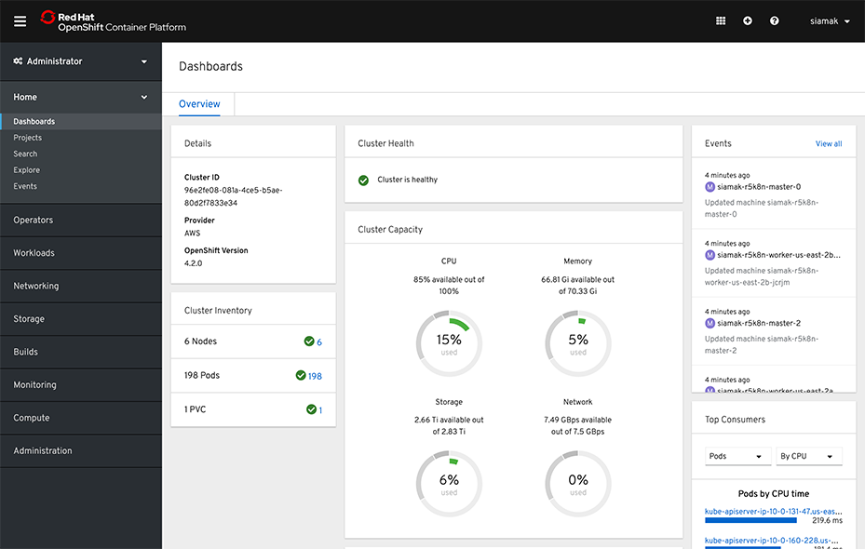
Open Shift

Slide 31
Check-in to deployment process
Container Build
Download
Container file etc.
Kubernetes
Repo
PR completed
Triggered
Triggered Deployment
Create image file
Control plane
Worker Plane
Push image to Container registry

Slide 32

Get Help and Contribution
Slack channels:
- #platform-support-openshift
- In this channel, developers can ask questions or resolve issues by sharing their solutions
- #platform-support-openshift-request-queue
- This channel will notify the platform team when you raise a PR in a platform-related repository. You can also discuss any PR-related concerns here.
- #platform-announcements-openshift
- This channel is where the platform team will make announcements related to OpenShift

Slide 33

Any Questions?

Slide 34
Thank You

