Slide 1
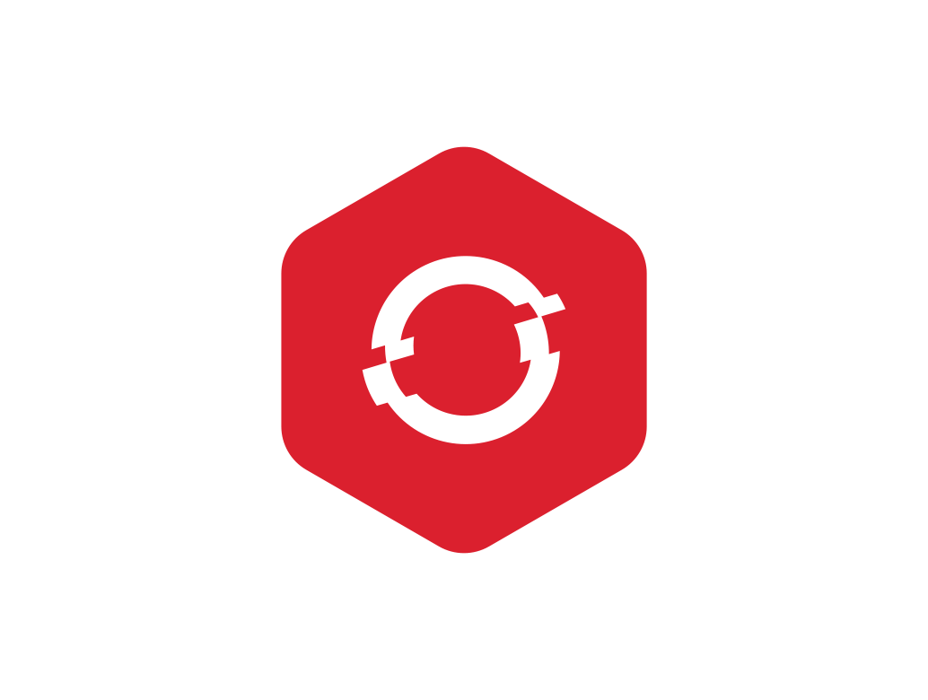
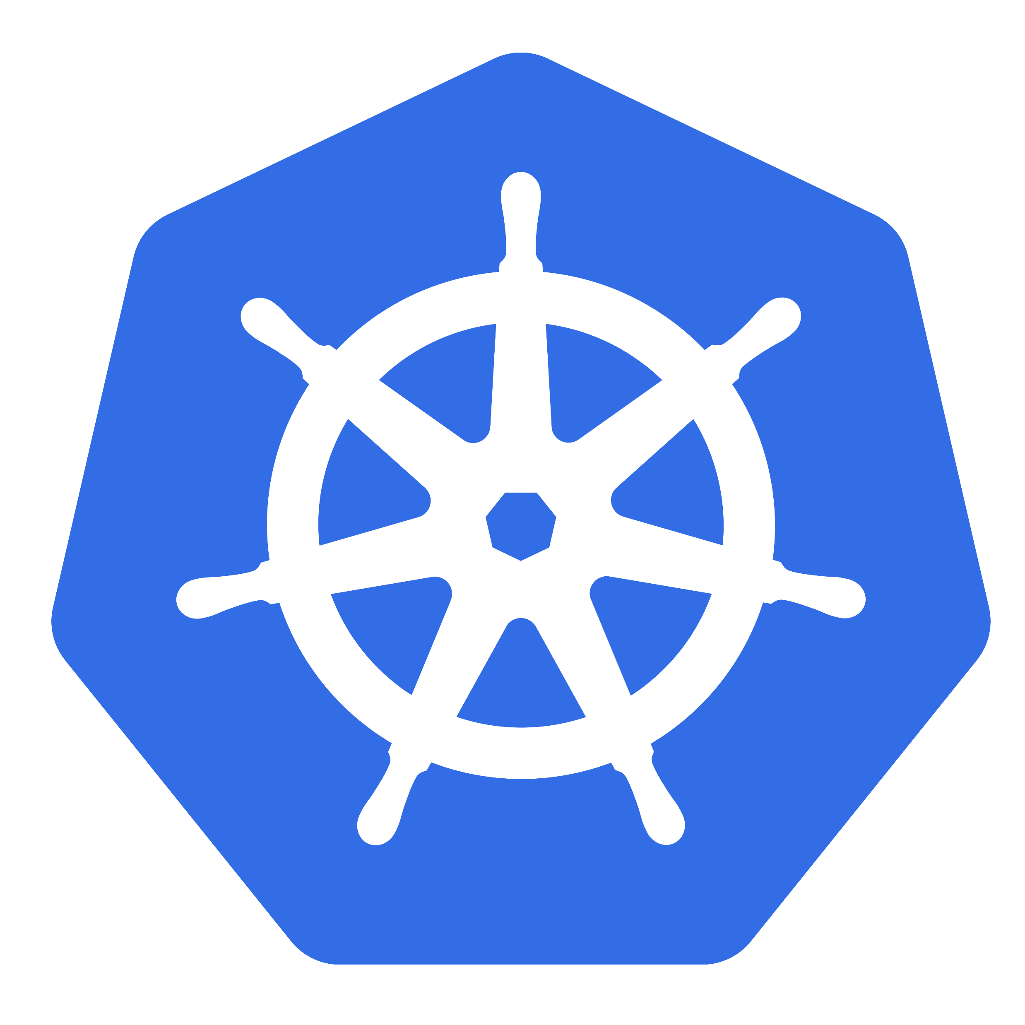
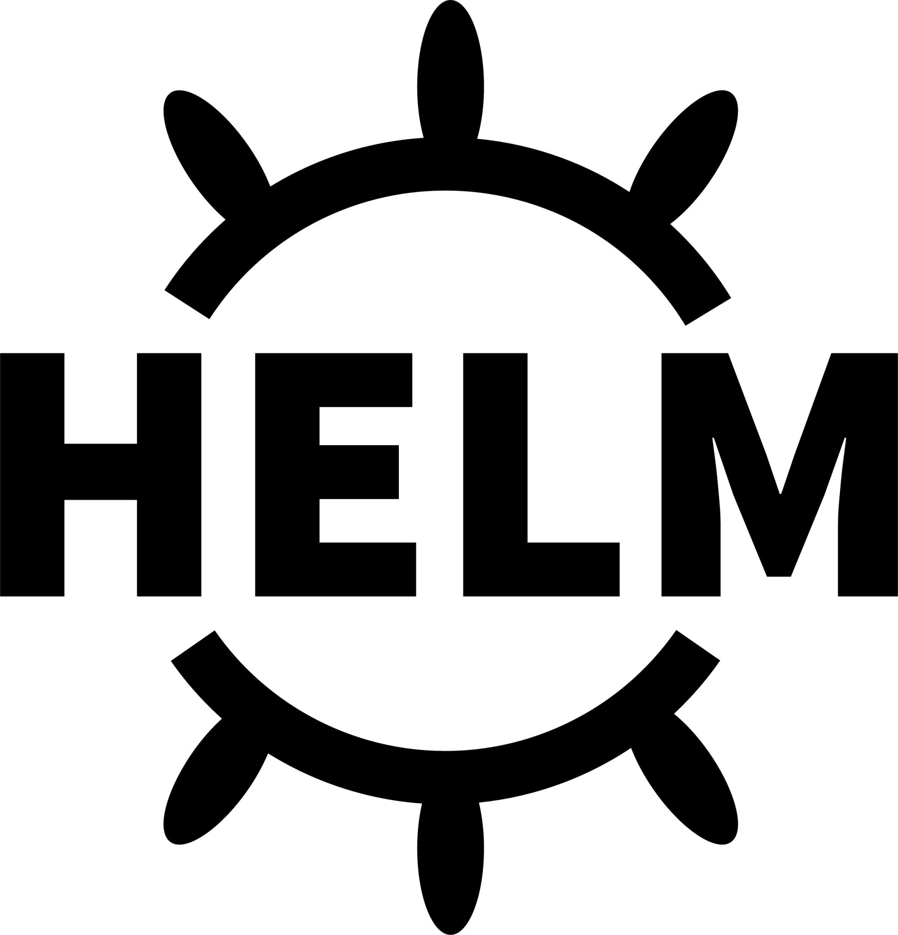

Helm Deep Dive
By Anish Jain
Steering Your Kubernetes Deployments

Slide 2

Chaliye Shuru Karte hai

Slide 3
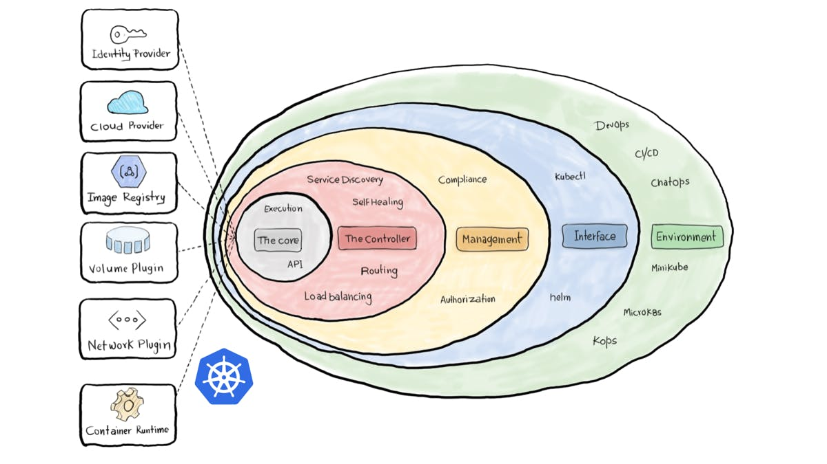
Agenda
Why Helm is important?
- AZDO Pipe line benefits
- Problem 1: Challenges Without Azure DevOps CI/CD in Kubernetes
- Problem 2: Deployment Challenges in Kubernetes Without Helm Chart
- What is Helm?
- Helm's Handling of Kubernetes Object Tree
Helm Chart Directory & K8s Objects
- Chart Directory
- Defining Kubernetes Resources with Helm Templates
- Deployments
- Services
- ConfigMaps
- Secrets
Helm Chart Template
- Template Syntax
- Defining a Helper for Labels
- values.yaml
- Pipe
- Scopes
- Release.Name
- Linting
- Helm Hooks
Best Practices
- Labelling and Selectors
- Security
- Resource Policies
- Documentation
- Plugins for Helm Charts in Visual Studio Code
Microlise helm chart
Microlise Repo to refer
More About Helm

Slide 4
Upcoming sessions
HELM CHART
- Introduction to Helm and Kubernetes:
- Helm Chart Structure
- Values Files
- Templates
- Labels and Annotations
- Dependencies and Subcharts
- Helm CLI Commands
- Security
- Hooks and Tests
- Best Practices
Deployment
- Introduction to Deployments
- Deployment Object Structure
- Creating and Managing Deployments
- ReplicaSets
- Rolling Updates and Rollbacks
- Scaling Applications
- Deployment Strategies
Resource Quota Allocation
- Introduction to Resource Quotas
- Setting Resource Quotas
- Resource Requests and Limits
- Namespace Isolation
Networking
- Introduction to Kubernetes Networking
- Cluster Networking
- Network Policies
- Service Types
- Route
- Container-to-Container Networking
- Pod-to-Service Networking
- External-to-Service Networking
Volume
- Introduction to Kubernetes Volumes
- Volume Types
- Persistent Volumes (PV) and Persistent Volume Claims (PVC)
- Storage Classes
- VolumeMounts
- Data Persistence and Sharing
- Configuring Volumes in Pod Specifications
- Security Considerations
Issue investigation
- Deployment issue
- Resources quota issue etc.

Slide 5

Why Helm is important?

Slide 6
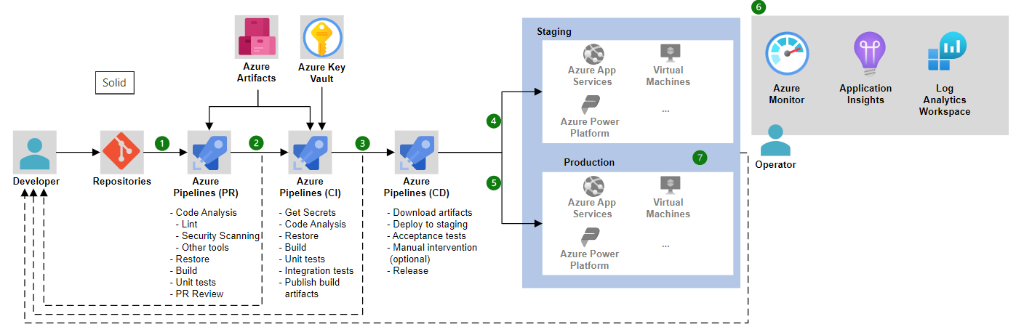
AZDO Pipe line benefits

Slide 7
Problem 1: Challenges Without Azure DevOps CI/CD in Kubernetes
Key Problems
Lack of Automation: Absence of automated build, test, and deployment processes.
Inconsistent Environments: Manual deployments can lead to differences between development, staging, and production environments.
Security Risks: Increased chances of human error in manual deployments.
Resource Management: Difficulty in managing resources and infrastructure efficiently.
Collaboration Challenges: Lack of CI/CD can hinder collaboration between development, QA, and operations teams.
Compliance and Governance: Ensuring adherence to policies and standards without automation is challenging.

Slide 8
Problem 2: Deployment Challenges in Kubernetes Without Helm Chart
Key Challenges
Complex YAML Management: Managing multiple YAML files for different resources (e.g., deployments, services, ingresses) can become cumbersome and error-prone.
Repetitive Configuration: Repetition of similar configurations across different files can lead to inconsistencies and maintenance overhead.
Deployment Consistency: Ensuring consistent deployments across different environments (development, staging, production) can be challenging without a standardized approach.
Security Concerns: Ensuring security policies and practices without Helm can be more complex.

Slide 9
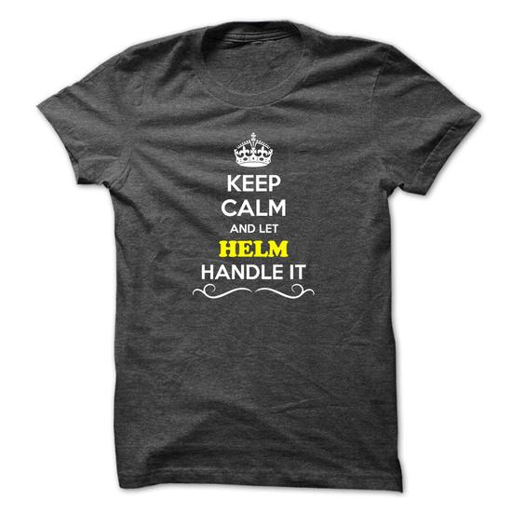
What is Helm?
Helm is a Package Manager for Kubernetes
package multiple K8s resources into a single logical deployment unit: Chart
Helm is a Deployment Management for Kubernetes
do a repeatable deployment
management dependencies: reuse and share
update, rollback and test application deployments (Releases)

Slide 10
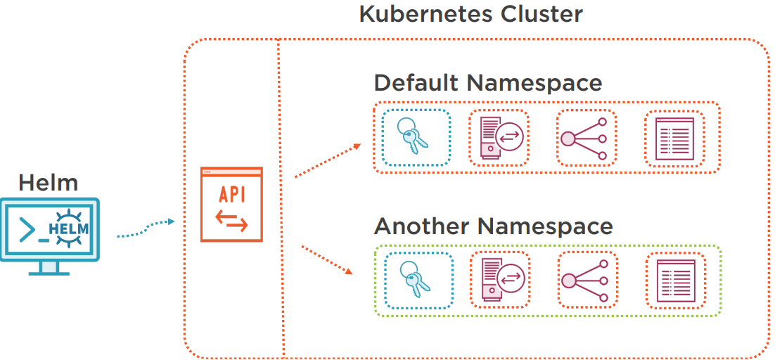
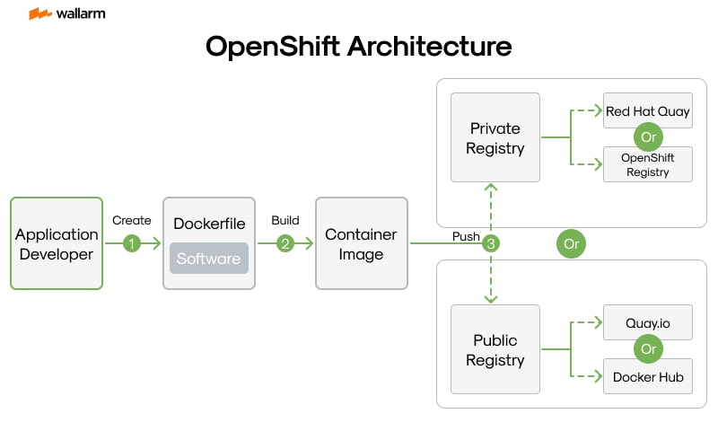
Helm's Handling of Kubernetes Object Tree
Helm's Process
Helm Chart Definition: Helm uses charts, which are collections of YAML templates and configuration files, to define Kubernetes objects.
Rendering Templates: Helm renders the templates using the values specified in the `values.yaml` file or provided by the user.
Helm Install/Upgrade Command: Helm uses the `helm install` or `helm upgrade` command to deploy or update the Kubernetes objects.
Kubernetes API Interaction: Helm interacts with the Kubernetes API server to apply the rendered manifests.
Checking Existing Objects: Helm checks if the objects defined in the rendered manifests already exist in the Kubernetes cluster.
Object Comparison and Update: Helm compares the existing objects with the new rendered manifests to determine changes.
Apply Changes: Helm applies the changes by sending the updated manifests to the Kubernetes API server.

Slide 11
Helm Chart Directory & K8s Objects

Slide 12

Chart Directory
charts/: This directory contains any dependencies your chart has. You can include other Helm charts here that your chart depends on.
templates/: This is where you define your Kubernetes resources (manifests) using templates. Common files include deployment.yaml, service.yaml, and _helpers.tpl for helper templates.
Chart.yaml: This file contains metadata about your chart. It is essential for defining the name, version, and other properties of the chart.
values.yaml: This file holds the default configuration values for your chart. Users can override these values when they install the chart.
values.schema.json (optional): This JSON schema file can be used to validate the values.yaml file, ensuring that the provided values conform to expected types and formats.
README.md: This file provides documentation for your chart, explaining what it does, how to use it, and any configuration options available.
my-chart/
├── charts/
├── templates/
│ ├── deployment.yaml
│ ├── service.yaml
│ ├── _helpers.tpl
│ └── ...
├── Chart.yaml
├── values.yaml
├── values.schema.json (optional)
└── README.md

Slide 13
Defining Kubernetes Resources with Helm Templates
Helm templates are used to define Kubernetes resources in YAML files. These templates generate the manifest files that Kubernetes uses to create and manage resources.
Types of Resources
Deployments: Define the desired state for application deployments.
Services: Define how to expose your application inside and outside the cluster.
ConfigMaps: Store non-confidential data in key-value pairs.
Secrets: Securely store sensitive data like passwords, OAuth tokens, and SSH keys.

Slide 14
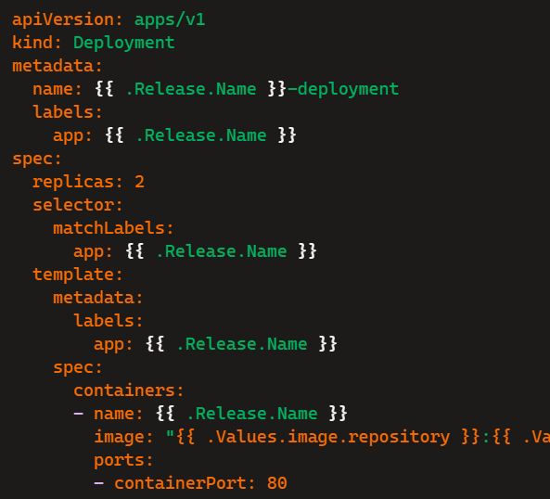

Deployments

Slide 15
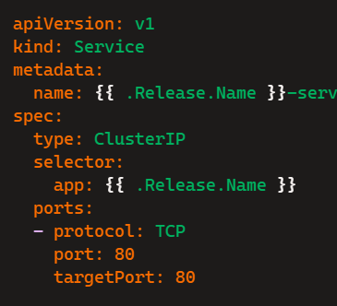

Services

Slide 16
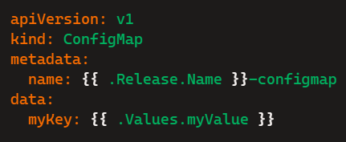
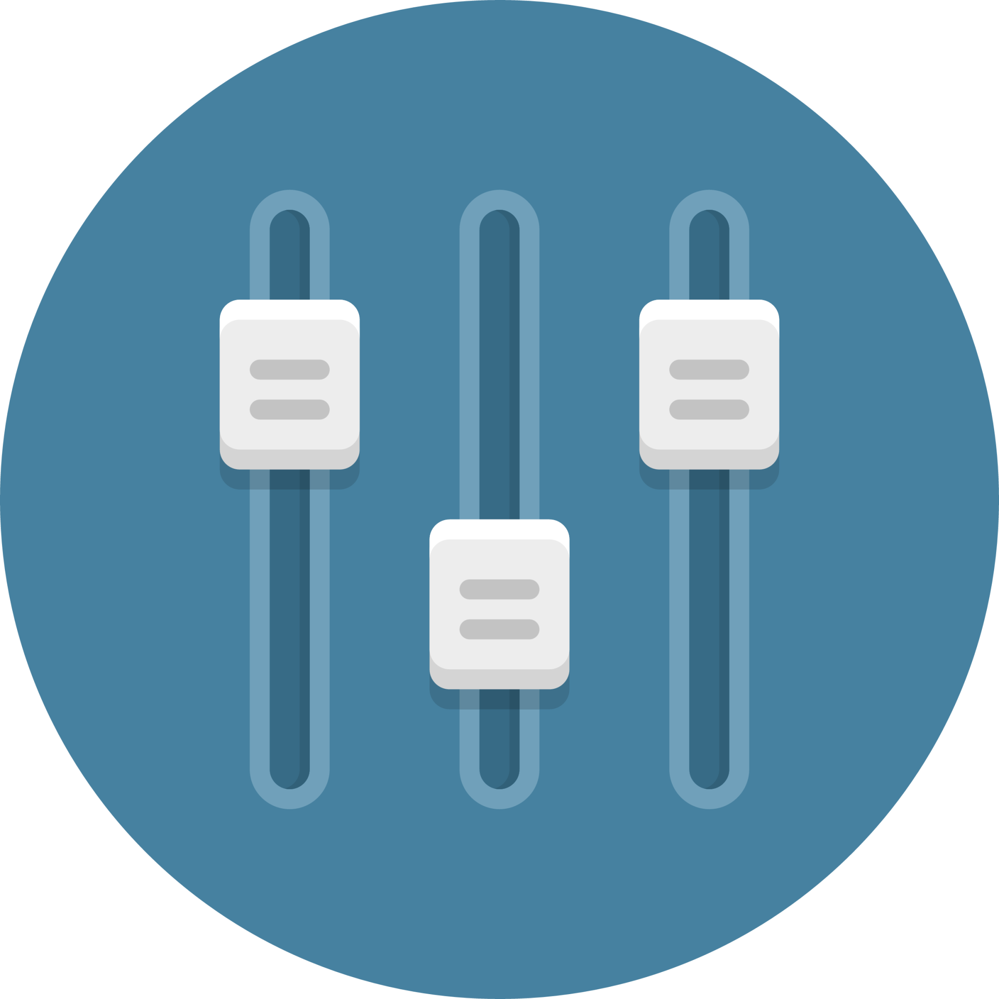
ConfigMaps

Slide 17
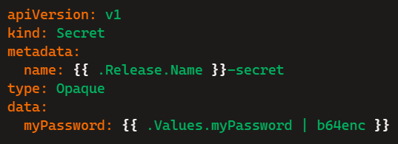

Secrets

Slide 18
Helm Chart Template

Slide 19
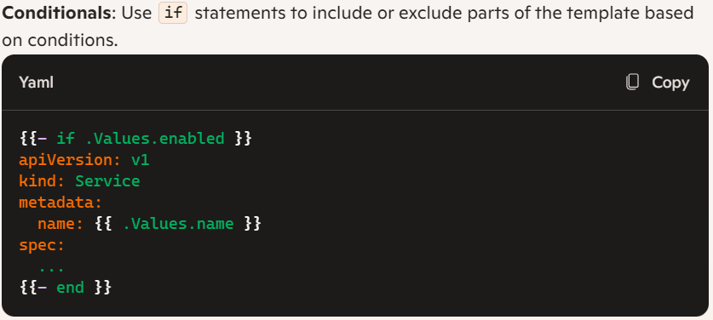
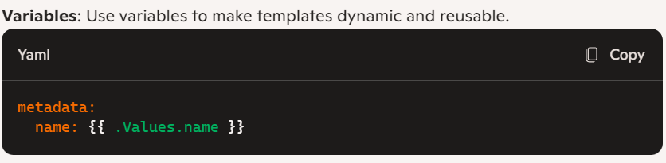
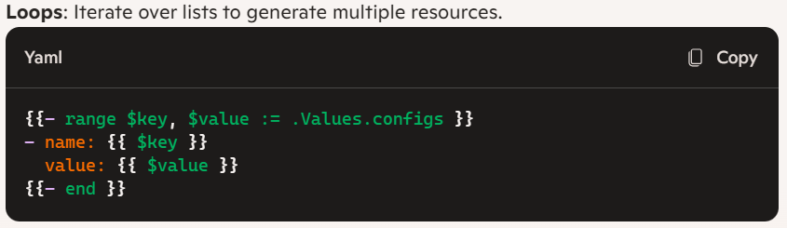
Template Syntax

Slide 20
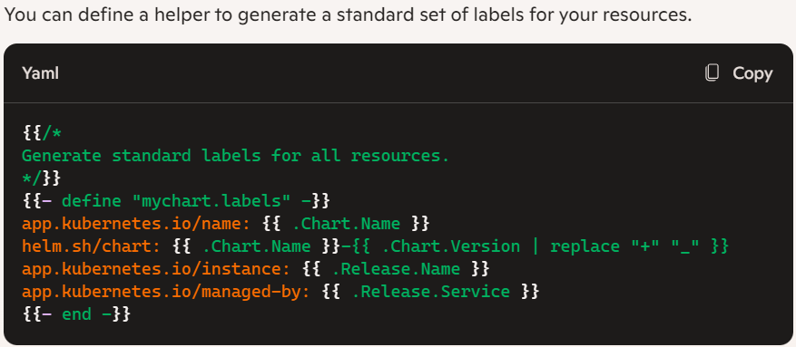
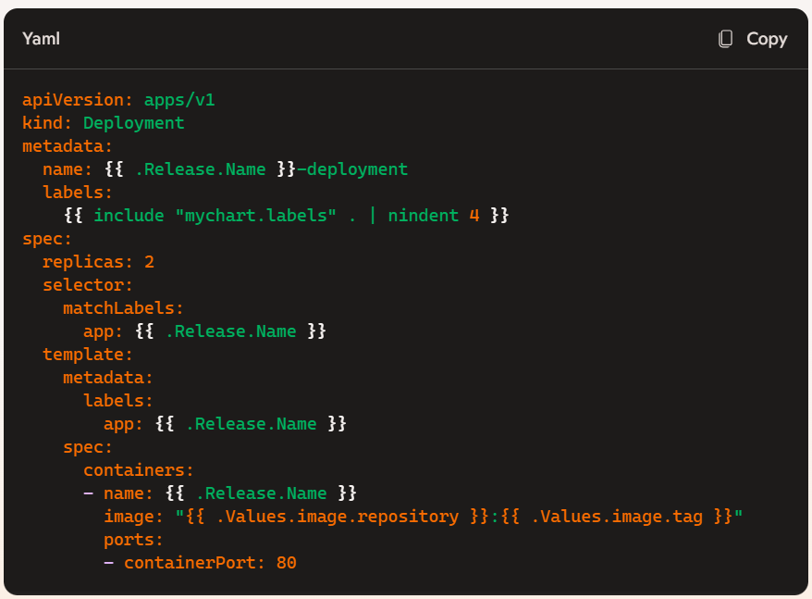
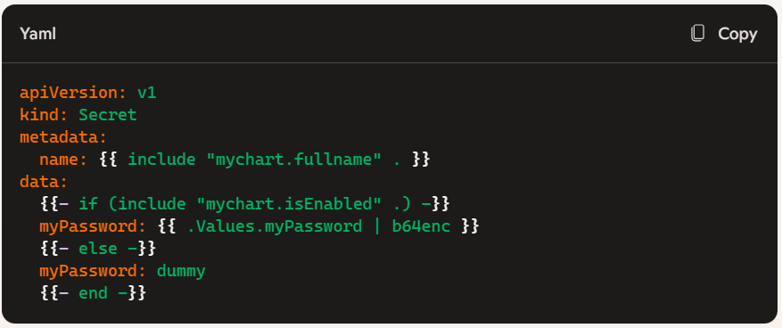
Defining a Helper for Labels

Slide 21

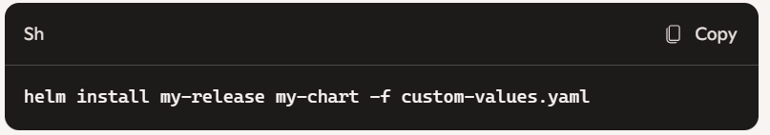
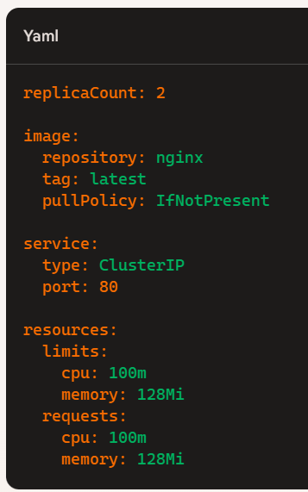
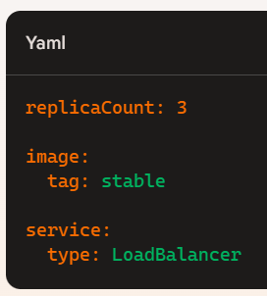
values.yaml
Purpose: The `values.yaml` file is used to define the default configuration values for your Helm chart.
Structure: This file contains key-value pairs that specify the default settings for your chart. These values are used to populate the templates in the `templates` directory.
Customization: Users can override these default values during chart installation to tailor the deployment to their specific needs.
Custom Values File: Users can specify a custom values file with the `-f` or `--values` flag.

Slide 22

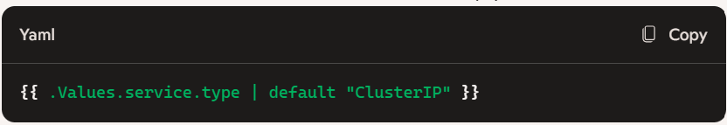
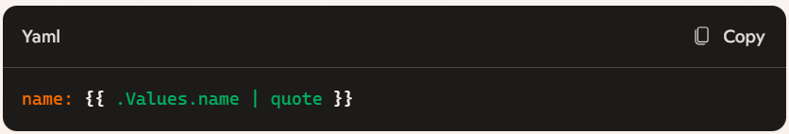
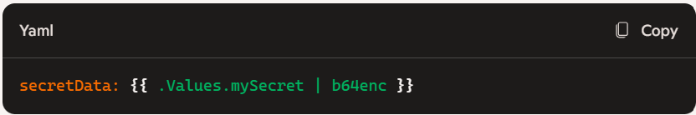
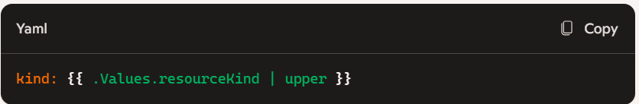
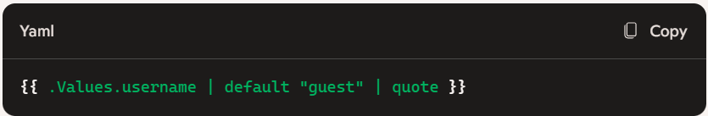
Pipe
Purpose: Pipes are used in Helm charts to process and transform values within templates. They allow you to format, modify, and handle values dynamically, making your Helm templates more powerful and flexible.
Chaining Functions: Use pipes to chain multiple functions together for more complex transformations.

Slide 23
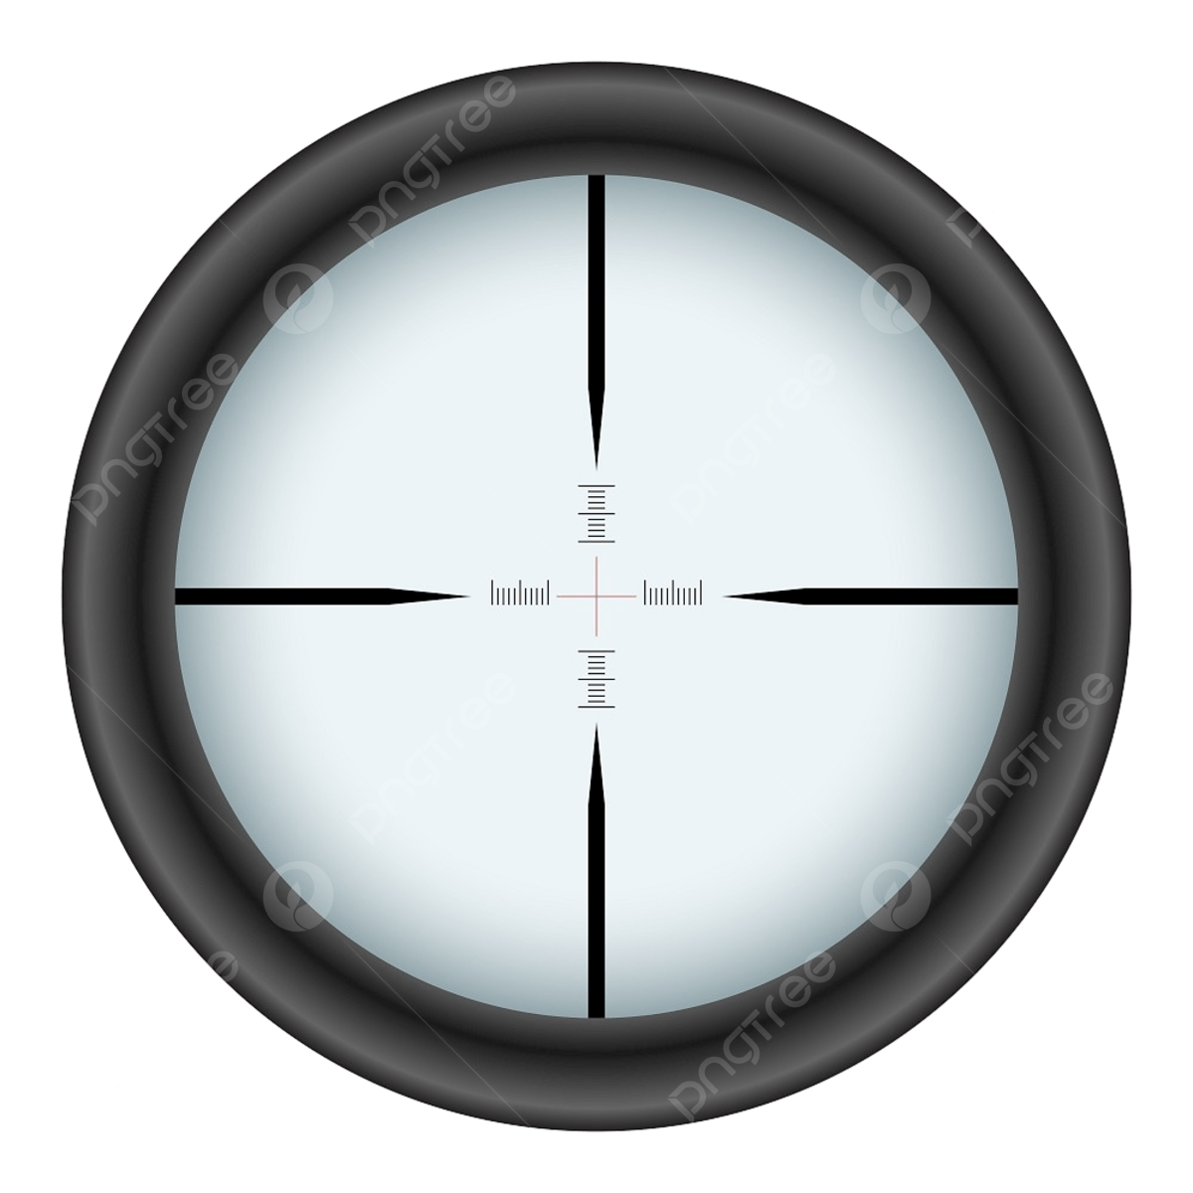
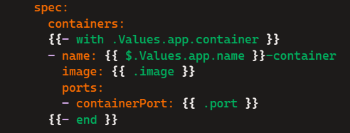
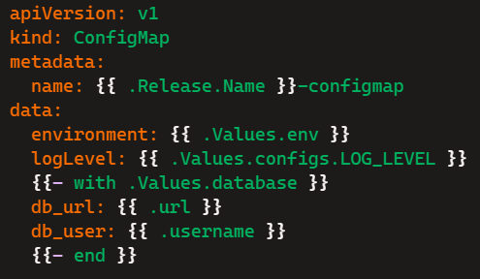
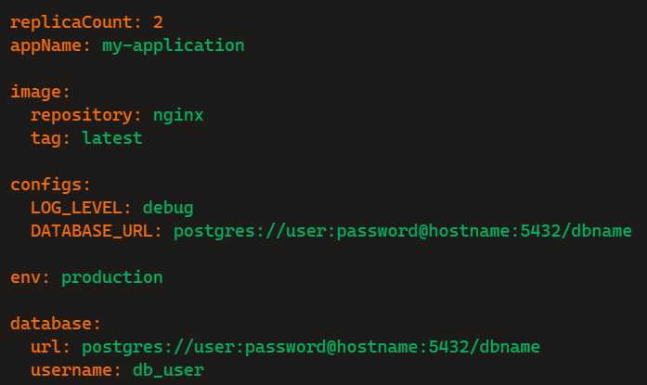
Scopes
Purpose: Understanding scopes in Helm charts is crucial for creating dynamic and flexible templates. Scopes determine the context in which templates are rendered, allowing you to manage variables and functions effectively.
Dot (.)
Purpose: The . symbol represents the current context or scope, which includes the data and functions available at that point in the template.
Dollar ($)
Purpose: The $ symbol is used to capture and reference the top-level or root scope, allowing you to access global values from within nested scopes.

Slide 24
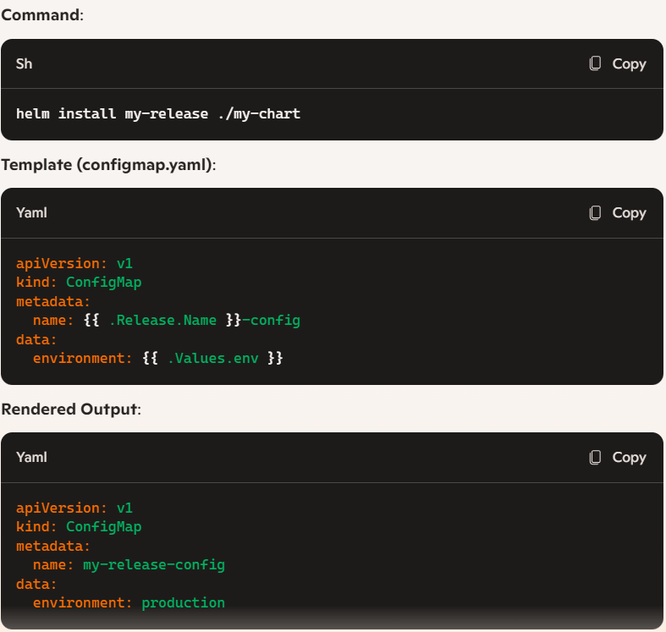
Release.Name
Release.Name: When you install or upgrade a Helm chart, you specify the release name. This name is then available to all templates in the chart.

Slide 25

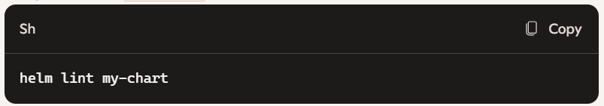
Linting
Purpose: Linting checks your chart for common issues and enforces best practices. This ensures your chart is syntactically correct and adheres to Helm standards.
Helm Lint Command: Use the helm lint command to validate your chart.
Usage: Run the helm lint command in the directory of your chart.
Output: The command outputs any errors, warnings, or suggestions for improvement in your chart's YAML files and templates.
Common Checks: helm lint checks for issues such as missing mandatory fields, template syntax errors, and best practice violations.

Slide 26

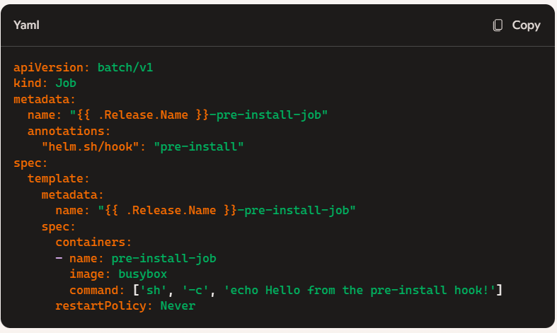
Helm Hooks
Purpose: Helm hooks are special Kubernetes resources that execute at specific points during the release lifecycle, such as pre-install, post-install, pre-delete, and more. They allow you to automate and customize the deployment process.
pre-install: Executes before any resources are installed.
post-install: Executes after all resources are installed.
pre-delete: Executes before any resources are deleted.
post-delete: Executes after all resources are deleted.
pre-upgrade: Executes before any resources are upgraded.
post-upgrade: Executes after all resources are upgraded.
pre-rollback: Executes before any resources are rolled back.
post-rollback: Executes after all resources are rolled back.

Slide 27
Best Practices

Slide 28

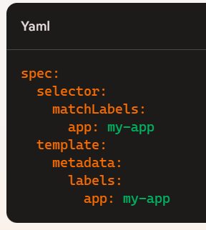
Labelling and Selectors
Purpose: Labels and selectors are key to managing Kubernetes resources effectively. They help organize and group resources, making it easier to apply configurations and policies.
Labels:
Definition: Key-value pairs attached to Kubernetes objects, such as pods, services, and deployments.
Usage: Use meaningful labels to categorize and identify resources. For example, app: my-app, environment: production, tier: backend.
Best Practices: Standardize label keys and values across your organization for consistency.
Selectors:
Definition: Used to match a set of resources based on their labels.
Usage: Define selectors in controllers like Deployments and Services to identify which resources they should manage.

Slide 29

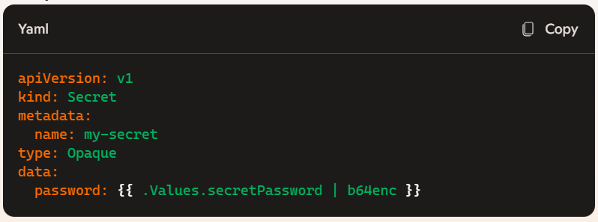
Security
Purpose: Protect sensitive information, such as passwords and API keys, by securing them within your Helm charts.
Helm Secrets:
Definition: Helm Secrets plugin encrypts your Helm value files to secure sensitive data
Kubernetes Secrets:
Definition: Kubernetes-native way to store and manage sensitive information.
Usage: Define Secrets in your Helm templates and reference them in your deployments.

Slide 30

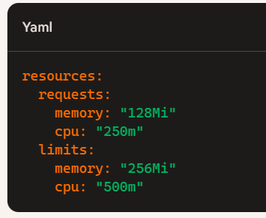
Resource Policies
Purpose: Manage resource usage to ensure your applications have the necessary resources and to prevent resource contention.
Resource Requests and Limits:
Definition: Requests specify the minimum resources required for a container, while limits specify the maximum resources a container can use.
Usage: Define resource requests and limits in your Helm templates to manage CPU and memory usage.

Slide 31
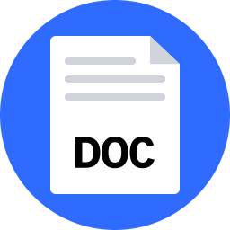
Documentation
Purpose: The README.md file provides clear and comprehensive documentation for your Helm chart, helping users understand how to install and use the chart.
Content:
Introduction: Briefly describe the chart and its purpose.
Prerequisites: List any prerequisites needed to use the chart (e.g., Kubernetes version, Helm version).
Installation Instructions: Provide step-by-step instructions on how to install the chart.
Configuration: Detail all configurable parameters and their default values.
Contributing: Provide guidelines for contributing to the chart, if applicable.

Slide 32

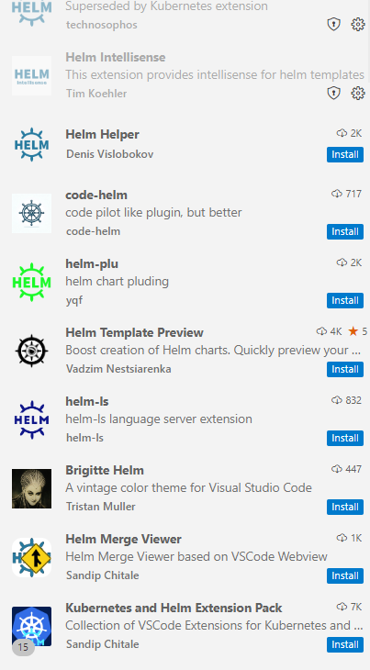
Plugins for Helm Charts in Visual Studio Code

Slide 33
Microlise helm chart
Standard Helm chart
Custom Helm chart

Slide 34
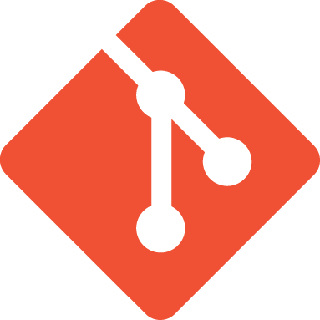
Microlise Repo to refer
Gryphon.OpenShift.Pipeline.ReleaseAgentScripts – Repos
MicroliseStandardHelmChart - Repos
Alchemy.TemperatureIngestService.Carrier.Release – Repos
AssetTagService.Release – Repos
Alchemy.TemperatureIngestService.Carrier Release - Pipelines

Slide 35
More About Helm
Helm Chart Tutorial: A comprehensive guide to creating and managing Helm charts.
Complete Helm Chart Tutorial: From Beginner to Expert Guide: A detailed tutorial covering everything from basic concepts to advanced usage.
Kubernetes Helm Chart Tutorial: A Comprehensive Guide to Managing Kubernetes Applications]: A step-by-step guide to managing Kubernetes applications using Helm.

Slide 36

Any Questions?

Slide 37
Thank You

