Slide 1
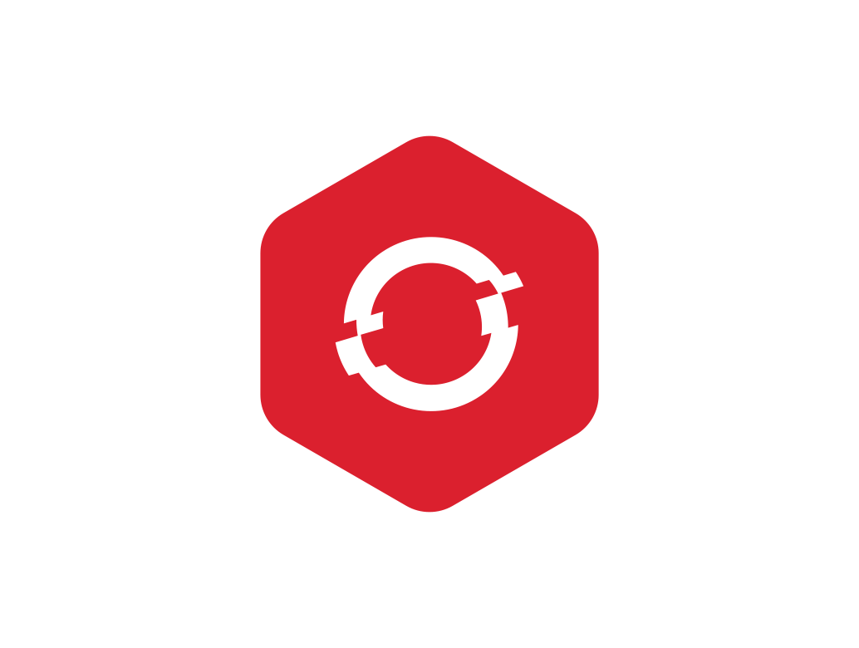

Embracing Agility: The Shift to Microservices
By Anish Jain
Accelerating Innovation, One Microservice at a Time

Slide 2
Agenda
Introduction to Microservices

Slide 3

Introduction to Microservices

Slide 4
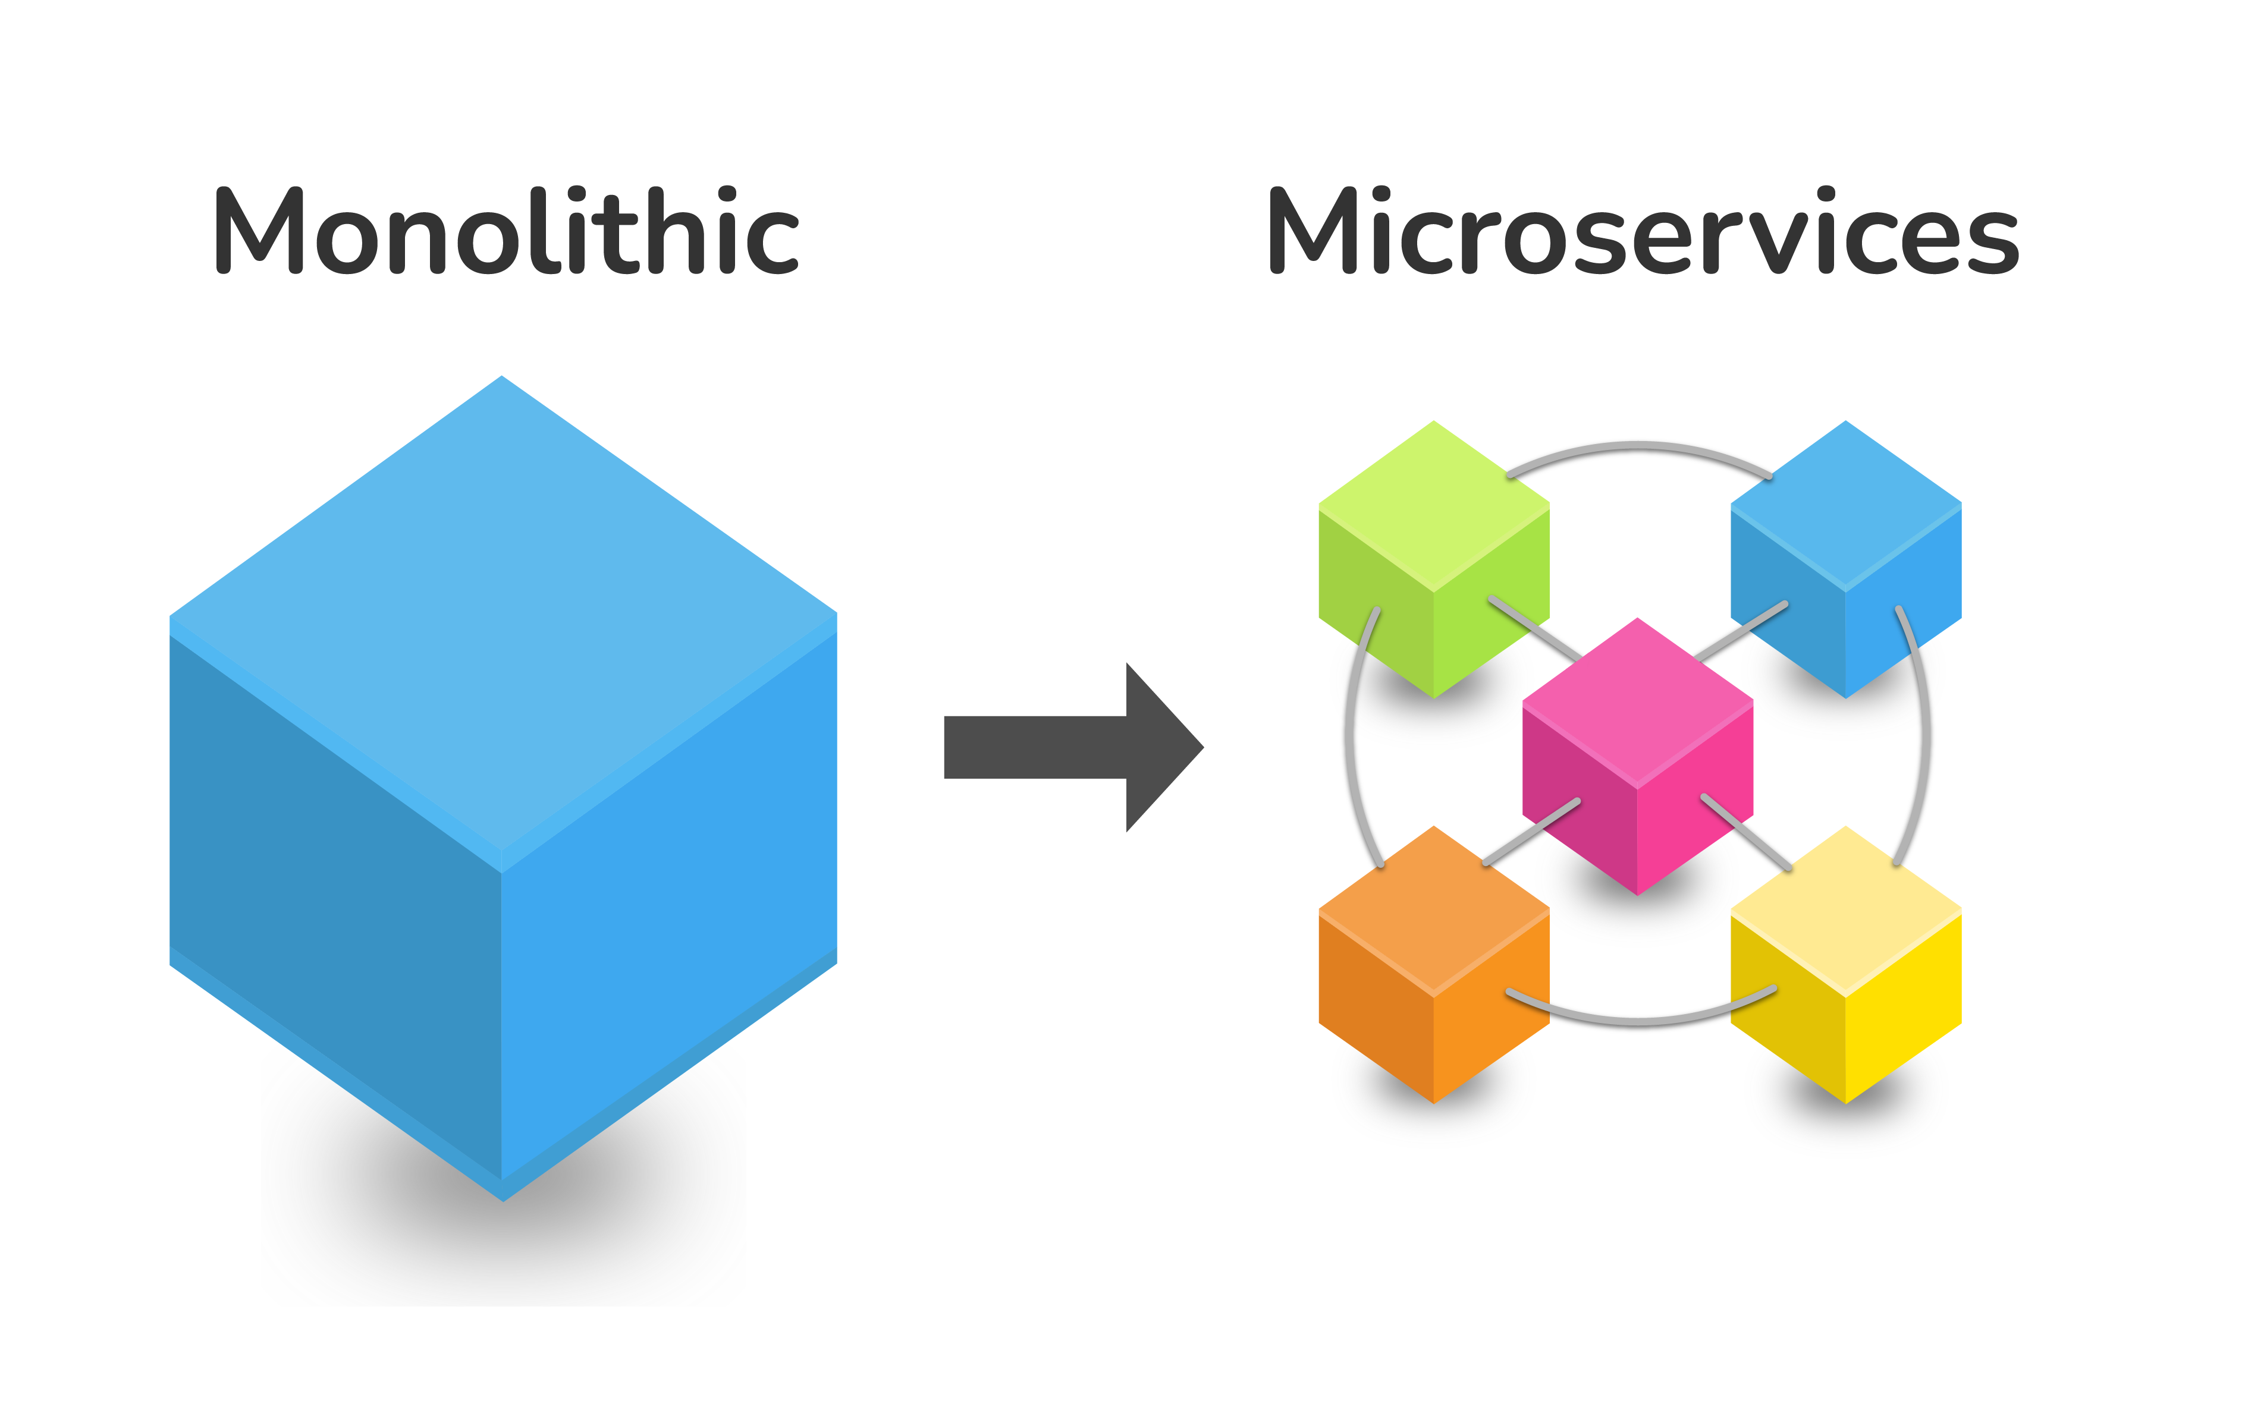
Basic Principles of Microservices
Single Responsibility Principle
Independence and Autonomy
Decentralized Data Management
Inter-Service Communication
Polyglot Programming
Continuous Delivery and DevOps
Notes:
Basic Principles of Microservices
1. Single Responsibility Principle
- Each microservice should have a single responsibility, focusing on a specific business capability. This principle ensures that each service is simple, focused, and easier to manage.
2. Independence and Autonomy
- Microservices are independently deployable and scalable. Each service can be developed, tested, deployed, and scaled without affecting other services.
3. Decentralized Data Management
- Each microservice manages its own database or data storage. This decentralization allows services to be more resilient and reduces the risk of a single point of failure.
4. Inter-Service Communication
- Microservices communicate with each other through well-defined APIs, often using lightweight protocols like HTTP/REST or messaging protocols. This ensures loose coupling between services.
5. Polyglot Programming
- Microservices architecture supports the use of different programming languages and technologies for different services, allowing teams to choose the best tools for the job.
6. Continuous Delivery and DevOps
- Microservices enable continuous integration and continuous delivery (CI/CD) practices, allowing for rapid and reliable deployment of changes.

Slide 5
Comparison with monolithic architecture
Aspect | Monolithic Architecture | Microservices Architecture
Structure | Single, indivisible unit | Collection of small, autonomous services
Scalability | Scales as a whole | Each service can be scaled independently
Flexibility | Less flexible, harder to adopt new technologies | Easier to adopt new technologies and make changes
Deployment | Requires redeploying the entire application | Independent deployment of services
Maintenance | Becomes complex and difficult to maintain as the application grows | Easier to maintain due to smaller, focused services
Fault Isolation | Failure in one part can affect the entire application | Fault isolation ensures failures in one service don’t affect others
Development Speed | Faster development cycles initially | May have slower initial development due to complexity
Data Management | Centralized data management | Decentralized data management, each service manages its own data
Communication | Internal communication within a single unit | Inter-service communication through APIs
Continuous Delivery | Less support for CI/CD practices | Supports CI/CD practices, allowing rapid and reliable deployment

Slide 6
Benefits of Microservices

Slide 7
Agility and Speed of Deployment in Microservices
Independent Development and Deployment
Continuous Integration and Continuous Delivery (CI/CD)
Scalability and Flexibility
Reduced Time to Market
Fault Isolation
Notes:
1. Independent Development and Deployment
- Each microservice is developed, tested, and deployed independently. This means that teams can work on different services simultaneously without waiting for other parts of the application to be ready.
- New features or updates can be deployed quickly without affecting the entire application.
2. Continuous Integration and Continuous Delivery (CI/CD)
- Microservices align perfectly with CI/CD practices, allowing for automated testing and deployment. This ensures that changes are deployed rapidly and reliably.
- Frequent and smaller releases reduce the risk of deployment failures and make it easier to roll back changes if needed.
3. Scalability and Flexibility
- Individual services can be scaled independently based on demand. This flexibility allows for efficient resource utilization and faster response to changing market needs.
- Teams can choose the best technologies and tools for each service, fostering innovation and efficiency.
4. Reduced Time to Market
- The ability to deploy updates and new features quickly gives businesses a competitive edge by reducing the time to market.
- Faster deployment cycles enable organizations to respond swiftly to customer feedback and market changes.
5. Fault Isolation
- Since microservices are independent, a failure in one service does not affect the entire application. This isolation enhances the overall resilience and stability of the system.

Slide 8
Scalability and flexibility
Aspect | Scalability | Flexibility
Independent Scaling | Each microservice can be scaled independently based on demand. | Each service can use different technologies and programming languages.
Horizontal Scaling | Additional instances of a service can be added to handle increased load. | Teams can choose the best tools for each specific task.
Resource Allocation | Precise resource allocation for each service. | Modular design allows for independent development, testing, and deployment.
Load Balancing | Ensures traffic is evenly distributed across multiple instances. | Changes or updates to one service do not impact others.
Fault Isolation | Failure in one service does not affect the entire application. | Enhances fault isolation and system resilience.
Rapid Deployment | Supports CI/CD practices for faster deployment. | Enables rapid deployment of new features and updates.
Scalability Efficiency | Optimizes resource utilization and reduces costs. | Facilitates faster time-to-market and response to customer feedback.

Slide 9
Fault isolation and resilience
Aspect | Fault Isolation | Resilience
Definition | Containing failures within a single service to prevent system-wide impact. | Ability to withstand failures and continue operating smoothly.
Key Strategies | - Circuit Breakers: Prevent repeated calls to failing services. | - Self-Healing: Automatically detect and recover from failures.
 | - Bulkheads: Partition services into isolated groups. | - Redundancy: Deploy multiple instances of critical services.
 | - Timeouts and Retries: Manage transient failures. | - Graceful Degradation: Maintain core operations under high load or failure.
 | - Service Mesh: Handle service-to-service communication. | - Monitoring and Alerts: Continuous monitoring with automated alerts.
Benefits | - Minimized Impact: Prevents cascading failures. | - High Availability: Ensures system remains functional during failures.
 | - Simplified Debugging: Easier to diagnose and fix isolated failures. | - Improved User Experience: Reliable performance and quick recovery.

Slide 10
Challenges with monolithic software
Difficult to scale
Long Build/Test/Release Cycles (who broke the build?)
Operations is a nightmare (module X is failing, who’s the owner?)
Architecture is hard to maintain and evolve
New releases take months
Long time to add new features
Lack of agility
Lack of innovation
Frustrated customers

Slide 11
Benefits of microservices
Easier to scale each individual micro-service
Rapid Build/Test/Release Cycles
Clear ownership and accountability
Easier to maintain and evolve system
New releases take minutes
Short time to add new features
Increased agility
Faster innovation
Delighted customers

Slide 12
Transitioning from Monolithic to Microservices

Slide 13
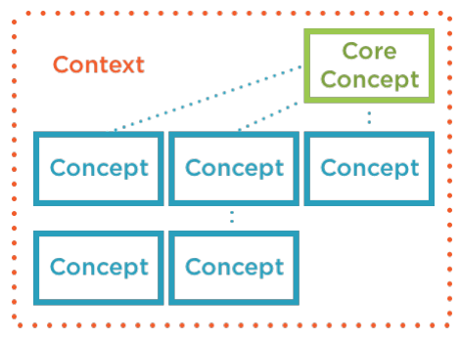
Identifying Capabilities as Bounded Contexts
Identify core domain concepts
Using natural groupings and language
Strongly related functionality and data
Using the UI and user groups
Group interaction points
Group interaction points around core concepts
Group remaining data and functions around core concepts
Overlapping sub-concepts, duplicate or promote to a core concept

Slide 14
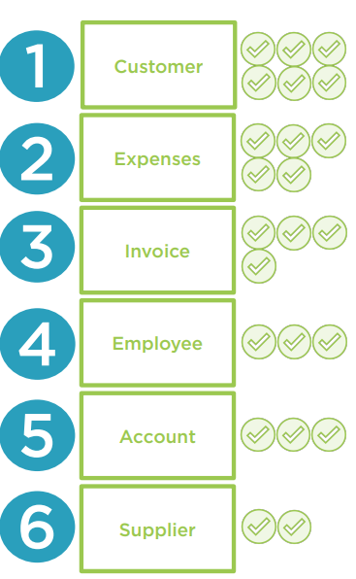
Prioritize Capability Bounded Contexts for Transition
Actual usage (use metrics)
Simplest to refactor
Presents minimal risk
Will reduce future releases
Good test coverage
Smaller to reduce work
Larger to simplify integration

Slide 15
Leading from interaction points
Provides physical starting point to start code extraction of capability
Follow and extract the business logic from the interaction points
Extract additional referenced objects as required that fit within our bounded context
Using the same tech stack for new microservice
Easier to lift, shift and refactor
Avoid changing software development stack
Transition to microservices before changing tech stack
The same software development stack simplifies rollback by avoiding subtle changes in data

Slide 16
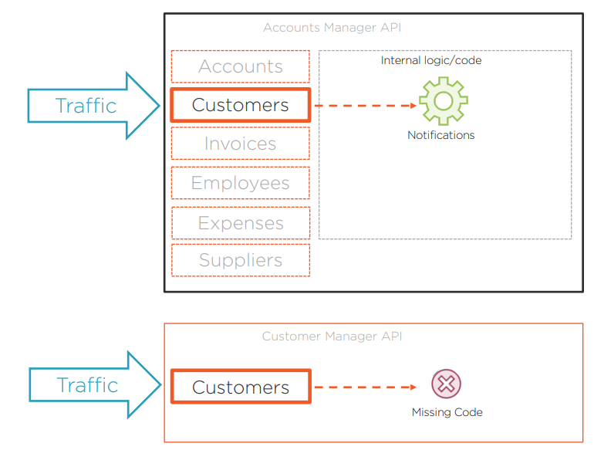
Shared database
Allows rollback to the monolithic version of the capability if new microservice goes wrong
Sharing database is only short-term to evaluate new microservice
Long-term all microservices should have their own database
The easier approach is to decompose monolith into microservices first and then decompose database at the end
Missing dependencies
Functionality required from monolith
Branch by abstraction pattern

Slide 17
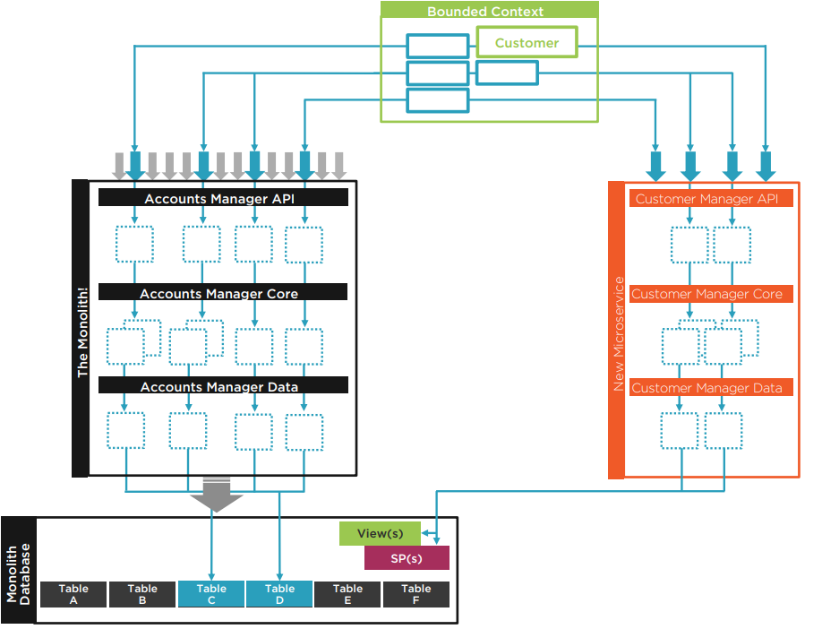
Summary
Creating your microservice
Use existing tech to enable greater focus on learning microservices
Leading from interaction points lift-refactor and rewrite code and tests
Missing dependencies resolve with branch by abstraction
Compare and test contracts between the monolith and new service
Temporarily share the database with monolith
Use abstraction layer to help with database decomposition stages
Use a DB service if database decomposition unrealistic
A new database will require syncing to enable rollback to the monolith

Slide 18
Resolving missing dependency on a hidden monolith capability
Changes to monolith may be required to expose hidden functionality
Use branch by abstraction pattern to time the changes
Use branch by abstraction pattern to organize the code
Service to service calls cause temporal coupling issues

Slide 19
Microservice to Monolith

Slide 20
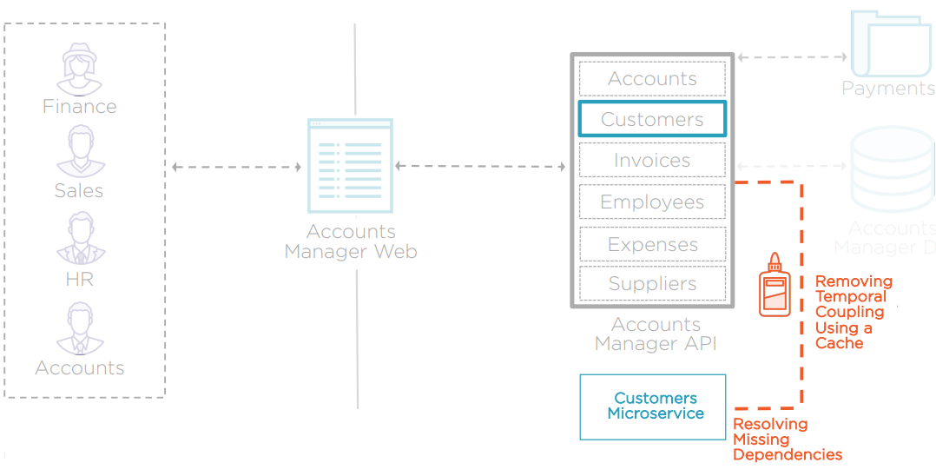

Slide 21
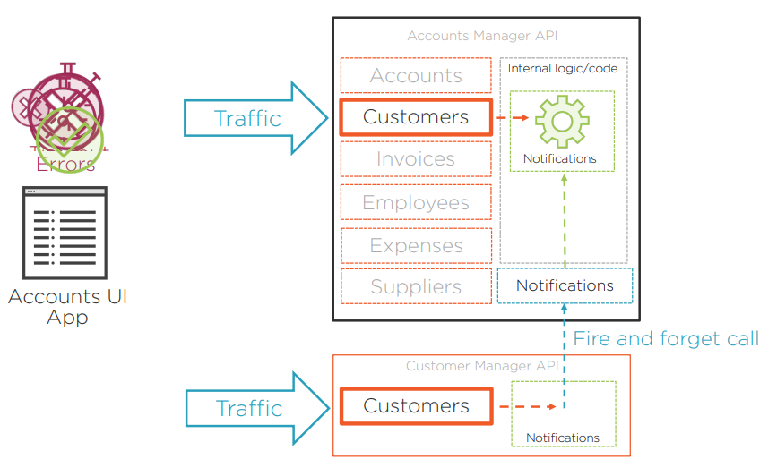

Slide 22
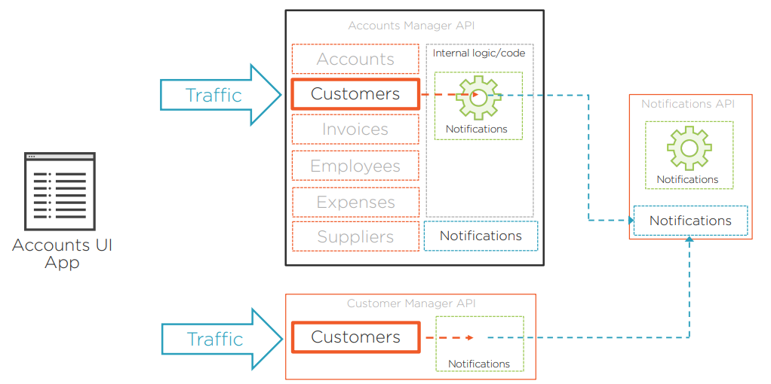

Slide 23
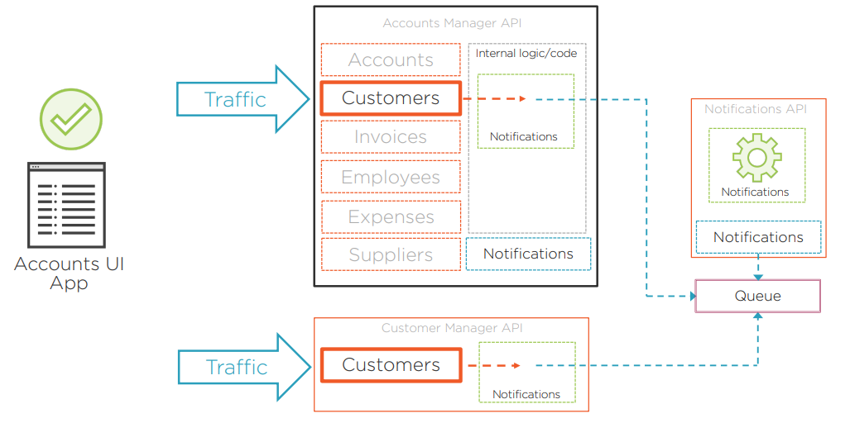

Slide 24
Monolith to Microservice

Slide 25
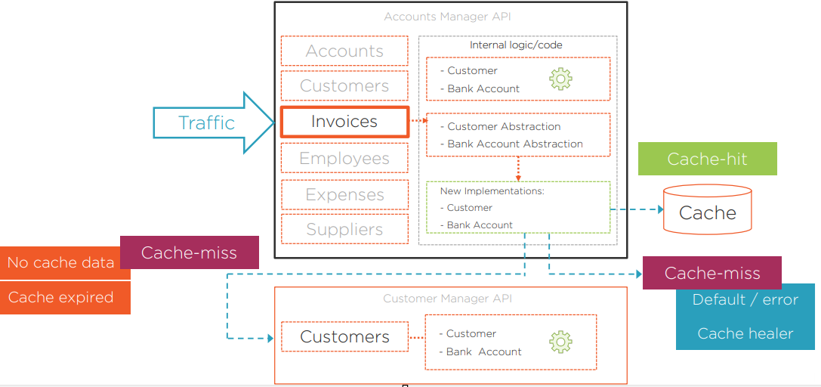

Slide 26
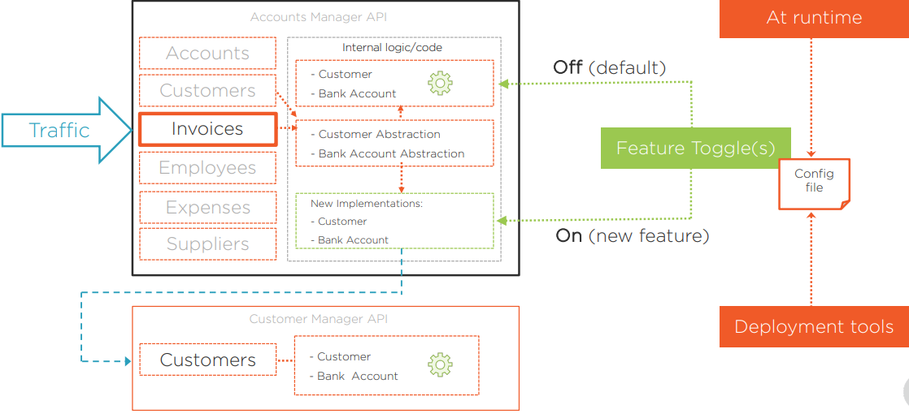
Feature Toggle Pattern

Slide 27
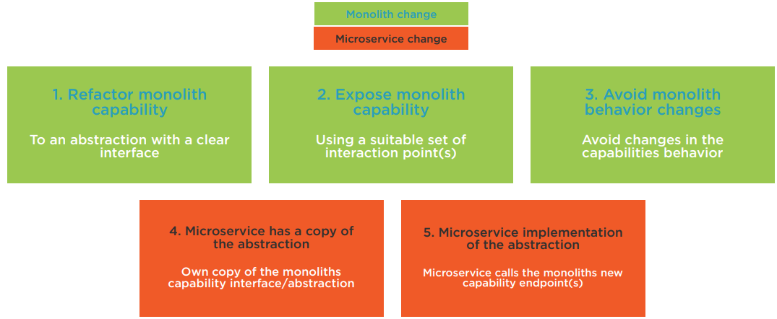
Cheat Sheet: Microservice Uses an Internal Monolith Capability

Slide 28
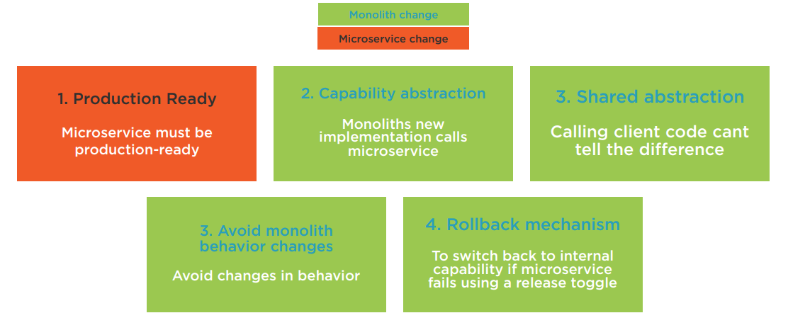
Cheat Sheet: Monolith Needs to Use a Microservice Capability

Slide 29
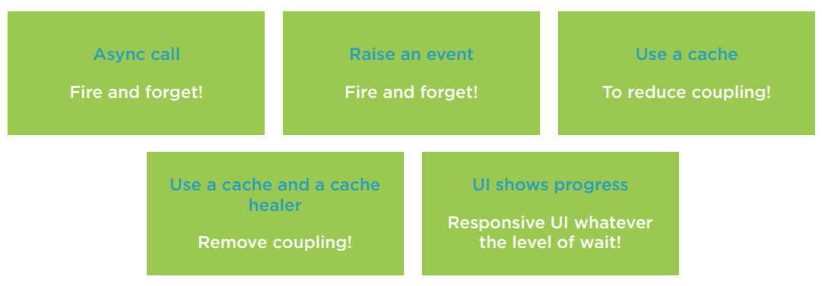
Cheat Sheet: Reducing Temporal Coupling

Slide 30
Links

Slide 31

Any Questions?

Slide 32
Thank You

