Slide 1


Monitoring using OPEN TELEMETRY
By: Anish Jain

Slide 2
Agenda
Introduction to Open telemetry
What is open telemetry used for?
OTEL library
Distributed tracing
OTEL collector & its pipeline
Asset Tag services implementation
Demo
Questions?

Slide 3
OpenTelemetry: It is framework and toolkit designed to create and manage telemetry data such as traces etc.
Focused on the generation, collection, management, and export of telemetry
CNCF community-driven open-source project
Vendor-agnostic
Instrument our cloud-native applications
Collects logs, metrics, and traces and acts as the glue
One specification that is respected by all vendors

Slide 4
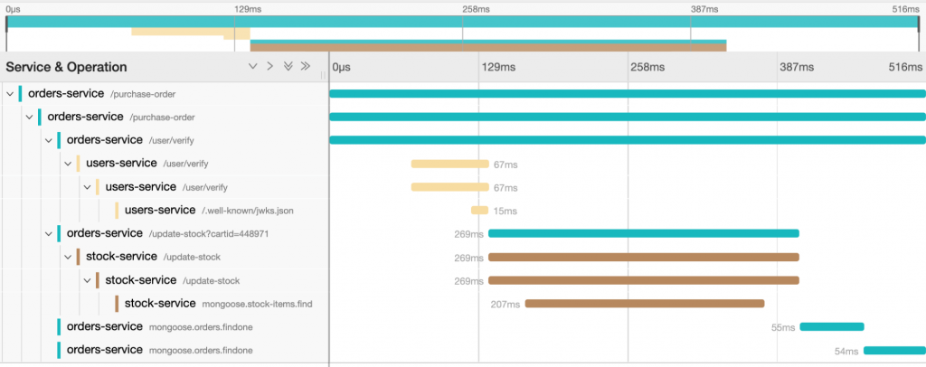
What is OpenTelemetry used for?
- respond quickly to incidents
- understand the full picture
The Three Types of Telemetry
- Log
- Metrics
- Traces

Slide 5
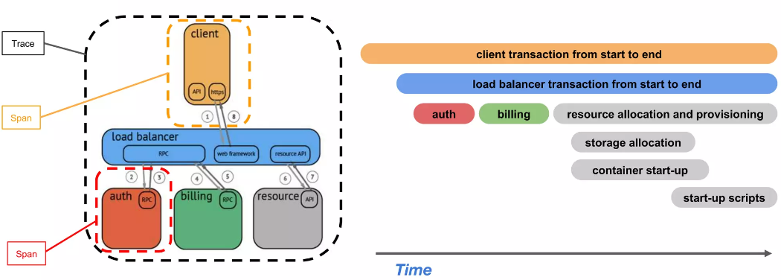
Distributed Tracing

Slide 6
OTEL collector
- Collect Process, and export telemetry data
- Support multiple type of telemetry
- Highly extensible and customizable
- Components
- Receivers
- Processors
- Exporters
- Extensions

Slide 7
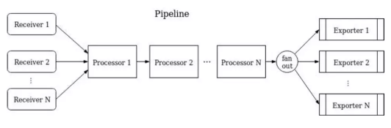
Pipelines

Slide 8
Open Telemetry Libraries
OpenTelemetry.Exporter.Console: To output traces to the console during development.
OpenTelemetry.Exporter.OpenTelemetryProtocol: To export our traces to our OpenTelemetry Collector using OpenTelemetry Protocol (OTLP).
OpenTelemetry.Extensions.Hosting: To register the .NET OpenTelemetry provider.
OpenTelemetry.Instrumentation.AspNetCore: To collect telemetry about incoming web requests.
OpenTelemetry.Instrumentation.Http: To collect telemetry about outgoing web requests.

Slide 9
Current implementation
KAFKA
KIBANA
POD
POD
POD
AssetTagAPI/Service
OTEL Collector (side-car)
DB

Slide 10

DEMO

Slide 11
Questions
1. What is opentelemetry? why we are using it , though we have Serilog?
2. why we are using both serilog and opentelemetry both together?
3. what changes are required to make it work in openshift?
4. what changes we will be still required to make in our projects like logging needs to be change?
5. How does this affect out ELK logs, what's changed and how do we browse logs with OTel?
6. Previously there was some discussion about logging to Console for Openshift, will we no longer get log files?
7. Is Kibana the only way to view logs in openshift(prod, for eg. since we probably won't be allowed to see log stream in the openshift console)
8. OTel has now enabled "tracing" I assume, can we get a brief idea on how its different/better than plane logging?

