Slide 1

Balancing Speed and Quality: Understanding Technical Debt and Refactoring
By Anish Jain
Achieve Excellence: Master the Art of Balancing Speed and Quality

Slide 2

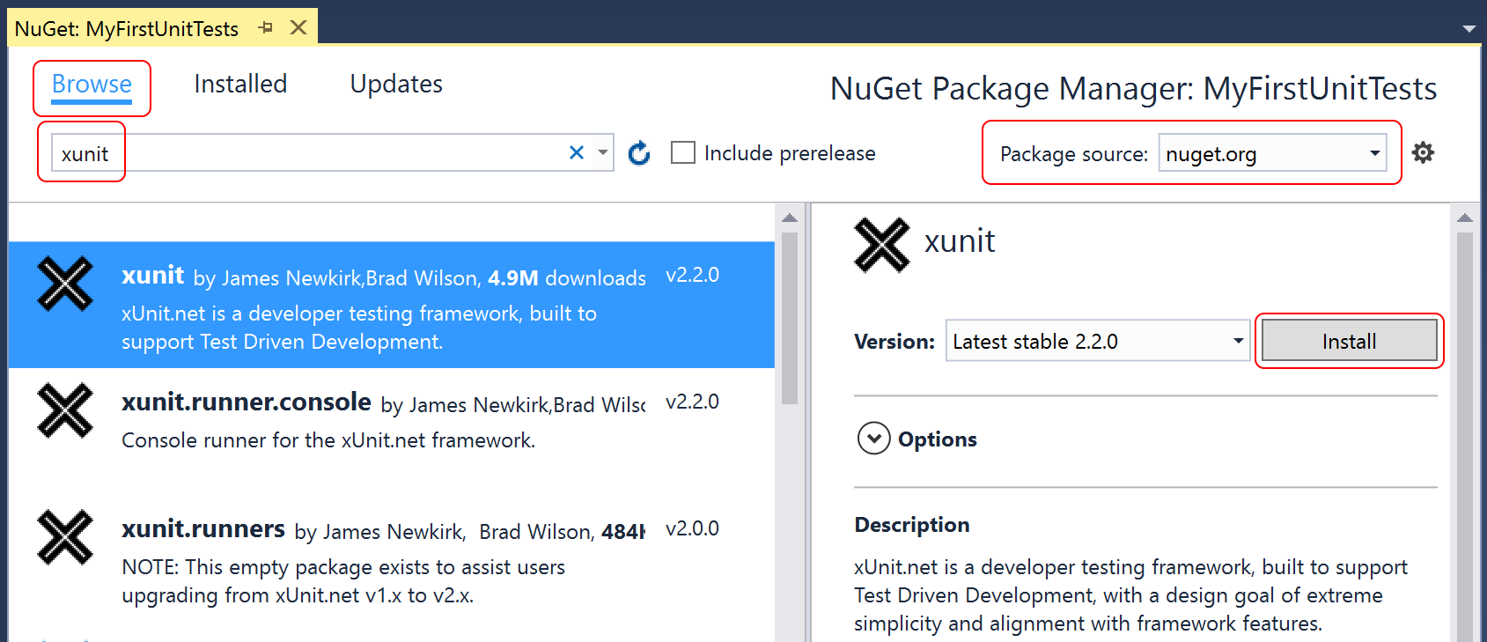
Agenda
1. Let’s talk about unit testing frameworks
- XUnit vs NUnit vs MSTest
2. When and Where to Use Each Framework
- xUnit: Modern, Extensible, and Lightweight
- NUnit: Flexible and Feature-Rich
- MSTest: Microsoft’s Default and Reliable Framework
3. XUnit Test Life cycle
- IClassFixture & CollectionFixture in xUnit
- Collection Attribute in xUnit
- IAsyncLifetime
- BeforeAfterTestAttribute
- Life cycle of Test
4. Test Dependency Injection
- ClassFixture
- Interface ITestOutputHelper
5. Features
- Xunit Nuget Packages
- Turning Off Test Parallel Execution in xUnit
- Traits in xUnit
- Theory Attribute in xUnit
- Member Data
- Custom DataAttribute
- Skip
- Migrating existing NUnit tests to Xunit
6. Demo
7. Any Questions?
8. Reference Links

Slide 3
Refactoring Code to Load a Document
Encapsulating the loading logic to avoid complex and tedious code. This involves creating a clear separation between the data loading and data manipulation logic.
Three Loading Strategies:
Tree Model: Loading the entire JSON document into a tree structure, which allows for flexible manipulation but can be cumbersome for large documents.
Data Binding: Mapping JSON data directly to Java objects, which is straightforward but can lead to tightly coupled code.
Streaming: Processing JSON data as it is read, which is efficient for large documents but can be complex to implement.
Solution:
Combination of these strategies based on the specific use case. By encapsulating the loading logic and choosing the appropriate strategy, developers can create more maintainable and efficient code.

Slide 4
Example: Tree Model
Using the JsonDocument class from System.Text.Json to load the entire JSON document into a tree structure.
using System;
using System.Text.Json;
public class TreeModelExample
{
public static void Main()
{
string jsonString = "{\"Album\":\"The Dark Side of the Moon\",\"Artist\":\"Pink Floyd\",\"Year\":1973}";
using (JsonDocument doc = JsonDocument.Parse(jsonString))
{
JsonElement root = doc.RootElement;
string album = root.GetProperty("Album").GetString();
string artist = root.GetProperty("Artist").GetString();
int year = root.GetProperty("Year").GetInt32();
Console.WriteLine($"Album: {album}, Artist: {artist}, Year: {year}");
}
}
}

Slide 5
Example: Data Binding
Using the JsonSerializer class to map JSON data directly to C# objects.
using System;
using System.Text.Json;
public class Album
{
public string AlbumName { get; set; }
public string Artist { get; set; }
public int Year { get; set; }
}
public class DataBindingExample
{
public static void Main()
{
string jsonString = "{\"AlbumName\":\"The Dark Side of the Moon\",\"Artist\":\"Pink Floyd\",\"Year\":1973}";
Album album = JsonSerializer.Deserialize<Album>(jsonString);
Console.WriteLine($"Album: {album.AlbumName}, Artist: {album.Artist}, Year: {album.Year}");
}
}

Slide 6
Example: Streaming
using System;
using System.Text.Json;
public class StreamingExample
{
public static void Main()
{
string jsonString = "{\"Album\":\"The Dark Side of the Moon\",\"Artist\":\"Pink Floyd\",\"Year\":1973}";
byte[] jsonData = System.Text.Encoding.UTF8.GetBytes(jsonString);
Utf8JsonReader reader = new Utf8JsonReader(jsonData);
string album = null;
string artist = null;
int year = 0;
while (reader.Read())
{
if (reader.TokenType == JsonTokenType.PropertyName)
{
string propertyName = reader.GetString();
reader.Read();
switch (propertyName)
{
case "Album":
album = reader.GetString();
break;
case "Artist":
artist = reader.GetString();
break;
case "Year":
year = reader.GetInt32();
break;
}
}
}
Console.WriteLine($"Album: {album}, Artist: {artist}, Year: {year}");
}
}
Using the Utf8JsonReader class to process JSON data as it is read.

Slide 7
Refactoring: This class is too large
Why Refactor?:
improves code readability, maintainability, and to reduce complexity.
Refactoring Steps:
Rearrange Methods: Group related methods together to identify potential new classes.
Analyse Relationships: Understand how methods interact to determine how to split the class.
Create Covering Tests: Ensure that existing functionality is preserved by writing tests.
Extract New Classes: Gradually move methods to new classes, starting with the least dependent methods.
Solution:
The solution involves breaking down the large class into smaller, more focused classes. This is done through a series of small, incremental refactoring's, each preserving the existing behaviour of the code. By doing this, the code becomes easier to understand, test, and maintain.

Slide 8
Example:
public class FileHandler
{
public void LoadDocument(string filePath)
{
// Code to load document
}
public void SaveDocument(string filePath)
{
// Code to save document
}
}
public class DocumentProcessor
{
public void LoadDocument(string filePath)
{
// Code to load document
}
public void ParseDocument()
{
// Code to parse document
}
public void SaveDocument(string filePath)
{
// Code to save document
}
public void PrintDocument()
{
// Code to print document
}
public void ValidateDocument()
{
// Code to validate document
}
}
public class DocumentProcessor
{
private readonly FileHandler _fileHandler = new FileHandler();
private readonly DocumentValidator _validator = new DocumentValidator();
public void LoadDocument(string filePath)
{
_fileHandler.LoadDocument(filePath);
}
public void SaveDocument(string filePath)
{
_fileHandler.SaveDocument(filePath);
}
public void PrintDocument()
{
// Code to print document
}
public void ValidateDocument()
{
_validator.ValidateDocument();
}
public void ParseDocument()
{
// Code to parse document
}
}
public class DocumentValidator
{
public void ValidateDocument()
{
// Code to validate document
}
}

Slide 9
Preparatory refactoring
for each desired change, make the change easy (warning: this may be hard), then make the easy change
-- Kent Beck
Concept of preparatory refactoring, which involves restructuring existing code to make it easier to add new features. This approach is summarized by the phrase "make the change easy, then make the easy change."
1. The Starting Point:
- Wants to add a new feature to highlight specific parts of these code fragments.
2. Identifying the Need for Refactoring:
- Before adding the new feature, we need to realizes that the existing code structure is not conducive to the change. This is where preparatory refactoring comes in.
3. Refactoring Steps:
- Rearrange Methods: Group related methods together to identify potential new classes.
- Analyse Relationships: Understand how methods interact to determine how to split the class.
- Create Covering Tests: Ensure that existing functionality is preserved by writing tests.
- Extract New Classes: Gradually move methods to new classes, starting with the least dependent methods.
Solution:
The solution involves breaking down the large class into smaller, more focused classes through a series of small, incremental refactoring's. This makes the code more modular, easier to understand, and maintainable. By doing this, the code becomes easier to understand, test, and maintain.

Slide 10
Example:
public class FileHandler
{
public void LoadDocument(string filePath)
{
// Code to load document
}
public void SaveDocument(string filePath)
{
// Code to save document
}
}
Initial Code: Here's a class that processes documents and handles multiple tasks:
public class DocumentProcessor
{
public void LoadDocument(string filePath)
{
// Code to load document
}
public void ParseDocument()
{
// Code to parse document
}
public void SaveDocument(string filePath)
{
// Code to save document
}
public void PrintDocument()
{
// Code to print document
}
public void ValidateDocument()
{
// Code to validate document
}
}
Step 1: Rearrange Methods
Step 2: Extract New Classes
Step 3: Update DocumentProcessor
Step 4: Add New Feature
Step 5: Integrate New Feature
public class DocumentValidator
{
public void ValidateDocument()
{
// Code to validate document
}
}

Slide 11
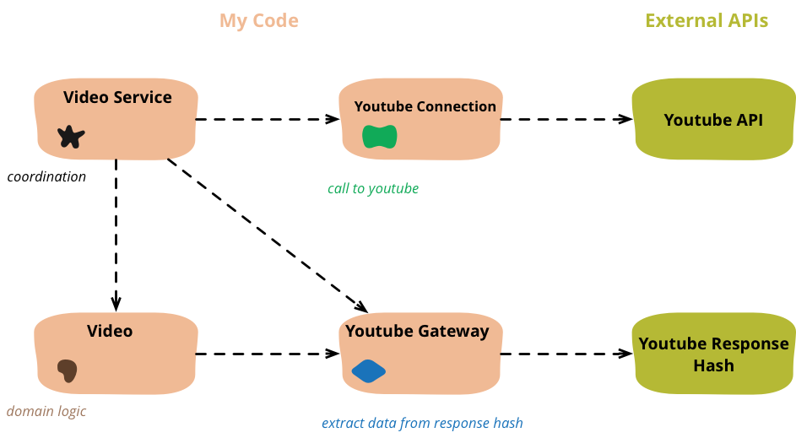
Refactoring Code That Accesses External Services
1. Initial Code:
- Starts with an example of congealed code that reads data from a JSON file, enriches it with data from YouTube, and returns the enriched data. The initial code is tightly coupled and difficult to maintain.
2. Separating Concerns:
- Separating concerns by breaking down the code into smaller, more focused objects. This involves creating separate objects for different responsibilities, such as handling external API calls and processing data.
3. Refactoring Steps:
- Connection Object: Create a connection object to handle the details of connecting to the external service.
- Gateway Object: Introduce a gateway object to encapsulate the interaction with the external service, making it easier to mock and test.
- Domain Object: Separate the domain logic into its own object to keep the business logic isolated from the external service interaction.
Solution:
The solution involves refactoring the code to separate the concerns of external service interaction and domain logic. By introducing connection and gateway objects, the code becomes more modular, easier to test, and maintainable.

Slide 12
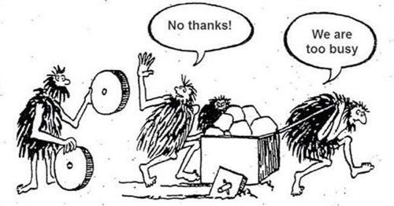
A good rule of thumb: Always leave the code better than you found it.
The goal isn’t to eliminate all tech debt — it’s to manage it wisely.

Slide 13
Refactoring to an Adaptive Model
1. Initial Code:
- The logic is embedded directly in the code, making it difficult to share and update across different platforms.
2. Adaptive Model:
- Refactoring the logic into a JSON data structure. This adaptive model allows the logic to be easily shared between different programming languages.
3. Refactoring Steps:
- Representing Conditions: Represent conditions in JSON.
- Extracting Logic: Extraction of specific logic, such as country-specific rules, into the JSON model.
- Parameterizing the Model: The model is parameterized to handle different scenarios.
- Handling Complex Conditions
4. Benefits:
- The adaptive model allows for easier updates and sharing of logic without changing the code. It also promotes a clear separation between the logic and the code that interprets it.

Slide 14
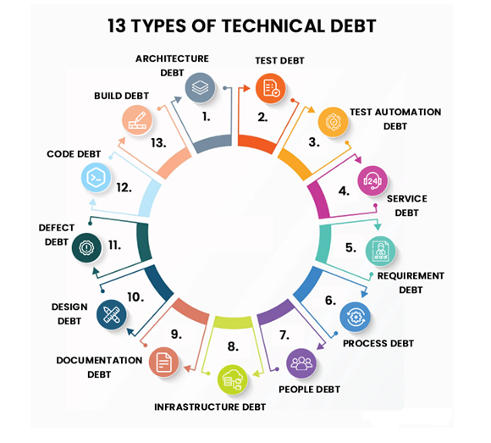
Type of Technical Debt
1. Intentional technical debt:
Developers knowingly submit code with room for improvement.
Used strategically to speed up product delivery.
Often due to looming deadlines.
2. Unintentional technical debt:
Results from poorly done work.
Not strategic and often problematic.

Slide 15
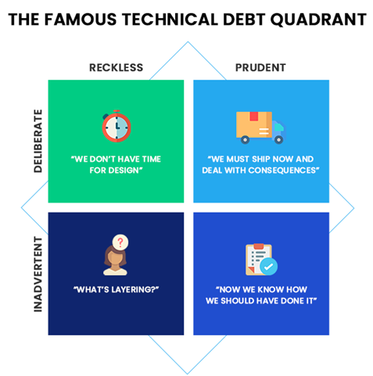
Technical Debt Quadrant
1. Deliberate and Prudent
Intentional: Taken on with careful consideration.
Example: Quick workaround for a deadline, with a plan to refactor later.
2. Deliberate and Reckless
Intentional: Sacrifices quality for speed without considering long-term impact.
Example: Rushing features without proper testing.
3. Inadvertent and Prudent
Unintentional: Managed responsibly once identified.
Example: Discovering and planning to fix a design flaw.
4. Inadvertent and Reckless
Unintentional: Results from ignorance or lack of experience.
Example: Creating a messy codebase due to unfamiliarity with best practices.

Slide 16

DEMO

Slide 17

Any Questions?

Slide 18

Reference Links
What is Technical Debt and How to Manage it? – Edvantis
Technical Debt and its Implications
https://martinfowler.com/articles/refactoring-adaptive-model.html

Slide 19
Thank You

