Slide 1


Slide 2
A project on ludo game simulation
Created By: Anish Timsina (THA077BEI007) Ashim Panthi (THA077BEI009) Bishal Khadka (THA077BEI015) Khagendra Raj Joshi (THA077BEI022)
Supervised By: Er. Saroj Shakya
Submitted To: Department of Electronics And Computer Engineering IOE Thapathali Campus

Slide 3
Introduction
Ludo is a strategy board game
Players race their four tokens from start to finish according to the rolls of a single die
The game and its variants are popular in many countries and under various names
Each player is assigned a colour and has four tokens of matching colour
Board is normally square with a cross-shaped game track

Slide 4
objectives
To develop an application named Ludo Game Simulation using c++.
To learn the use of graphics in object oriented programming.
To develop a multiplayer ludo game with simple codes as far as possible.

Slide 5
Existing work on this field
LUDO King
LUDO master
Ludo Pro-Hamro Games

Slide 6
Drawbacks of existing system
Board is required, carrying it can be tenacious.
The tokens required can get lost.
Cannot be played wherever we want

Slide 7
Methodology
This project contains 3 different windows.
This project contain 4 files two headers files and two cpp files.
This project contains a image of ludo board made by using paint.
This project contains image of tokens and numbers created by using paint.

Slide 8
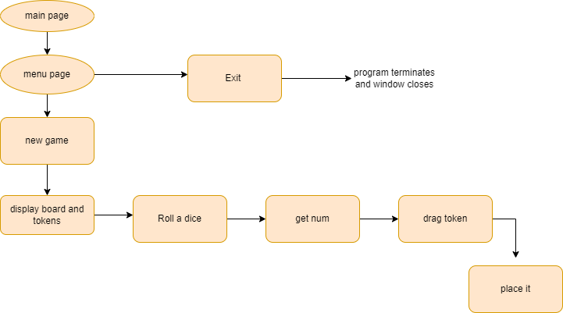
methodology

Slide 9
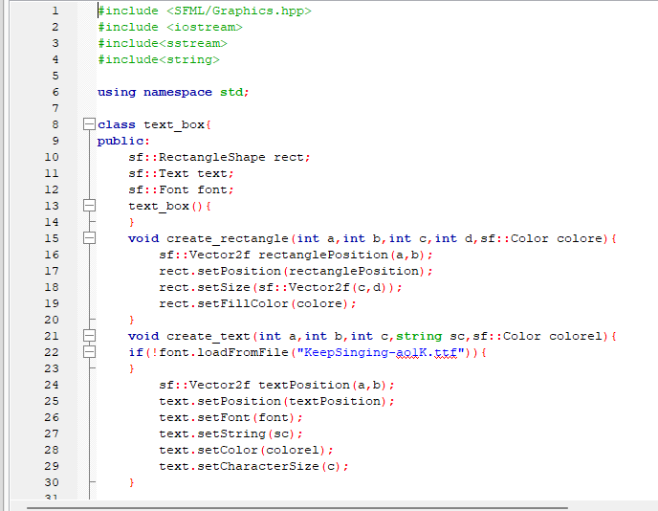
Header file (classreq.h)
Contains class for drawing rectangle and text in the sfml window.

Slide 10
header files (player.h)
Contains the class named player1,player2,player3,player4
Each class contains four member functions gotti1,gotti2,gotti3,gotti4
Each function contains the position of gotti at first

Slide 11
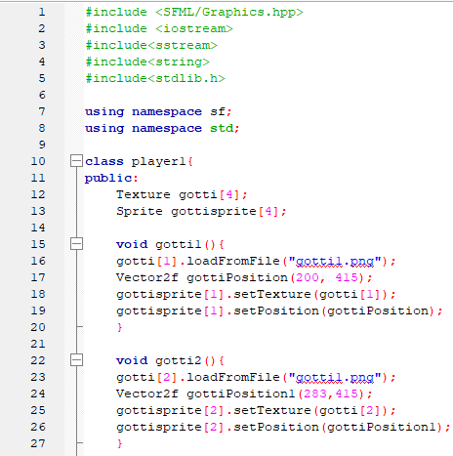
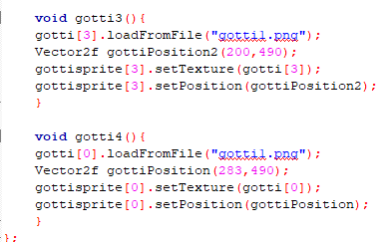
Sample of some code portion of player.h

Slide 12
main.cpp
Contains the main window
Starting window of project
Contains details of project
Contains the function call for another page

Slide 13
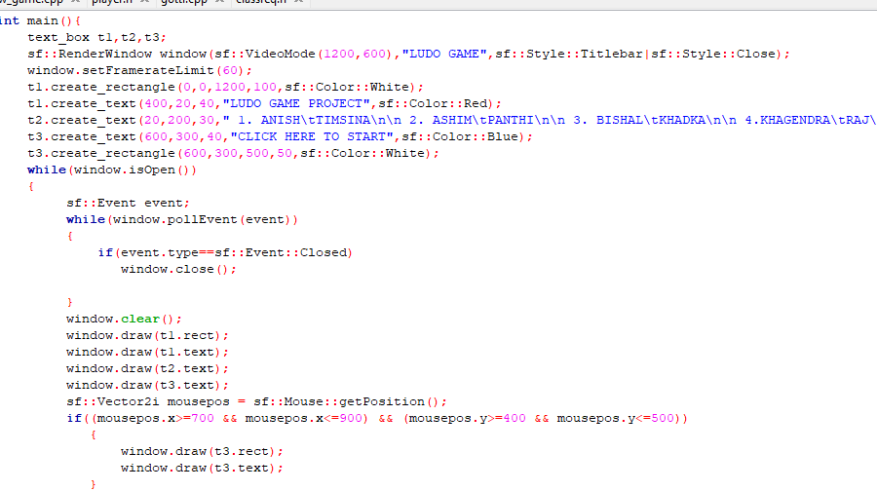
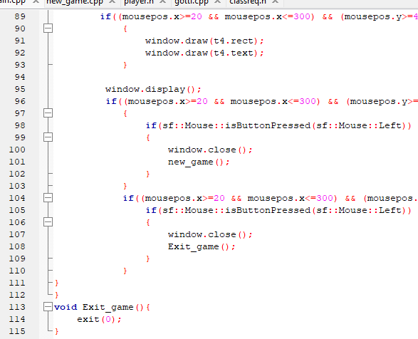
sample code

Slide 14
new_game.cpp
Insert the board tecture
Insert the tokens pic
Insert codes for drag and drop
Insert roll dice text
Contains the get_number() function to generate random number from 1 to 6

Slide 15
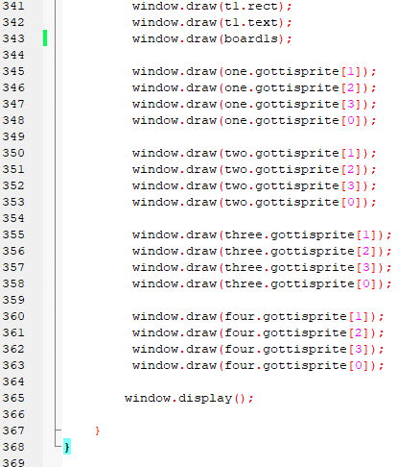
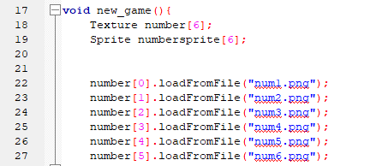
sample codes

Slide 16
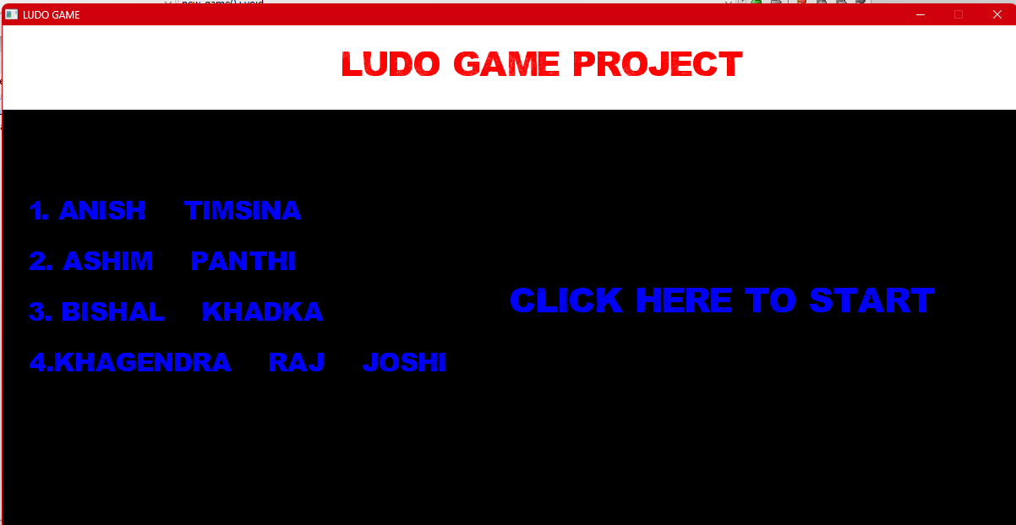
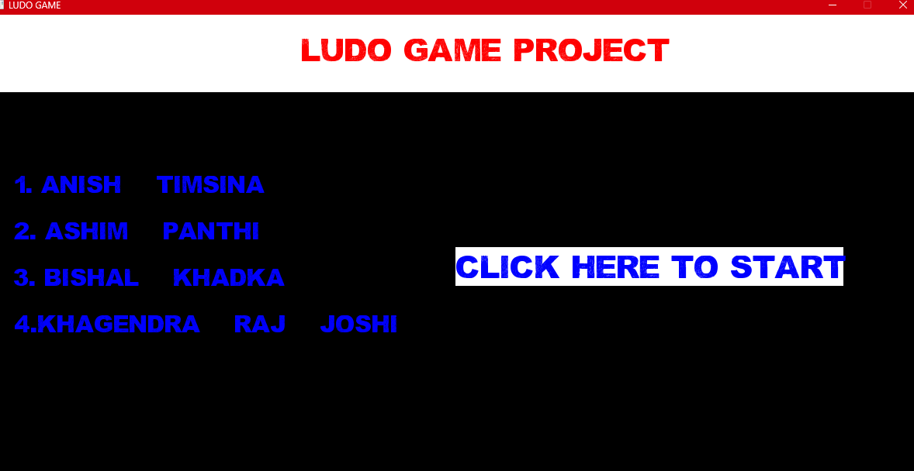
Main page when cursor position moves to click here to start it highlghts the text and when clicked moves to other window

Slide 17
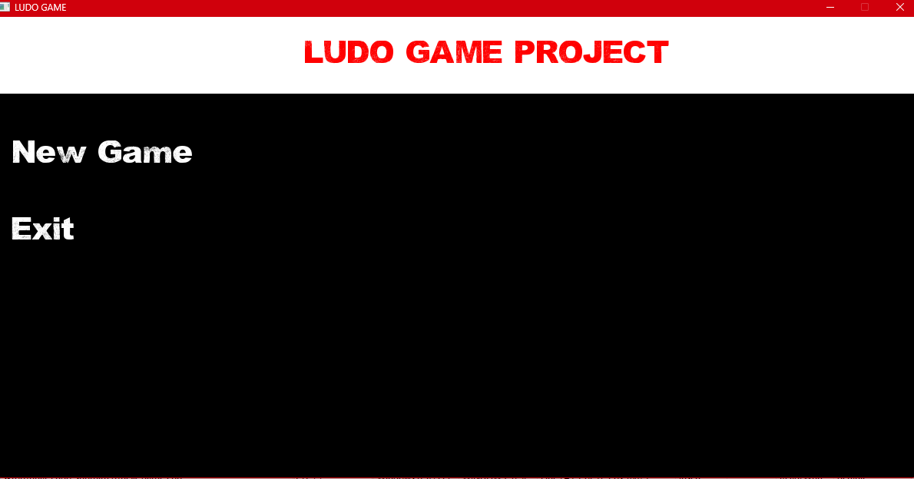
Menu

Slide 18
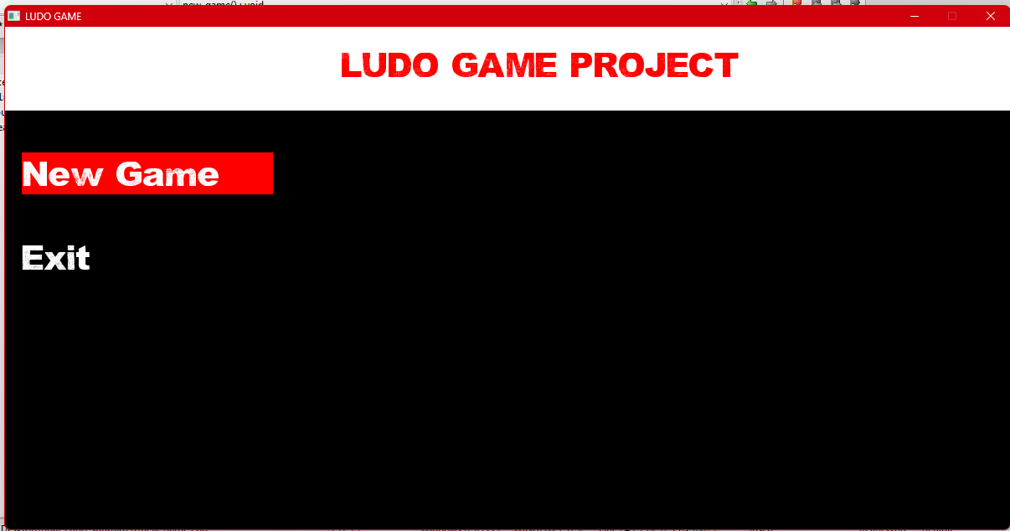
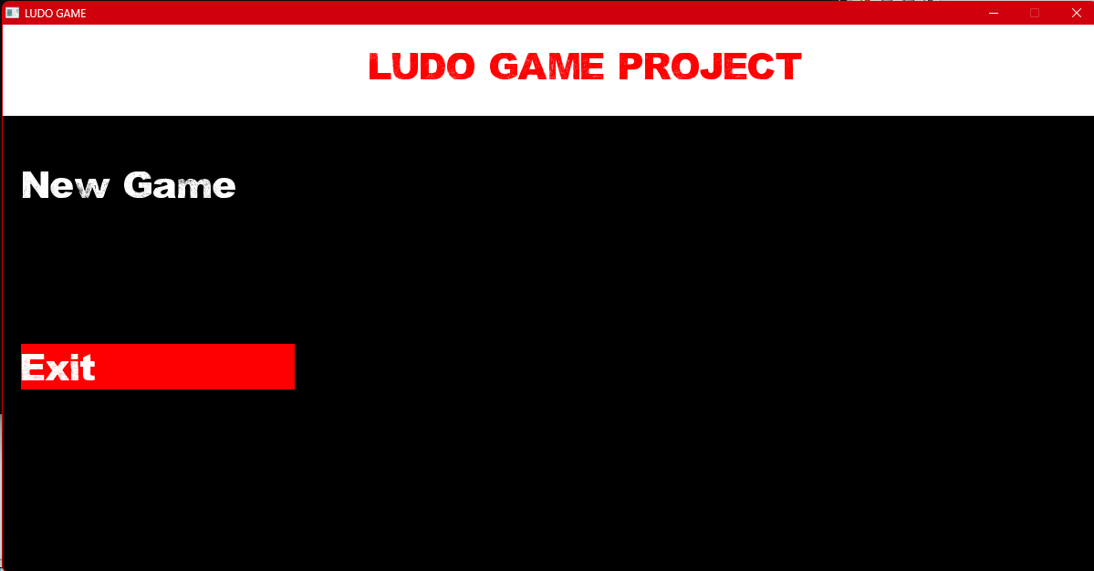
When cursor moves to new game or exit highlights the text and when clicked goes to other window

Slide 19
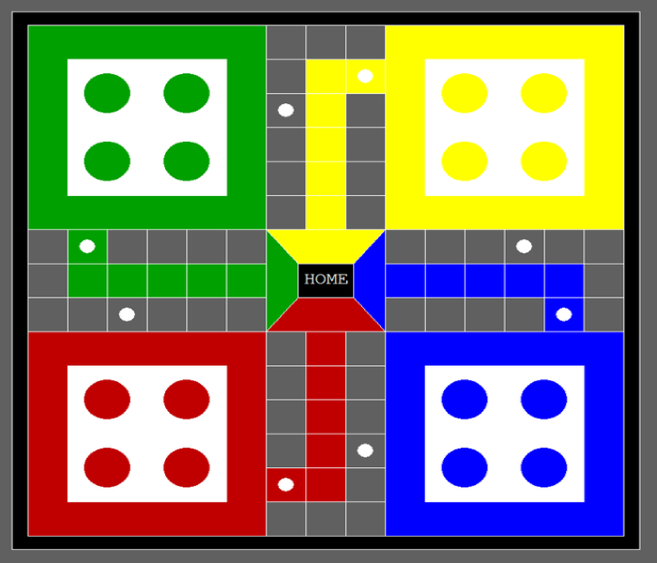
Board drawn on paint

Slide 20
Goti(Tokens) drawn on paint

Slide 21
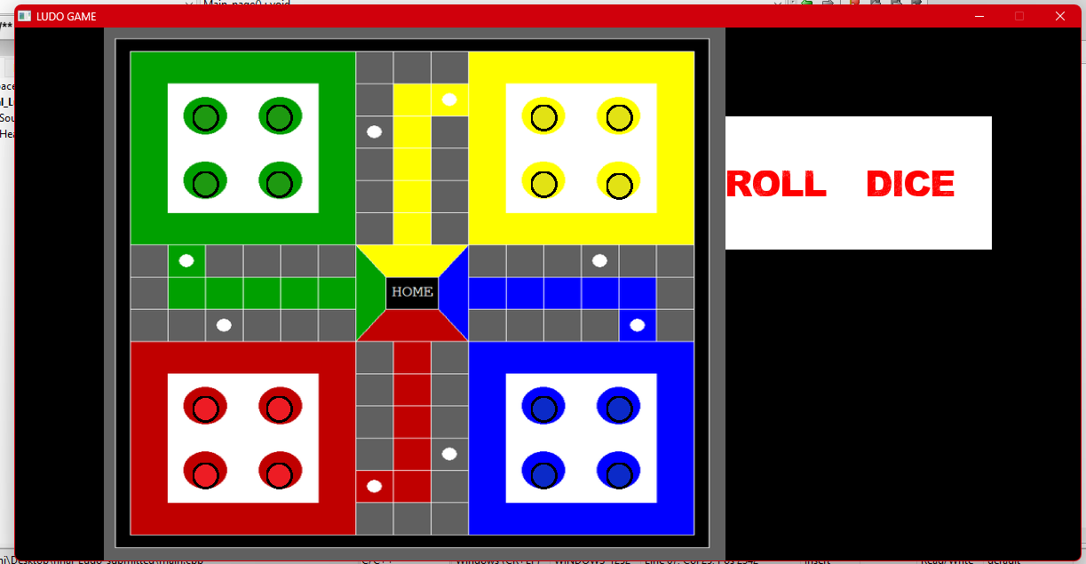
Final outcome

Slide 22
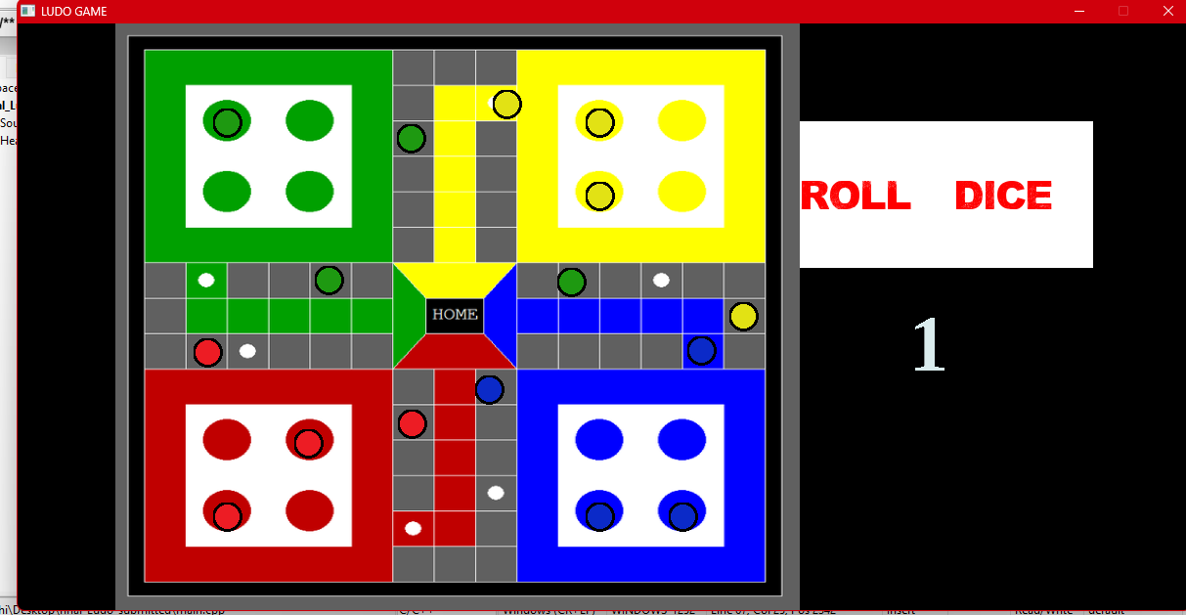

Slide 23

THANK YOU

