Slide 1


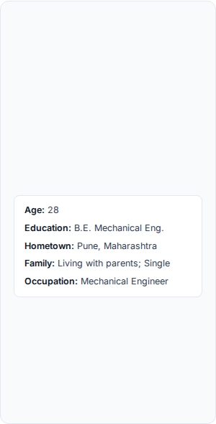


User Persona Profile: Anand Verma
Student:
PRN:
Panel:
Subject:
"I want an authentic piece of Indian horology history at fair prices directly from the source—without racing against glitched checkout screens or paying inflated prices to scalpers."
Goals
Frustrations
•
Purchase genuine heritage HMT mechanical & automatic watches (Kohinoor, Tareeq, Stellar) at official retail prices.
•
High-demand watch models becoming out-of-stock mid-checkout due to lack of temporary cart reservation.
Anand Verma
•
Complete online checkout seamlessly before limited stock sells out completely.
•
Lack of detailed physical dimensions (lug-to-lug, strap width, case thickness) on official product pages.
•
Access comprehensive technical specs (lug-to-lug, movement caliber, crystal type) before committing to purchase.
•
Onerous post-delivery requirements, such as mandating unboxing video proof for defect claims.
•
Experience a smooth, hassle-free process for product replacements, repairs, or returns if defects occur.
•
Complex refund policies, customer-arranged return logistics, and prolonged waiting periods for payment reversals.
User Scenario / Journey Narrative
Anand is a 28-year-old mechanical engineer with a passion for horology and Indian heritage. During work breaks, he actively monitors Reddit and Telegram communities for restock alerts on iconic models like the HMT Kohinoor. When a alert drops, Anand swiftly opens the official website on his phone to buy before scalpers exhaust inventory. However, he faces immense anxiety due to incomplete watch specifications, slow checkout validation, and the dread of rigid return procedures if the watch arrives with manufacturing defects.

Slide 2
