Slide 1
Practical Issues
Credits for slides: Allan, Arms, Manning, Lund, Noble, Page.

Slide 2
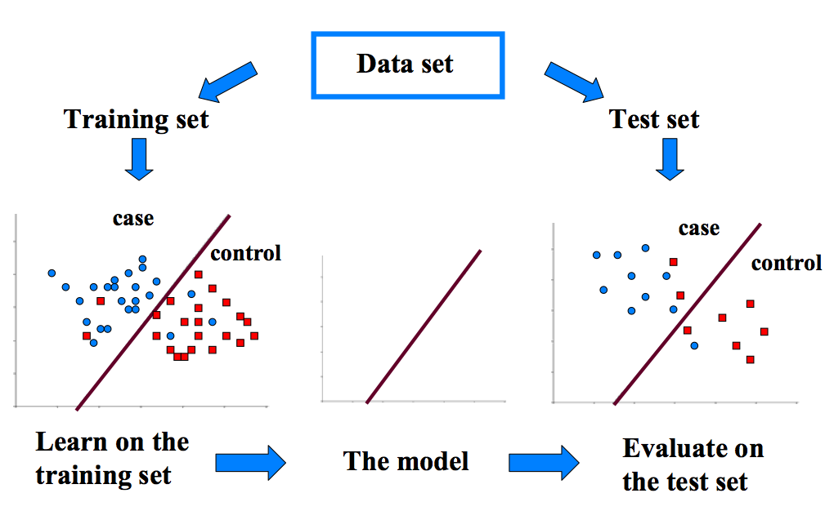
Evaluation Framework
+
+
-
-

Slide 3
Methods to Estimate Performance
Holdout
  Reserve ½ for training and ½ for testing
  Reserve 2/3 for training and 1/3 for testing
To limit the effect of one lucky or unlucky train/test split, it is common to average through:
  Random subsampling
    Repeated holdout
  Stratified sampling
    oversampling vs undersampling
  Cross validation
    Partition data into k disjoint subsets
    k-fold: train on k-1 partitions, test on the remaining one
    Leave-one-out: k=n

Slide 4
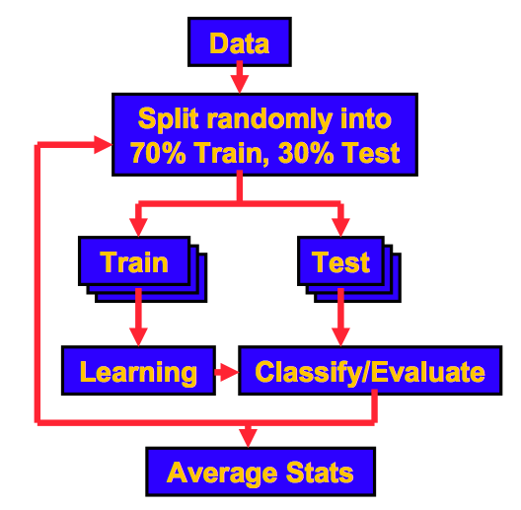
Random sub-sampling

Slide 5
Stratified Sampling
The holdout method reserves a certain amount for testing and uses the remainder for training
For small or “unbalanced” datasets, training samples might not be representative for all classes
For instance, few or none instances of some classes
Stratified sample
  Make sure that each class is represented with approximately equal proportions in both subsets

Slide 6
3-Fold Cross Validation
reoder
arbitrarily
train &
test #1
train &
test #2
train &
test #3
dataset
train
evaluate statistics for each iteration
and then compute the average
test

Slide 7
k-Fold Cross Validation
Split the data to k sets of approximately equal size (and class distribution, if stratified)
For i=1 to k:
  Use i-th subset for testing and remaining (k-1) subsets for training
Compute average accuracy
k-fold CV can be repeated several, say, 10 times

Slide 8
A Note on Parameter Tuning
It is important that the test data is not used in any way to create the classifier
Some learning schemes operate in two stages:
  Stage 1: builds the basic structure
  Stage 2: optimizes parameter settings
The test data can’t be used for parameter tuning!
Proper procedure uses three sets:
  training data, validation data, and test data
Validation data is used to optimize parameters

Slide 9
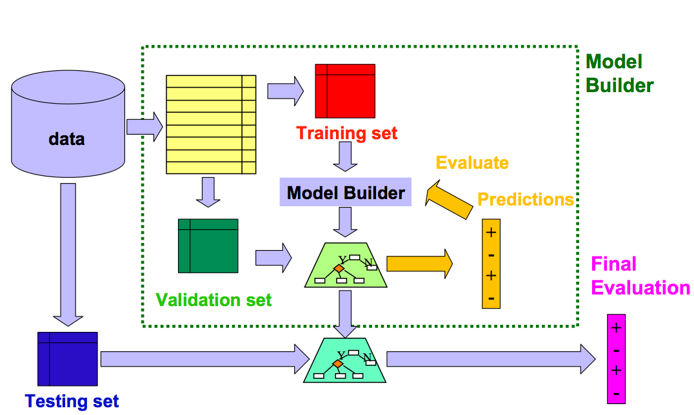
Train, Validation, and Test

Slide 10
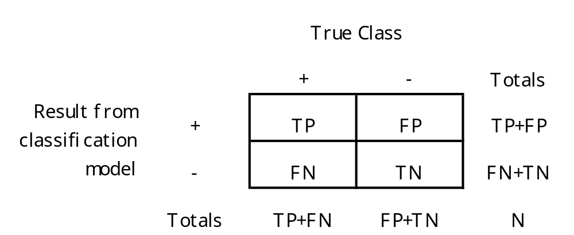
Test Statistics:
Contingency Table of Classification Results
true positive, false positive
false negative, true negative

Slide 11
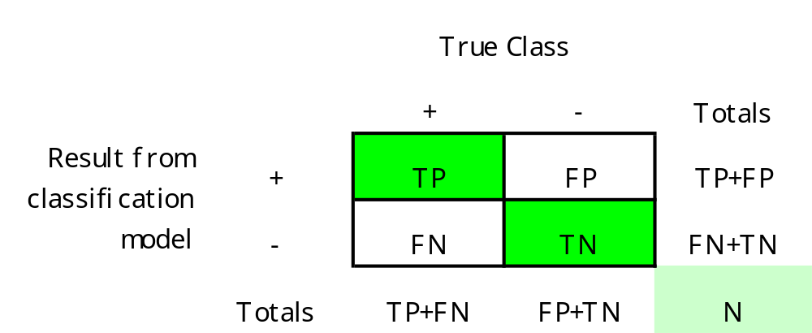
Classification Accuracy
CA = (TP+TN) / N
Proportion of correctly classified examples

Slide 12
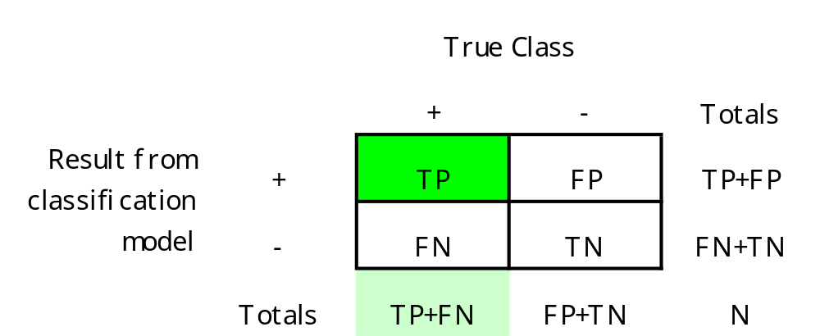
Sensitivity
Sensitivity = TP / (TP + FN)
Proportion of correctly detected positive examples
In medicine (+, -: presence and absence of a disease):
  chance that our model correctly identifies a patient with a disease

Slide 13
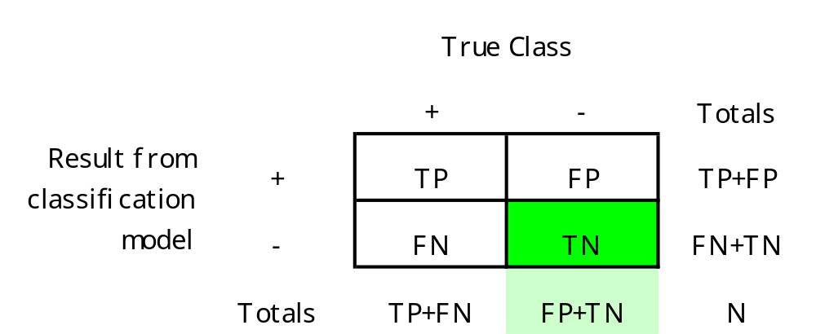
Specificity
Specificity = TN / (FP + TN)
Proportion of correctly detected negative examples
In medicine:
  chance that our model correctly identifies a patient without a disease

Slide 14
To summarize: Evaluation Measures
Of all patients that actually have the disease, what fraction did we correctly detect as having the disease?
Start with a CONTINGENCY table
actual +
actual -
Sensitivity/Recall
TP
SN =
predicted +
TP
FP
TP+FN
Precision
TP
PR =
predicted -
FN
TN
TP+FP
TP+TN
FP+FN
Of all patients we predicted +, what fraction actually have the disease?
Accuracy =
Error =
N
N
Specificity
TN
SP =
where N=TP+FP+FN+TN
TN+FP

Slide 15
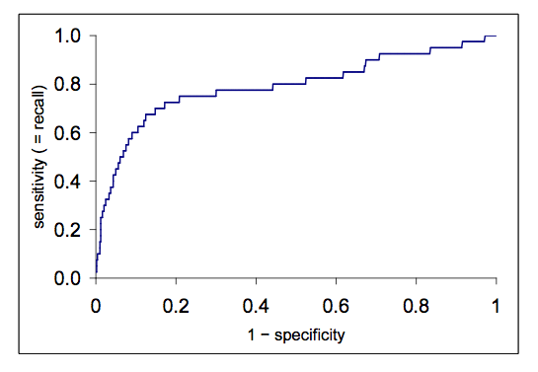
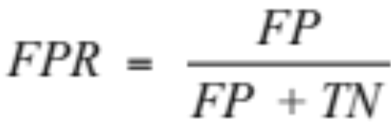
Receiver Operating Characteristic (ROC) Curve
True positive rate
Area Under Curve (AUC)
False positive rate

Slide 16
Comparing Two Learning Schemes
Frequent question: which of two learning schemes performs better?
Note: this is domain dependent!
Obvious way: compare 10-fold CV estimates
Never test on the learning set
Use some sampling procedure for testing
Bottom line: good models are those that are useful in practice

