Slide 1
Text Classification – Naive Bayes
Credits for slides: Allan, Arms, Manning, Lund, Noble, Page.

Slide 2
Required Reading
“Information Retrieval” textbook
  Chapter 13: Text classification & Naïve Bayes

Slide 3
Why Text Classification?
There is an information overload these days.
How do people avoid information overload?
The growth of the Web matters little to a physicist if at most a few dozen pages dealing with quantum electrodynamics are added or updated per week.

Slide 4
Classification Problems
Email filtering: spam / non spam
Email foldering / tagging: Work, Friends, Family, Hobby
Research articles by topics: Machine Learning, Data Mining, Algorithms

Slide 5
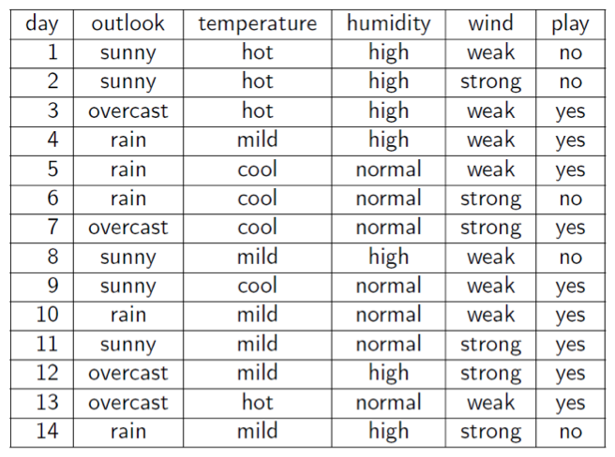
Data Representation

Slide 6
Data Representation
N = number of training examples
x’s = “input” variable / features
y’s = “output” variable / “target” variable
(x,y) – one training example
(x^{(i)},y^{(i)}) – the i^{th} training example

Slide 7
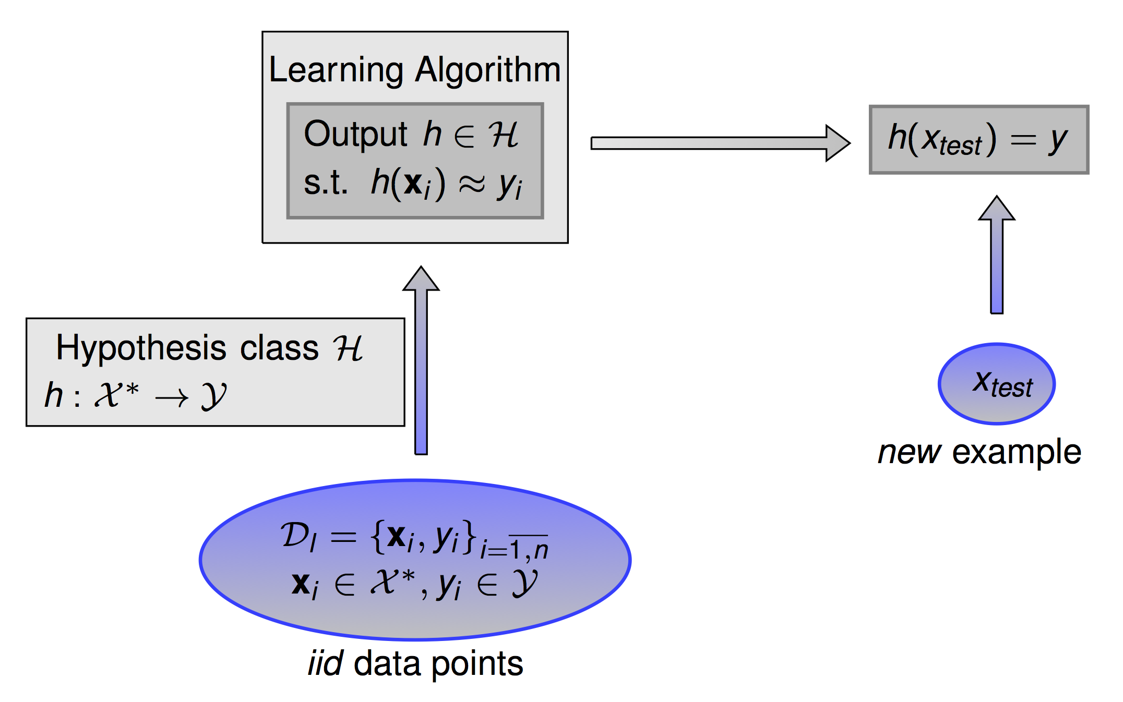
Training and Classification

Slide 8

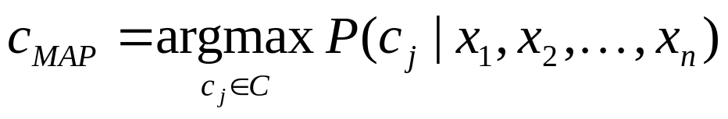
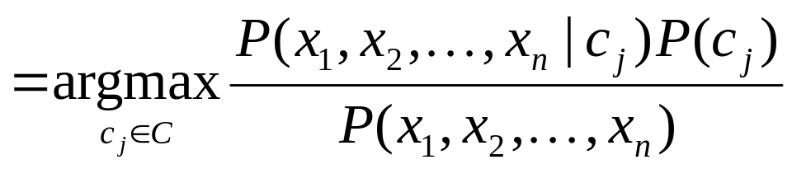
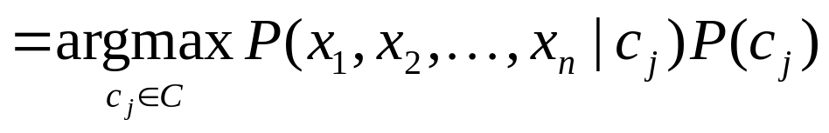
Bayes Classifiers for Categorical Data
Task: Classify a new instance x based on a tuple of attribute values into one of the classes c_{j} ∈ C
Example | Color | Shape | Class
1 | red | circle | positive
2 | red | circle | positive
3 | red | square | negative
4 | blue | circle | negative
attributes
values
Notes:
The most probable class given the attribute values

Slide 9


Joint Distribution
The joint probability distribution for a set of random variables, X₁,…,X_{n} gives the probability of every combination of values: P(X₁,…,X_{n})
The probability of all possible conjunctions can be calculated by summing the appropriate subset of values from the joint distribution.
positive
negative
 | circle | square
red | 0.20 | 0.02
blue | 0.02 | 0.01
 | circle | square
red | 0.05 | 0.30
blue | 0.20 | 0.20

Slide 10
Joint Distribution
The joint probability distribution for a set of random variables, X₁,…,X_{n} gives the probability of every combination of values: P(X₁,…,X_{n})
The probability of all possible conjunctions can be calculated by summing the appropriate subset of values from the joint distribution.
positive
negative
 | circle | square
red | 0.20 | 0.02
blue | 0.02 | 0.01
 | circle | square
red | 0.05 | 0.30
blue | 0.20 | 0.20

Slide 11
Joint Distribution
The joint probability distribution for a set of random variables, X₁,…,X_{n} gives the probability of every combination of values: P(X₁,…,X_{n})
The probability of all possible conjunctions can be calculated by summing the appropriate subset of values from the joint distribution.
Therefore, all conditional probabilities can also be calculated.
positive
negative
 | circle | square
red | 0.20 | 0.02
blue | 0.02 | 0.01
 | circle | square
red | 0.05 | 0.30
blue | 0.20 | 0.20

Slide 12

Joint Distribution
The joint probability distribution for a set of random variables, X₁,…,X_{n} gives the probability of every combination of values: P(X₁,…,X_{n})
The probability of all possible conjunctions can be calculated by summing the appropriate subset of values from the joint distribution.
Therefore, all conditional probabilities can also be calculated.
positive
negative
 | circle | square
red | 0.20 | 0.02
blue | 0.02 | 0.01
 | circle | square
red | 0.05 | 0.30
blue | 0.20 | 0.20

Slide 13
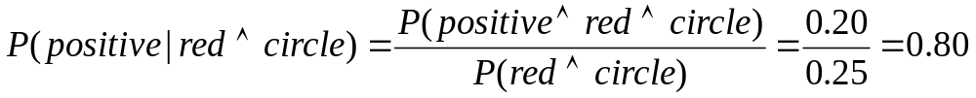
Joint Distribution
The joint probability distribution for a set of random variables, X₁,…,X_{n} gives the probability of every combination of values: P(X₁,…,X_{n})
The probability of all possible conjunctions can be calculated by summing the appropriate subset of values from the joint distribution.
Therefore, all conditional probabilities can also be calculated.
positive
negative
 | circle | square
red | 0.20 | 0.02
blue | 0.02 | 0.01
 | circle | square
red | 0.05 | 0.30
blue | 0.20 | 0.20

Slide 14
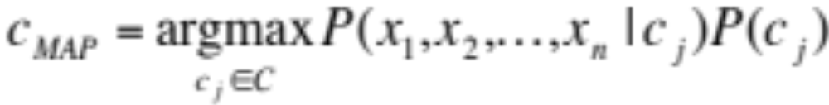
Bayes Classifiers

Slide 15
Bayes Classifiers
P(c_{j})
  Can be estimated from the frequency of classes in the training examples.
P(x₁,x₂,…,x_{n}|c_{j})
  O(|X|^{n}|C|) parameters
  Could only be estimated if a very, very large number of training examples was available.
  Need to make some sort of independence assumptions about the features to make learning tractable.

Slide 16
The Naïve Bayes Classifier
Flu
X₁
X₂
X₃
X₄
X₅
runnynose
sinus
cough
fever
muscle-ache
Conditional Independence Assumption: attributes are independent of each other given the class:
Multi-valued variables: multivariate model
Binary variables: multivariate Bernoulli model

Slide 17
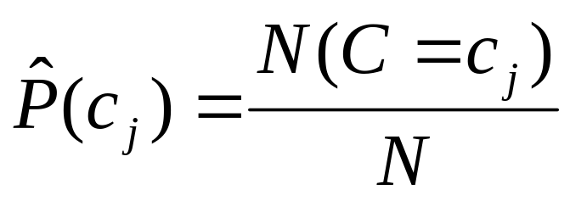
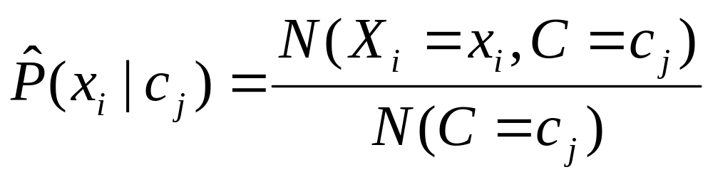
Learning the Model
C
X₁
X₂
X₃
X₄
X₅
X₆
First attempt: maximum likelihood estimates
  simply use the frequencies in the data

Slide 18
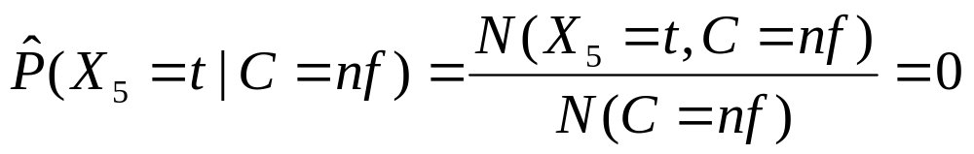
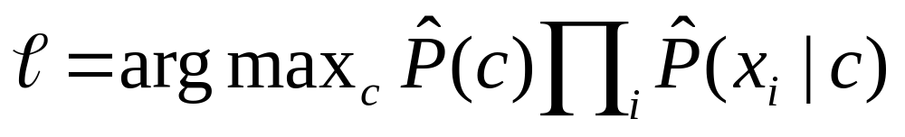
Problem with Max Likelihood
Flu
X₁
X₂
X₃
X₄
X₅
runnynose
sinus
cough
fever
muscle-ache
What if we have seen no training cases where patient had no flu and muscle aches?
Zero probabilities cannot be conditioned away, no matter the other evidence!

Slide 19
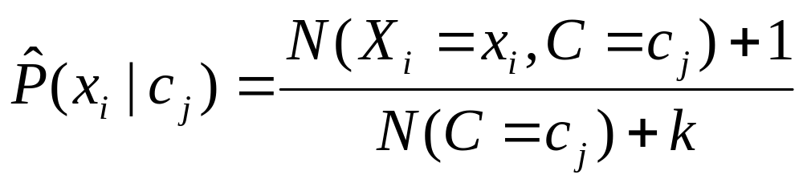
Smoothing to Improve Generalization on Test Data
# of values of X_{i}

Slide 20
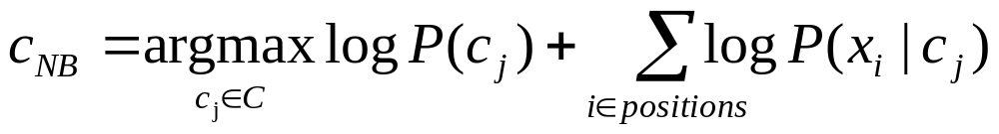
Underflow Prevention
Multiplying lots of probabilities, which are between 0 and 1 by definition, can result in floating-point underflow.
Since log(xy) = log(x) + log(y), it is better to perform all computations by summing logs of probabilities rather than multiplying probabilities.
Class with highest final un-normalized log probability score is still the most probable.

Slide 21
Probability Estimation Example
Ex | Size | Color | Shape | Class
1 | small | red | circle | positive
2 | large | red | circle | positive
3 | small | red | triangle | negative
4 | large | blue | circle | negative
Probability | positive | negative
P(Y)
P(small | Y)
P(medium | Y)
P(large | Y)
P(red | Y)
P(blue | Y)
P(green | Y)
P(square | Y)
P(triangle | Y)
P(circle | Y)

Slide 22
Probability Estimation Example
Ex | Size | Color | Shape | Class
1 | small | red | circle | positive
2 | large | red | circle | positive
3 | small | red | triangle | negative
4 | large | blue | circle | negative
Probability | positive | negative
P(Y) | 0.5 | 0.5
P(small | Y) | 0.5 | 0.5
P(medium | Y) | 0.0 | 0.0
P(large | Y) | 0.5 | 0.5
P(red | Y) | 1.0 | 0.5
P(blue | Y) | 0.0 | 0.5
P(green | Y) | 0.0 | 0.0
P(square | Y) | 0.0 | 0.0
P(triangle | Y) | 0.0 | 0.5
P(circle | Y) | 1.0 | 0.5

Slide 23
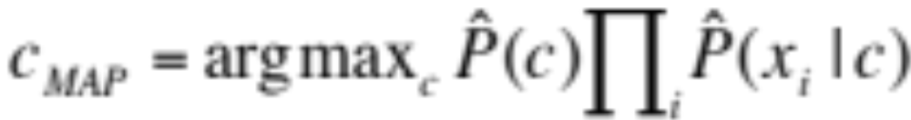
Naïve Bayes Example
Probability | positive | negative
P(Y) | 0.5 | 0.5
P(small | Y) | 0.4 | 0.4
P(medium | Y) | 0.1 | 0.2
P(large | Y) | 0.5 | 0.4
P(red | Y) | 0.9 | 0.3
P(blue | Y) | 0.05 | 0.3
P(green | Y) | 0.05 | 0.4
P(square | Y) | 0.05 | 0.4
P(triangle | Y) | 0.05 | 0.3
P(circle | Y) | 0.9 | 0.3
Test Instance:
<medium ,red, circle>

Slide 24
Naïve Bayes Example
Probability | positive | negative
P(Y) | 0.5 | 0.5
P(medium | Y) | 0.1 | 0.2
P(red | Y) | 0.9 | 0.3
P(circle | Y) | 0.9 | 0.3
Test Instance:
<medium ,red, circle>
P(positive | X) =?
P(negative | X) =?

Slide 25

Naïve Bayes Example
Probability | positive | negative
P(Y) | 0.5 | 0.5
P(medium | Y) | 0.1 | 0.2
P(red | Y) | 0.9 | 0.3
P(circle | Y) | 0.9 | 0.3
Test Instance:
<medium ,red, circle>
P(positive | X) = P(positive)*P(medium | positive)*P(red | positive)*P(circle | positive) / P(X)
0.5 * 0.1 * 0.9 * 0.9
= 0.0405 / P(X)
= 0.0405 / 0.0495 = 0.8181
P(negative | X) = P(negative)*P(medium | negative)*P(red | negative)*P(circle | negative) / P(X)
0.5 * 0.2 * 0.3 * 0.3
= 0.009 / P(X)
= 0.009 / 0.0495 = 0.1818
P(positive | X) + P(negative | X) = 0.0405 / P(X) + 0.009 / P(X) = 1
P(X) = (0.0405 + 0.009) = 0.0495

Slide 26
Naïve Bayes for Text Classification
Two models:
Multivariate Bernoulli Model
Multinomial Model

Slide 27
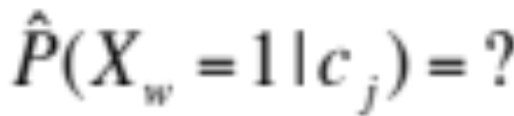
Model 1: Multivariate Bernoulli
One feature X_{w} for each word in dictionary
X_{w} = true (1) in document d if w appears in d
Naive Bayes assumption:
  Given the document’s topic, appearance of one word in the document tells us nothing about chances that another word appears
Parameter estimation

Slide 28
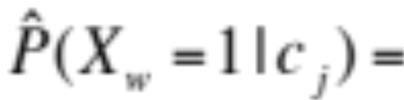
Model 1: Multivariate Bernoulli
One feature X_{w} for each word in dictionary
X_{w} = true (1) in document d if w appears in d
Naive Bayes assumption:
  Given the document’s topic, appearance of one word in the document tells us nothing about chances that another word appears
Parameter estimation
fraction of documents of topic c_{j}
in which word w appears

Slide 29
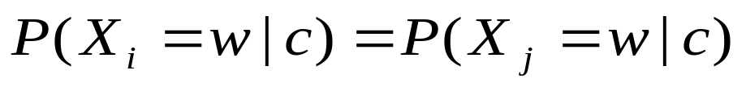
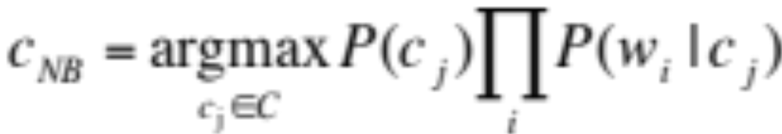
Model 2: Multinomial Naive Bayes Classifiers
  Assumptions:
    Given the document’s topic, appearance of one word in the document tells us nothing about chances that another word appears
    Classification is independent of the positions of the words (word appearance does not depend on position)
for all positions i,j, word w, and class c
  Use same parameters for each position
  Result is bag of words model (over tokens)

Slide 30
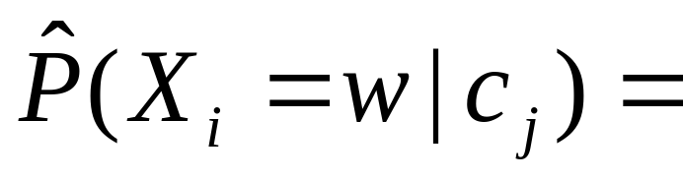
Multinomial Naïve Bayes for Text
Smooth probability using Laplace (or add-1) smoothing.
fraction of times in which
word w appears
across all documents of topic c_{j}

Slide 31
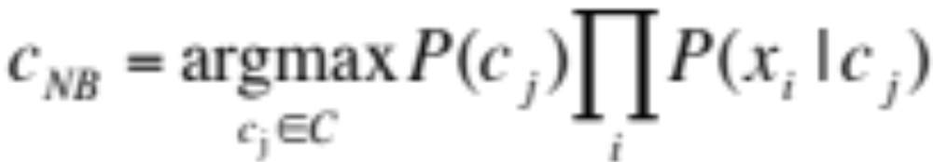
Naïve Bayes Classification

Slide 32

Parameter Estimation
Multivariate Bernoulli model:
Multinomial model:
  Can create a mega-document for topic j by concatenating all documents in this topic
  Use frequency of w in mega-document
fraction of documents of topic c_{j}
in which word w appears
fraction of times in which
word w appears
across all documents of topic c_{j}

Slide 33
Classification
Multinomial vs Multivariate Bernoulli?
Multinomial model is almost always more effective in text applications!

Slide 34

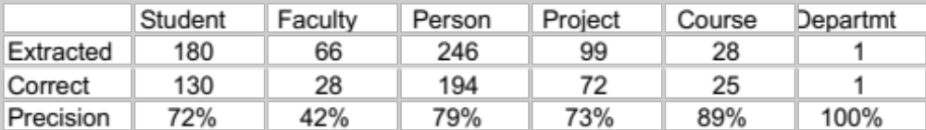
WebKB Experiment
Classify webpages from CS departments into:
  student, faculty, course, project, etc.
Train on ~5,000 hand-labeled web pages
  Cornell, Washington, U.Texas, Wisconsin
Crawl and classify a new site (CMU)
Results:

Slide 35
Naive Bayes is Not So Naive
Naïve Bayes: First and Second place in KDD-CUP 97 competition, among 16 (then) state of the art algorithms
  Goal: Financial services industry direct mail response prediction model: Predict if the recipient of mail will actually respond to the advertisement – 750,000 records.
A good baseline for text classification!
Very Fast: Learning with one pass of counting over the data; testing linear in the number of attributes, and document collection size
Low Storage requirements

