Slide 1
Loan Lending Case Study
Anish Alapattu
Pranjal Rathore

Slide 2
Background
Company - You work for a consumer finance company which specializes in lending various types of loans to urban customers.
Context – When the company receives a loan application, the company has to make a decision for loan approval based on the applicant’s profile
Problem Statement – Identify patterns which indicate if a person is likely to default, which may be used for taking actions such as denying the loan, reducing the amount of loan, lending (to risky applicants) at a higher interest rate, etc.

Slide 3
Analysis Approach
Data Cleaning
Univariate Analysis
Segmented Univariate Analysis
Bivariate Analysis
Summarize Results

Slide 4

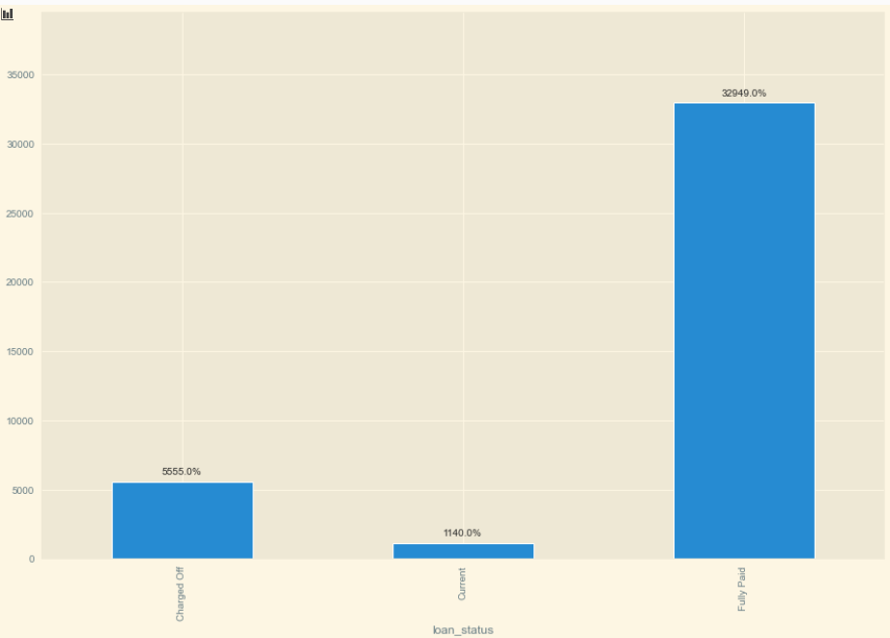



Loan Status Analysis
5555 out of 39644 loans are charged off i.e ~14%

Slide 5
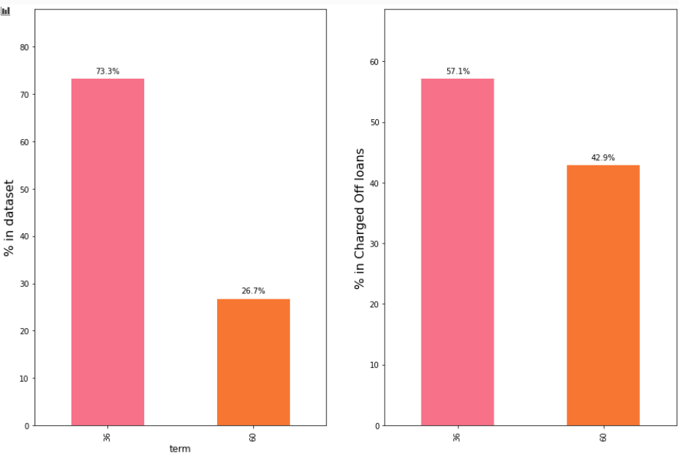
Term Analysis
73% of the loans are for 36 months
42% of the loans that are for 60 months are charged off

Slide 6

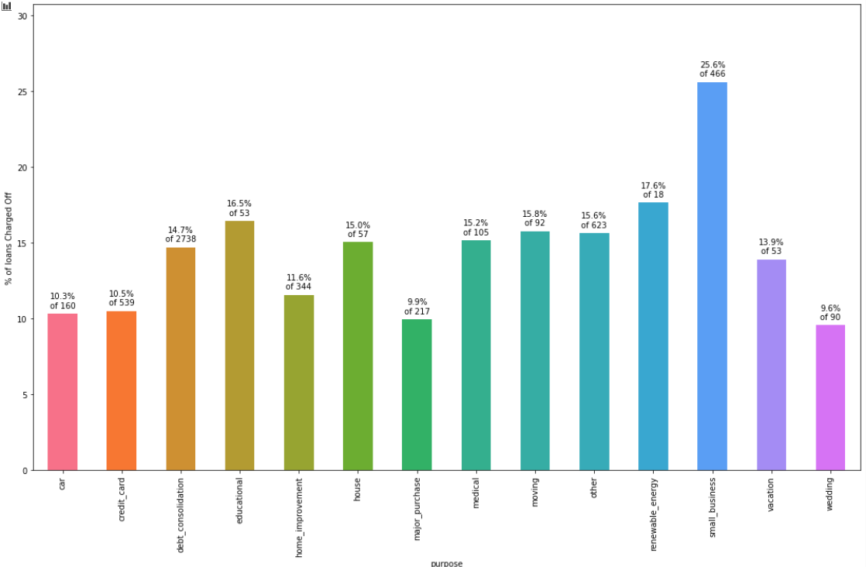
Term Analysis
46% of loans are for 'debt_consolidation'
49.3% of the total charged off loans are constituted of 'debt_consolidation'
However, if we drill down a bit more, we see that percentage wise, loans for 'small_businesses' are most charged off

Slide 7
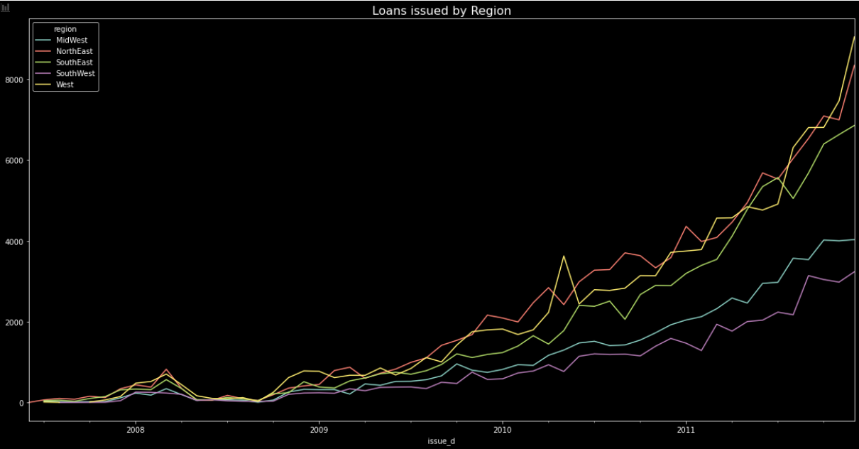
Region Analysis
SouthEast , West and NorthEast regions had the highest amount of loans issued.
West and SouthWest had a rapid increase in debt-to-income starting after 2010.

Slide 8
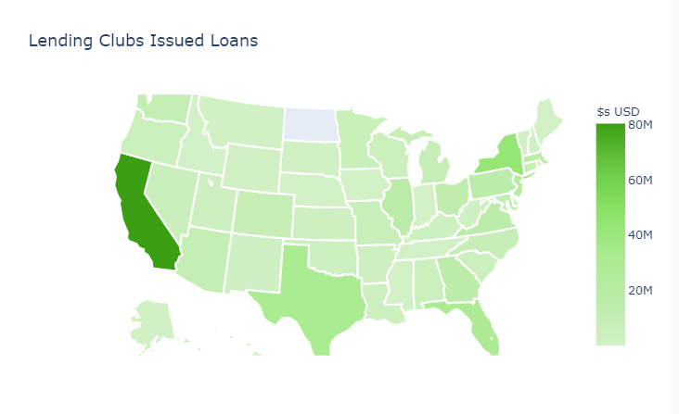
State Analysis
California, Texas and new York are the states in which highest amount of loans were issued

Slide 9
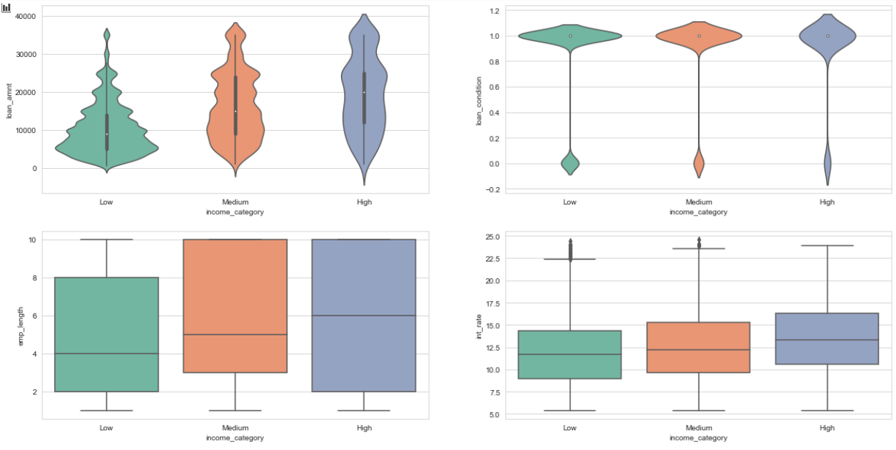
Income Analysis
Borrowers that made part of the high income category took higher loan amounts than people from low and medium income categories. Of course, people with higher annual incomes are more likely to pay loans with a higher amount. (First row to the left of the subplots)
Loans that were borrowed by the Low income category had a slightly higher change of becoming a bad loan. (First row to the right of the subplots)
Borrowers with High and Medium annual incomes had a longer employment length than people with lower incomes.(Second row to the left of the subplots)
Borrowers with a lower income had on average lower interest rates while people with a higher annual income had higher interest rates on their loans. (Second row to the right of the subplots)

Slide 10
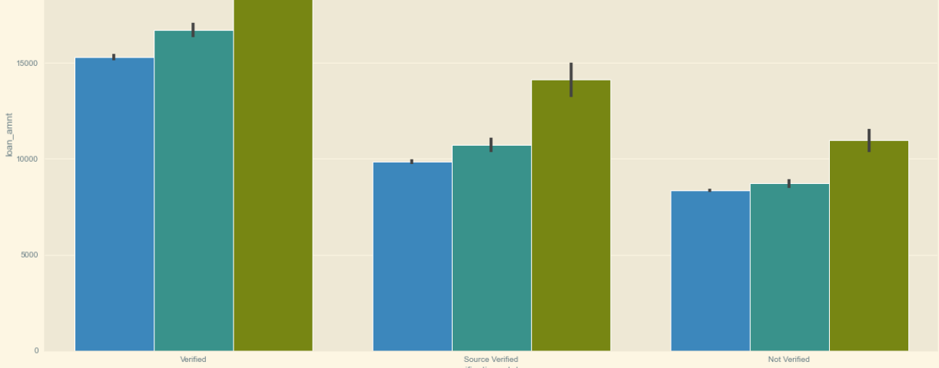
Verification Analysis
Higher loan amounts are verified often

