Slide 1

Notes:
Introduce the project in one breath: we built a system that predicts heart disease from 13 routine clinical measurements, compared three ways of choosing which measurements matter, and wrapped it in a web app. Fill in the team, guide and college names before presenting.

Slide 2
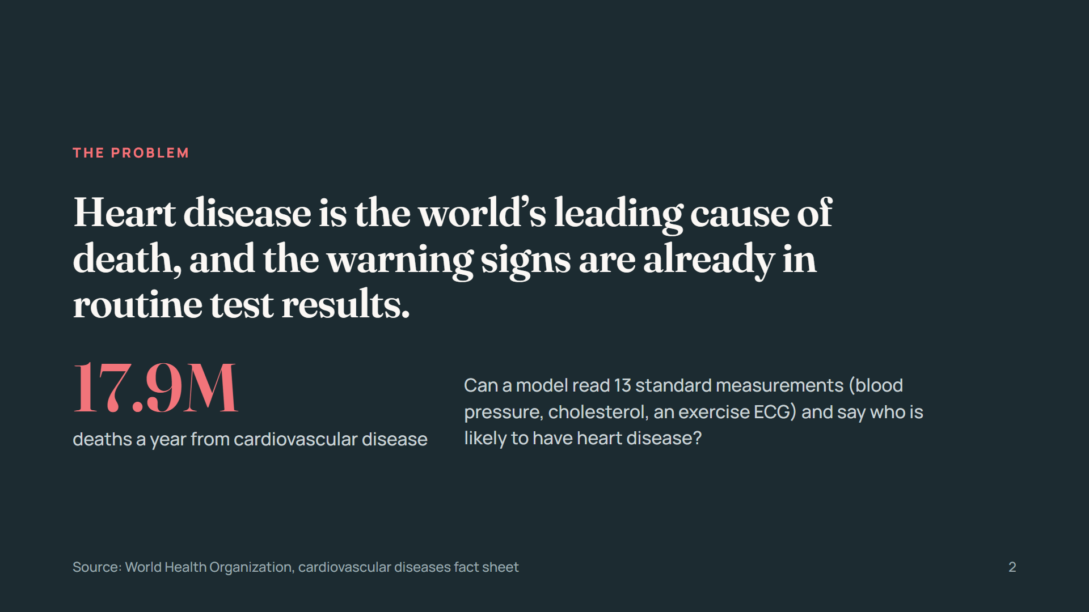
Notes:
Set up the motivation. The 17.9 million figure is the WHO estimate for cardiovascular deaths per year; check the latest fact sheet before presenting. The question the project answers: can routine measurements predict heart disease well enough to be useful as a first screen?

Slide 3
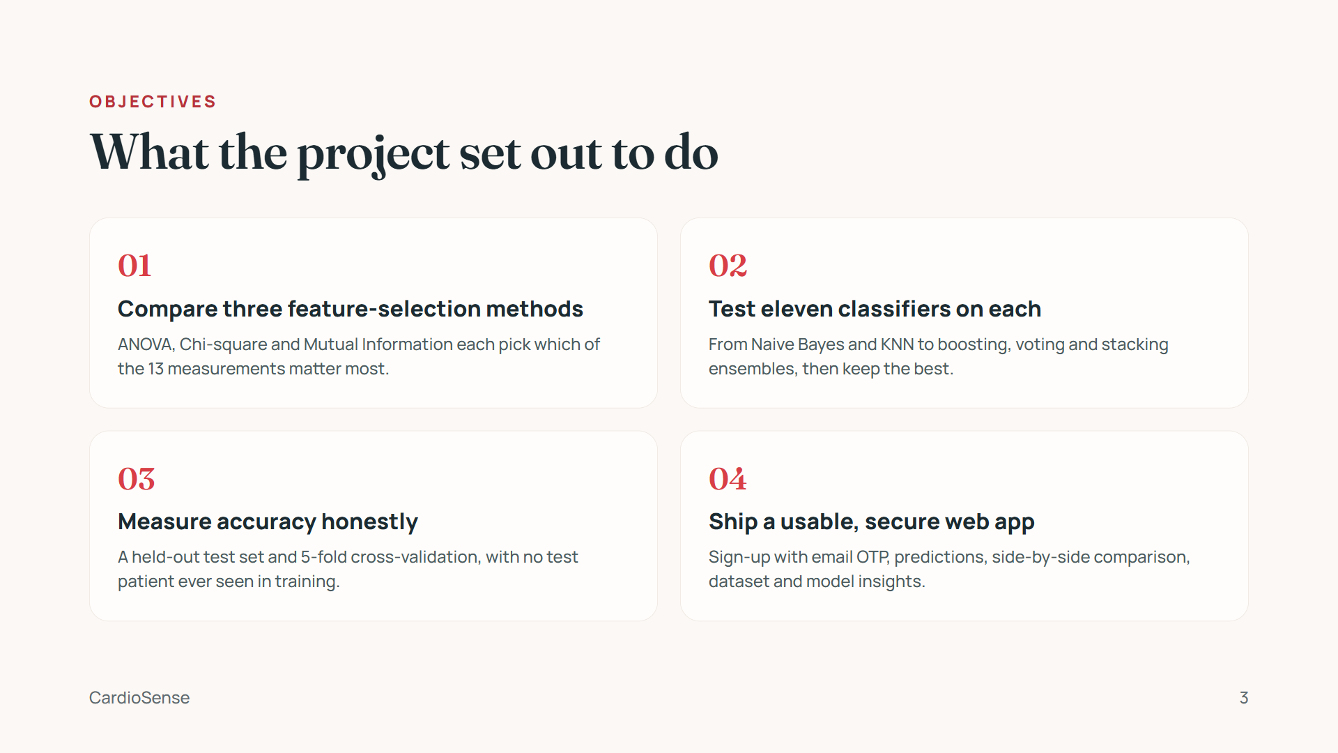
Notes:
Four goals, in order of the talk: the comparison of feature-selection methods is the core research question; the classifiers and honest evaluation are how we answer it; the web app makes it usable and demonstrable.

Slide 4
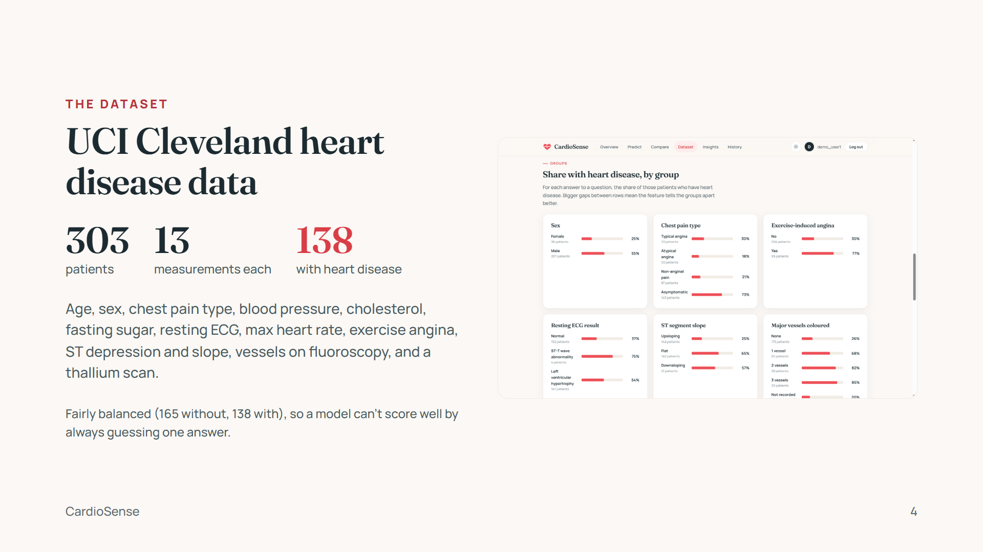
Notes:
The Cleveland subset is the one ML researchers use: the other three UCI hospitals are missing most of the vessel and thallium values every model relies on, so we did not merge them. The screenshot is the app's Dataset page: for each answer to a question, the share of patients who have heart disease. For example, 77% of patients with exercise angina have it, versus 30% without.

Slide 5
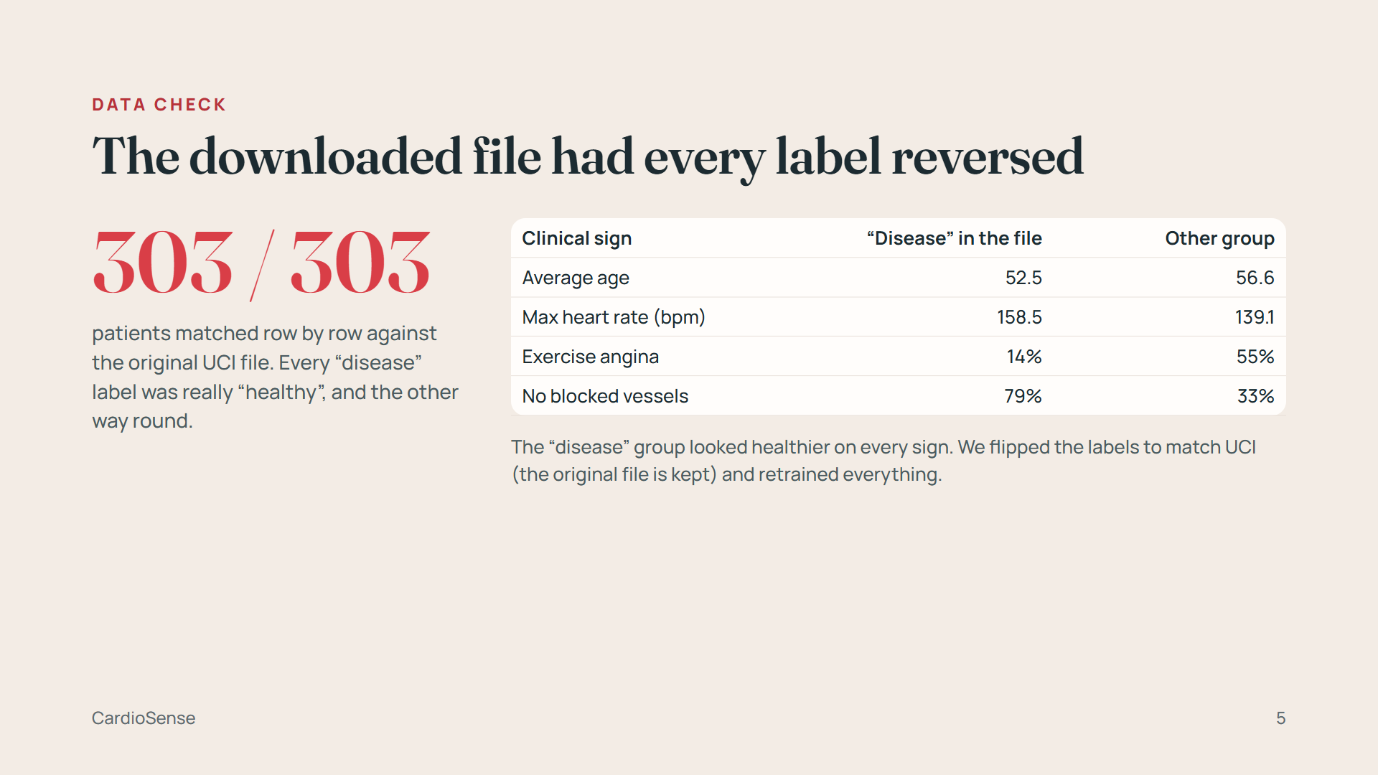
Notes:
This is a strong point to make in a viva. A reversed label does not lower accuracy at all: a model is just as good at predicting the opposite answer. The only way to catch it is a sense check against medicine and the original source. We matched every row of the Kaggle copy against UCI's processed.cleveland.data on eight columns stored the same way in both, and all 303 labels were the opposite. The original file is kept as heart_kaggle_original.csv.

Slide 6
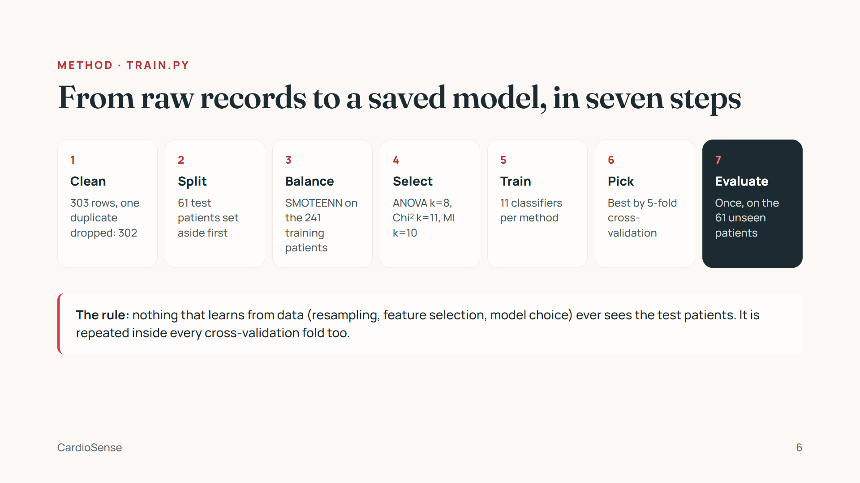
Notes:
Walk left to right. The order matters: splitting first is what keeps the final score honest. Steps 3 to 6 are done inside an imbalanced-learn Pipeline during cross-validation, so each fold resamples and selects features on its own training part only. train.py is reproducible: a fixed random seed, about 3 minutes to run, and it writes the three model files plus metrics.json, which the app reads for its forms and charts.

Slide 7
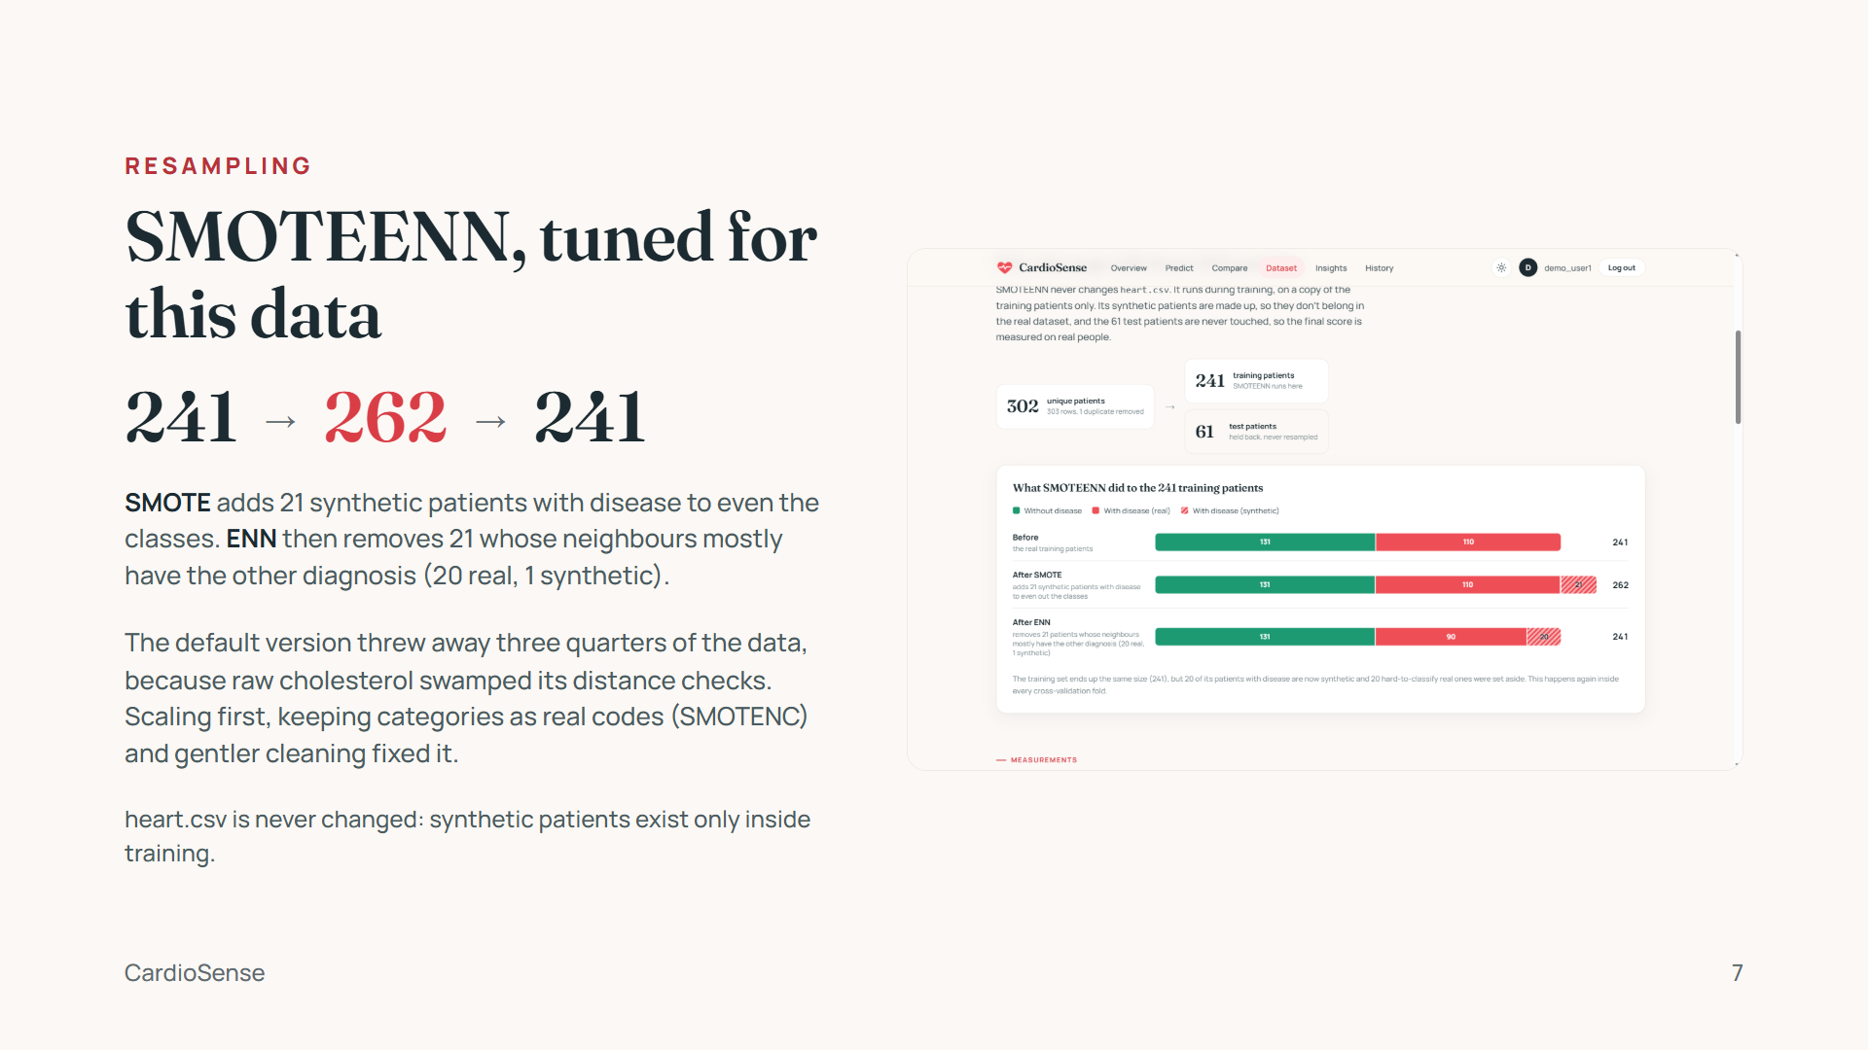
Notes:
Explain both halves of SMOTEENN: SMOTE oversamples the smaller class with synthetic points between real neighbours; ENN (edited nearest neighbours) removes points whose neighbours mostly disagree. The finding worth stating: the default settings were harmful here, because unscaled cholesterol dominated the distance calculation. On this fairly balanced data the tuned version gives a small, consistent gain: cross-validated accuracy 85.5 vs 84.6% (ANOVA), 84.6 vs 83.0% (Chi-square), 83.8 vs 82.2% (MI) compared with no resampling.

Slide 8
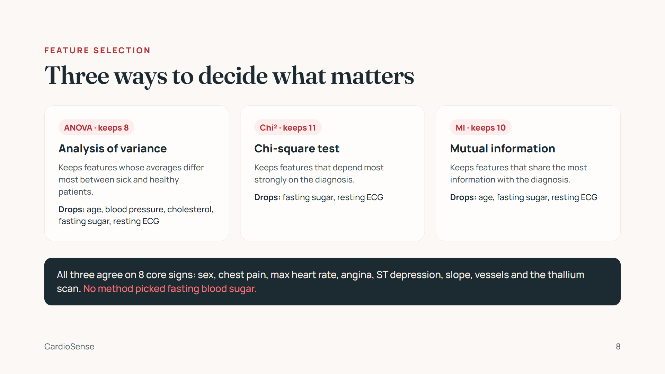
Notes:
Each method is a SelectKBest scorer in scikit-learn: f_classif for ANOVA, chi2, and mutual_info_classif. The k values match the original notebooks. Selection is fitted on the resampled training data only. The Insights page shows each method's score for all 13 features, with the selected ones highlighted.

Slide 9
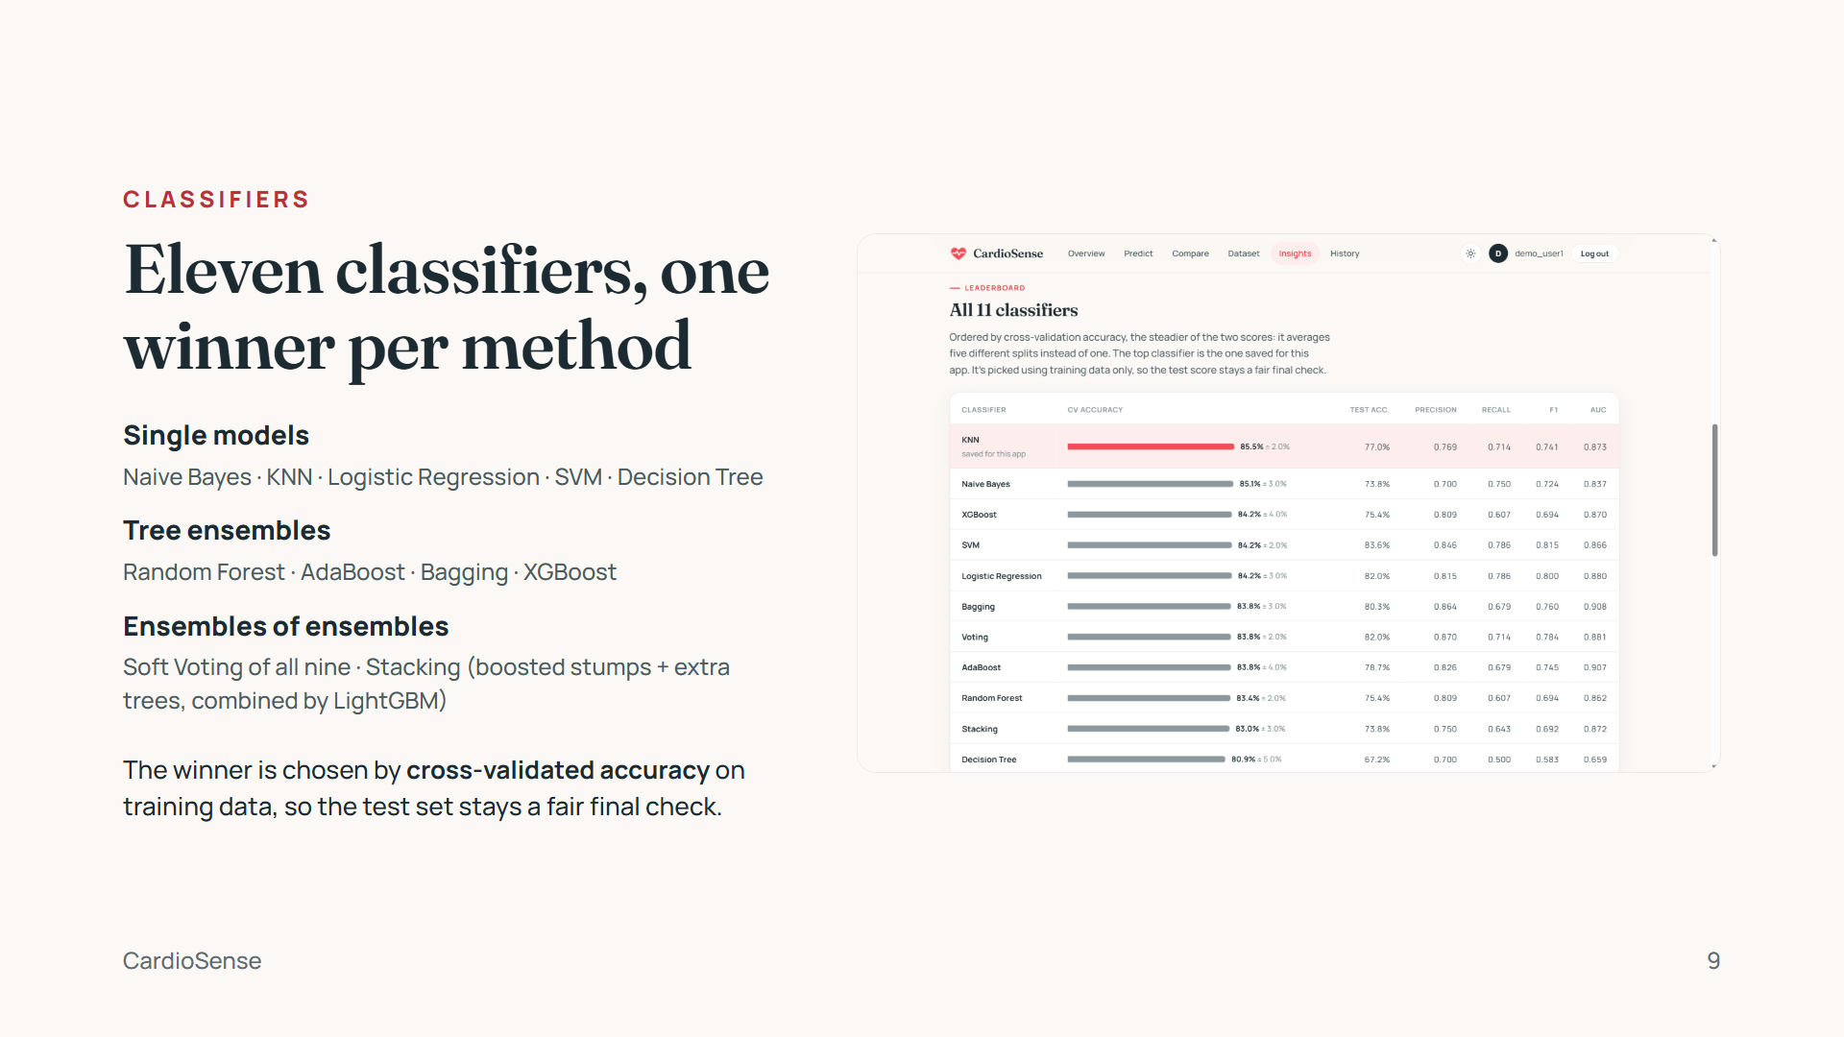
Notes:
The original notebooks always saved the Stacking model. Picking the best per method by cross-validation raised accuracy by 2 to 5 points and recall from 54–64% to 71–79%. SVM, KNN and logistic regression get a StandardScaler in front, because they compare raw distances and unscaled cholesterol would dominate. The screenshot is the leaderboard on the Insights page.

Slide 10
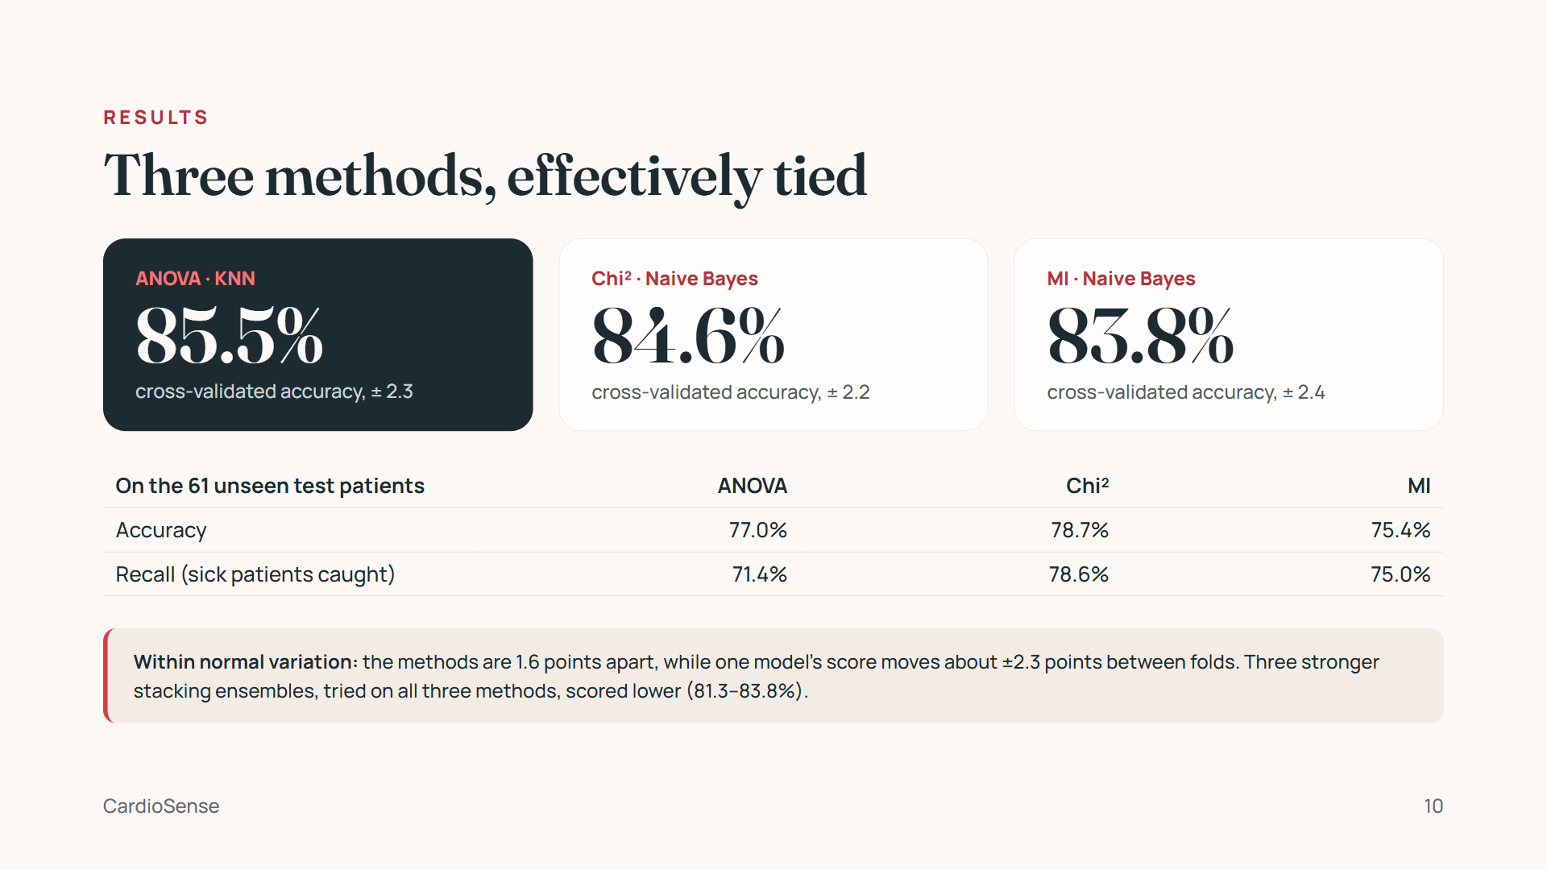
Notes:
Lead with the honest headline: the three methods are effectively tied. ANOVA with KNN has the highest cross-validated accuracy, but the 1.6-point gap to MI is smaller than the ±2.3-point spread one model shows between folds, so no method is clearly better. We also tried three stronger stacking ensembles (different base models combined by logistic regression) on all three methods with the same cross-validation; none beat the saved models (they scored 81.3 to 83.8%), so they were not kept. On the test set: Chi-square catches the most sick patients (recall 78.6%); ROC AUC is 0.87 (ANOVA), 0.85 (Chi-square) and 0.84 (MI). Anyone can reproduce the stacking check with python experiment_stacking.py.

Slide 11
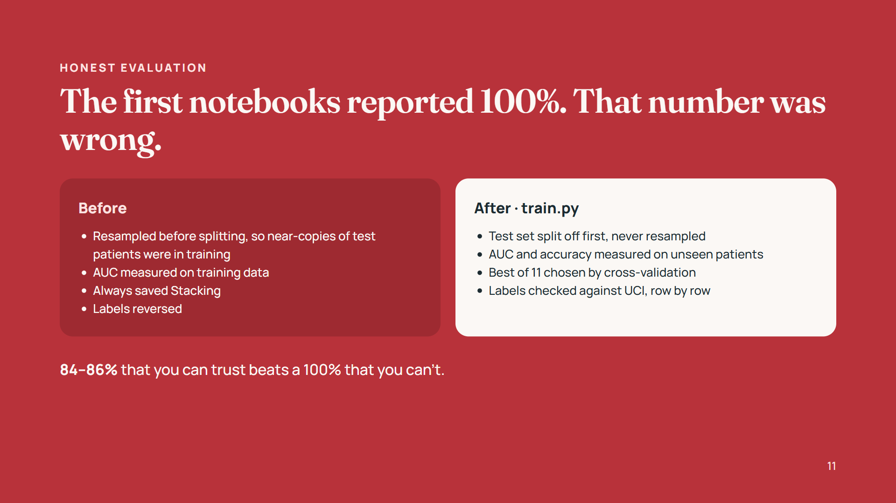
Notes:
This is the slide examiners remember. Data leakage is the most common mistake in student ML projects: if synthetic copies of a test patient are made before splitting, the model has effectively seen the answer. The original stacking model scored 100% on 66 validation rows for exactly that reason. Our numbers are lower and real.

Slide 12
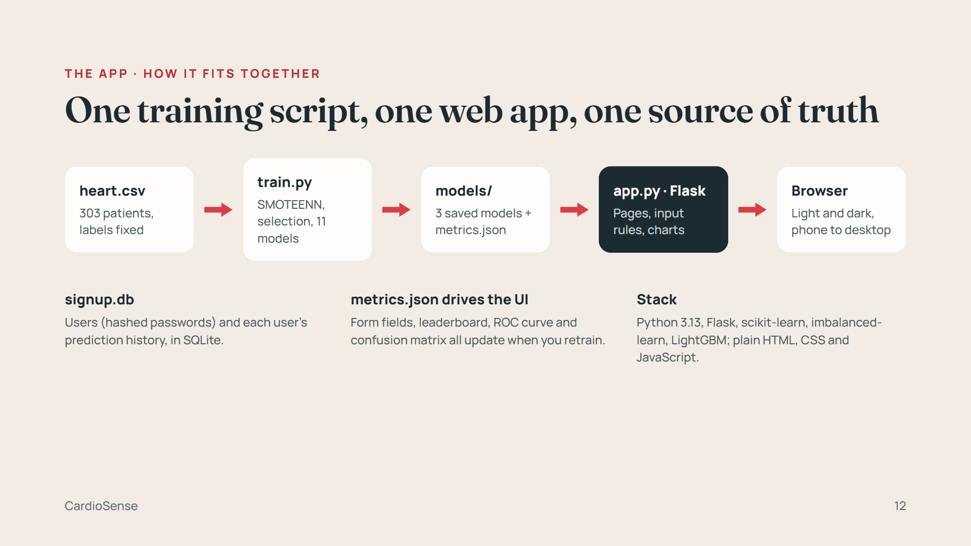
Notes:
The design choice to explain: nothing in the app is typed in by hand. train.py writes metrics.json, and the app reads the feature list for each form, the leaderboard and every chart from it. Retrain, restart, and the whole app reflects the new models. The front end uses no framework: Jinja templates, one stylesheet and one small JavaScript file.

Slide 13
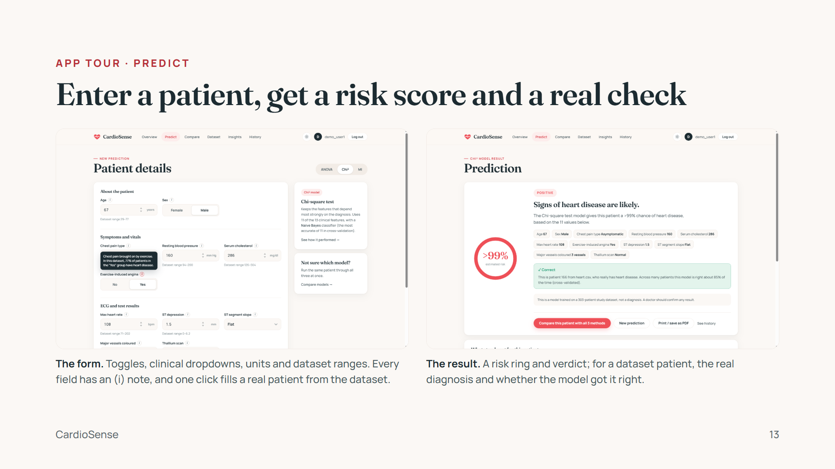
Notes:
Demo here if you can: pick ANOVA, click "Random patient from dataset", Predict. Point out the (i) notes; each combines a plain explanation with a fact computed from the data, for example 77% of patients with exercise angina have heart disease. Below the result, "What stands out for this patient" marks each value as pointing toward or away from heart disease, compared with the dataset.

Slide 14
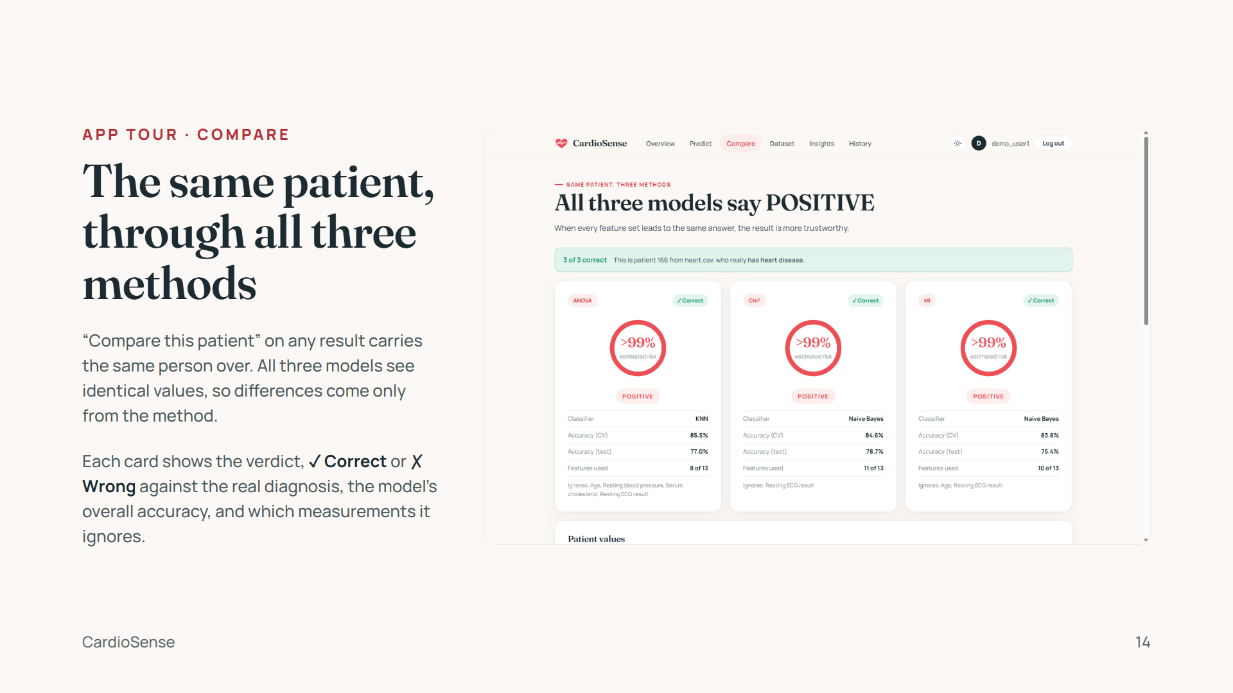
Notes:
Demo: from the result you just showed, click "Compare this patient with all 3 methods". Patient 166 (a 67-year-old man with exercise angina and 3 blocked vessels) is POSITIVE in all three, 3 of 3 correct. Make the point on the slide: one patient shows how methods differ; the accuracy line on each card is the fair comparison. A typed-in patient opens the Compare form pre-filled, asking only for the extra values the other methods need.

Slide 15
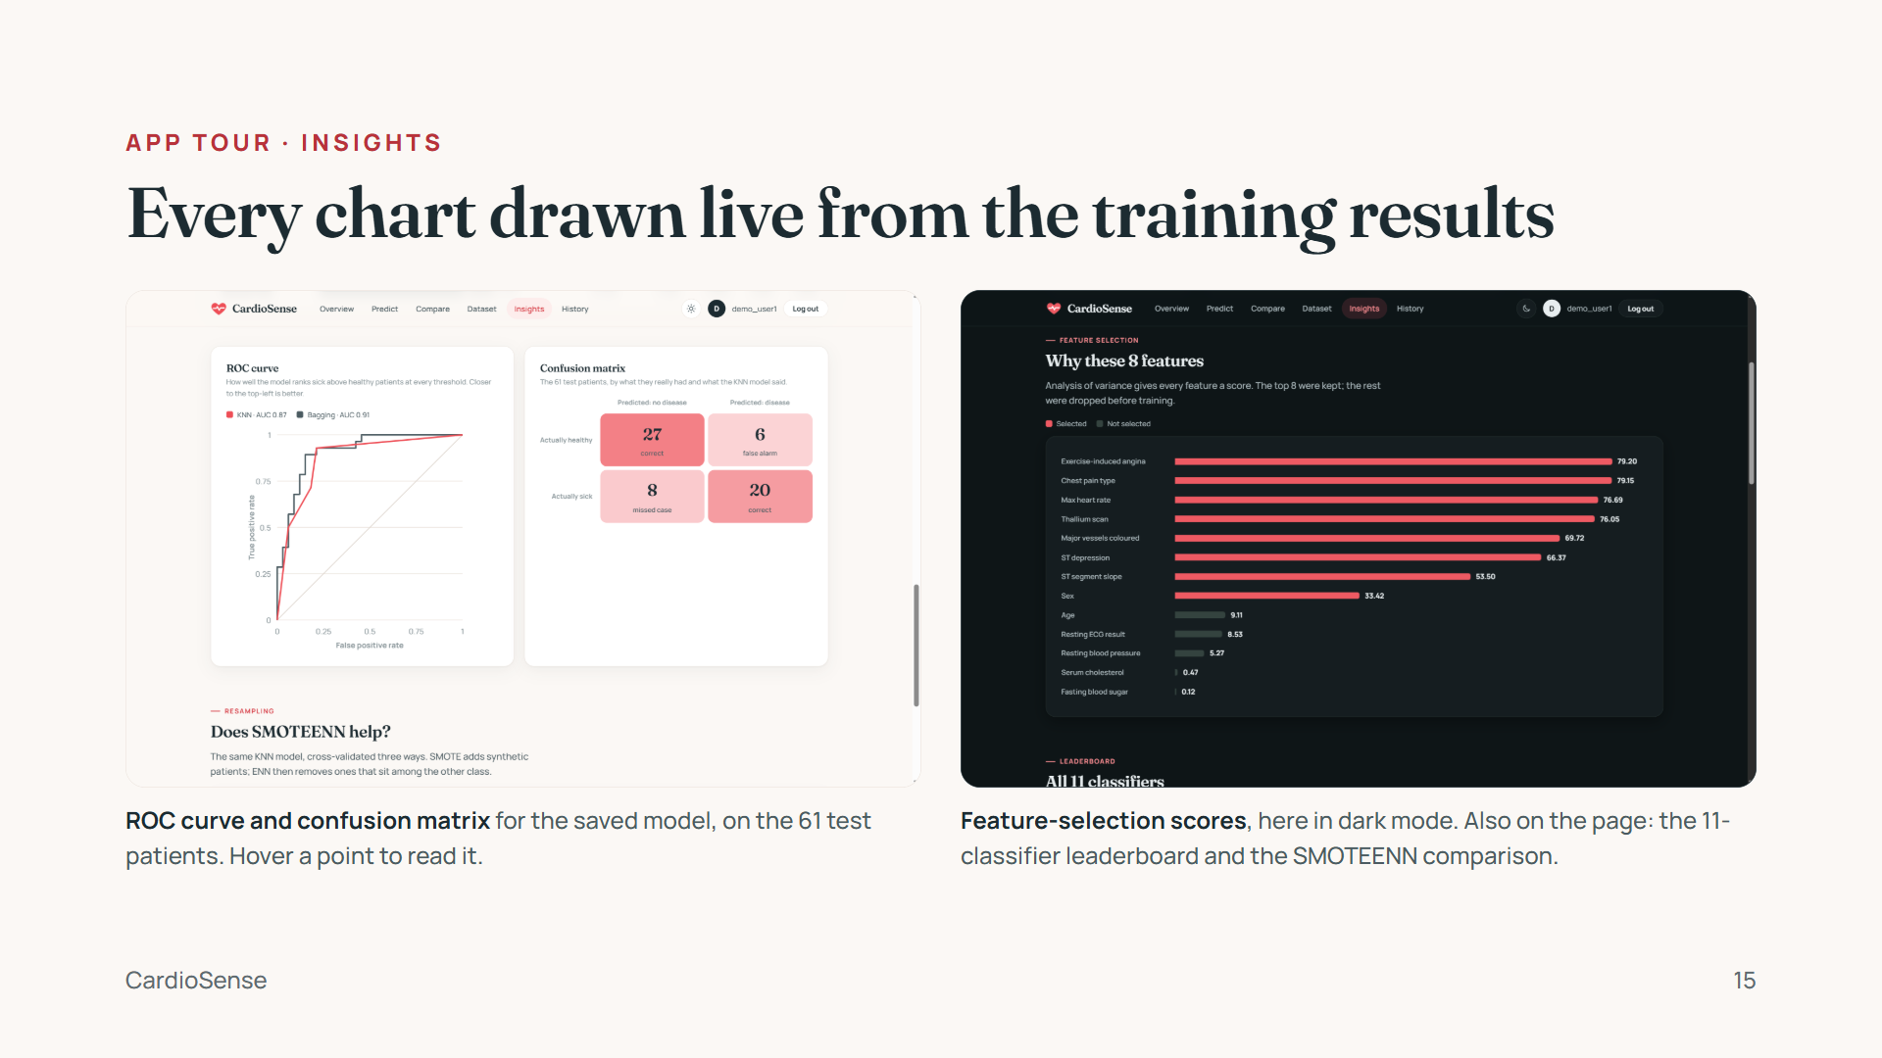
Notes:
The old version showed the notebook's static PNG charts. Now every chart is built from metrics.json in HTML and SVG, animates in gently, has hover tooltips, and works in both themes. The colour pair (coral and teal) was checked for colour-blind readers, and every chart also labels its values in text.

Slide 16
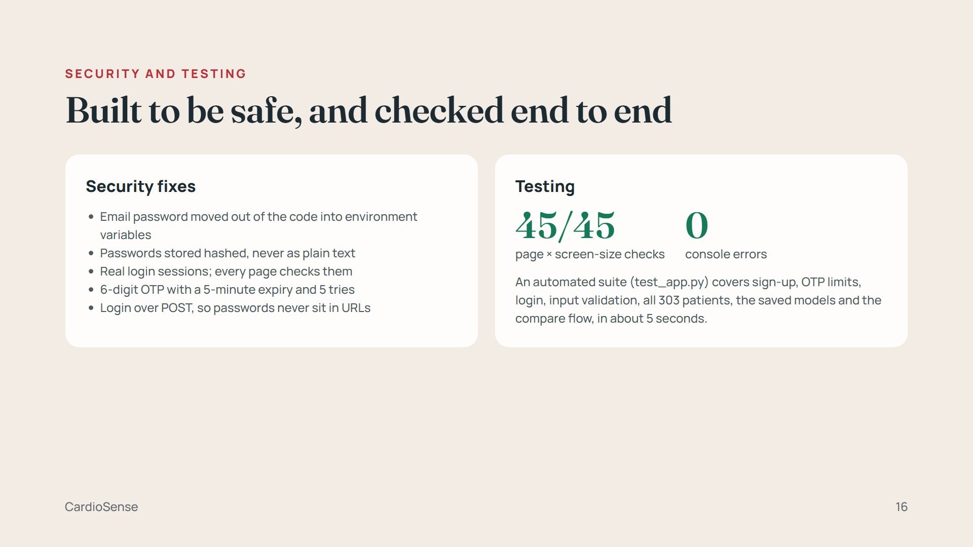
Notes:
The project started with a security review: a Gmail password was hard-coded, user passwords were stored as plain text, login didn't actually protect any page, and signup state was shared between all visitors. All of these are fixed. The 45 browser checks load 15 pages at desktop, tablet and phone widths and confirm nothing overflows or breaks. The full details are in SECURITY_REPORT.md and TEST_REPORT.md.

Slide 17
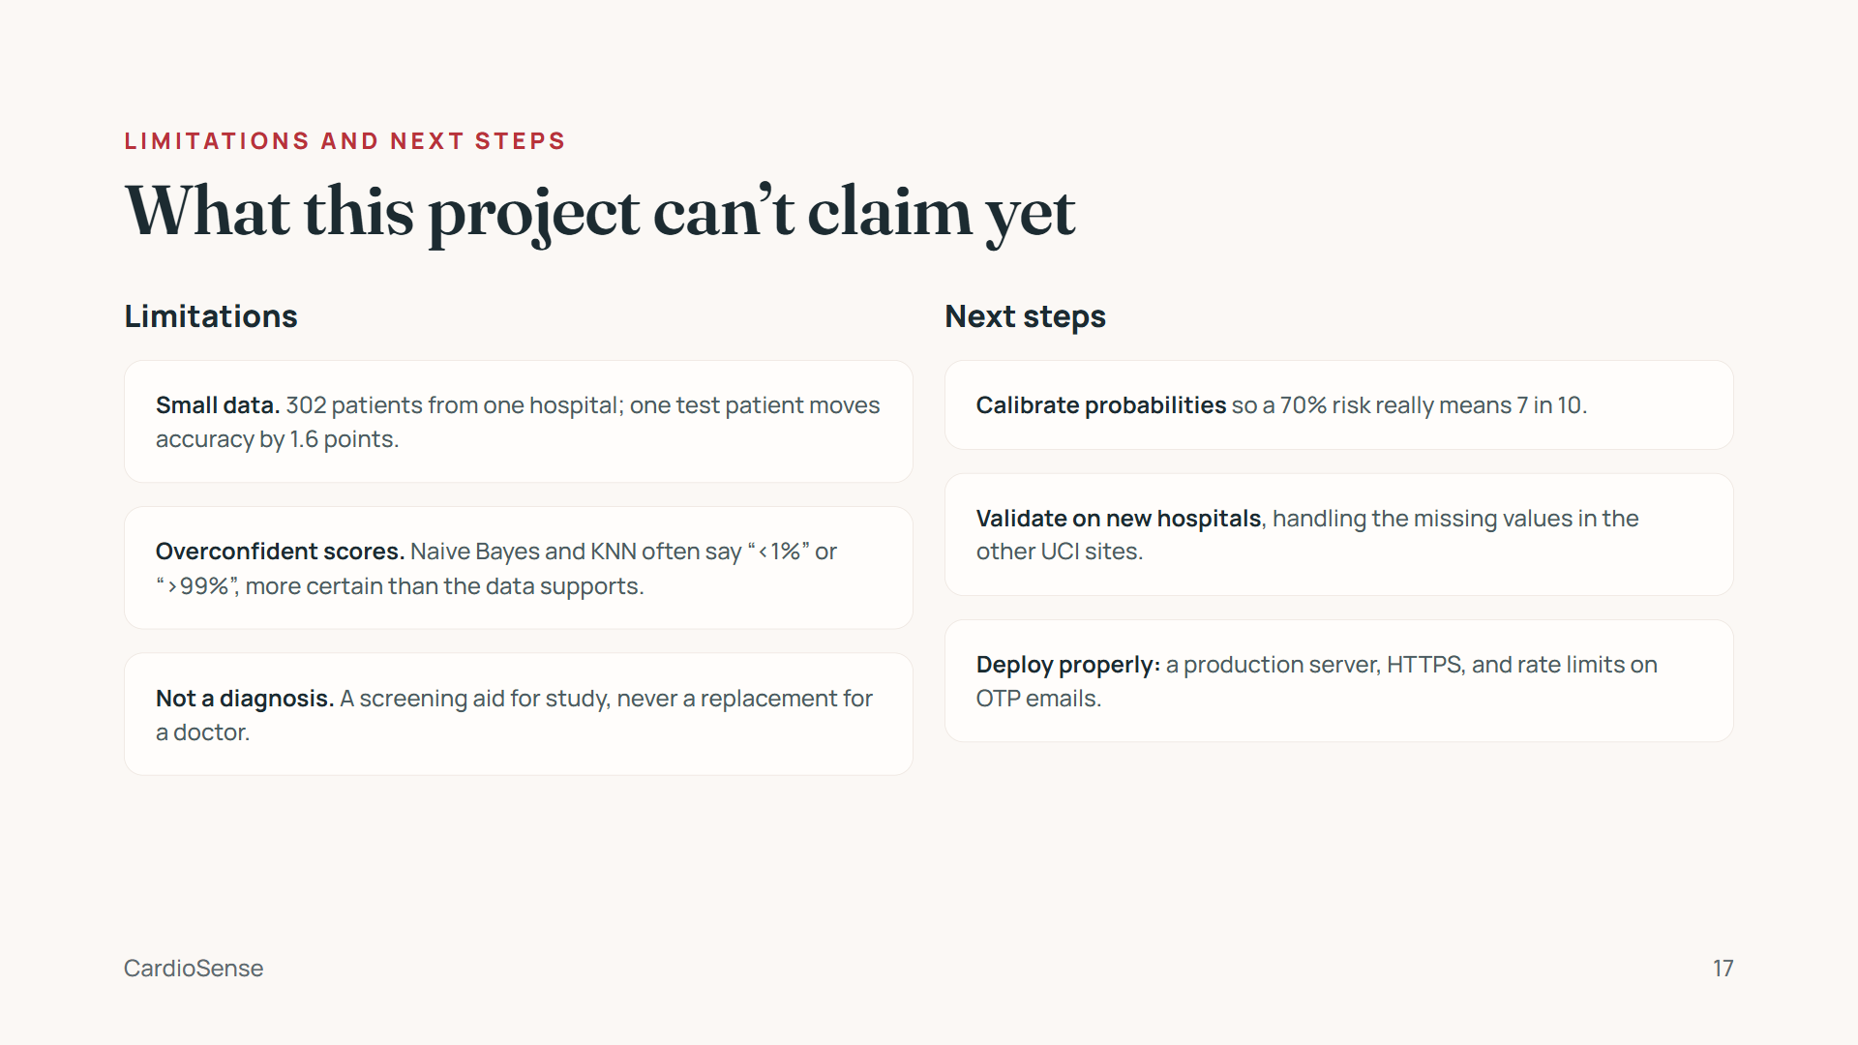
Notes:
Being upfront about limits reads as strength in a review. The most important next step is calibration: wrapping the saved model in scikit-learn's CalibratedClassifierCV so its percentages are meaningful. External validation would show whether 84–86% holds outside Cleveland.

Slide 18
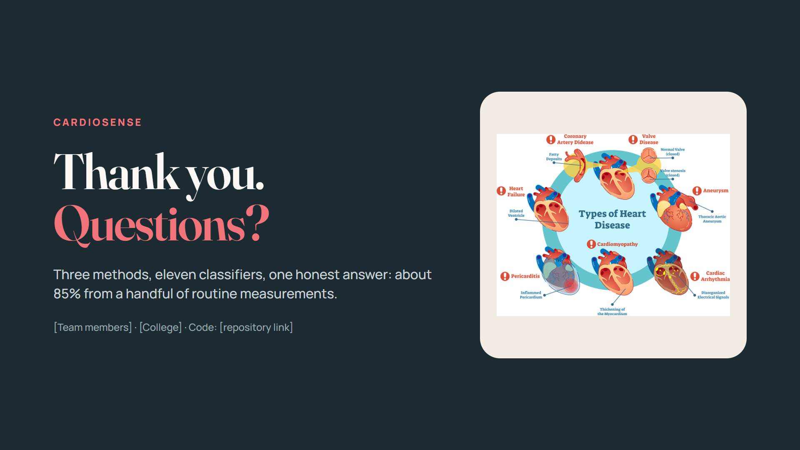
Notes:
Close by restating the one-line result and invite questions. Likely questions: why SMOTEENN if the data is balanced (small gain, and we measured it); why KNN beats ensembles here (small data, 8 well-chosen features); how you know the labels are right now (row-by-row match against UCI).

