Slide 1

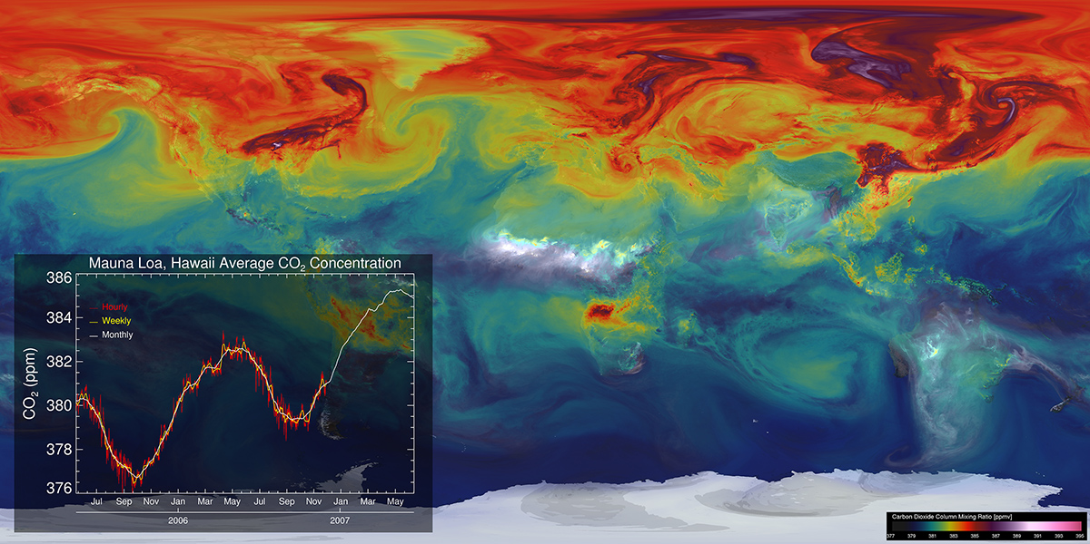
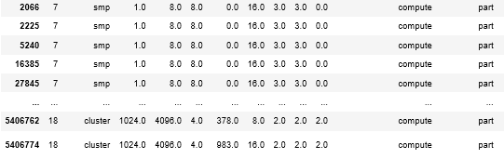
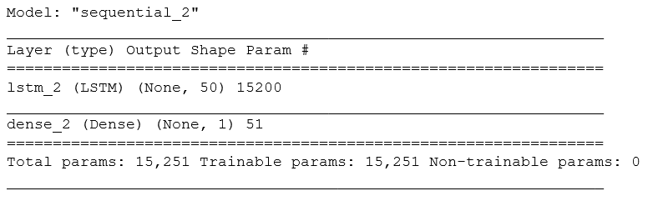
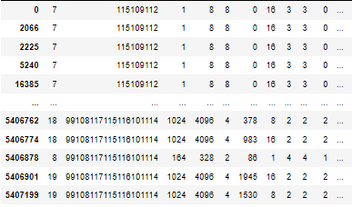
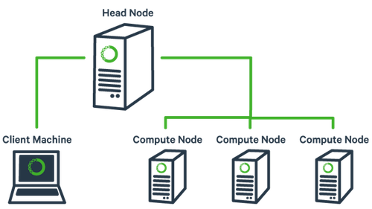
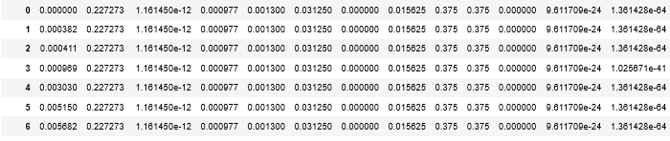
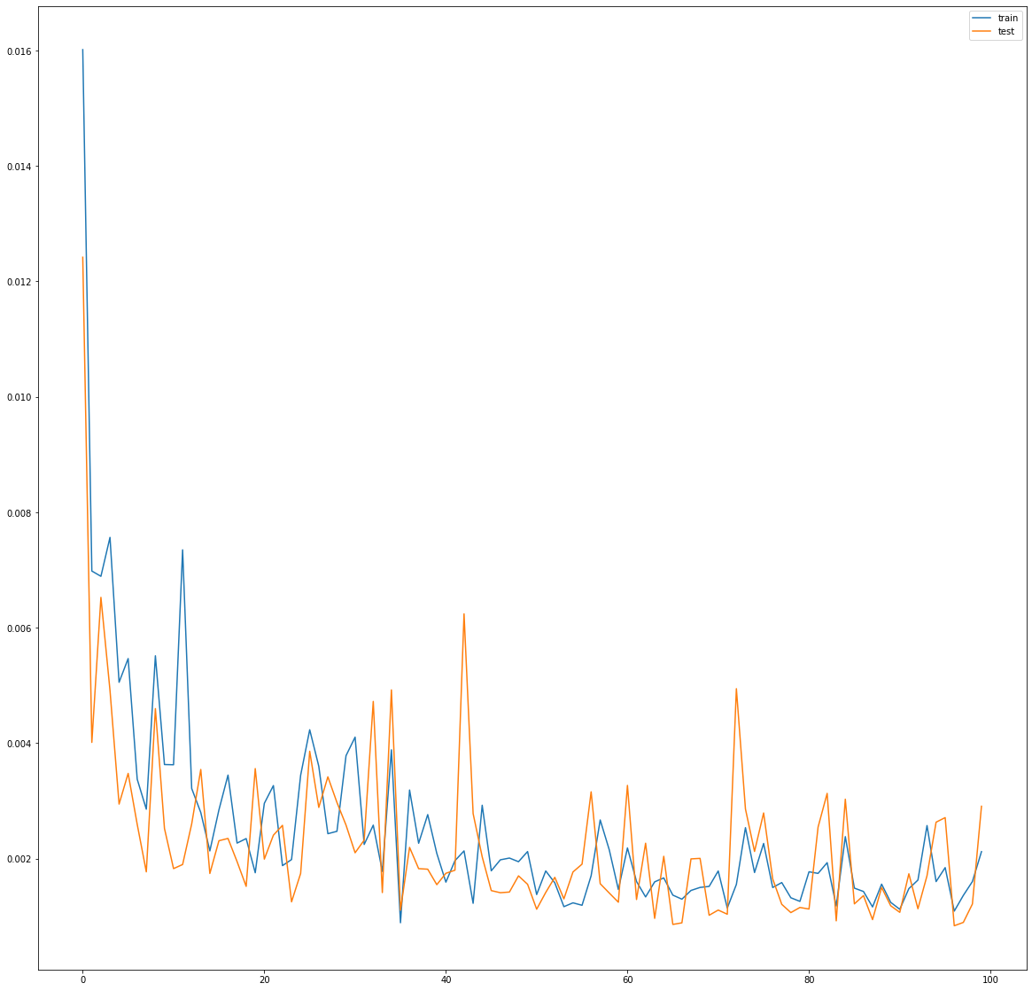
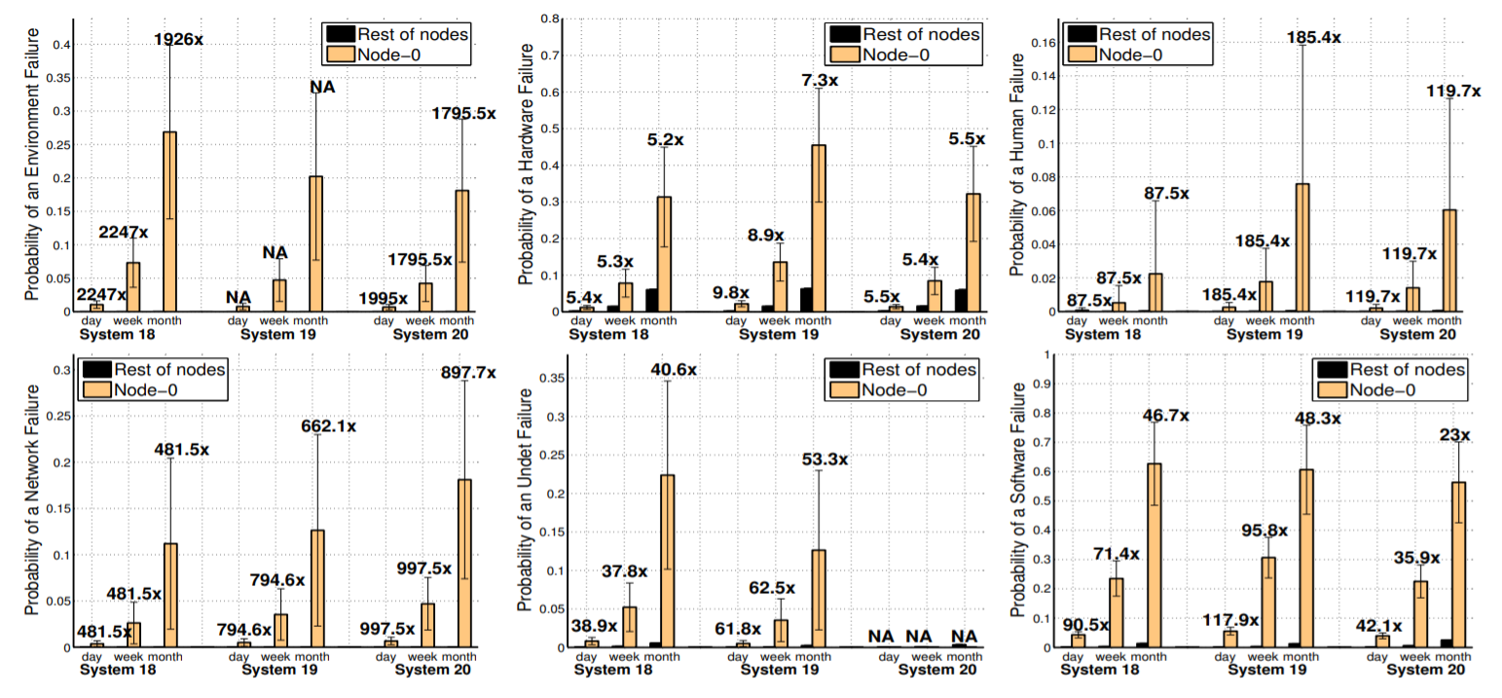

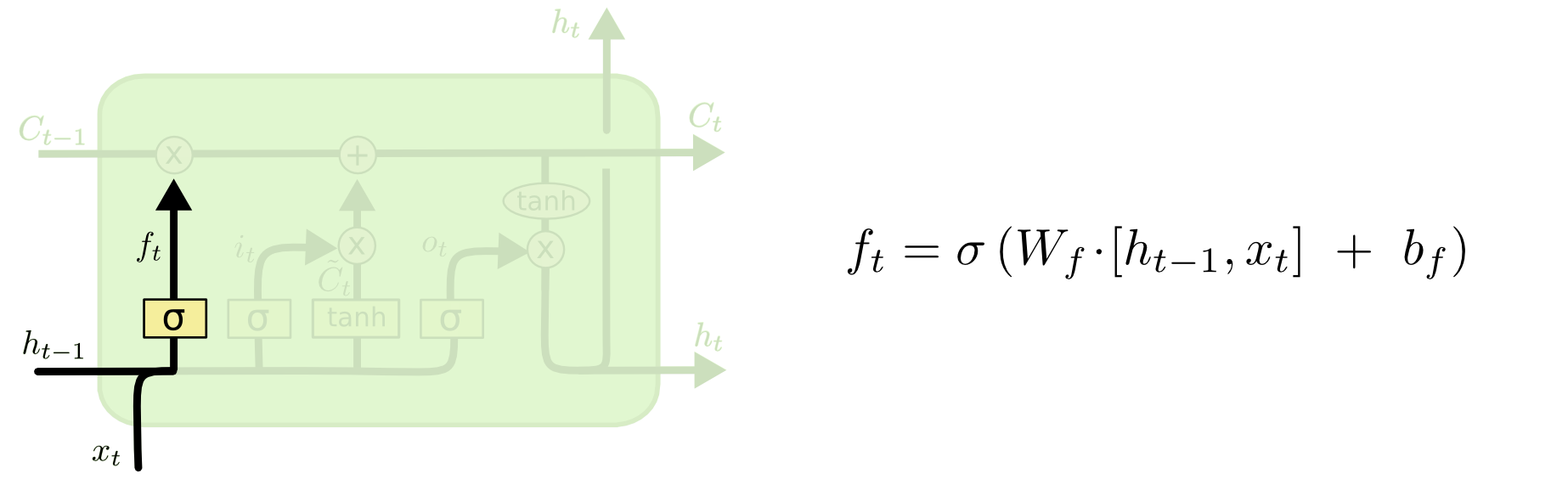
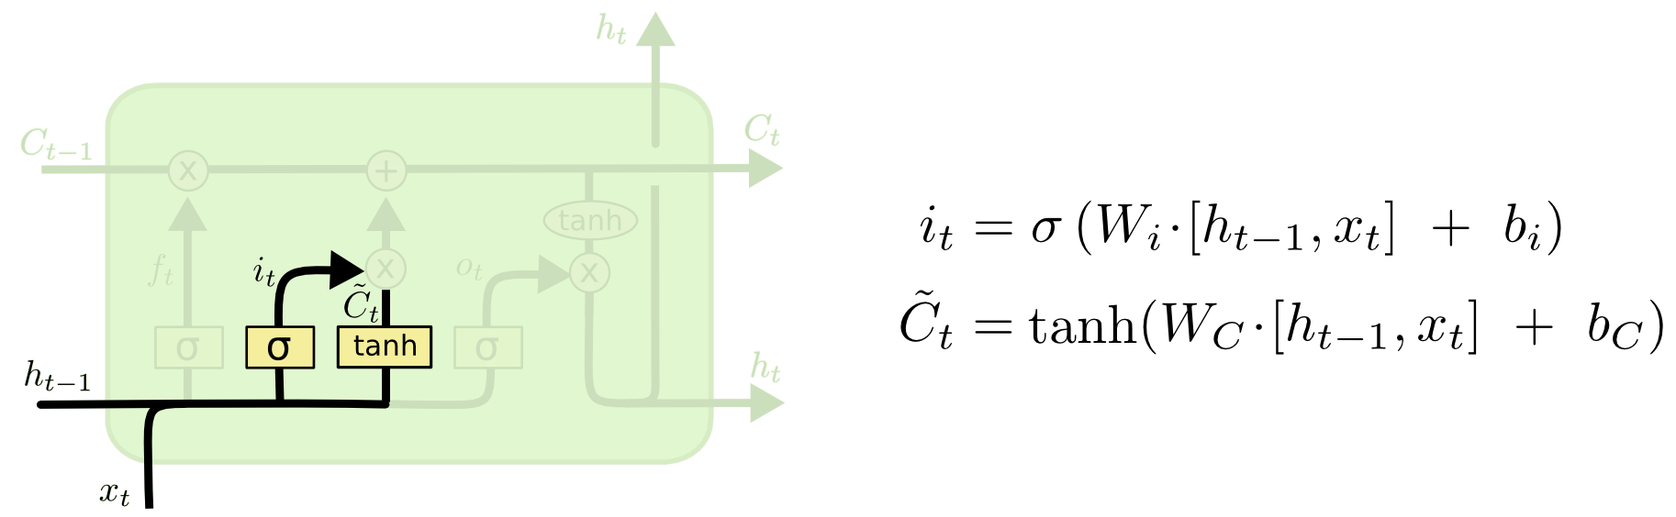
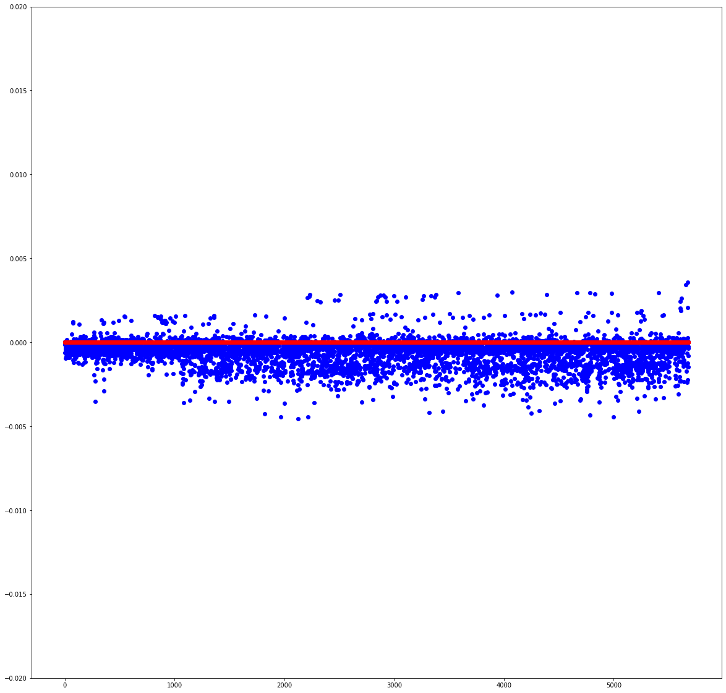
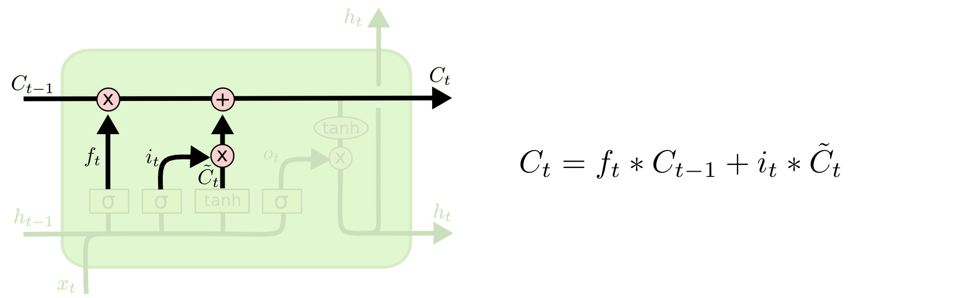
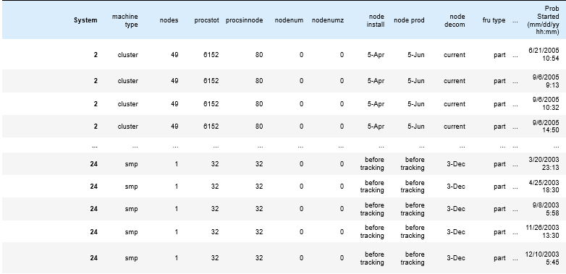
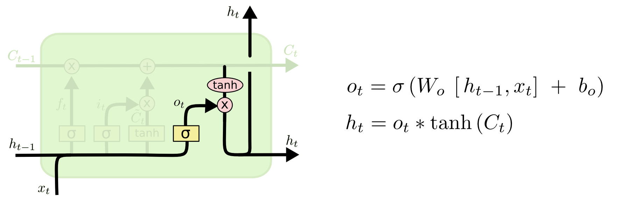
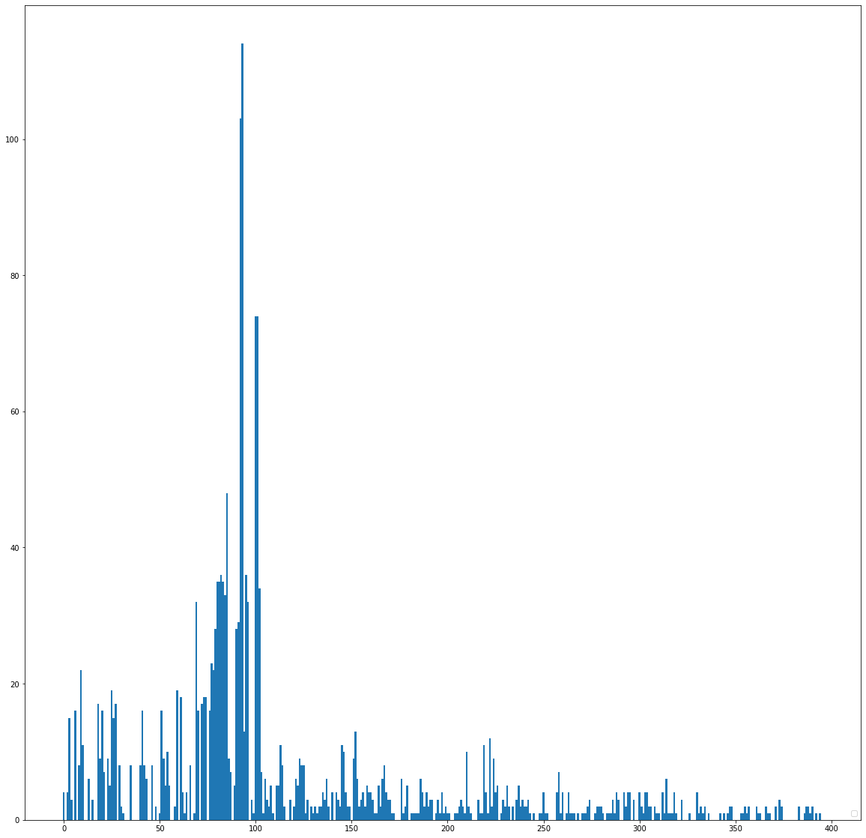
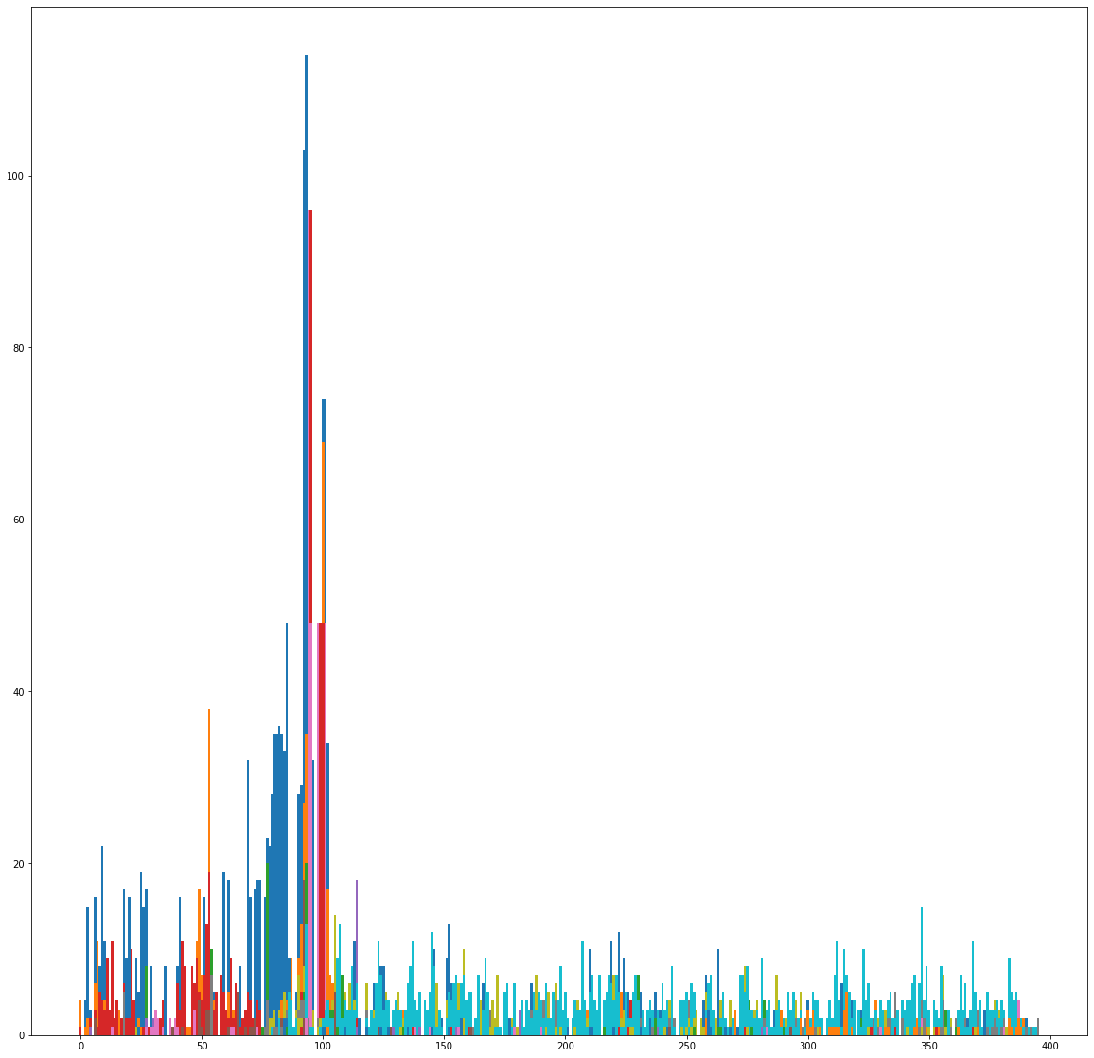
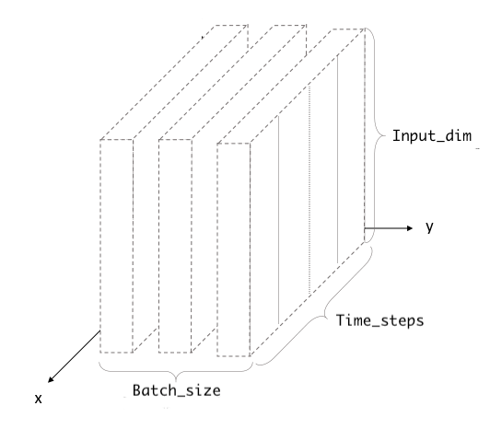
Predicting Errors in HPC Clusters Using Long Short-Term Memory Networks
Authors: Anish Rao, Suyash Tandon ME 390, Instructor: Eric Johnsen
https://ieeexplore.ieee.org/stamp/stamp.jsp?tp=&arnumber=6575356
The Problem.
Data Preparation.
Features selection to reduce complexities in model training.
Removed redundant features: node production date, CPU decommissioning dates
Transformed keywords into numbers with characters’ ASCII values
Data normalization to scale all features values between 0 & 1 with Scikitlearn’s MinMax Scaler
Results.
LSTM model has 2 layers with 50 nodes
1 dense layer with Linear activation
The model predictions are evaluated against actual targets with a metric score of mean squared error (MSE)
MSE / RMSE penalizes outliers, and enforce better model performance
Ideal RMSE of ~.0133 with a batch size of 50
Inclusion of the excluded features led to drastic overfitting in tests.
The LSTM can predict the next error, but still cannot give an accurate time and location
It is hypothesized that through backpropagation of one error, we can find the ties to others
Supercomputers facilitate complex physics calculations
Large compute power enables faster computations
Leadership High Performance Computer (HPC) facilities feature heterogeneous architecture
Sheer number of components are prone to errors
Figure 7: Deleted Keywords (LANL)
Figure 1: Weather Simulation (NASA@SC14)
Figure 16: Model type and layer
Figure 8: Words to ASCII (LANL)
Figure 9: Scaled Data (LANL)
Predicted (Blue) vs. Actual (Red)
Figure 2: Basic Node structure (Programmer)
The LSTM Network.
A variant of Recurrent Neural Network
Repeating module has 4 interacting layers
The cell state is updated
Forget gate layer, decides what information is to be removed
Input gate layer, decides what information to update
The cell state update is the result of the pointwise operators, and pushes data through
Output gate layer, decides what to output and filters the information
Value
Figure 8: LSTM diagram (Olah)
Figure 3: Probabilities of failure vs. Node (El-Sayed)
Epoch
Research Objective:
To predict the next error within a Supercomputing cluster and its location
Figure 11: Forget Layer (Olah)
Training (Blue) vs. Testing (Red)
Figure 12: tanh and input gate (Olah)
Loss
Our Approach.
Figure 13: Cell-state update (Olah)
Some HPC clusters have
node-by-node error logs
Logs are combinations of keywords, timestamps, trace descriptors, etc.
Statistical data analysis on unstructured data becomes difficult
Neural Networks can extract feature from complex datasets
A variant of neural networks, the Long Short-Term Memory (LSTM) can learn long term dependencies
Batch
Figure 14 Output Layer (Olah)
Acknowledgements
I want to thank Suyash Tandon for his great help in writing the code, and helping in all parts of the research, and thanks to Dr. Eric Johnsen for being a great instructor, and allowing me to work on this project. I want to thank the ME department for allowing this proposal, as well as the RISE coordinators for setting this up.
References:
El-Sayed, Nosayba, and Bianca Schroeder. “Reading between the Lines of Failure Logs: Understanding How HPC Systems Fail.”
2013 43rd Annual IEEE/IFIP International Conference on Dependable Systems and Networks (DSN), 2013, doi:10.1109/dsn.2013.6575356.
“NASA@SC14: Global Mesoscale Modeling with GEOS-5: Global Weather at
Local Scales.” NASA, NASA, www.nas.nasa.gov/SC14/demos/demo35.html.
Olah, Christopher. “Understanding LSTM Networks.” Understanding LSTM Networks -- Colah's Blog, colah.github.io/posts/2015-
08-Understanding-LSTMs/.
Programmer, Scientific. “Introduction to High Performance Computing (HPC) Clusters.” Medium, Learn Scientific Programming,
19 Nov. 2017, learn.scientificprogramming.io/introduction-to-high-performance-computing-hpc-clusters-9189e9daba5a.
Verma, Shiva. “Understanding Input and Output Shapes in LSTM: Keras.” Medium, Medium, 2 Dec. 2019,
medium.com/@shivajbd/understanding-input-and-output-shape-in-lstm-keras-c501ee95c65e.
Figure 4: The unedited data (LANL)
Preparing the Data for LSTM.
LSTMs require 3-D input data:
[batch size, timestamp, and features]
For on-the-fly prediction capabilities: timestamp is 1, and batch size is 50
Feature size is the number of values in each row – normalized dataset has 22 features
Figure 5: Node 49’s Compute Errors
Figure 6: All of Node 49’s Errors
Figure 15: LSTM input visualization (Verma)

