Slide 1
PROJECT SEMINAR ON
TITLE | “Enhancing Stock Market Prediction Using Multimodal Deep Learning Model"
GUIDE NAME | Ms. Soume Sanyal
STUDENT NAMES | Anish Grandhe Karthik Peetela
Roll Numbers | 1602-22-737-133 1602-22-737-317

Slide 2
Abstract
A novel multimodal Temporal Convolutional Network is introduced for NIFTY 50 trading, integrating price data, technical indicators, news, social media sentiment, ESG factors, and macroeconomic variables. It combines sentiment analysis with numerical features and uses an adaptive fusion gate to weight each data source. The dual-output design predicts prices and evaluates risk through measures like volatility and Sharpe ratio, while its continuous learning setup adapts to changing market conditions to deliver risk-adjusted position sizing and actionable trading signals

Slide 3
Motivation
Traditional single-modality models rely mainly on price data and fail to capture market sentiment, external factors, and complex market dynamics.
There is a strong need for real-time sentiment analysis from news and social media, especially since retail investors lack the advanced tools used by institutions.
Rapidly changing market conditions demand adaptive models with strong risk management, an area often neglected in typical algorithmic trading systems.
There is a gap between academic research and real-world trading systems, and TCNs offer practical advantages over LSTMs through parallel processing, longer memory, and avoiding vanishing gradients

Slide 4
Problem Statement
The system must integrate highly heterogeneous data — numerical market data, technical indicators, news, and social media text — while capturing long-range temporal patterns and extracting reliable sentiment.
It requires an adaptive fusion mechanism that dynamically weights different data sources based on changing market conditions, along with robust uncertainty estimation for volatile markets.
The model must support continuous learning without catastrophic forgetting and convert predictions into clear, risk-adjusted, executable trading signals.

Slide 5
Literature Survey
Paper | Year | Contribution | Methodology | Limitations | Relevance
Dual Output TCN with Attention (Biswas et al.) | 2025 | TCN + attention for price & risk prediction | Dilated causal CNN + attention + dual outputs | Single modality, 2 stocks only | Dual-output architecture, TCN design
GA-TCN-LSTM (Shi et al.) | 2025 | Genetic algorithm optimizes TCN-LSTM | GA optimization + hybrid architecture | Complex hyperparameter tuning | Hybrid model design, optimization
Stock2Vec (Wang et al.) | 2020 | Entity embedding for stocks + TCN | Stock embeddings + TCN + technical indicators | No sentiment analysis | Stock embedding concept, TCN for finance
Knowledge-Driven TCN (Deng et al.) | 2019 | Event extraction + KG for prediction | Event tuples + KG embeddings + TCN | Limited to news events only | Event-based prediction, explainability

Slide 6
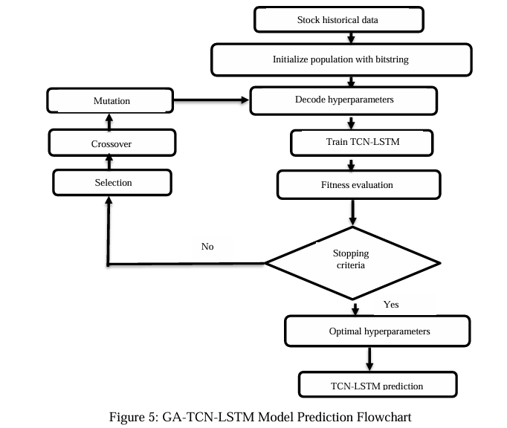
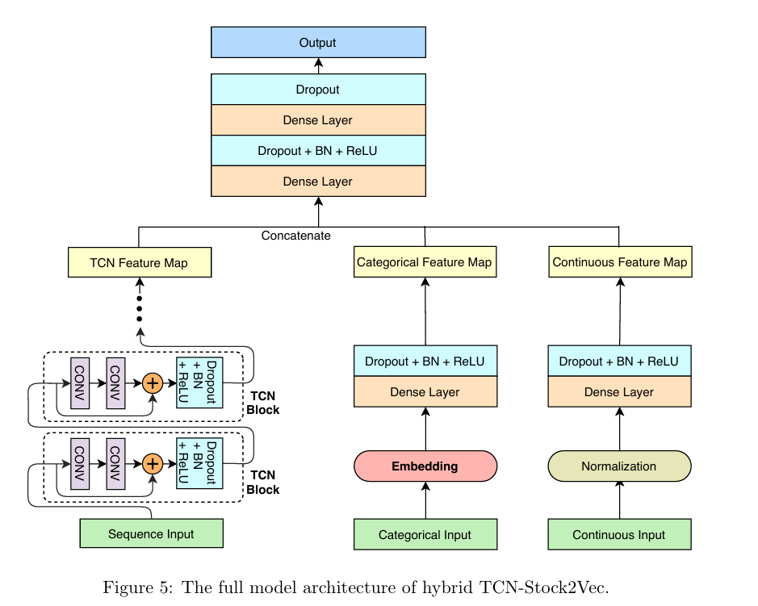
Existing Models

Slide 7
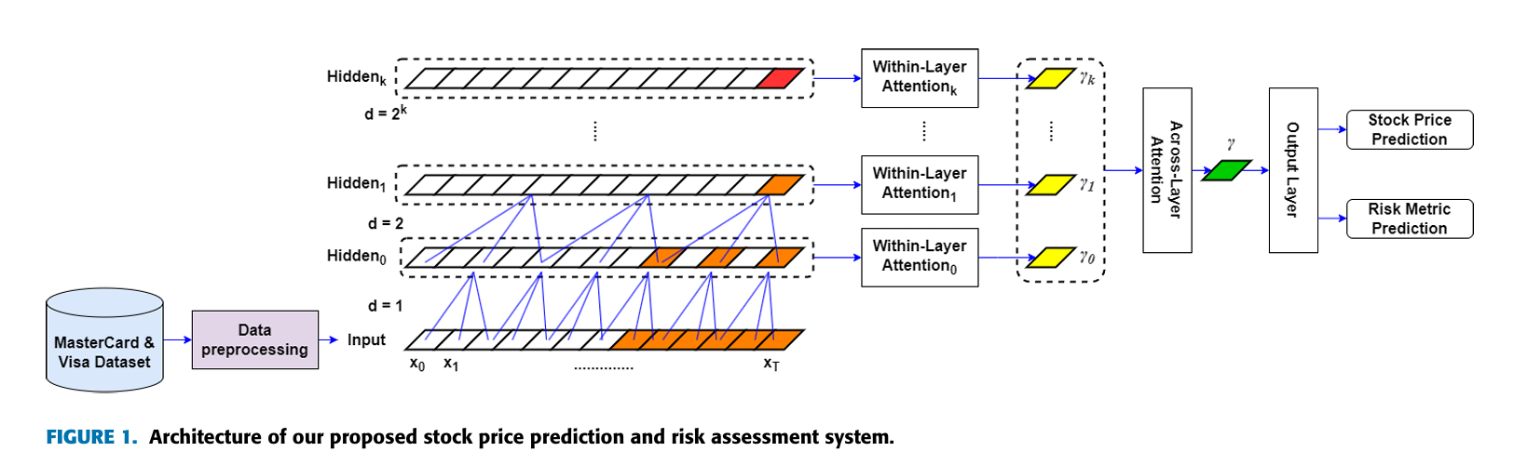
Existing Models

Slide 8
Proposed Model
Multi-Source Data Integration:
Combines six heterogeneous inputs—price history, technical indicators, news, social media sentiment, ESG metrics, and macroeconomic indicators—into a unified feature pipeline.
Specialized Encoding Branches:
Price data, textual data (via DistilBERT), and ESG/macro factors are encoded through dedicated TCN, transformer, and MLP branches to produce rich latent embeddings.
Adaptive Fusion & Prediction:
An adaptive fusion gate dynamically weights each modality based on market conditions, followed by a fusion head that generates calibrated price predictions, quantiles, and uncertainty scores.
Risk-Aware Execution Pipeline:
Outputs feed into risk mapping and position sizing modules, enabling controlled trade decisions, paper-trading execution, and real-time monitoring via dashboard.

Slide 9
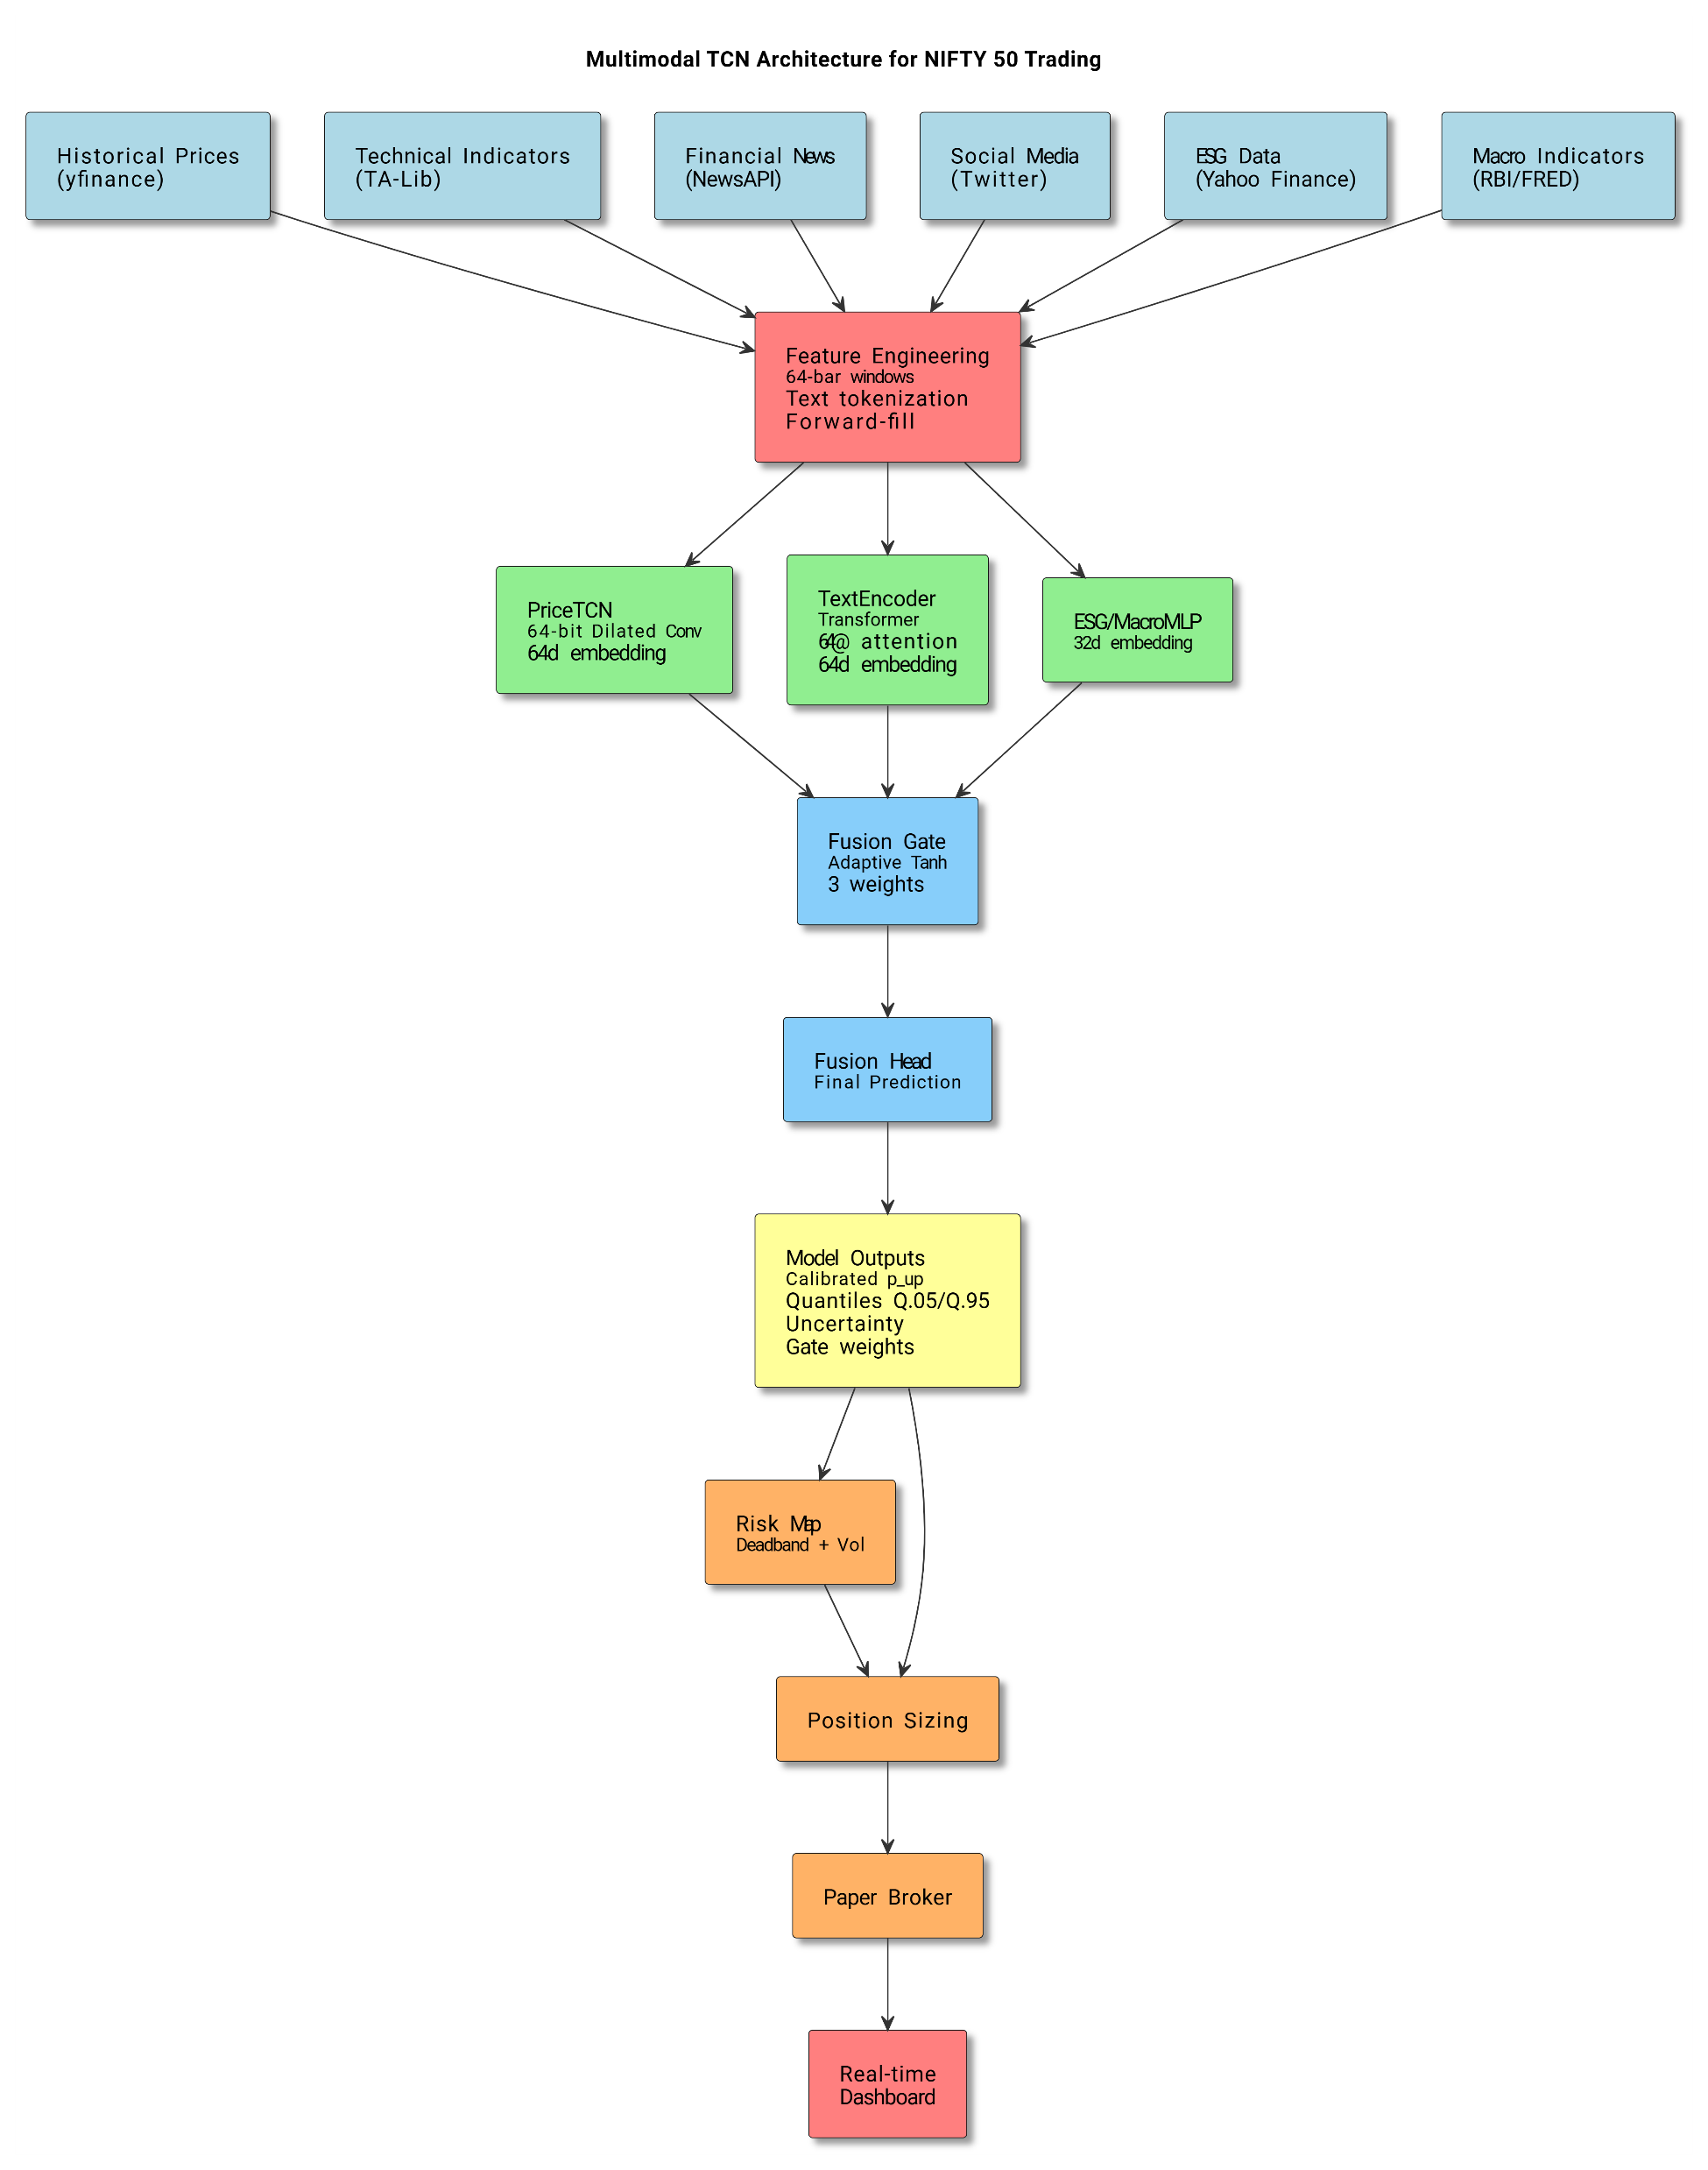
Architecture Diagram

Slide 10
Dataset
Historical market data: OHLVC time series for all NIFTY 50 constituents from past to present, used as the primary numerical input for price modeling.
Stock-level sentiment: Centered, stock-specific sentiment vectors derived from news and social media to train the textual encoder and capture investor mood.
Technical features: TA-Lib computed indicators (RSI, MACD, EMA, ATR, etc.) added to the feature set and aligned with price and sentiment timestamps for model training.

Slide 11
Plan of Implementation
Phase 1 - Feature Engineering
Phase 2 - Model (TCN+BiLSTM)
Phase 3 - Post Processing(Risk Map, Continous Learning)
Phase 4 - Deployment and Testing

Slide 12
Conclusion
First multimodal TCN for Indian markets integrating 6 data sources, delivering MAE 1.23 vs. 1.45 LSTM with dual price + risk outputs.
Adaptive fusion gate, continuous learning, and strong risk modeling enable stable performance under dynamic market conditions.
Provides institutional-grade analytics to retail users, faster reaction to news/sentiment, explainable forecasts, and robust capital protection.
Scalable to global markets and future-ready with extensions like reinforcement learning, alternative data integration, derivatives modeling, and multi-asset optimization.

Slide 13
References
[1] Biswas, A.K., et al. (2025). "A Dual Output Temporal Convolutional Network with Attention Architecture for Stock Price Prediction and Risk Assessment." IEEE Access, Vol. 13, pp. 53621-53639.
[2] Shi, Z., Ibrahim, O., & Hashim, H.I.C. (2025). "Stock Index Prediction Using Temporal Convolutional Network and Long Short-Term Memory Network Optimized by Genetic Algorithm." JoWUA, Vol. 16(1), pp. 508-527.
[3] Wang, X., Wang, Y., Weng, B., & Vinel, A. (2020). "Stock2Vec: A Hybrid Deep Learning Framework for Stock Market Prediction with Representation Learning and Temporal Convolutional Network." arXiv:2010.01197.
[4] Deng, S., Zhang, N., Zhang, W., Chen, J., Pan, J.Z., & Chen, H. (2019). "Knowledge-Driven Stock Trend Prediction and Explanation via Temporal Convolutional Network." WWW '19 Companion, pp. 678-685.

