Slide 1
Code
Package
Execute
Output Data
Analyze/
Visualize
Manuscript
Input Data

Slide 2





















Code
Package
Execute
Output Data
Analyze/
Visualize
Manuscript
Input Data

Slide 3



Code
Package
Execute
Output Data
Analyze/
Visualize
Manuscript
Input Data

Slide 4
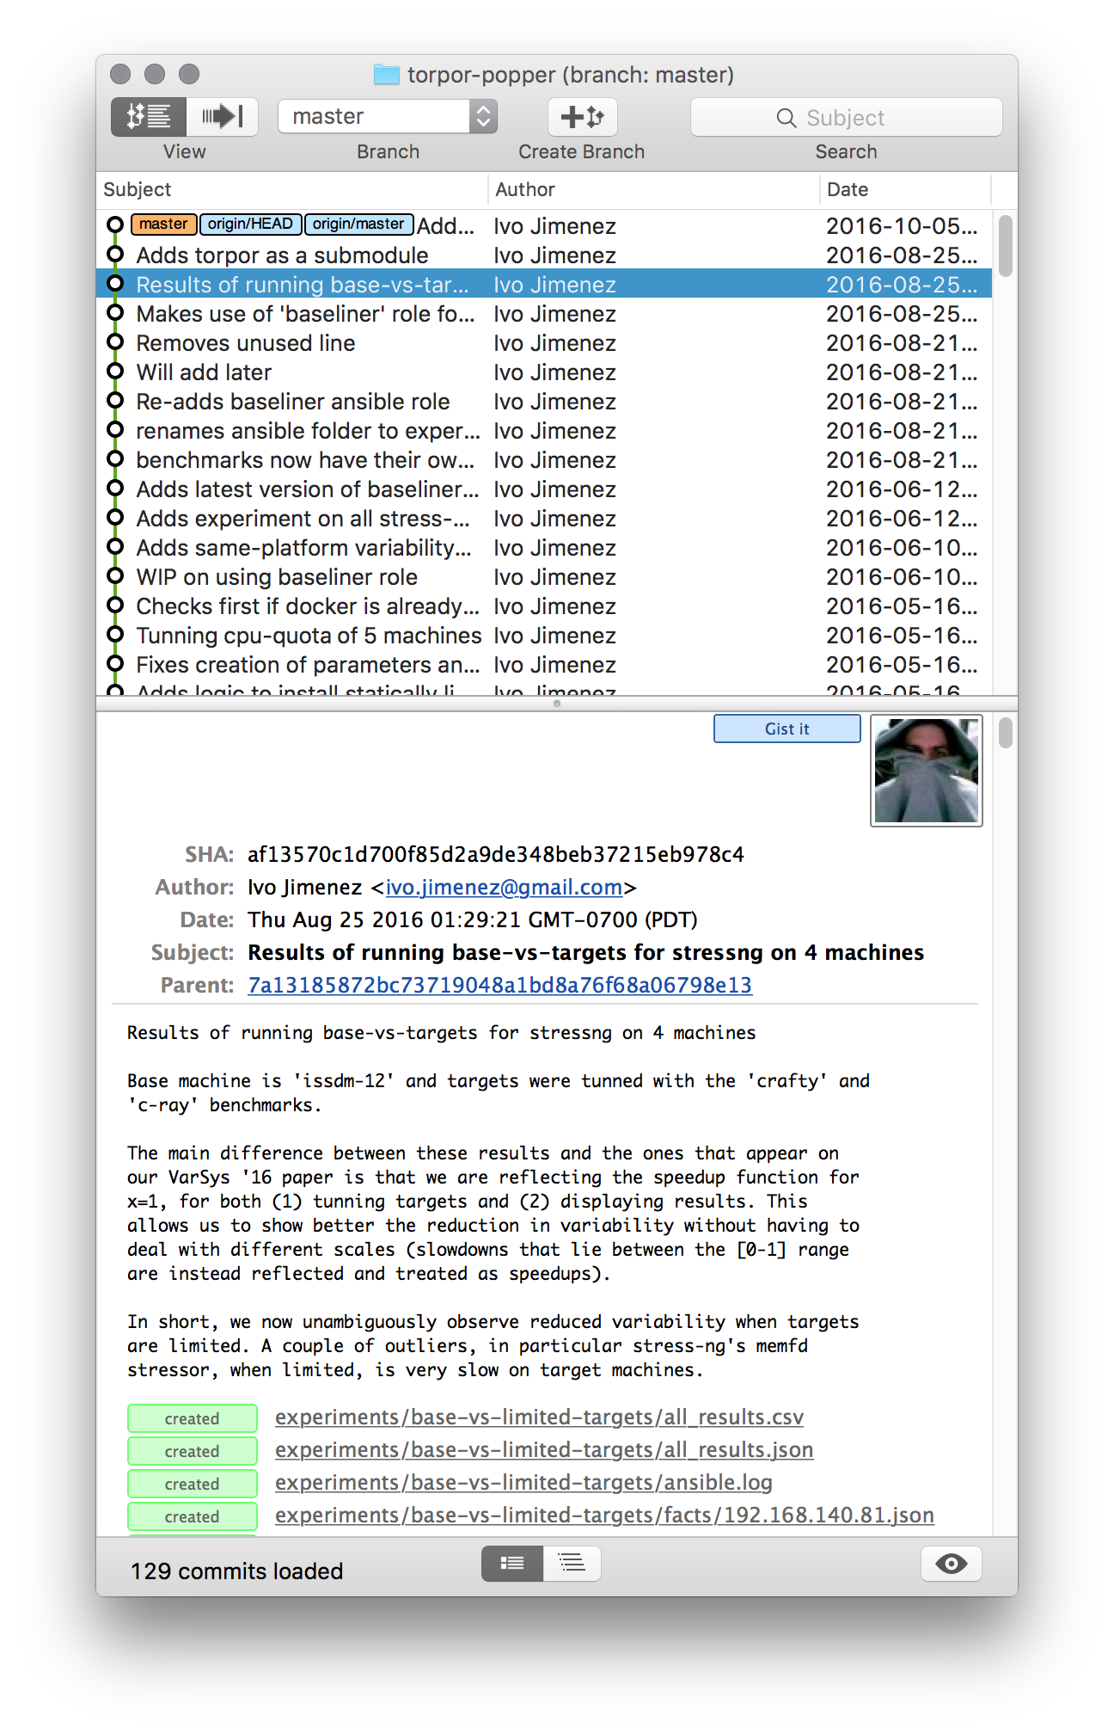
Code
Package
Execute
Output Data
Analyze/
Visualize
Manuscript
Input Data

Slide 5

Code
Package
Execute
Output Data
Analyze/
Visualize
Manuscript
Input Data

