Slide 1




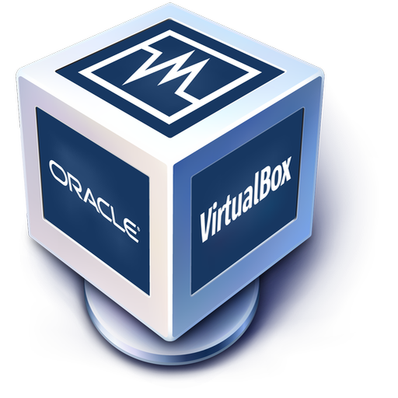

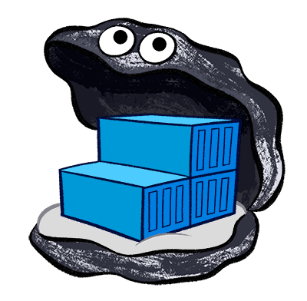

1
2
kernel
src
7
4
your
work
5
3
6
VM with custom Kernel
build kernel packages (container)
build dependencies (docker image)
build
environment
base VM (vagrant box)
test
environment

