Slide 1

IoT based Smart Shopping Cart
Presented By:
AKHILESH SHINDHE | 17BTLEC002
VIJAYKUMAR S RAYANAGOUDRA | 17BTLEC008
ANISH KUMAR SINGH | 17BTREC017
RAHUL RAO SHINDE K | 17BTLEC012
Project Details
Batch No.: | ECE-17
Domain: | IoT,ML,Embedded
Category: | IoT/Microcontrollers/HTML/CSS
Project Guide Details
Name of Guide: | Prof.Basavaraj.H
Qualification: | M.Tech
Specialization : | VLSI Design and Embedded Systems

Slide 2
Introduction
In this busy world, waiting in the long queue during shopping has become tedious process.
Customers who need to purchase different products in Walmart or supermarkets needs lots of time and patience in coordinating among them self for successful shopping.
The customers have to drop every product which they wish to purchase into the shopping cart and then proceed to checkout at the billing counter.
In this project, we depict reasonable and cost-effective Smart Shopping Cart utilizing IoT and Barcode Scanner.
Aims to reduce and possibly eliminate the total waiting time of customers.

Slide 3
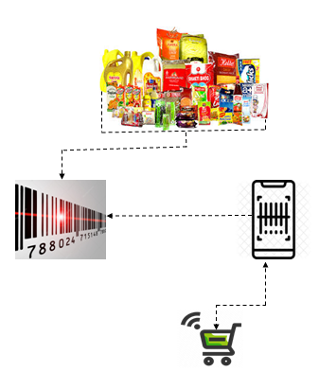
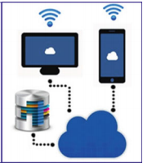
The smart cart database system

Slide 4
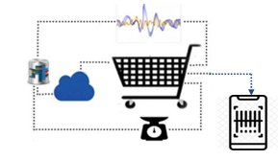
The smart cart feedback system

Slide 5
Literature Review
Anjali Verma et al. [1] proposed RFID based Smart Multitasking Shopping Trolley System evaluates many strategies to assist shopper to minimize the overall shopping time required in the mall.
V. N. Prithvish et al [2] where authors have presented their idea where they have implemented concept of IoT with a conventional bar code as the tagging identity and payment connected to credit/debit card swiping machines present at remote locations of the store.
Vrinda et al.[3] have featured a cart equipped with an RFID reader, a ZigBee transceiver and an LCD display and however lacks built-in security
Ankush Yewatkar et al.[4] proposed Smart Cart with Automatic Billing, Product Information. One of the important feature this system introduced for anti-theft by attaching an RFID reader at the exit door.
G.S.Rajagopal et al.[5] proposed a Smart Intelligent System for Shopping and Billing.Implementation of centralized billing system to automatically bill the shopper for the the purchases.
Budic et al.[6] proposed a system of Cash register lines optimization system which requires maintenance of a web application server. No necessary steps have been taken for the products that are accidentally dropped into the trolley by the customer
P. Chandrasekar et al.[7] the authors have presented their idea in which each commodity in a mall will be attached with an RFID tag and each trolley will be attached with an RFID reader

Slide 6

Problem Definition
We can see huge rush at supermarkets on holidays and weekends which has resulted in large crowds at supermarkets which have to lead to long lines at the billing counter. The billing process is quite tedious and highly time consuming and has created the need to employ more human resources in the billing section. The ongoing covid19 crisis demands from everyone to make safety and hygiene standards the top The proposed project will help in reducing customer contact with anything that someone else might have touched or had contact with it. The prevailing system had included more investment in the production of customized hardware which was not economical compared to the proposed prototype provide a feasible solution to reduce the time spent by the customer in the store, mainly while standing in line for billing payment. This is because of a lack of alternative mode of payments. The main drawback is the lack of satisfaction and ease of use on the part of the customer.

Slide 7
Objectives
The main objective of the project is to reduce and eliminate time in billing counter in super markets.
To implement contactless shopping in concerns with people’s health and safety to limit physical contact in supermarkets.
By designing an smart shopping cart which allows users to selfcheckout and increase productivity time.

Slide 8
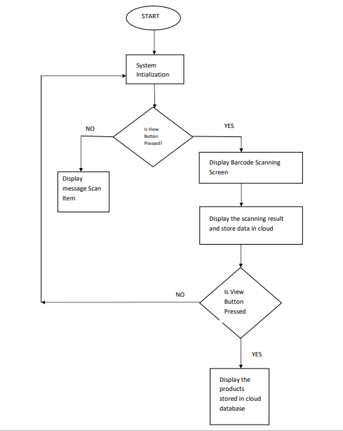
Design and Implementation of Software
Figure 1.1

Slide 9
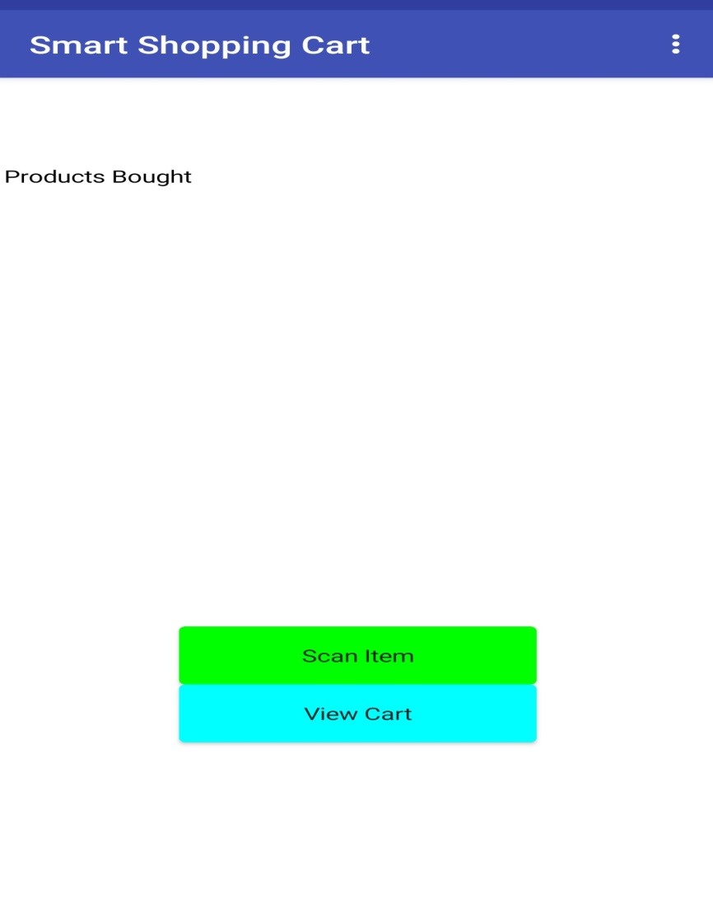
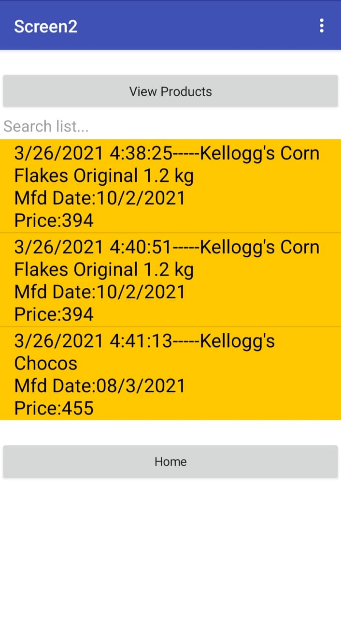
Design and Implementation of Software
Figure 1.2
Figure 1.3

Slide 10

Design and Implementation of Software
Fig 1.1 shows the design of the smart shopping cart app, which utilizes bar code scanner as the sensing element of the subsystem, that takes bar codes of different commodities as input to the system
In fig1.2 when a user clicks on the scan button it directs it to barcode scanner allowing the user to scan their desired product and description of these products is shown in the products bought section
Following each scan the data is being revised in the inventory. This app will keep updating the restocking process so that no product is off the shelf.
In fig 1.3 view cart button will keep customers informed about their billing amount to aid them to make further purchase decisions.
The Recommend button in the app recommend products to the user based upon their present and past purchasing behavior

Slide 11
Design and Implementation of Software

Slide 12
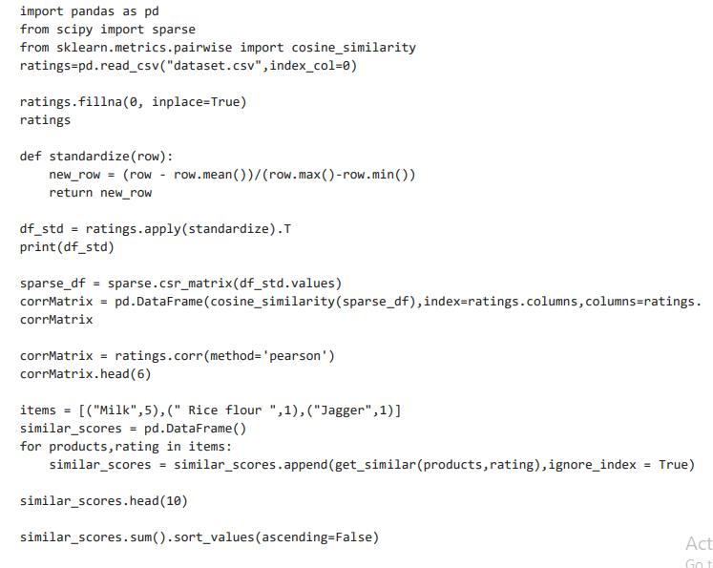
Design and Implementation of Software

Slide 13
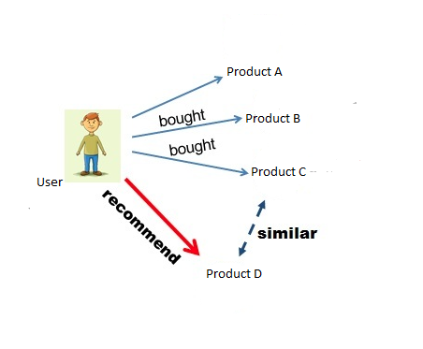
Item-to-Item Based Collaborative Filtering

Slide 14
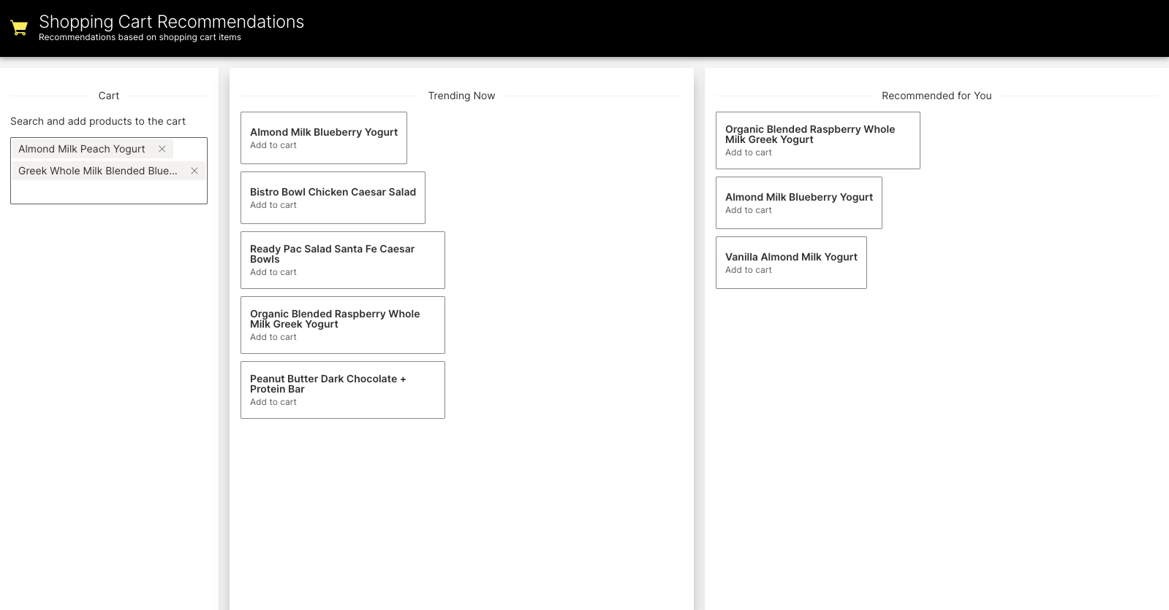
Design and Implementation of Software

Slide 15
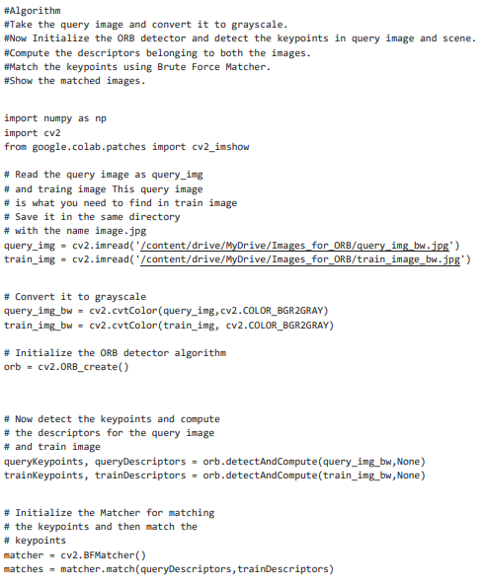
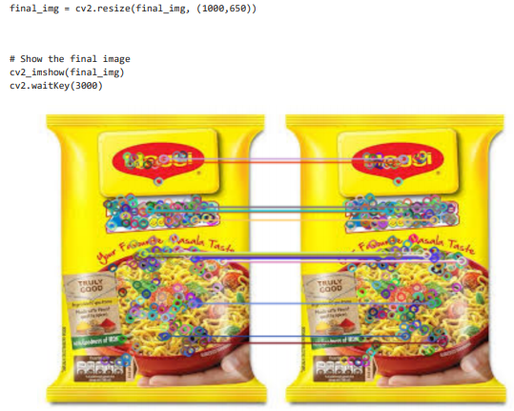
Design and Implementation of Software

Slide 16
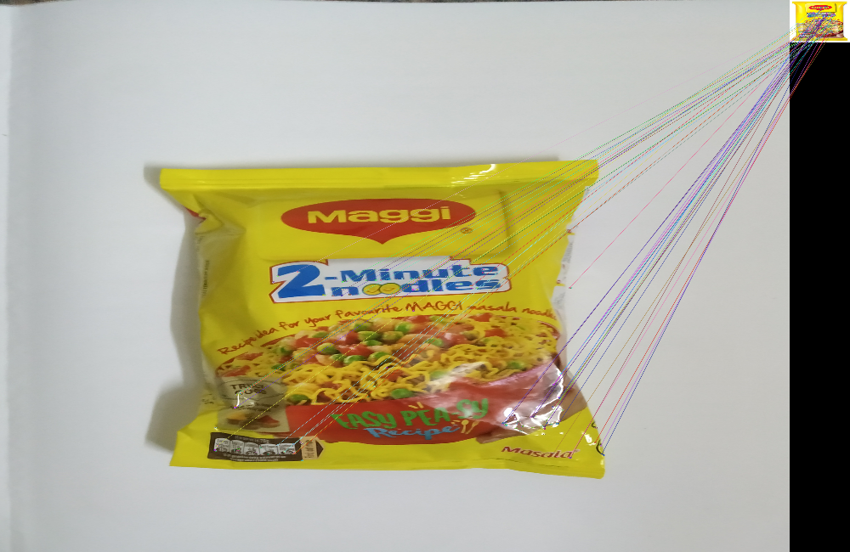
Simulation
Figure 1.4
Product Imaging Simulation Results

Slide 17
Simulation
In fig 1.4 takes a real-time feed of the top layer of the smart cart all the time and cross verifies the products visible with the scanned products
In case if any additional item comes into picture which has not been scanned previously the cart gets locked and it is not functional to the customer
This is achieved by means of scale invariant feature transform (ORB) algorithm which acts as a product tracking mechanism for the cart
The loopholes present in the system can be nullified by the above product imaging mechanism being implemented in the cart

Slide 18
Limitations and Applications
Limitations:
Facility to store data is upto a certain extent.
Difficulty in analysis of data and trends ,If implemented need to use the facility on the cloud and needs to analyse data further with advanced data analytics software or
services
Usage of this product is limited to only smart phone users.
Applications
Super Markets
Shopping Center’s

Slide 19
Conclusion and Future Scope
The drawbacks addressed in previous smart cart applications has been overcome in this application
The application developed for the IoT based smart shopping cart will eliminate the cost of deploying contemporary bar code scanners and the cost incurred for its maintenance and as well as the investment in customized central hardware
The synchronization latency ,royalty fees, less accuracy occurred due to the SIFT algorithm has been improved with the implementation ORB algorithm which yields better results compared to the previous algorithm
The future scope includes adding more computation at the cloud end
Implementation of such a system in retail shall bring down labour dependency, easy management at the owner’s end and in turn will improve the pre and post-shopping experience

Slide 20
References
[1] Anjali Verma Butti Khyathi Likhitha1 , Bajana Akshitha Varma2 , Chepuru Preethi3 , K.K.Thyagharajan Low Cost Shopping Robot System with Real time Shopping Experience 2020
[2] V.K Prithvish,Shraddha Agrawal, and John Sahaya Rani Alex,An IoT based Smart Shopping Cart Using Contemporary Barcode Scanner.Published on Jan 1st 2018
[3] Vrinda Gupta1 and Niharika Garg2, Analytical Model for Automating Purchases
ISSN 0974-2239 Volume 4, Number 5 2016
[4] Ankush Yewatkar ,Faiz Inamdar Smart Cart with Automatic Billing Product Information, Product Recommendation with Anti-Theft 2016
[5] G.S.Rajagopal, Mr.S.Grout, Prof. M.Janarthanan. Smart Intelligent System for Shopping and Billing. International Journal of Advanced Research Trends in Engineering and Technology April 2014
[6] Budic D, Martinovic Z, Simunic D, Cash register lines optimization system using RFID technology 2014
[7] Mr P. Chandrasekar and Ms T. Sangeetha Smart ShoppingCart with Automatic Billing System through RFID and ZigBee 2014

