Slide 1
Quality Report Japan Jan - June 2026

Slide 2
Quality Score for month of Japan Jan 2026
Observation | 3
Error | 2
No Error | 78
Total Task | 80
Quality Score | 97.50%

Slide 3
Developer Report Japan Jan 2026
Developer Name | Error | No Error | Observation | Grand Total | Quality Score
Sarika Joshi | 1 | 19 | 2 | 20 | 95.00 %
DEEPIKA DAMBARLAL SAMBARIA | 1 | 7 | 0 | 8 | 87.50 %
Neha Lal | 0 | 12 | 1 | 12 | 100.00 %
KOMAL RITEN GALA | 0 | 2 | 0 | 2 | 100.00 %
Neha Gupta | 0 | 1 | 0 | 1 | 100.00 %
SACHIN SHIVPRAKASH PRAJAPATI | 0 | 24 | 0 | 24 | 100.00 %
SUPRIYA SANTOSH MHASHELKAR | 0 | 13 | 0 | 13 | 100.00 %
Grand Total | 2 | 78 | 3 | 80 | 97.50 %

Slide 4
Error Analysis Internal & External for Japan Jan 2026
Error Type | Test link(Internal) | Live link(External) | Total
Content Related | 1 | 0 | 1
LinkBuilder | 0 | 0 | 0
Navigation Related | 0 | 0 | 0
Design Related | 1 | 0 | 1
EDM | 0 | 0 | 0
Images related | 0 | 0 | 0
Total | 2 | 0 | 2

Slide 5
Error Trend Analysis for Japan Jan 2026

Slide 6
Quality Score for month of Japan Feb 2026
Observation | 0
Error | 0
No Error | 44
Total Task | 44
Quality Score | 100.00%

Slide 7
Developer Report Japan Feb 2026
Developer Name | No Error | Error | Grand Total | Quality Score
DEEPIKA DAMBARLAL SAMBARIA | 6 | 0 | 6 | 100%
Neha Lal | 11 | 0 | 11 | 100%
SACHIN SHIVPRAKASH PRAJAPATI | 7 | 0 | 7 | 100%
Sarika Rupesh Joshte | 13 | 0 | 13 | 100%
SUPRIYA SANTOSH MHASHELKAR | 7 | 0 | 7 | 100%
Grand Total | 44 | 0 | 44 | 100%

Slide 8
Quality Score for month of Japan Mar 2026
Observation | 7
Error | 0
No Error | 76
Total Task | 76
Quality Score | 100.00%

Slide 9
Developer Report Japan Mar 2026
Developer Name | No Error | Observation | Grand Total | Quality Score
DEEPIKA DAMBARLAL SAMBARIA | 4 | 0 | 4 | 100%
Neha Lal | 17 | 3 | 17 | 100%
SACHIN SHIVPRAKASH PRAJAPATI | 6 | 1 | 6 | 100%
Sarika Rupesh Joshte | 23 | 2 | 23 | 100%
SUPRIYA SANTOSH MHASHELKAR | 24 | 0 | 24 | 100%
KOMAL RITEN GALA | 2 | 1 | 2 | 100%
Grand Total | 76 | 7 | 76 | 100%

Slide 10
Quality Score for month of Japan Apr 2026
Observation | 3
Error | 1
No Error | 107
Total Task | 108
Quality Score | 99.07%

Slide 11
Developer Report Japan Apr 2026
Developer Name | Error | No Error | Observation | Grand Total | Quality Score
Neha Lal | 1 | 32 | 1 | 33 | 96.97%
KOMAL RITEN GALA | 0 | 3 | 0 | 3 | 100.00 %
Mithesh Gupta | 0 | 7 | 1 | 7 | 100.00 %
SACHIN SHIVPRAKASH PRAJAPATI | 0 | 13 | 0 | 13 | 100.00 %
Sarika Rupesh Joshte | 0 | 26 | 0 | 26 | 100.00 %
SUPRIYA SANTOSH MHASHELKAR | 0 | 26 | 1 | 26 | 100.00 %
Grand Total | 1 | 107 | 3 | 108 | 99.07 %

Slide 12
Error Analysis Internal & External for Japan Apr 2026
Error Type | Test link(Internal) | Live link(External) | Total
Content Related | 0 | 0 | 0
LinkBuilder | 0 | 0 | 0
Redirected links related | 1 | 0 | 1
Design Related | 0 | 0 | 0
EDM | 0 | 0 | 0
Images related | 0 | 0 | 0
Total | 1 | 0 | 1

Slide 13
Error Trend Analysis for BMW Japan Apr 2026

Slide 14
Quality Score for month of Japan May 2026
Observation | 0
Error | 2
No Error | 65
Total Task | 67
Quality Score | 97.01%

Slide 15
Developer Report Japan May 2026
Developer Name | Error | No Error | Grand Total | Quality Score
Neha Lal | 2 | 17 | 19 | 89.47 %
KOMAL RITEN GALA | 0 | 1 | 1 | 100.00 %
Mitesh Umashankar Gupta | 0 | 2 | 2 | 100.00 %
SACHIN SHIVPRAKASH PRAJAPATI | 0 | 7 | 7 | 100.00 %
Sarika Rupesh Joshte | 0 | 16 | 16 | 100.00 %
SUPRIYA SANTOSH MHASHELKAR | 0 | 22 | 22 | 100.00 %
Grand Total | 2 | 65 | 67 | 97.01 %

Slide 16
Error Analysis Internal & External for Japan May 2026
Error Type | Test link(Internal) | Live link(External) | Total
Content Related | 1 | 0 | 1
LinkBuilder | 0 | 0 | 0
Navigation link related | 1 | 0 | 1
Design Related | 0 | 0 | 0
EDM | 0 | 0 | 0
Images related | 0 | 0 | 0
Total | 2 | 0 | 2

Slide 17
Error Trend Analysis for BMW Japan May 2026

Slide 18
Quality Score for month of Japan June 2026
Observation | 0
Error | 2
No Error | 74
Total Task | 76
Quality Score | 97.37%

Slide 19
Developer Report Japan June 2026
Developer Name | Error | No Error | Grand Total | Quality Score
Neha Lal | 1 | 23 | 24 | 95.83 %
SUPRIYA SANTOSH MHASHELKAR | 1 | 23 | 24 | 95.83 %
DIPALI TANAJI DUGAOKAR | 0 | 2 | 2 | 100.00 %
KOMAL RITEN GALA | 0 | 5 | 5 | 100.00 %
SACHIN SHIVPRAKASH PRAJAPATI | 0 | 1 | 1 | 100.00 %
Sarika Rupesh Joshte | 0 | 20 | 20 | 100.00 %
Grand Total | 2 | 74 | 76 | 97.37 %

Slide 20
Error Analysis Internal & External for Japan June 2026
Error Type | Test link(Internal) | Live link(External) | Total
Content Related | 2 | 0 | 2
LinkBuilder | 0 | 0 | 0
Navigation link related | 0 | 0 | 0
Design Related | 0 | 0 | 0
EDM | 0 | 0 | 0
Images related | 0 | 0 | 0
Total | 2 | 0 | 2

Slide 21
Error Trend Analysis for BMW Japan June 2026

Slide 22
Quality Score Dashboard Jan – June BMW Japan

Slide 23
BMW Japan QA Summary Report
(Jan – June 2026)
KPI | Value
Total Tasks Audited | 451
Error Free Tasks | 444
Total Defects | 7
Internal Defects | 7
External Defects | 0
Total Observations | 13
Total Developers Audited | 9
Developers Below 90% | 0
Average Quality Score | 98.45%

Slide 24
Developer Summary Report BMW Japan
(Jan – Jun 2026)
Developer Name | Total Tasks | Error Tasks | Error-Free Tasks | Observations | Overall Quality Score
DEEPIKA DAMBARLAL SAMBARIA | 18 | 1 | 17 | 0 | 94.44 %
Neha Lal | 116 | 4 | 112 | 5 | 96.55 %
SUPRIYA SANTOSH MHASHELKAR | 116 | 1 | 115 | 1 | 99.14 %
Sarika Rupesh Joshte | 118 | 1 | 117 | 4 | 99.15 %
SACHIN SHIVPRAKASH PRAJAPATI | 58 | 0 | 58 | 1 | 100.00 %
KOMAL RITEN GALA | 13 | 0 | 13 | 1 | 100.00 %
Mithesh Gupta / Mitesh Umashankar Gupta* | 9 | 0 | 9 | 1 | 100.00 %
DIPALI TANAJI DUGAOKAR | 2 | 0 | 2 | 0 | 100.00 %
Neha Gupta | 1 | 0 | 1 | 0 | 100.00 %
Grand Total | 451 | 7 | 444 | 13 | 98.45%

Slide 25
Defect Category Breakdown BMW Japan
(Jan – June 2026)
Defect Category | Test Link (Internal) | Live Link (Internal) | Total Defects | % of Total
Content Related | 4 | 0 | 4 | 57.14%
Design Related | 1 | 0 | 1 | 14.29%
Image Related | 0 | 0 | 0 | 0.00%
Video Related | 0 | 0 | 0 | 0.00%
Redirect Links | 2 | 0 | 2 | 28.57%
Functionality | 0 | 0 | 0 | 0.00%
Multiple Issues | 0 | 0 | 0 | 0.00%
Grand Total | 7 | 0 | 7 | 100.00%

Slide 26
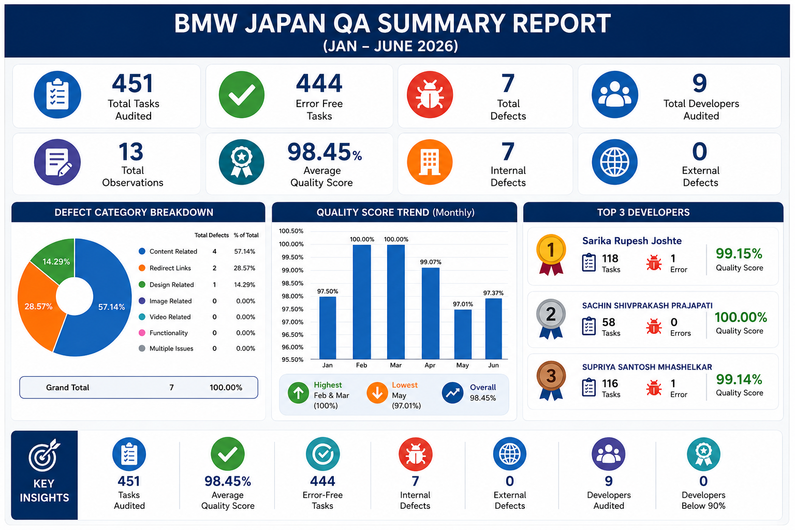

Slide 27
Thank you

