Slide 1
Quality Report C3 Jan - June 2026

Slide 2
Quality Score for month of C3 Jan 2026
Observation | 4
Error | 3
No Error | 121
Total Task | 124
Quality Score | 97.63%

Slide 3
Developer Report C3 Jan 2026
Developer Name | Error | No Error | Observation | Grand Total | Quality Score
Krupa Jalgaonkar | 2 | 9 | 0 | 11 | 81.82 %
Komal Gala | 1 | 16 | 1 | 17 | 94.12 %
Anish Kulkarni | 0 | 26 | 0 | 26 | 100.00 %
Dan Dsouza | 0 | 4 | 0 | 4 | 100.00 %
Dipali Dugaokar | 0 | 19 | 3 | 19 | 100.00 %
JYOTI SAJANLAL GUPTA | 0 | 18 | 0 | 18 | 100.00 %
Neha Lal | 0 | 24 | 0 | 24 | 100.00 %
Mitesh Gupta | 0 | 2 | 0 | 2 | 100.00 %
Supriya Mhashelkar | 0 | 3 | 0 | 3 | 100.00 %
Grand Total | 3 | 121 | 4 | 124 | 97.63 %

Slide 4
Error Analysis Internal & External for C3 Jan 2026
Error Type | Test link(Internal) | Live link(External) | Total
Content Related | 3 | 0 | 3
LinkBuilder | 0 | 0 | 0
Navigation Related | 0 | 0 | 0
Design Related | 0 | 0 | 0
EDM | 0 | 0 | 0
Images related | 0 | 0 | 0
Total | 3 | 0 | 3

Slide 5
Error Trend Analysis for C3 Jan 2026

Slide 6
Quality Score for month of C3 Feb 2026
Observation | 1
Error | 8
No Error | 60
Total Task | 68
Quality Score | 88.23%

Slide 7
Developer Report C3 Feb 2026
Developer Name | Error | No Error | Observation | Grand Total | Quality Score
DEEPIKA DAMBARLAL SAMBARIA | 1 | 1 | 0 | 2 | 50.00 %
Krupa | 2 | 2 | 0 | 4 | 50.00 %
JYOTI SAJANLAL GUPTA | 2 | 8 | 0 | 10 | 80.00 %
Dipali Dugaokar | 1 | 11 | 0 | 12 | 91.67 %
Neha Lal | 1 | 12 | 0 | 13 | 92.31 %
Anish Kulkarni | 1 | 18 | 1 | 19 | 94.74 %
Dan Dsouza | 0 | 2 | 0 | 2 | 100.00 %
Komal Gala | 0 | 2 | 0 | 2 | 100.00 %
Mitesh Gupta | 0 | 1 | 0 | 1 | 100.00 %
Supriya Mhashelkar | 0 | 3 | 0 | 3 | 100.00 %
Grand Total | 8 | 60 | 1 | 68 | 88.23 %

Slide 8
Error Analysis Internal & External for C3 Feb 2026
Error Type | Test link(Internal) | Live link(External) | Total
Content Related | 5 | 0 | 5
LinkBuilder | 0 | 0 | 0
Navigation Related | 1 | 0 | 1
Design Related | 1 | 1 | 2
EDM | 0 | 0 | 0
Images related | 0 | 0 | 0
Total | 7 | 1 | 8

Slide 9
Error Trend Analysis for C3 Feb 2026

Slide 10
Quality Score for month of C3 Mar 2026
Observation | 8
Error | 10
No Error | 119
Total Task | 129
Quality Score | 92.25%

Slide 11
Developer Report C3 Mar 2026
Developer name | Error | No Error | Observation | Grand Total | Quality Score
Jyoti Gupta | 5 | 22 | 0 | 27 | 81.48 %
Krupa Jalgaonkar | 1 | 7 | 0 | 8 | 87.50 %
Neha lal | 4 | 33 | 2 | 37 | 89.19 %
Anish Kulkarni | 0 | 12 | 1 | 12 | 100.00 %
Dan | 0 | 5 | 1 | 5 | 100.00 %
Dipali | 0 | 29 | 4 | 29 | 100.00 %
Supriya | 0 | 3 | 0 | 3 | 100.00 %
Kapil Kumar | 0 | 5 | 0 | 5 | 100.00 %
Komal | 0 | 2 | 0 | 2 | 100.00 %
Neha Gupta | 0 | 1 | 0 | 1 | 100.00 %
Grand Total | 10 | 119 | 8 | 129 | 92.25 %

Slide 12
Error Analysis Internal & External for C3 Mar 2026
Error Type | Test link(Internal) | Live link(External) | Total
Content Related | 5 | 0 | 5
LinkBuilder | 0 | 0 | 0
Redirected link | 2 | 2 | 4
Design Related | 1 | 0 | 1
EDM | 0 | 0 | 0
Images related | 0 | 0 | 0
Total | 8 | 2 | 10

Slide 13
Error Trend Analysis for C3 Mar 2026

Slide 14
Quality Score for month of C3 Apr 2026
Observation | 4
Error | 4
No Error | 90
Total Task | 94
Quality Score | 95.74%

Slide 15
Developer Report C3 Apr 2026
Developer Name | Error | No Error | Observation | Grand Total | Quality Score
Gaurav | 1 | 2 | 0 | 3 | 66.67%
DAN DSOUZA | 1 | 4 | 0 | 5 | 80.00 %
Jyoti Gupta | 1 | 18 | 1 | 19 | 94.74 %
ANISH AJIT KULKARNI | 1 | 42 | 0 | 43 | 97.67 %
DIPALI TANAJI DUGAOKAR | 0 | 15 | 2 | 15 | 100.00 %
Kapil Kumar | 0 | 1 | 0 | 1 | 100.00 %
Komal Gala | 0 | 2 | 0 | 2 | 100.00 %
NEHA LAL | 0 | 6 | 1 | 6 | 100.00 %
Grand Total | 4 | 90 | 4 | 94 | 95.74 %

Slide 16
Error Analysis Internal & External for C3 Apr 2026
Error Type | Test link(Internal) | Live link(External) | Total
Content Related | 1 | 0 | 1
LinkBuilder | 0 | 0 | 0
Redirected link | 0 | 0 | 0
Design Related | 2 | 1 | 3
EDM | 0 | 0 | 0
Images related | 0 | 0 | 0
Total | 3 | 1 | 4

Slide 17
Error Trend Analysis for C3 Apr 2026

Slide 18
Quality Score for month of C3 May 2026
Observation | 11
Error | 9
No Error | 89
Total Task | 98
Quality Score | 90.82%

Slide 19
Developer Report C3 May 2026
Developer Name | Error | No Error | Observation | Grand Total | Quality Score
DAN DSOUZA | 2 | 1 | 0 | 3 | 33.33 %
GAURAV PARDESHI | 1 | 1 | 0 | 2 | 50.00 %
Dipali | 2 | 6 | 1 | 8 | 75.00 %
Jyoti Gupta | 4 | 23 | 4 | 27 | 85.19 %
ANISH AJIT KULKARNI | 0 | 24 | 2 | 24 | 100.00 %
Kapil Kumar | 0 | 6 | 0 | 6 | 100.00 %
Mitesh Salunkhe | 0 | 5 | 0 | 5 | 100.00 %
Neha Lal | 0 | 11 | 2 | 11 | 100.00 %
Sachin | 0 | 1 | 0 | 1 | 100.00 %
Mitesh Gupta | 0 | 5 | 1 | 5 | 100.00 %
Supriya Mhashelkar | 0 | 6 | 1 | 6 | 100.00 %
Grand Total | 9 | 89 | 11 | 98 | 90.82 %

Slide 20
Error Analysis Internal & External for C3 May 2026
Error Type | Test link(Internal) | Live link(External) | Total
Content Related | 7 | 1 | 8
LinkBuilder | 0 | 0 | 0
Redirected link | 0 | 0 | 0
Design Related | 1 | 0 | 1
EDM | 0 | 0 | 0
Images related | 0 | 0 | 0
Total | 8 | 1 | 9

Slide 21
Error Trend Analysis for C3 May 2026

Slide 22
Quality Score for month of C3 June 2026
Observation | 10
Error | 9
No Error | 119
Total Task | 128
Quality Score | 92.97%

Slide 23
Developer Report C3 June 2026
Developer Name | Error | No Error | Observation | Grand Total | Quality Score
DIPALI TANAJI DUGAOKAR | 3 | 10 | 0 | 13 | 76.92 %
Mitesh Gupta | 3 | 18 | 1 | 21 | 85.71 %
Jyoti Gupta | 2 | 19 | 0 | 21 | 90.48 %
Mitesh Salunkhe | 1 | 20 | 3 | 21 | 95.24 %
Neha Lal | 0 | 9 | 2 | 9 | 100.00 %
Dan Dsouza | 0 | 1 | 0 | 1 | 100.00 %
Kapil K | 0 | 6 | 1 | 6 | 100.00 %
Supriya | 0 | 9 | 1 | 9 | 100.00 %
ANISH AJIT KULKARNI | 0 | 27 | 2 | 27 | 100.00 %
Grand Total | 9 | 119 | 10 | 128 | 92.97 %

Slide 24
Error Analysis Internal & External for C3 June 2026
Error Type | Test link(Internal) | Live link(External) | Total
Content Related | 7 | 1 | 7
LinkBuilder | 0 | 0 | 0
Redirected link | 1 | 0 | 1
Design Related | 0 | 0 | 0
EDM | 0 | 0 | 0
Images related | 0 | 0 | 0
Total | 8 | 1 | 8

Slide 25
Error Trend Analysis for C3 June 2026

Slide 26
Quality Score Dashboard Jan – June BMW C3

Slide 27
BMW C3 QA Summary Report
(Jan – June 2026)
KPI | Value
Total Tasks Audited | 641
Error Free Tasks | 598
Total Defects | 43
Internal Defects | 37(86.05%)
External Defects | 6(13.95%)
Total Observations | 38
Total Developers Audited | 15
Developers Below 90% | 6
Average Quality Score | 93.29%

Slide 28
Developer Summary Report BMW C3
(Jan – Jun 2026)
Developer Name | Total Tasks | Error Tasks | No Error Tasks | Observations | Quality Score
Deepika Dambarlal Sambaria | 2 | 1 | 1 | 0 | 50.00%
Gaurav Pardeshi | 5 | 2 | 3 | 0 | 60.00%
Krupa Jalgaonkar | 23 | 5 | 18 | 0 | 78.26 %
Dan Dsouza | 20 | 3 | 17 | 1 | 85.00 %
Jyoti Gupta | 122 | 14 | 108 | 5 | 88.52 %
Mitesh Gupta | 29 | 3 | 26 | 2 | 89.66 %
Dipali Dugaokar | 96 | 6 | 90 | 10 | 93.75 %
Neha Lal | 100 | 5 | 95 | 7 | 95.00 %
Komal Gala | 23 | 1 | 22 | 1 | 95.65 %
Mitesh Salunkhe | 26 | 1 | 25 | 3 | 96.15 %
ANISH AJIT KULKARNI | 151 | 2 | 149 | 6 | 98.68 %
Supriya Mhashelkar | 24 | 0 | 24 | 2 | 100.00 %
Kapil Kumar | 18 | 0 | 18 | 1 | 100.00 %
Neha Gupta | 1 | 0 | 1 | 0 | 100.00 %
Sachin | 1 | 0 | 1 | 0 | 100.00 %
Total | 641 | 43 | 598 | 38 | 93.29 %

Slide 29
Defect Category Breakdown BMW C3
(Jan – June 2026)
Defect Category | Test Link (Internal) | Live Link (Internal) | Total Defects | % of Total
Content Related | 28 | 2 | 30 | 69.77%
Design Related | 5 | 2 | 7 | 16.28%
Image Related | 0 | 0 | 0 | 0.00%
Video Related | 0 | 0 | 0 | 0.00%
Redirect Links | 4 | 2 | 6 | 13.95%
Functionality | 0 | 0 | 0 | 0.00%
Multiple Issues | 0 | 0 | 0 | 0.00%
Grand Total | 37 | 6 | 43 | 100.00%

Slide 30
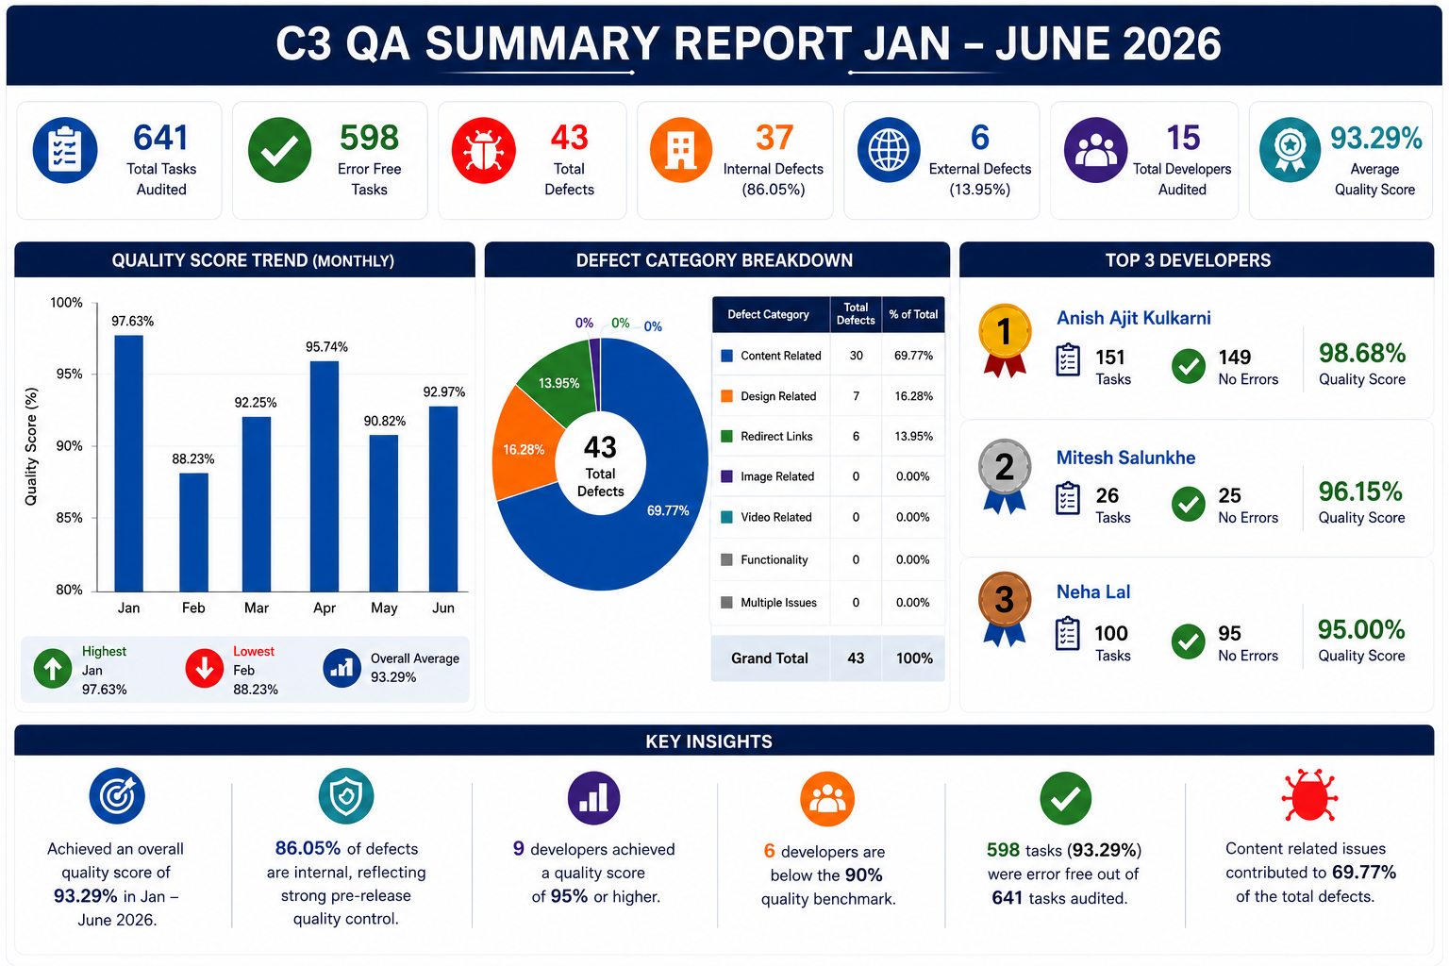

Slide 31
Thank you

