Slide 1
FAKE NEWS DETECTION USING MACHINE LEARNING
Rohith Saxena(RA2011026010250)
Anish Parkhe(RA2011026010285)

Slide 2
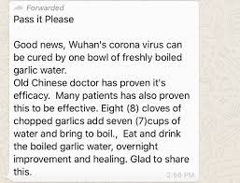
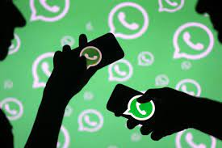
How many of us receive forwarded news in WhatsApp daily?

Slide 3

How many of us can verify each and every piece of news we read before believing it?

Slide 4

WhatsApp
In India, WhatsApp is the platform most vulnerable to fake news. Millions of Indians
(a vast percentage is uneducated) using mobile internet innocently forwarding ‘good
morning’ messages every day are seen as most vulnerable to fake news.

Slide 5

This fake news causes many problems directly and indirectly.
Muzaffarnagar riots of 2013: fake video fueled communal passions.
President Kovind makes Twitter debut; gains 3 million followers in one hour (Republic, Zee news, TOI etc.).
GPS tracking nanochip in 2000 Rupee notes (Nov 2016).
Child kidnapping rumors lead to lynching's by a mob in Jharkhand.

Slide 6




Research shows that in India every 1 in 2 Indians receive fake news via WhatsApp and Facebook every day.
As per a survey by social media matters and institute for governances policies and politics.

Slide 7
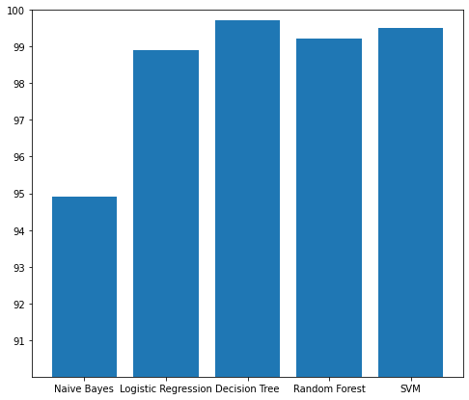
Our model
We have used five different types of classifiers in this project to test and train the data.
The classifiers are:
Naïve bayes
Random forest
Decision tree
Support vector machine
Logistic regression

Slide 8
Accuracies
Naive bayes 94.91%
Logistic regression 98.91%
Decision tree 99.73%
SVM 99.52%
Random forest 99.22%

Slide 9
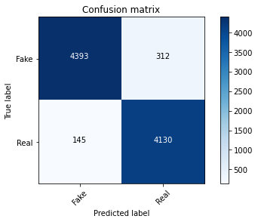
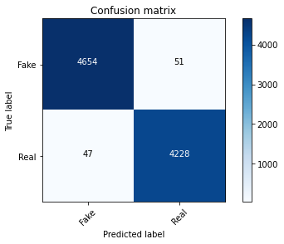
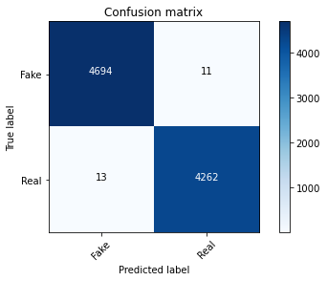


Confusion matrixes

Slide 10
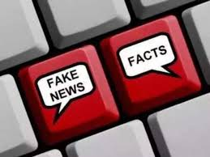
Real world applications
Elections.
Fake Job Rackets.
Checking the credibility of news on Facebook, WhatsApp, and other news platforms.
Fake medical news messages.
Fake lotteries and prize winning scams.

Slide 11
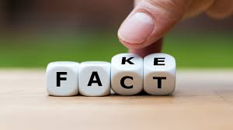
Real world implementation
To implement in real life, we can design a application or website , where users could enter the links of news or copy paste the news.
We can add integrated feature in social media platforms.
In the future, this model could improved a lot using more features which could also tackle not only fake news articles but also tackle rumours spread by individuals.

Slide 12

Thank you

