Slide 1
Week 1 Internship
A Journey from Python Scripts to Deployed Web Applications
Anish Rallabandi | Actoryx Internship | Week 1
Python
Streamlit
Gradio
FastAPI
MongoDB
Hugging Face
GitHub
16
32
7
5
Python Scripts
Apps Deployed
Technologies
Days
Recorded on Zoom • May 2026

Slide 2
5 Days · 7 Technologies · End-to-End Development Pipeline
Week Overview
Day 1
Day 2
Day 3
Day 4
Day 5
🐍
🌐
⚡
☁️
🔗
Python Basics
Web Apps
FastAPI
Deployment
GitHub
16 programs written & run in VS Code terminal
16 Streamlit + 16 Gradio interactive web apps
16 REST endpoints + full CRUD application
32 apps on Hugging Face + MongoDB cloud database
All code pushed via GitHub Desktop
All code version-controlled on GitHub throughout the week

Slide 3
16 Programs · Loops · Conditions · Pattern Matching · Pandas
Day 1 — Python Basics in VS Code
16 Programs Implemented
▸ Print 1 to 10 (for loop basics)
▸ Custom Multiplication Table
▸ While Loop 1 to N (user input)
▸ Sum of a List
▸ Odd / Even Checker
▸ Sum of Digits of a Number
▸ Positive / Negative / Zero
▸ Factorial Calculator
▸ Voting Eligibility Checker
▸ Divisors of a Number
▸ Compare Two Numbers
▸ Prime Number Checker
▸ 4-Operation Calculator (match/case)
▸ Grade Calculator (3 subjects)
▸ Multiplication Table of 9
▸ CSV File Viewer (pandas)
Key Concepts: for / while loops · if / elif / else · match / case · int(input()) · pandas · f-strings

Slide 4
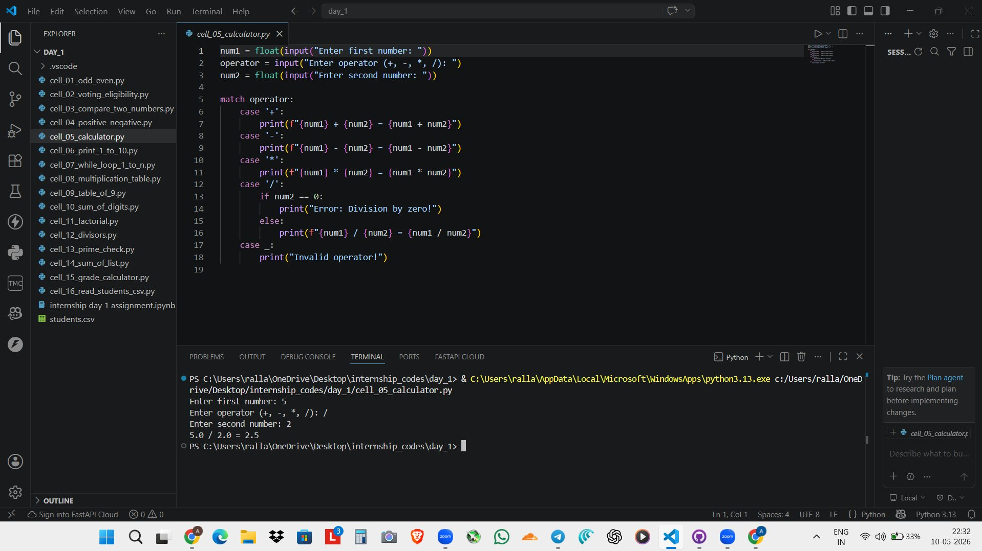
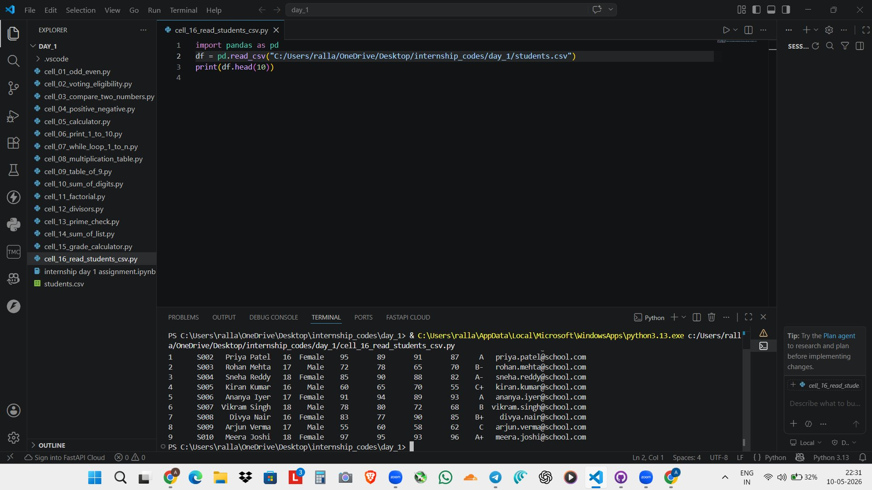
VS Code · Python 3 · pandas · match/case
Day 1 — Spotlight: Calculator & CSV Viewer
Calculator — match/case pattern
CSV Viewer — pandas
Why match/case?
What is pandas?
▸ Cleaner than long if-elif chains
▸ Third-party library for data manipulation
▸ case _ acts as a catch-all (like 'else')
▸ read_csv() loads the file into a DataFrame
▸ Handles division by zero as a nested edge case
▸ head(10) returns the first 10 rows as a table
▸ Available from Python 3.10 onwards

Slide 5
All 16 Programs → Interactive Web Applications · 32 Apps Total
Day 2 — Streamlit & Gradio Web Apps
🎈 Streamlit
🔶 Gradio
What is it?
What is it?
A Python library that turns scripts into web apps — no HTML or JavaScript needed. Each widget re-runs the script on change.
Declare a Python function + its inputs/outputs — Gradio auto-generates the entire interface. Faster to set up than Streamlit.
Key components used:
Key components used:
st.number_input()
Numeric input field
gr.Number()
Numeric input
st.selectbox()
Dropdown for operators
gr.Text()
Text output display
st.button()
Trigger calculations
gr.Dropdown()
Operator selection
st.success()
Green result display
gr.Dataframe()
Tabular CSV display
st.error()
Red error messages
gr.Interface(fn=,
Wraps any Python fn
st.dataframe()
Render CSV as a table
inputs=, outputs=)
into a full web UI

Slide 6
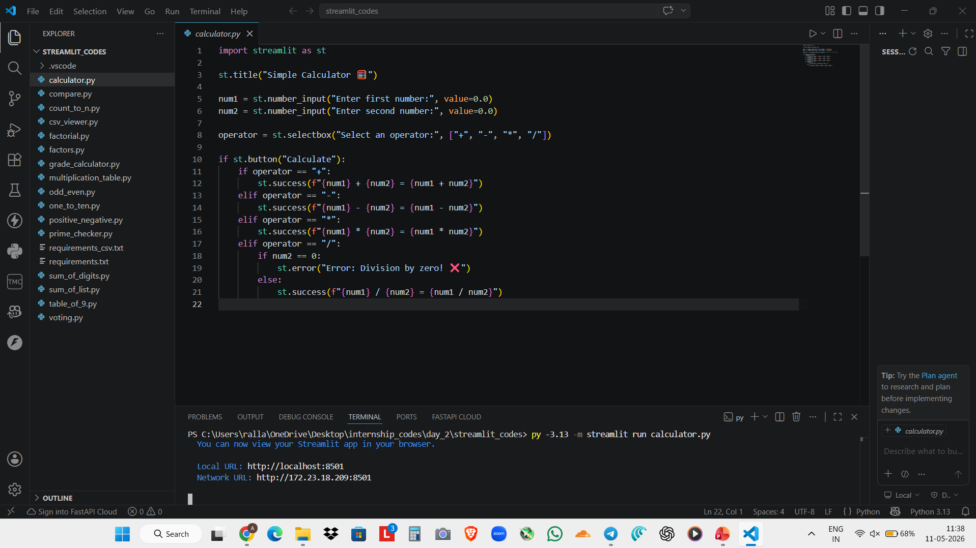
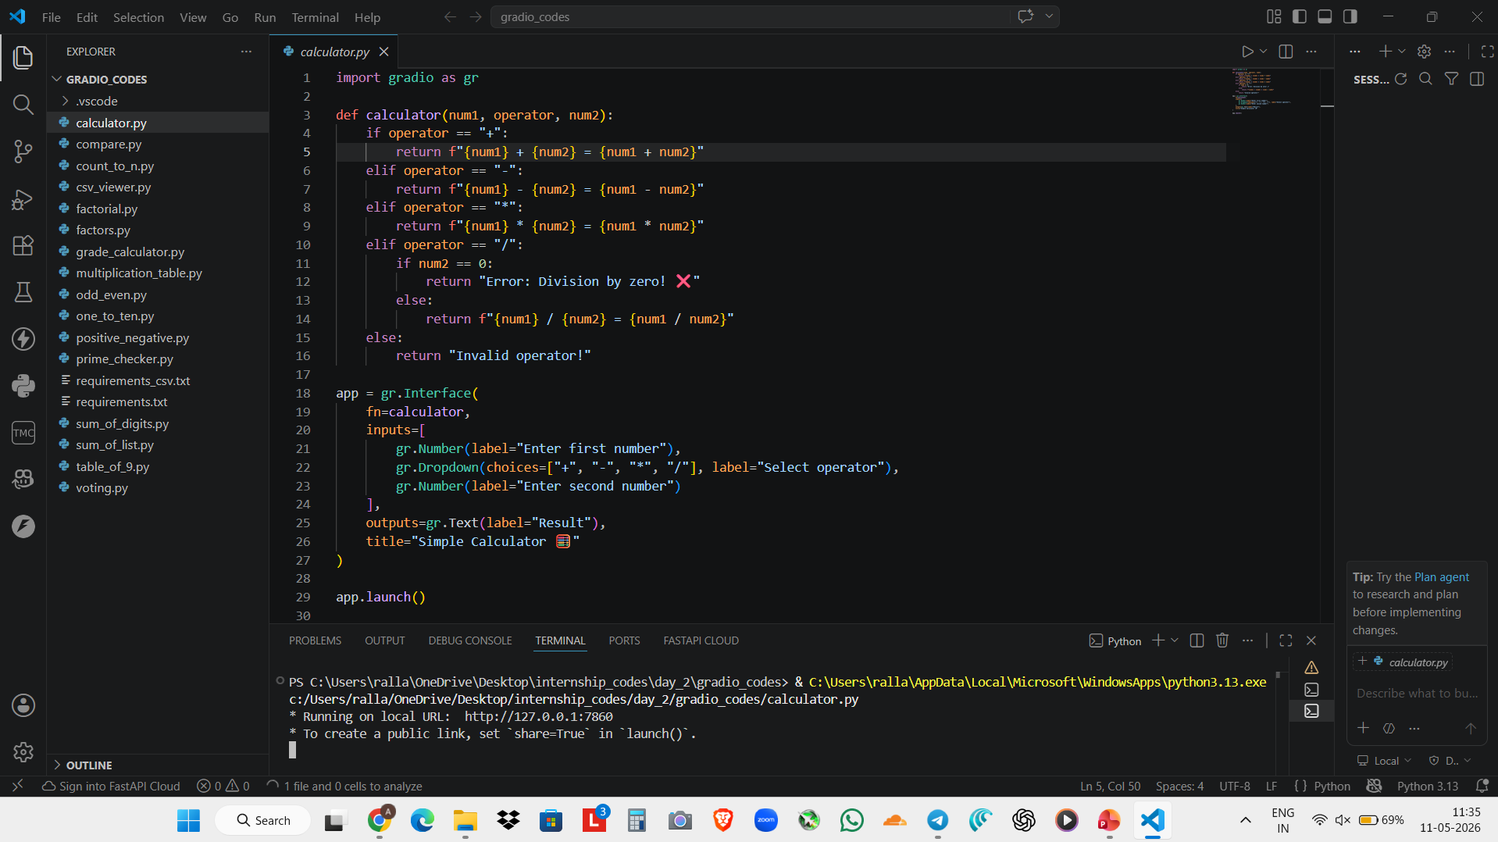
Streamlit and Gradio Calculator.py codes

Slide 7
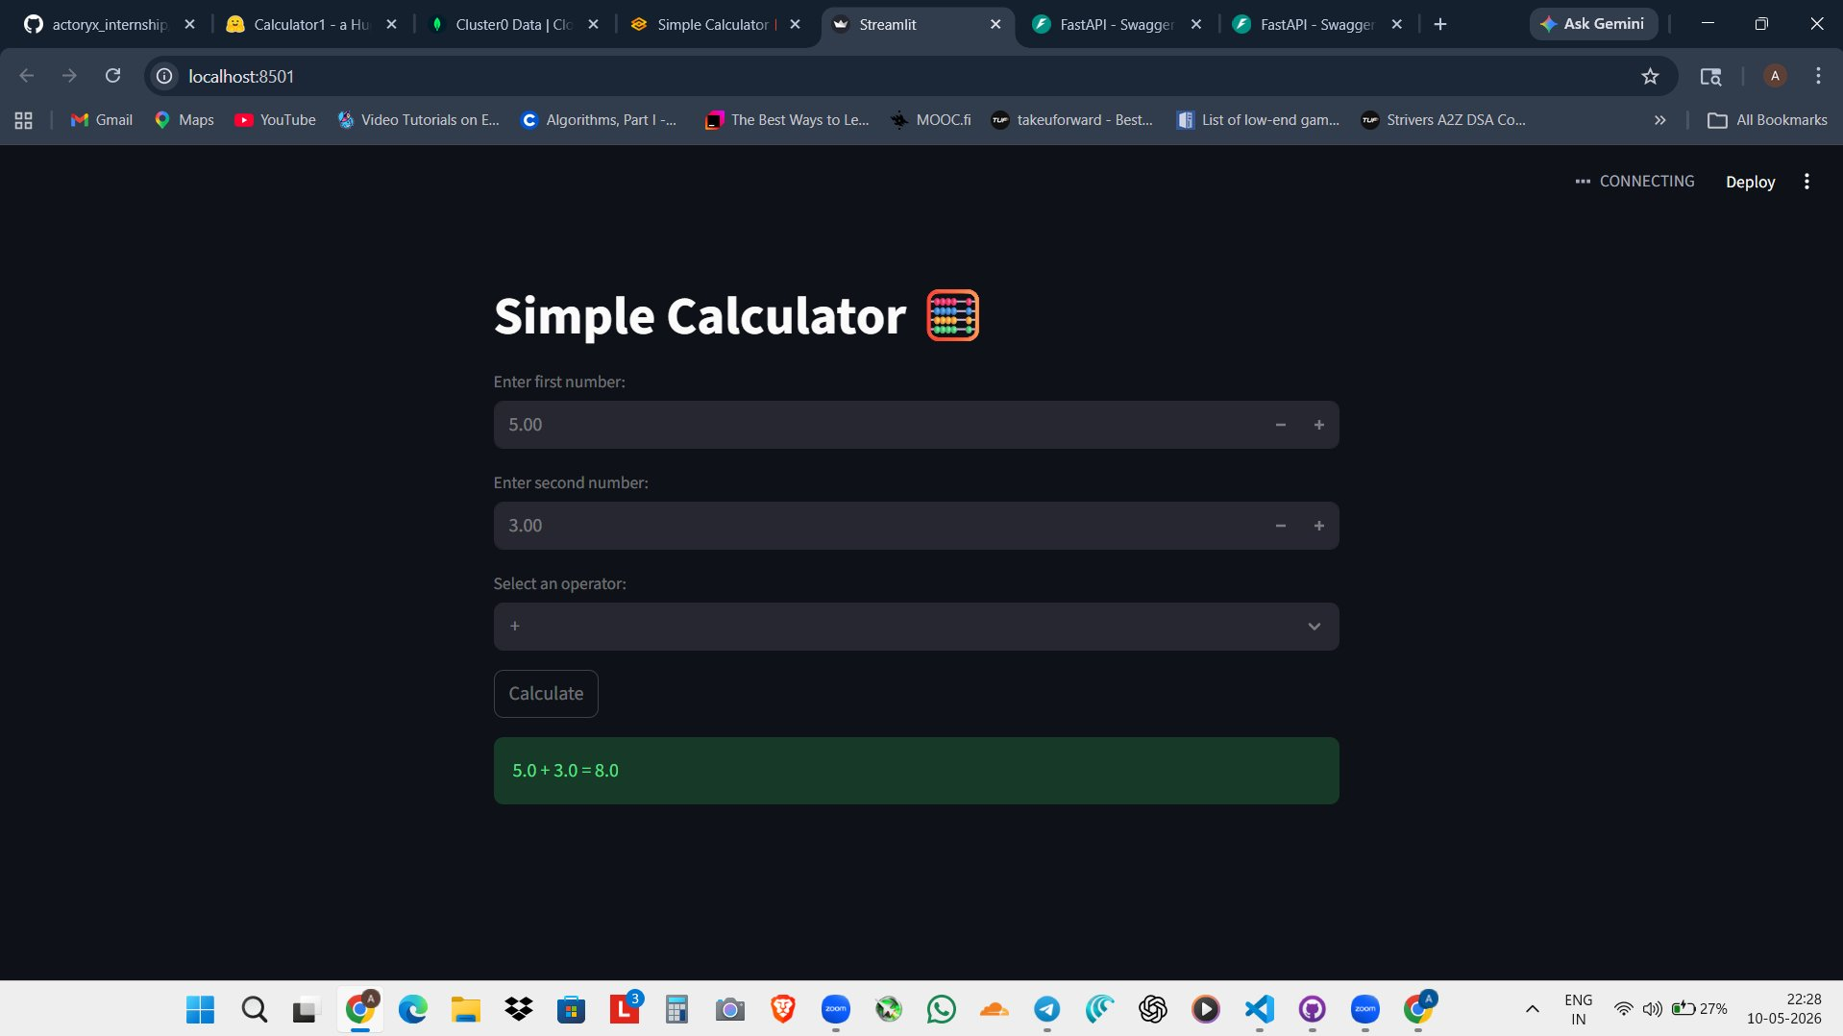
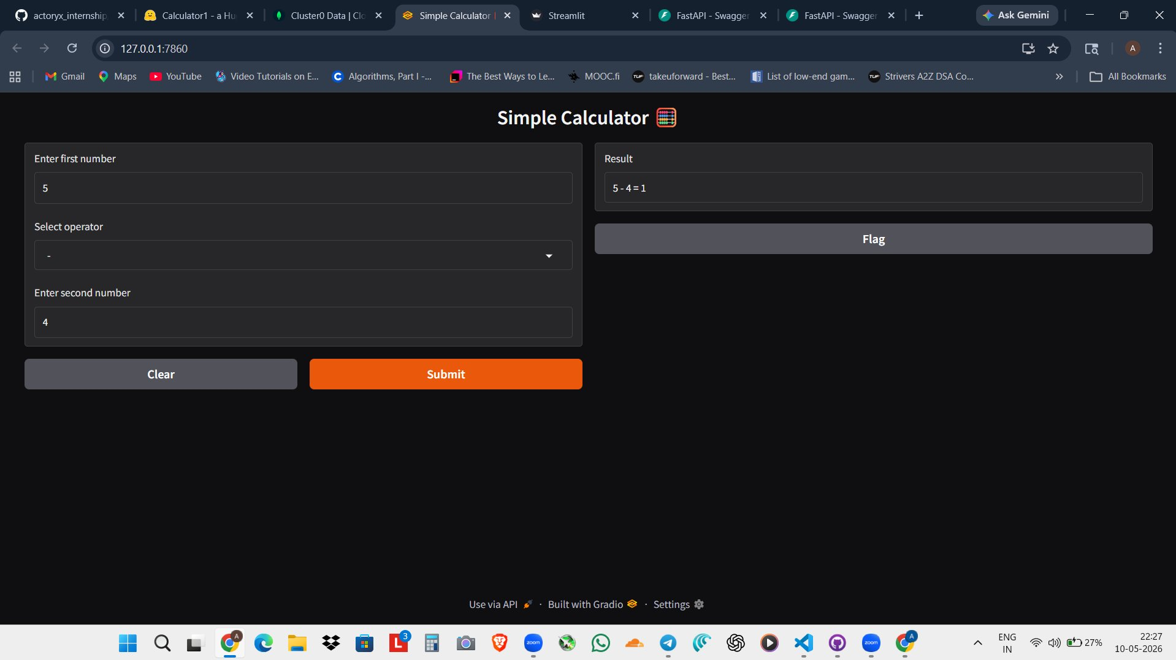
Same calculator logic · Two completely different UI frameworks
Day 2 — Live Screenshots: Streamlit vs Gradio
Streamlit Calculator (localhost:8501)
Gradio Calculator (localhost:7860)
localhost:8501 — st.number_input + st.selectbox + st.success()
localhost:7860 — gr.Interface() auto-generated layout
▸ Full layout control — you design the page
▸ UI auto-generated from the function signature
▸ Reruns the Python script on every widget change
▸ Inputs on the left, output panel on the right
▸ st.success() renders the green result box
▸ Submit button created automatically
Key difference: Streamlit = full layout control in Python | Gradio = declare the function, UI is auto-generated

Slide 8
REST API Endpoints + Full CRUD Application
Day 3 — FastAPI
⚡ 16 Programs as API Endpoints
🔄 CRUD Application
What is FastAPI?
What is CRUD?
A modern Python framework for building REST APIs. Instead of a web page, it exposes endpoints that other programs call over HTTP.
Create, Read, Update, Delete — the 4 fundamental database operations every real application needs.
@app.get("/odd-even")
def check(num: int):
result = "Even" if num%2==0 else "Odd"
return {"result": result}
# Test at: http://127.0.0.1:8000/docs
POST
Create
Add a new user record
GET
Read
Retrieve user by ID
HTTP Methods used:
GET
Parameters passed via URL query string
PUT
Update
Modify existing user
POST
Data sent in request body as JSON
Swagger
Auto-generated /docs for live testing
DELETE
Delete
Remove user from DB
Pydantic
Validates incoming request body shape
uvicorn main:app --reload
# Swagger UI → http://127.0.0.1:8000/docs

Slide 9
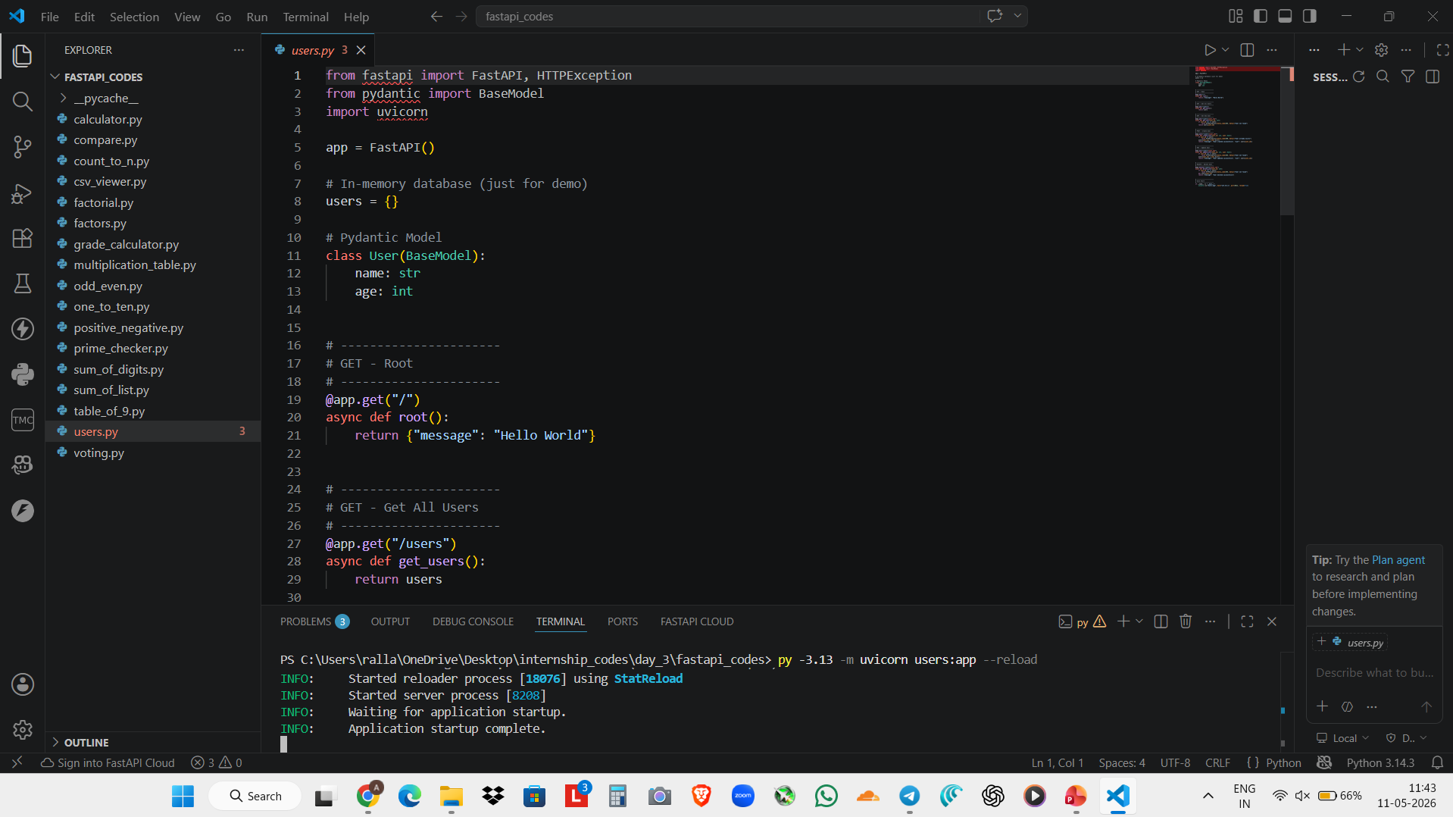
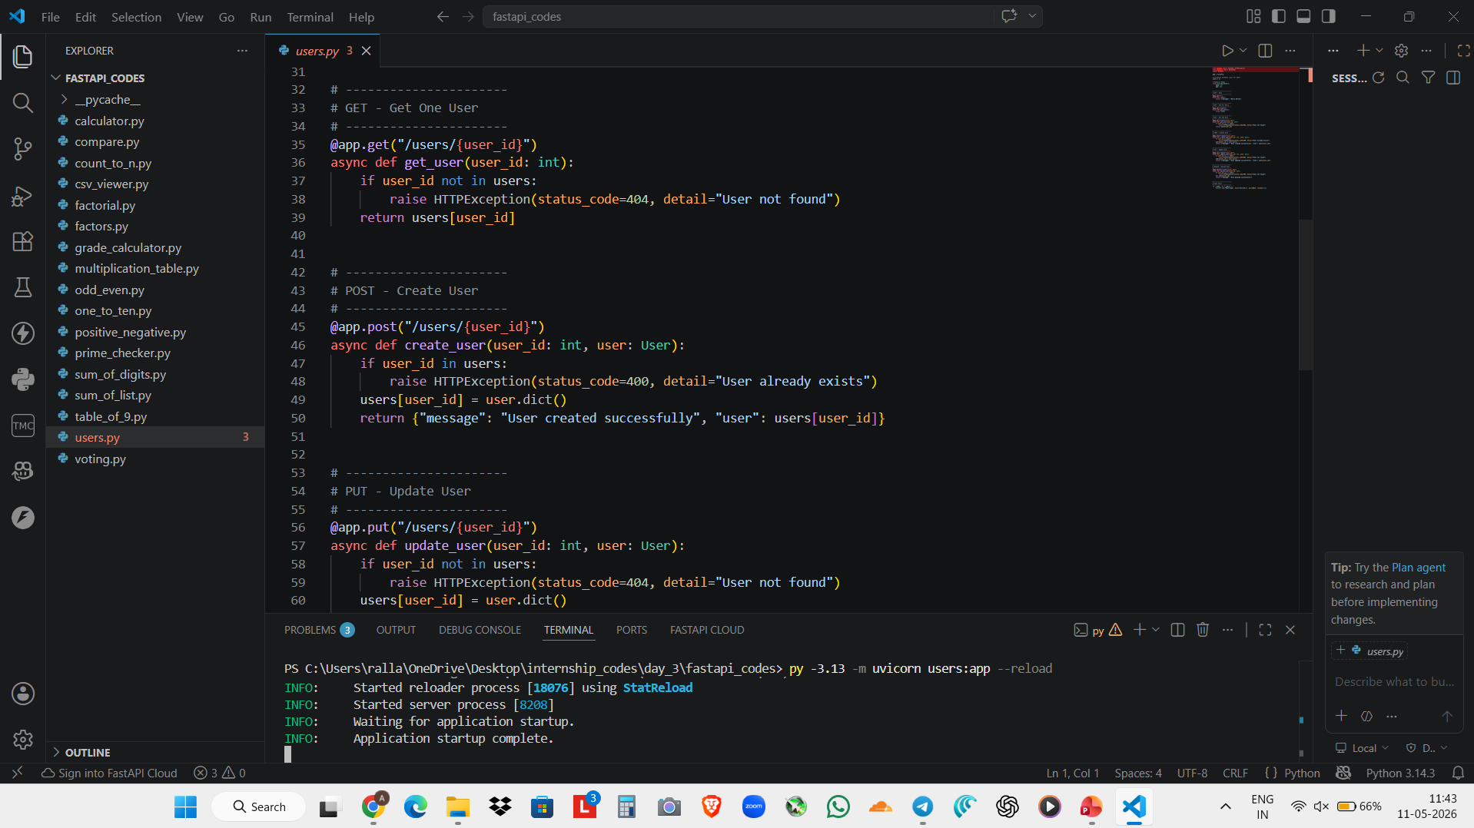
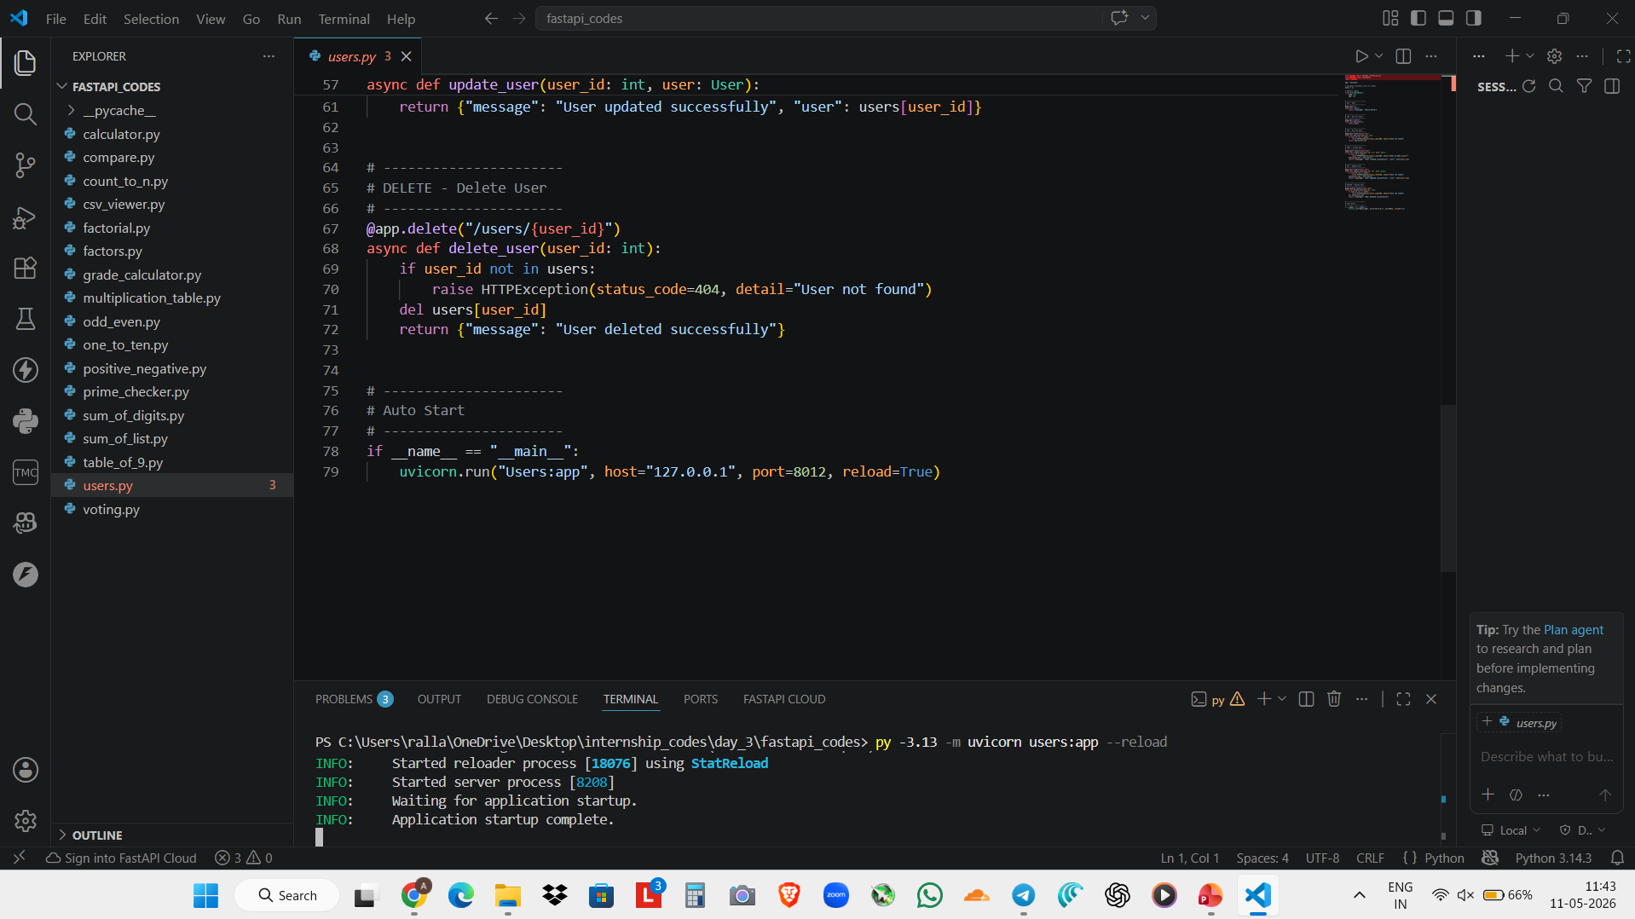
FastAPI CRUD App Code

Slide 10
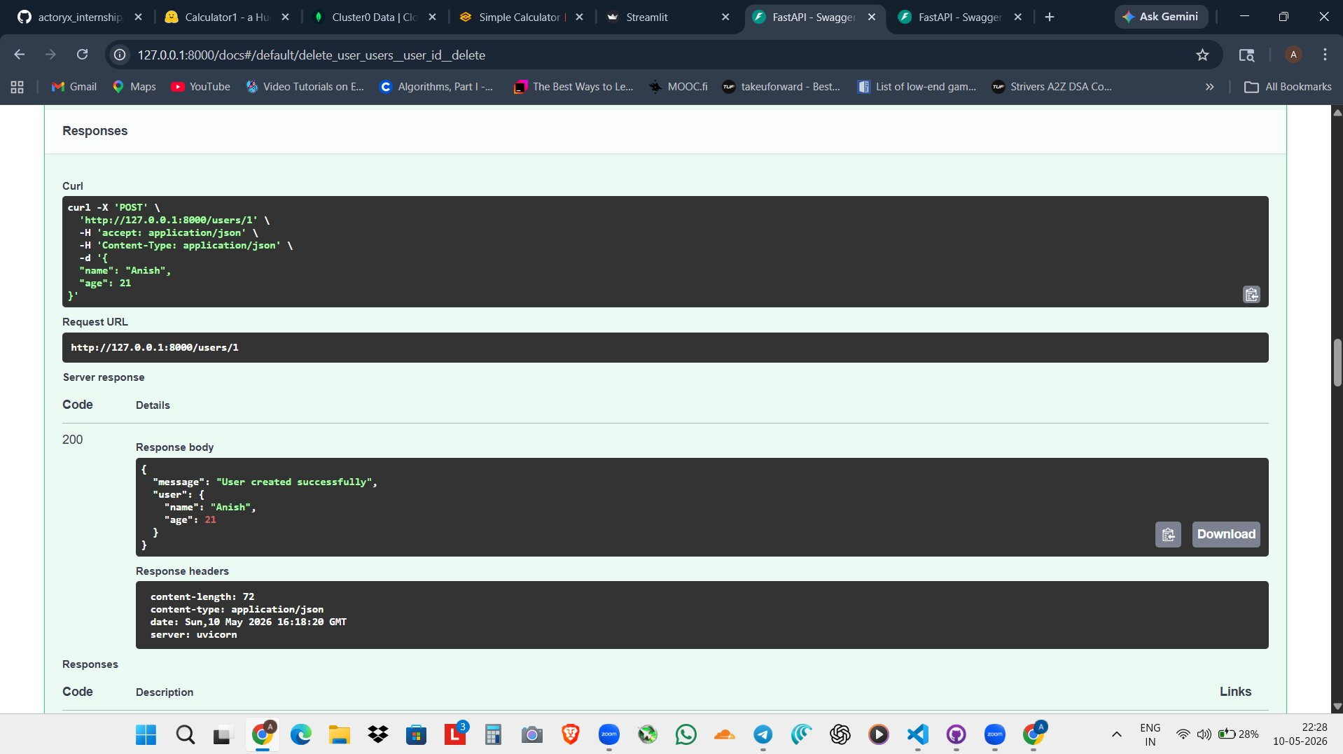
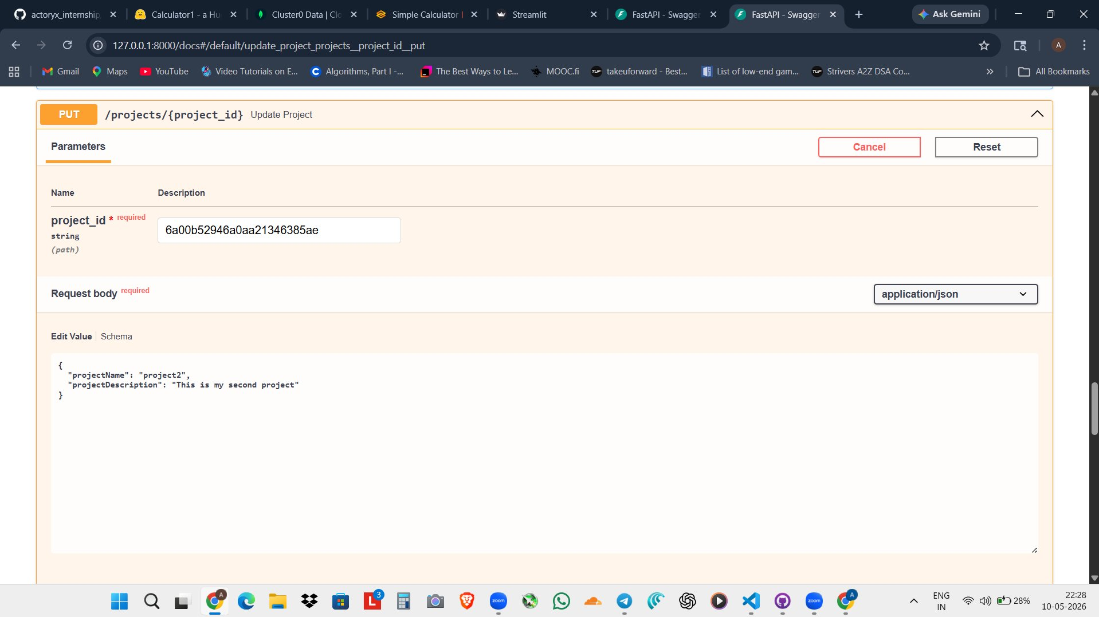
Tested live in browser at 127.0.0.1:8000/docs — no Postman needed
Day 3 — FastAPI Swagger UI in Action
POST /users — Create a user (200 OK response)
PUT /projects/{id} — Update a record
Response: { message: User created successfully, user: { name: Anish, age: 21 } }
PUT — projectName: project2, projectDescription: This is my second project
▸ Sent { name: 'Anish', age: 21 } as JSON body
▸ Passed project_id as a path parameter
▸ Server returned 200 OK with the created record
▸ Sent updated fields in the JSON request body
▸ Auto-generated cURL command shown below
▸ Pydantic validates the body shape automatically
FastAPI generates this entire Swagger UI automatically — no extra tools or configuration required

Slide 11
Cloud Deployment + Persistent Database Storage
Day 4 — Hugging Face Spaces & MongoDB Atlas
🤗 Hugging Face Spaces
🍃 MongoDB Atlas
What is it?
What is it?
Free cloud hosting for Streamlit and Gradio apps. Each Space = one app. Upload app.py + requirements.txt → it's live.
A NoSQL cloud database. Unlike SQL tables, MongoDB stores data as JSON documents inside collections — flexible, no fixed schema.
What was deployed:
Setup steps:
▸ 16 Streamlit apps — each with its own Space
▸ Created a free M0 cluster on atlas.mongodb.com
▸ 16 Gradio apps — each with its own Space
▸ Created a database user + connection string
▸ Total: 32 publicly accessible URLs
▸ Whitelisted IP address for access
▸ Each Space has app.py + requirements.txt
▸ Used pymongo library to connect FastAPI
▸ Correct SDK selected: Streamlit or Gradio
▸ CRUD operations now write to Atlas cloud
▸ Zero server setup — fully managed by HuggingFace
▸ Data persists even after server restarts
# requirements.txt
streamlit
pandas
client = MongoClient("mongodb+srv://...")
db = client["genai"]["projects"]

Slide 12
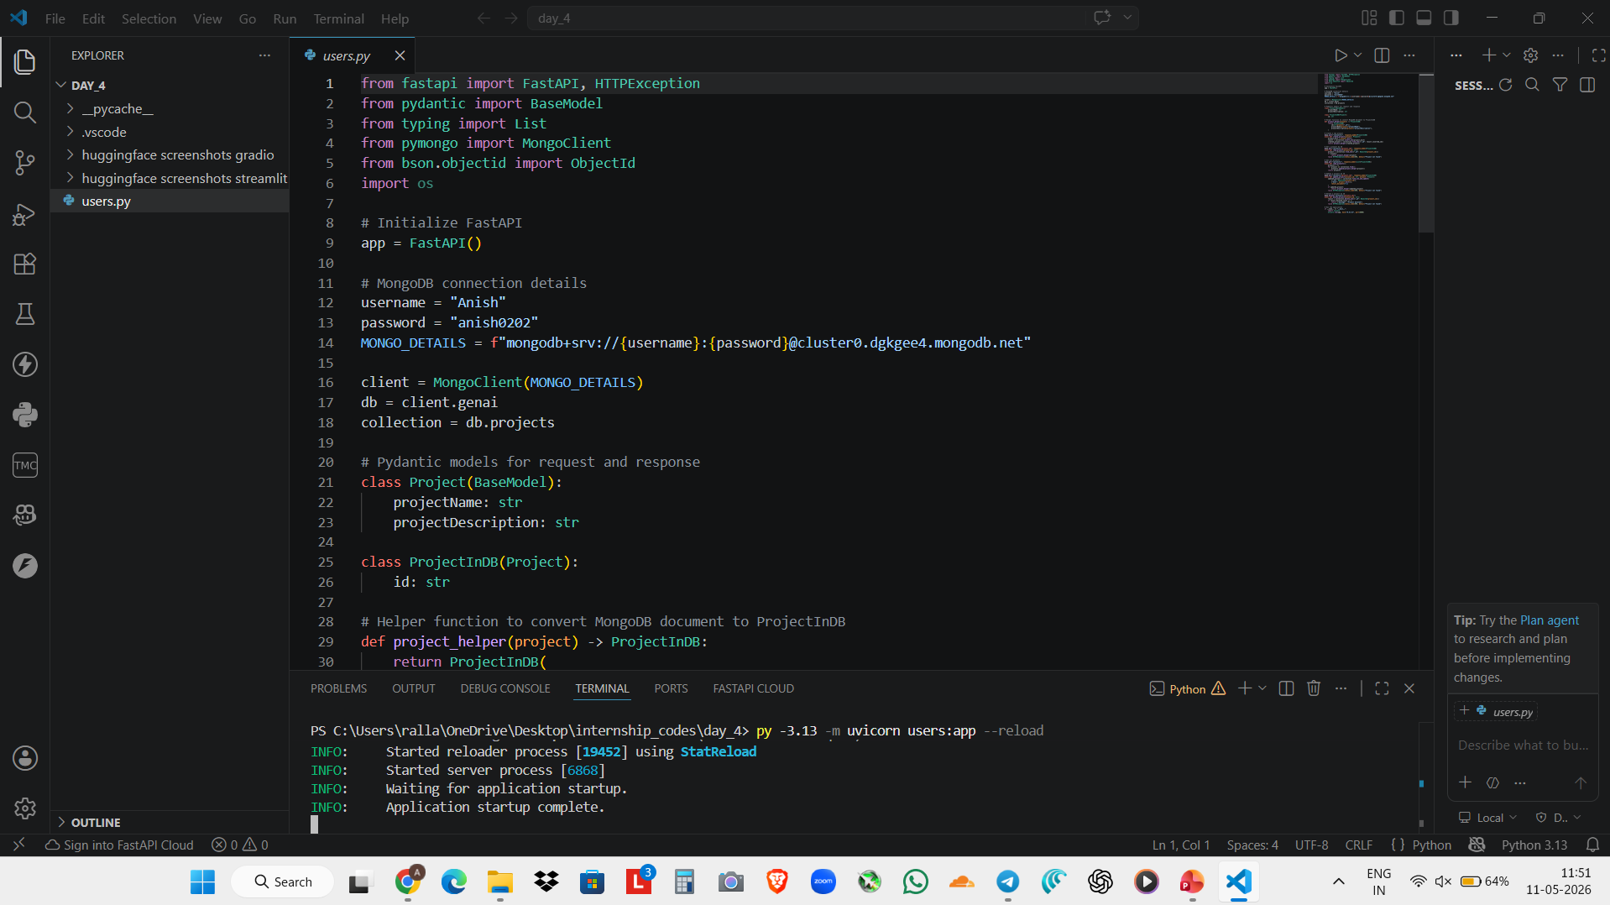
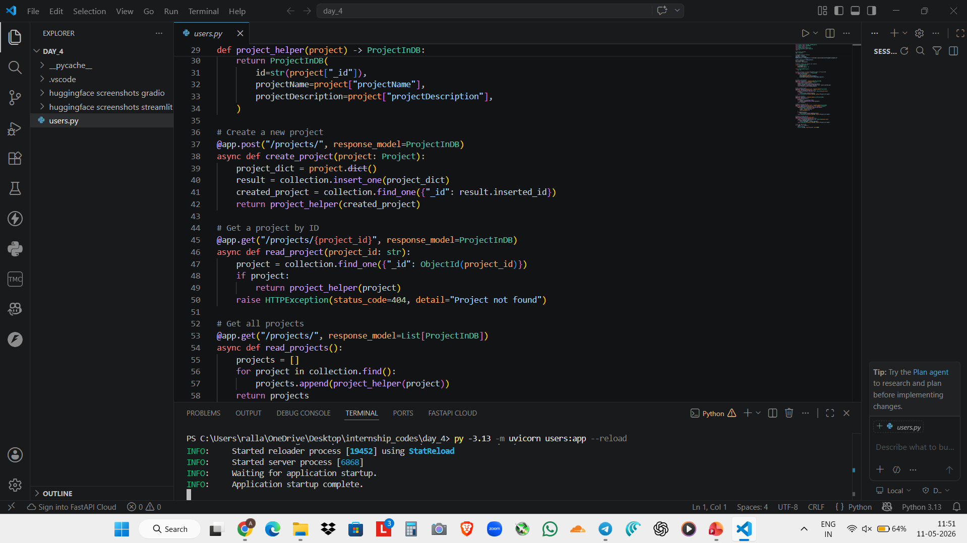
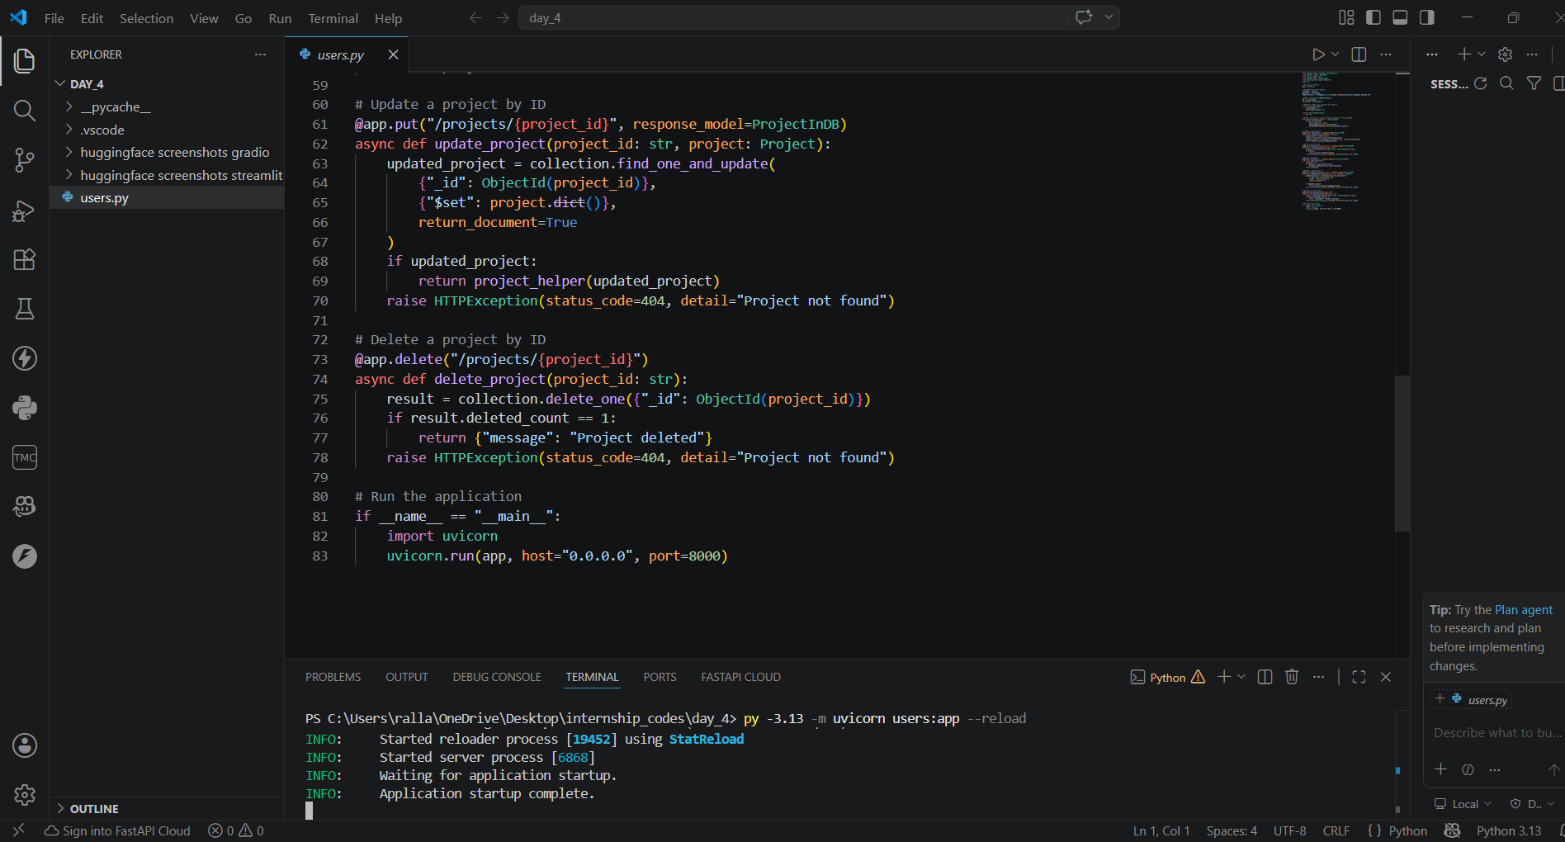
Code for the FastAPI CRUD App with MongoDB for persistent storage

Slide 13
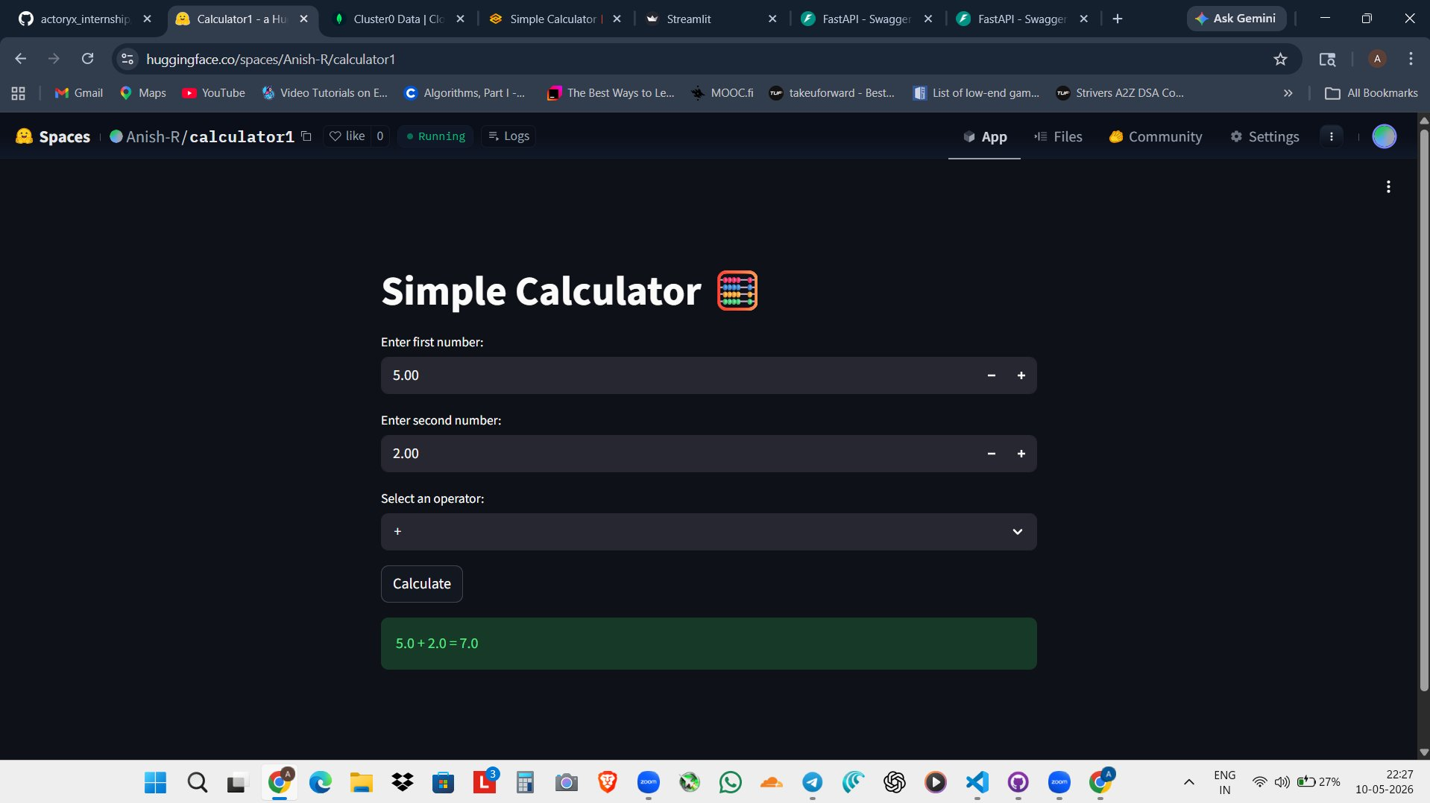
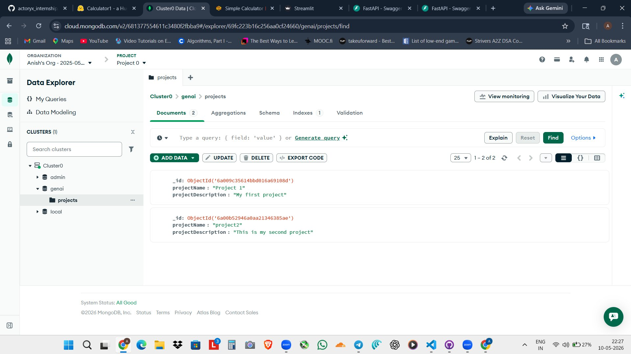
Apps deployed to the cloud · Data stored permanently
Day 4 — Live: HuggingFace Space & MongoDB Atlas
HuggingFace Space — Calculator App (Live)
MongoDB Atlas — Data Explorer
huggingface.co/spaces/Anish-R/calculator1 · Status: Running
Atlas → genai → projects collection → 2 documents stored
▸ Public URL — accessible by anyone, anywhere
▸ 2 project documents stored as JSON in Atlas
▸ Same app as localhost:8501 but hosted in cloud
▸ Each has _id (auto), projectName, projectDescription
▸ No Python installation needed for users
▸ Data persists permanently — survives server restart
Before MongoDB: data lost on server restart → After MongoDB Atlas: data lives permanently in the cloud

Slide 14
GitHub Desktop · All code organized and pushed to the cloud
Day 5 — Version Control with GitHub
What is GitHub?
A cloud platform for storing and tracking code using Git. Every change is recorded with a commit message — giving a full history of the project.
Repository Structure
Why it matters
actoryx_internship/
├── day_1/ → 16 Python programs (.py)
├── day_2/ → 16 Streamlit + 16 Gradio apps
├── day_3/ → FastAPI endpoints + CRUD app
└── day_4/ → HuggingFace apps + MongoDB
▸ Backup — code is safe even if local machine fails
▸ History — every day's work is recorded with timestamps
▸ Transparency — mentor can review all code at any time
▸ Collaboration — multiple people can work on same project
Key Git Concepts
▸ GitHub Desktop — visual UI, no command-line git needed
Repository
Project folder tracked by GitHub
▸ Organized by day — easy to navigate for presentations
Commit
Saved snapshot with a description
Workflow: Write code in VS Code → Open GitHub Desktop → Review changed files → Write commit message → Push to GitHub
Push
Upload local commits to GitHub
README.md
Project description shown on the repo page

Slide 15
7 Tools · 1 Complete Development Pipeline
Technologies Summary
🐍 Python
Foundation for all 16 programs. Loops, conditions, pattern matching (match/case), pandas for data.
🍃 MongoDB
NoSQL cloud database (Atlas). Connected to FastAPI with pymongo so CRUD data persists permanently.
🎈 Streamlit
Converted Python scripts to web apps. Full layout control using widgets like st.number_input and st.dataframe.
🤗 Hugging Face
Deployed all 32 web apps as public Spaces. Each app = its own URL. Free hosting, zero server management.
🔶 Gradio
Declarative UI — wrap any Python function with gr.Interface() and Gradio builds the entire page automatically.
🐙 GitHub
Version control for all code, organized by day. Used GitHub Desktop — no command-line git required.
⚡ FastAPI
Built REST API endpoints for all 16 programs + a CRUD app with POST/GET/PUT/DELETE and auto Swagger docs.

Slide 16
Week 1 Reflection
Key Takeaways
01
Went from basic Python scripts to fully deployed cloud applications — in just 5 days
02
Understood how 7 technologies connect into one real pipeline: write → UI → API → store → deploy → track
03
Built and publicly deployed 32 web applications (16 Streamlit + 16 Gradio) on Hugging Face Spaces
04
Implemented a complete CRUD API (POST, GET, PUT, DELETE) backed by a persistent MongoDB cloud database
05
Used GitHub for version control — all work organized into a clean, daily-folder repository structure

Slide 17
Thank You
Questions & Discussion
Anish Rallabandi | Actoryx Internship | Week 1
🔗 github.com/AnishR-02/actoryx_internship
16
32
7
5
Python Programs
Apps Deployed
Technologies
Days

