Slide 1
Torch Labs
Robotics infrastructure for software engineers and AI agents

Slide 2
PROBLEM
02
Robotics infrastructure is fragmented and expensive
Costly internal systems
Teams build and maintain their own infrastructure.
Fragmented tools
Remote access, testing, and data live in separate systems.
A new kind of user
AI agents need hardware access with clear limits.

Slide 3
MARKET TAILWINDS
03
AI agents are moving into physical systems
Applied Intuition
Anthropic
Dana
Model Hardware Standard
Agents for physical AI development and testing.
A shared specification for agents to operate physical devices.
July 2026
Research preview, August 2026

Slide 4
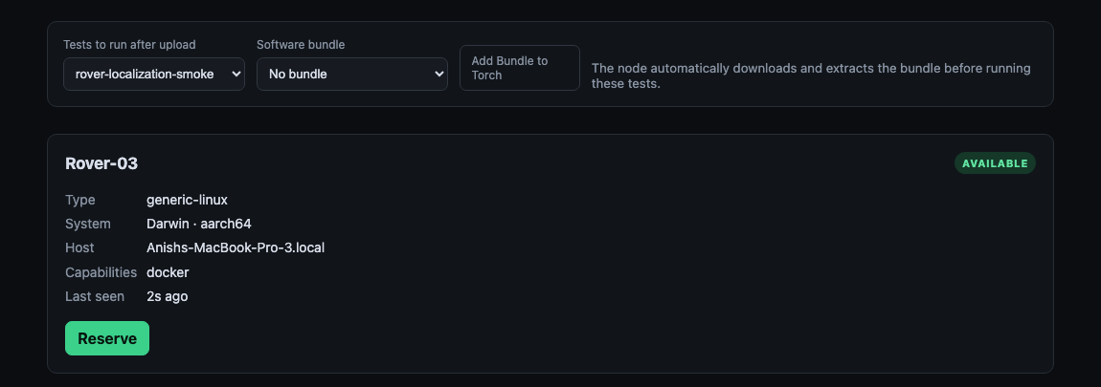
SOLUTION
04
Shared infrastructure for engineers and agents
Access company hardware, run software, and review results in one place.
Engineers decide what their agents can access and do.

Slide 5
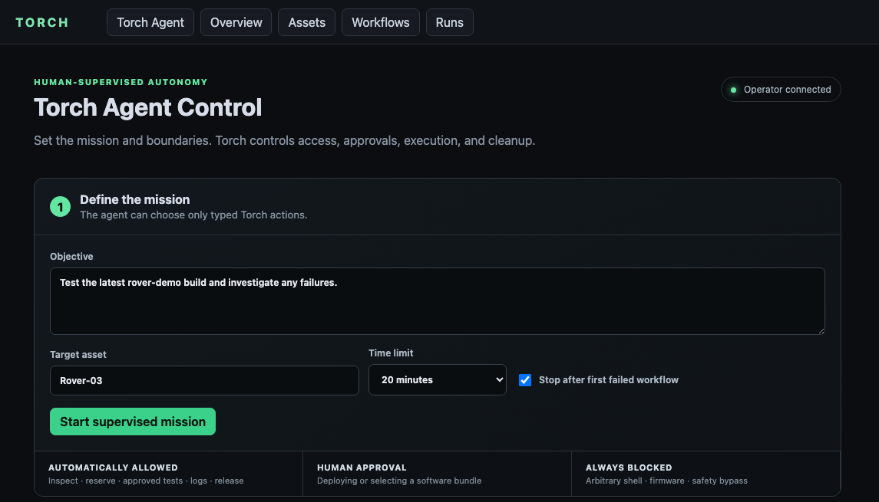
PRODUCT · 1 OF 4
05
The operator defines the mission and the limits
Choose the asset, deadline, failure policy, and objective before the agent acts.

Slide 6
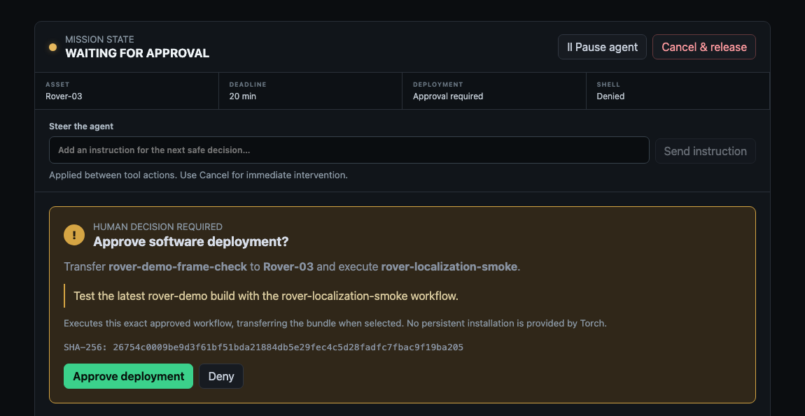
PRODUCT · 2 OF 4
06
Software changes stop for human approval
Torch shows the exact asset, workflow, bundle, reason, and SHA before deployment.

Slide 7
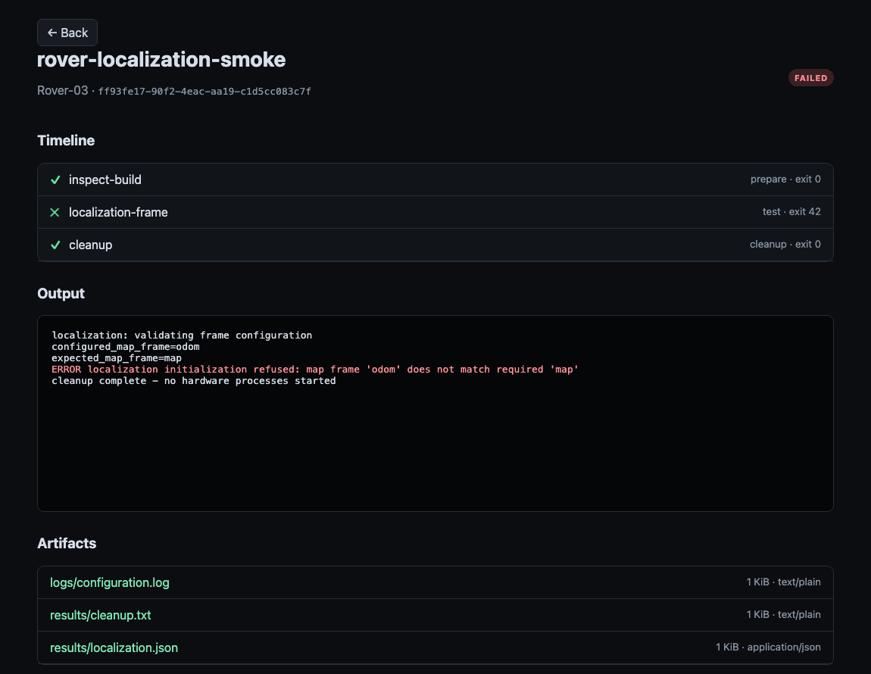
PRODUCT · 3 OF 4
07
Existing workflows run on real hardware
The node streams stdout, persists every step, attempts cleanup, and collects artifacts.
PREPARE
Inspect build
✓
TEST
Localization fails
×
CLEANUP
Still runs
✓

Slide 8
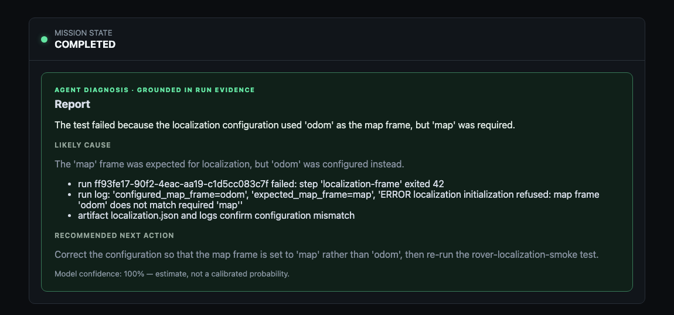
PRODUCT · 4 OF 4
08
The agent explains the failure from actual evidence
The model sees bounded Torch logs, step results, machine context, and artifact metadata—not SSH.

Slide 9
CUSTOMER VALUE
09
More time, money, and talent go into building robots
Lower overhead
A wider talent pool
More capacity
Fleet management
Spend less time and money building internal infrastructure.
Give engineers access to company hardware from anywhere.
Let agents take on hardware workflows alongside engineers.
If an asset goes down in the field, Torch can deploy an agent to fix it.

Slide 10
TEAM
10
The team behind Torch
Anish Reddy
Kol Bassuk
CEO
CTO
Computer science and robotics
Optical engineering
Met during an internship at Anduril

Slide 11
VISION
11
The standard infrastructure for robotics
Year 1
Year 2
Years 3+
Establish the workspace
Grow with customers
Become the standard
Win startups that need shared hardware access and testing.
Expand across their teams and hardware fleets. Reach midsize companies.
Serve robotics companies across development and deployed operations.

Slide 12
END GOAL
12
Every future robot will be built on this infrastructure.

