Slide 1

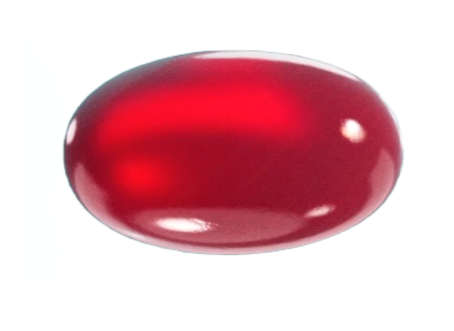


Superba Krill: The Natural Combination of Key Cellular Nutrients in Optimal Form
Natural multi-nutrient
Providing the highest levels of essential nutrients
PHOSPHOLIPIDS
CHOLINE
The key advantage of krill oil is the phospholipids, which are the exact form the body needs to better absorb and deliver the omega-3 and choline benefits throughout the body.
Krill oil contains choline, which is an essential nutrient that 9 in 10 people don’t get enough of in their diet. It helps regulate memory, mood, muscle control, and other important functions.*
OMEGA-3 EPA/DHA
ASTAXANTHIN
Krill oil supplies omega-3 EPA/DHA, which is an important nutrient that 4 in 5 people don’t get enough of in their diet. It helps support many aspects of health including heart, brain, joint, immunity, women’s health, and sports performance.*
Krill oil contains astaxanthin, which protects krill oil from oxidation, eliminating the need to add preservatives, additives.*
Pure, Natural and Clean
FISH CONSUMPTION STAT: https://www.cdc.gov/nchs/products/databriefs/db321.htm
CHOLINE CONSUMPTION STAT: https://pubmed.ncbi.nlm.nih.gov/26886842/

