Slide 1
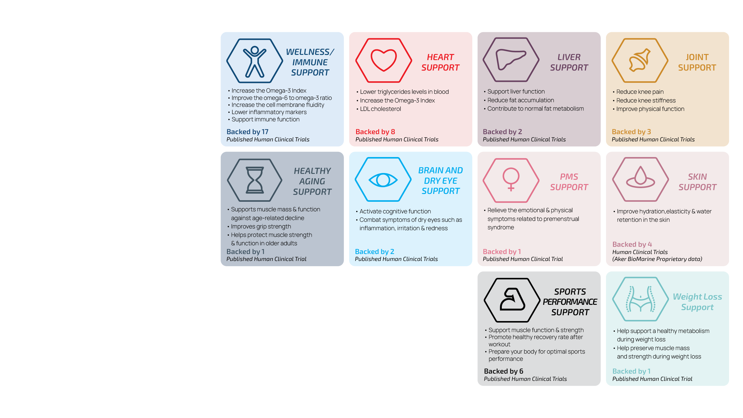
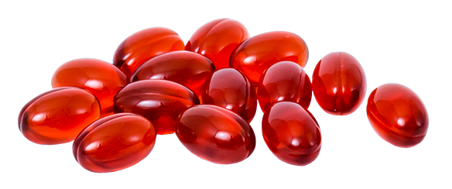
Multiple, proven health benefits
50+ Human Clinical Trials
135+
Total Studies
The above-mentioned bullet-points should not be interpreted as health claims. All prospective health claims should be checked by the customer for regulatory compliance

