Slide 1
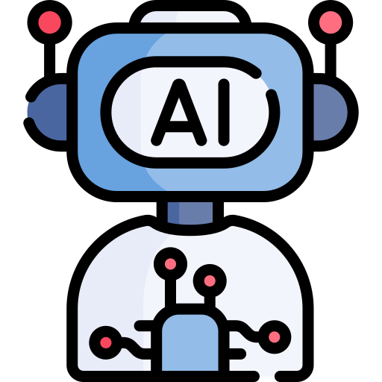
Introduction
Artificial Intelligence (AI) is a branch of computer science dedicated to creating systems that can perform tasks typically requiring human intelligence.

Slide 2
Historical Development
The origins of AI can be traced to philosophical discussions about the nature of intelligence and reasoning.

Slide 3
Core Areas of Artificial Intelligence
AI encompasses several subfields, each contributing to its overall capabilities: Machine Learning (ML): ML enables computers to learn from data without explicit programming.

Slide 4
Applications of AI
AI has become deeply integrated into daily life and industry: Healthcare: AI assists in diagnosing diseases, analyzing medical images, and developing personalized treatment plans.

Slide 5
Ethical and Societal Considerations
The rapid growth of AI raises important ethical and societal questions.

Slide 6
Future Prospects
AI continues to advance rapidly, with potential breakthroughs in areas such as artificial general intelligence (AGI), quantum computing, and bio-inspired algorithms.

Slide 7
Conclusion
Artificial Intelligence has transformed from a theoretical concept into a practical and indispensable tool for innovation and problem-solving.

