Slide 1
Basic Concepts of Statistics
A PRESENTATION BY:
GAURAV KR. PRAJAPAT
SR. AUDIT OFFICER
9461588507

Slide 2
What is Data?
Definition: Facts or figures, which are numerical or otherwise, collected with a definite purpose are called data.
Everyday we come across a lot of information in the form of facts, numerical figures, tables, graphs, etc.
These are provided by newspapers, televisions, magazines and other means of communication.
These may relate to cricket batting or bowling averages, profits of a company, temperatures of cities, expenditures in various sectors of a five year plan, polling results, and so on.
These facts or figures, which are numerical or otherwise, collected with a definite purpose are called data.

Slide 3
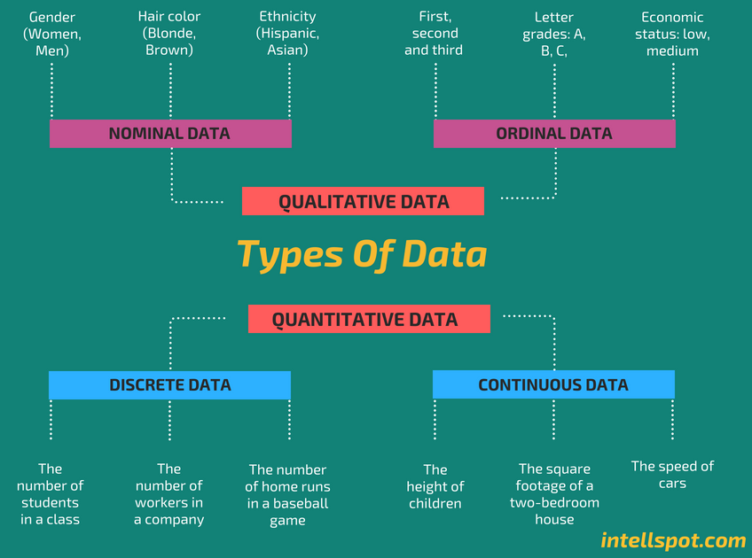

Slide 4
Primary Data Vs Secondary Data
Primary Data
Primary data is the data that is collected for the first time through personal experiences or evidence, particularly for research.
It is also described as raw data or first-hand information.
The mode of assembling the information is costly.
The data is mostly collected through observations, physical testing, mailed questionnaires, surveys, personal interviews, telephonic interviews, case studies, and focus groups, etc.

Slide 5
Primary Data Vs Secondary Data
Secondary Data
Secondary data is a second-hand data that is already collected and recorded by some researchers for their purpose, and not for the current research problem.
It is accessible in the form of data collected from different sources such as government publications, censuses, internal records of the organisation, books, journal articles, websites and reports, etc.
This method of gathering data is affordable, readily available, and saves cost and time.
However, the one disadvantage is that the information assembled is for some other purpose and may not meet the present research purpose or may not be accurate.

Slide 6
Discrete Vs continuous data
Discrete data (countable) is information that can only take certain values. These values don’t have to be whole numbers but they are fixed values – such as shoe size, number of teeth, number of kids, etc.
Discrete data includes discrete variables that are finite, numeric, countable, and non-negative integers (5, 10, 15, and so on).
Continuous data (measurable) is data that can take any value. Height, weight, temperature and length are all examples of continuous data.
Continuous data changes over time and can have different values at different time intervals like weight of a person.

Slide 7
Data Presentation
Two types of statistical presentation of data - graphical and numerical.
Graphical Presentation: We look for the overall pattern and for striking deviations from that pattern. Over all pattern usually described by shape, center, and spread of the data. An individual value that falls outside the overall pattern is called an outlier.
Bar diagram and Pie charts are used for categorical variables.
Histogram, stem and leaf and Box-plot are used for numerical variable.

Slide 8
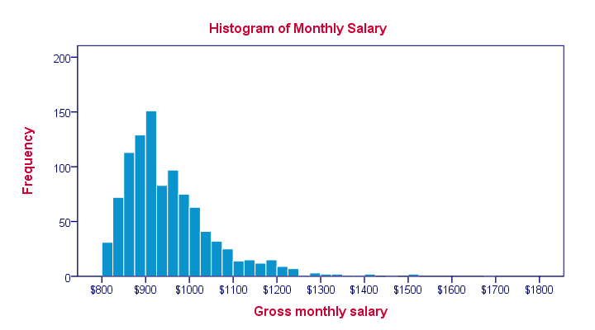
Histogram
A histogram is a graphical display of data using bars of different heights. In a histogram, each bar groups numbers into ranges. Taller bars show that more data falls in that range. A histogram displays the shape and spread of continuous sample data

Slide 9
Box Plotting
Box plots (also called box-and-whisker plots or box-whisker plots) give a good graphical image of the concentration of the data.
They also show how far the extreme values are from most of the data.
A box plot is constructed from five values: the minimum value, the first quartile, the median, the third quartile, and the maximum value.

Slide 10
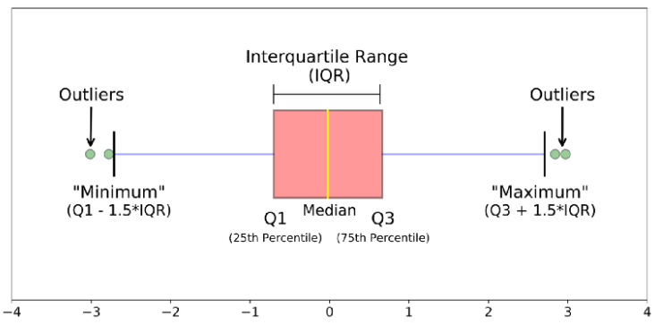
Box Plotting
The image above is a boxplot. A boxplot is a standardized way of displaying the distribution of data based on a five number summary (“minimum”, first quartile (Q1), median, third quartile (Q3), and “maximum”). It can tell you about your outliers and what their values are. It can also tell you if your data is symmetrical, how tightly your data is grouped, and if and how your data is skewed.

Slide 11
Statistical concepts of classification of Data
Classification is the process of arranging data into homogeneous (similar) groups according to their common characteristics.
Raw data cannot be easily understood, and it is not fit for further analysis and interpretation. Arrangement of data helps users in comparison and analysis. It is also important for statistical sampling.

Slide 12
Classification of Data
There are four types of classification. They are:
  Geographical classification
  When data are classified on the basis of location or areas, it is called geographical classification
  Chronological classification
  Chronological classification means classification on the basis of time, like months, years etc.
  Qualitative classification
  In Qualitative classification, data are classified on the basis of some attributes or quality such as gender, colour of hair, literacy and religion. In this type of classification, the attribute under study cannot be measured. It can only be found out whether it is present or absent in the units of study.
  Quantitative classification
  Quantitative classification refers to the classification of data according to some characteristics, which can be measured such as height, weight, income, profits etc.

Slide 13
Quantitative classification
There are two types of quantitative classification of data: Discrete frequency distribution and Continuous frequency distribution.
In this type of classification there are two elements
  variable
  Variable refers to the characteristic that varies in magnitude or quantity. E.g. weight of the students. A variable may be discrete or continuous.
  Frequency
  Frequency refers to the number of times each variable gets repeated. For example there are 50 students having weight of 60 kgs. Here 50 students is the frequency.

Slide 14
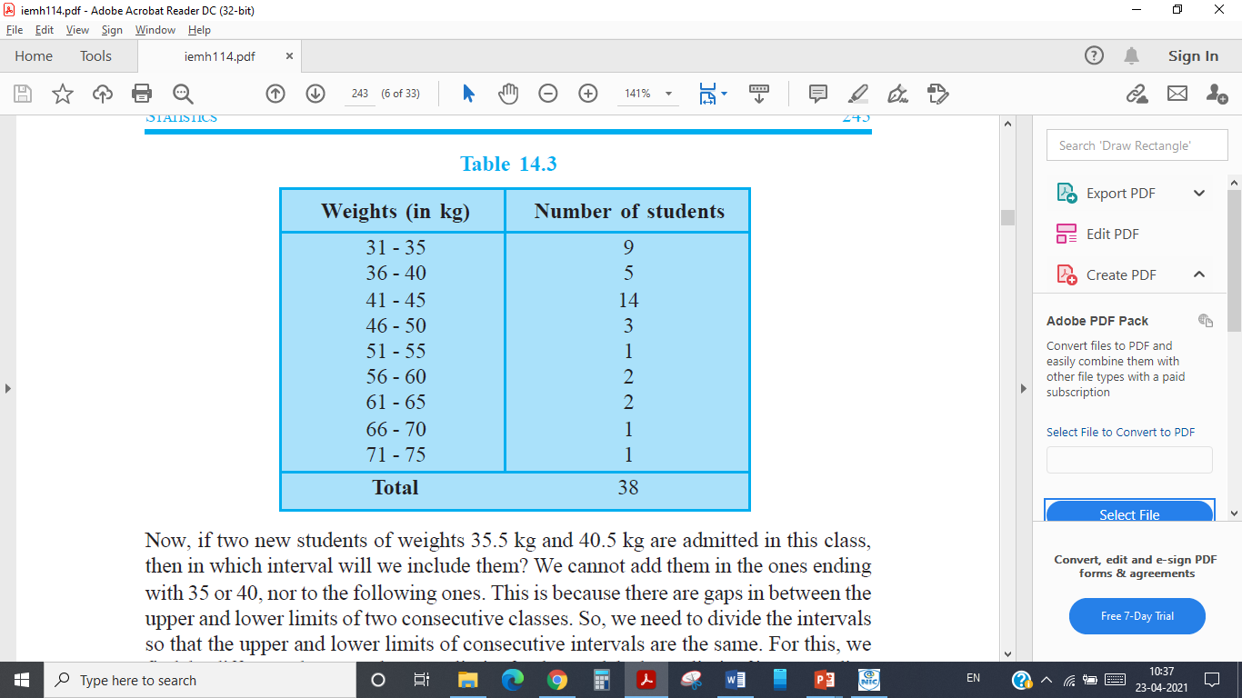
Frequency distribution
Frequency distribution refers to data classified on the basis of some variable that can be measured such as prices, weight, height, wages etc.

Slide 15
Frequency distribution
The following technical terms are important when a continuous frequency distribution is formed
Class limits: Class limits are the lowest and highest values that can be included in a class. For example take the class 51-55. The lowest value of the class is 51 and the highest value is 55. In this class there can be no value lesser than 51 or more than 55. 51 is the lower class limit and 55 is the upper class limit.
Class interval: The difference between the upper and lower limit of a class is known as class interval of that class.
Class frequency: The number of observations corresponding to a particular class is known as the frequency of that class

Slide 16
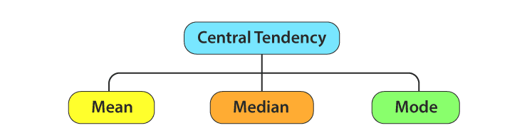
Measures of Centre Tendency
In statistics, the central tendency is the descriptive summary of a data set.
Through the single value from the dataset, it reflects the centre of the data distribution.
Moreover, it does not provide information regarding individual data from the dataset, where it gives a summary of the dataset. Generally, the central tendency of a dataset can be defined using some of the measures in statistics.

Slide 17
Mean
The mean represents the average value of the dataset.
It can be calculated as the sum of all the values in the dataset divided by the number of values. In general, it is considered as the arithmetic mean.
Some other measures of mean used to find the central tendency are as follows:
  Geometric Mean (nth root of the product of n numbers)
  Harmonic Mean (the reciprocal of the average of the reciprocals)
  Weighted Mean (where some values contribute more than others)
It is observed that if all the values in the dataset are the same, then all geometric, arithmetic and harmonic mean values are the same. If there is variability in the data, then the mean value differs.

Slide 18
Arithmetic Mean
Arithmetic mean represents a number that is obtained by dividing the sum of the elements of a set by the number of values in the set. So you can use the layman term Average. If any data set consisting of the values b₁, b₂, b₃, …., b_{n} then the arithmetic mean B is defined as:
B = (Sum of all observations)/ (Total number of observation)
The arithmetic mean of Virat Kohli’s batting scores also called his Batting Average is;
Sum of runs scored/Number of innings = 661/10
The arithmetic mean of his scores in the last 10 innings is 66.1.

Slide 19
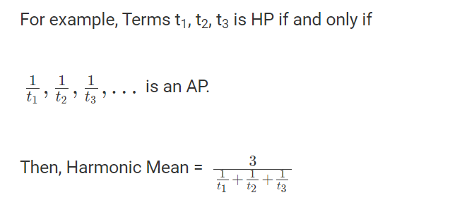
Harmonic Mean
A Harmonic Progression is a sequence if the reciprocals of its terms are in Arithmetic Progression, and harmonic mean (or shortly written as HM) can be calculated by dividing the number of terms by reciprocals of its terms.
In particular cases, especially those involving rates and ratios, the harmonic mean gives the most correct value of the mean. For example, if a vehicle travels a specified distance at speed x (eg 60 km / h) and then travels again at the speed y (e.g.40 km / h), the average speed value is the harmonic mean x, y (Ie, 48 km / h).

Slide 20
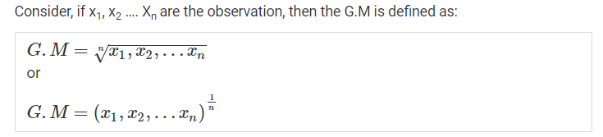
Geometric Mean
The Geometric Mean (GM) is the average value or mean which signifies the central tendency of the set of numbers by finding the product of their values.
Basically, we multiply the numbers altogether and take out the nth root of the multiplied numbers, where n is the total number of values.
For example: for a given set of two numbers such as 3 and 1, the geometric mean is equal to √(3+1) = √4 = 2.

Slide 21
Use of Geometric Mean
For example, suppose you have an investment which earns 10% the first year, 50% the second year, and 30% the third year. What is its average rate of return?
It is not the arithmetic mean, because what these numbers mean is that on the first year your investment was multiplied (not added to) by 1.10, on the second year it was multiplied by 1.60, and the third year it was multiplied by 1.20. The relevant quantity is the geometric mean of these three numbers.
The question about finding the average rate of return can be rephrased as: "by what constant factor would your investment need to be multiplied by each year in order to achieve the same effect as multiplying by 1.10 one year, 1.60 the next, and 1.20 the third?"
If you calculate this geometric mean
You get approximately 1.283, so the average rate of return is about 28% (not 30% which is what the arithmetic mean of 10%, 60%, and 20% would give you).

Slide 22
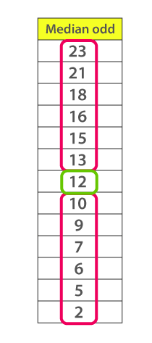
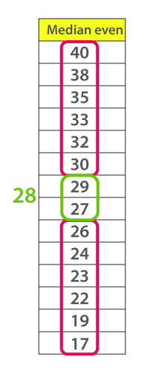
Median
Median is the middle value of the dataset in which the dataset is arranged in the ascending order or in descending order.
When the dataset contains an even number of values, then the median value of the dataset can be found by taking the mean of the middle two values.
If you have skewed distribution, the best measure of finding the central tendency is the median.
The median is less sensitive to outliers (extreme scores) than the mean and thus a better measure than the mean for highly skewed distributions, e.g. family income. For example mean of 20, 30, 40, and 990 is (20+30+40+990)/4 =270. The median of these four observations is (30+40)/2 =35. Here 3 observations out of 4 lie between 20-40. So, the mean 270 really fails to give a realistic picture of the major part of the data. It is influenced by extreme value 990.

Slide 23
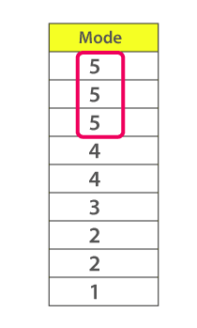
Mode
The mode represents the frequently occurring value in the dataset.
Sometimes the dataset may contain multiple modes and in some cases, it does not contain any mode at all.
If you have categorical data, the mode is the best choice to find the central tendency.

Slide 24
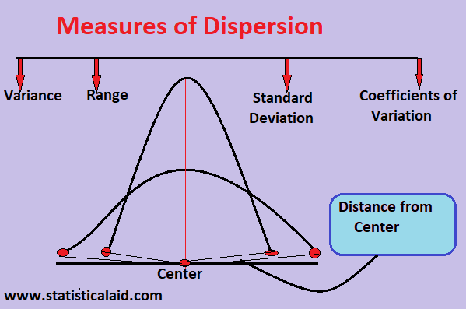
Measures of Dispersion
Dispersion is the state of getting dispersed or spread. Statistical dispersion means the extent to which a numerical data is likely to vary about an average value. In other words, dispersion helps to understand the distribution of the data.

Slide 25
Objectives of computing dispersion
Comparative study
Measures of dispersion give a single value indicating the degree of consistency or uniformity of distribution. This single value helps us in making comparisons of various distributions.
Reliability of an average
A small value of dispersion means low variation between observations and average. It means that the average is a good representative of observation and very reliable. A higher value of dispersion means greater deviation among the observations.
Control the variability
Different measures of dispersion provide us data of variability from different angles, and this knowledge can prove helpful in controlling the variation.
Basis for further statistical analysis
Measures of dispersion provide the basis for further statistical analysis like computing correlation, regression, test of hypothesis, sampling etc.

Slide 26
Types of Measures of Dispersion
There are two main types of dispersion methods in statistics which are:
  Absolute Measure of Dispersion
  Relative Measure of Dispersion

Slide 27
Absolute Measure of Dispersion
An absolute measure of dispersion contains the same unit as the original data set. Absolute dispersion method expresses the variations in terms of the average of deviations of observations like standard or means deviations. It includes range, standard deviation, quartile deviation, etc. The types of absolute measures of dispersion are:
Range: It is simply the difference between the maximum value and the minimum value given in a data set. Example: 1, 3,5, 6, 7 => Range = 7 -1= 6
Variance: Deduct the mean from each data in the set then squaring each of them and adding each square and finally dividing them by the total no of values in the data set is the variance. Variance (σ2)=∑(X−μ)2/N
Standard Deviation: The square root of the variance is known as the standard deviation i.e. S.D. = √σ.
Quartiles and Quartile Deviation: The quartiles are values that divide a list of numbers into quarters. The quartile deviation is half of the distance between the third and the first quartile.
Mean and Mean Deviation: The average of numbers is known as the mean and the arithmetic mean of the absolute deviations of the observations from a measure of central tendency is known as the mean deviation (also called mean absolute deviation).

Slide 28
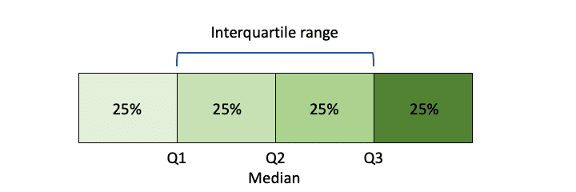
Range
It is the simplest method of measurement of dispersion.
It is defined as the difference between the largest and the smallest item in a given distribution.
Range = Largest item (L) – Smallest item (S)
Interquartile Range
It is defined as the difference between the Upper Quartile and Lower Quartile of a given distribution.
Interquartile Range = Upper Quartile (Q₃)–Lower Quartile(Q₁)

Slide 29
Variance
Variance is a measure of how data points differ from the mean.
A variance is a measure of how far a set of data (numbers) are spread out from their mean (average) value.
The more the value of variance, the data is more scattered from its mean and if the value of variance is low or minimum, then it is less scattered from mean. Therefore, it is called a measure of spread of data from mean.
the formula for variance is
  Var (X) = E[(X –μ) ²]
the variance is the square of standard deviation, i.e.,
Variance = (Standard deviation)²= σ²

Slide 30
Variance
Example: Find the variance of the numbers 3, 8, 6, 10, 12, 9, 11, 10, 12, 7.
Given,
3, 8, 6, 10, 12, 9, 11, 10, 12, 7
Step 1: Compute the mean of the 10 values given.
Mean (μ) = (3+8+6+10+12+9+11+10+12+7) / 10 = 88 / 10 = 8.8

Slide 31
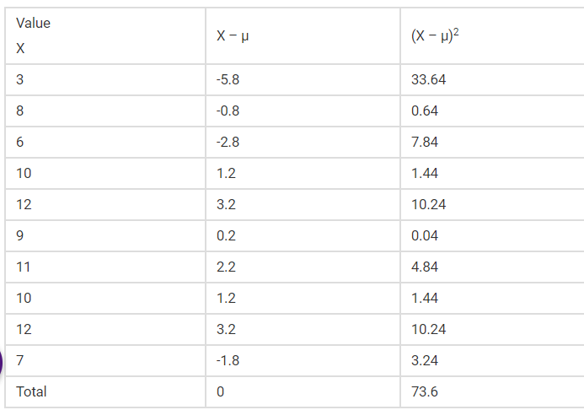
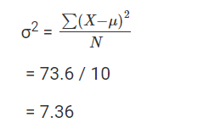
Variance

Slide 32

Coefficient of variance
The coefficient of variance (CV) is a relative measure of variability that indicates the size of a standard deviation in relation to its mean.
It is a standardized, unitless measure that allows you to compare variability between disparate groups and characteristics.
It is also known as the relative standard deviation (RSD).
The coefficient of variation facilitates meaningful comparisons in scenarios where absolute measures cannot.

Slide 33
Quartile Deviation
The Quartile Deviation (QD) is the product of half of the difference between the upper and lower quartiles.
Mathematically we can define as: Quartile Deviation = (Q3 – Q1) / 2
Quartile Deviation defines the absolute measure of dispersion. Whereas the relative measure corresponding to QD, is known as the coefficient of QD, which is obtained by applying the certain set of the formula: Coefficient of Quartile Deviation = (Q3 – Q1) / (Q3 + Q1)
A Coefficient of QD is used to study & compare the degree of variation in different situations.

Slide 34
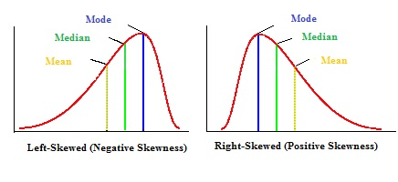
Skewness
Skewness is a measure of the degree of asymmetry of a distribution.
If the left tail (tail at small end of the distribution) is more pronounced than the right tail (tail at the large end of the distribution), the function is said to have negative skewness.
If the reverse is true, it has positive skewness. If the two are equal, it has zero skewness.

Slide 35
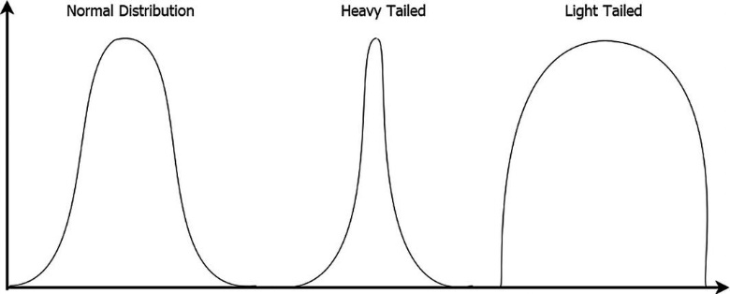
Kurtosis
Kurtosis is a measure of whether the data are heavy-tailed or light-tailed relative to a normal distribution.
That is, data sets with high kurtosis tend to have heavy tails, or outliers. Data sets with low kurtosis tend to have light tails, or lack of outliers.
Significant skewness and kurtosis clearly indicate that data are not normal.

