Slide 1
Machine Learning for Healthcare Readmission Prediction
Name: Anish Kumar Thakur
Unit: Machine Learning
Institution: International School of Management and Technology
Lecturer Name
Submission Date

Slide 2
Introduction
Healthcare generates massive patient data
Manual analysis is difficult
Machine Learning helps discover patterns
Goal: Predict patient readmission risk

Slide 3
Project Scenario – HealthGuard
HealthGuard wants to improve healthcare analytics
MediTech Solutions develops ML tools
Objective: Predict hospital readmission
Helps reduce cost and improve patient care

Slide 4
What is Machine Learning?
Computers learn patterns from historical data
Models make predictions on new data
Used in healthcare, finance, business analytics

Slide 5
Types of Machine Learning
Supervised Learning – uses labelled data
Unsupervised Learning – finds hidden patterns
Reinforcement Learning – learning through reward/penalty

Slide 6
Algorithms Used
Logistic Regression
Decision Tree
Random Forest
These algorithms are suitable for classification tasks

Slide 7
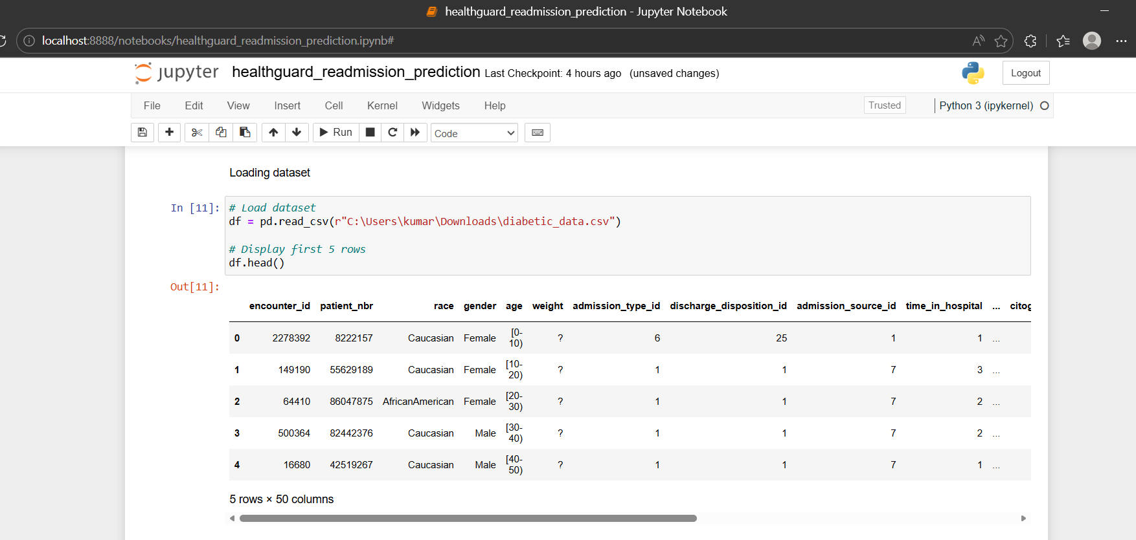
Dataset Overview
Diabetic patient dataset
101,766 records
50 features
Target variable: readmitted

Slide 8
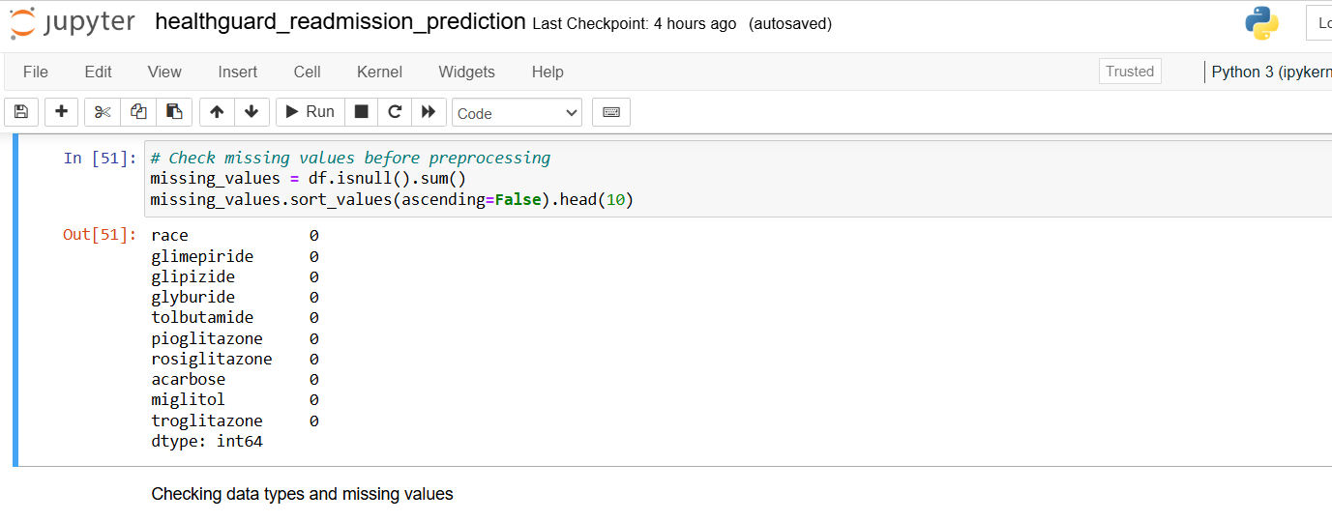
Data Preprocessing
Removed unnecessary columns
Handled missing values
Encoded categorical variables
Converted readmitted column
to binary

Slide 9
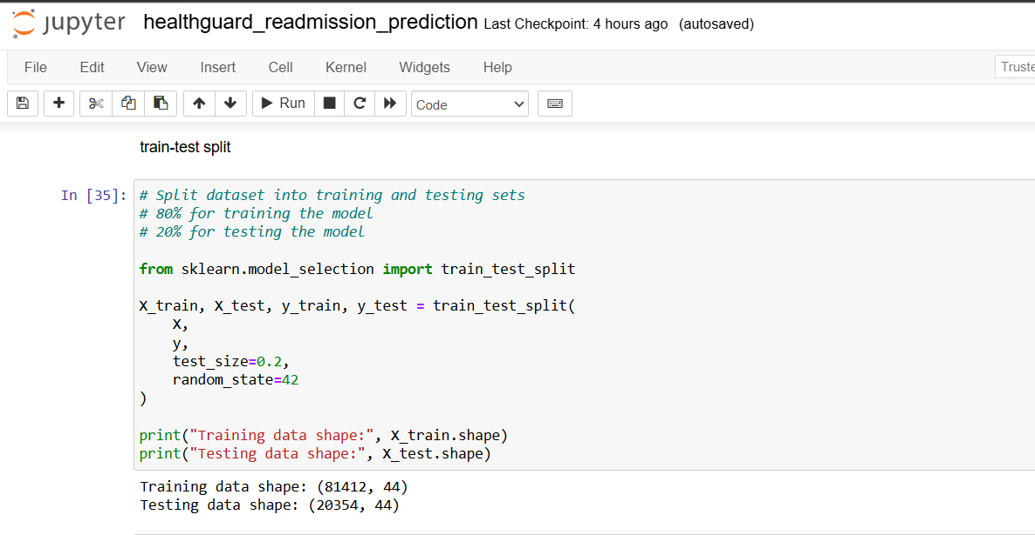
Train-Test Split
80% training data
20% testing data
Ensures model is evaluated
on unseen data

Slide 10
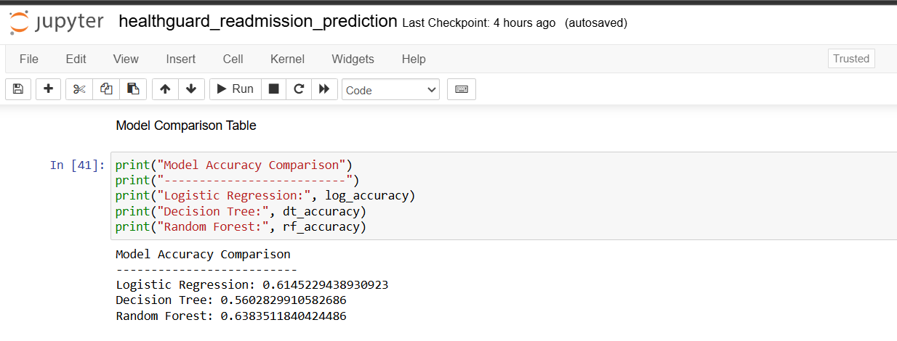
Model Accuracy Comparison
Logistic Regression: 61.45%
Decision Tree: 56.03%
Random Forest: 63.83%

Slide 11
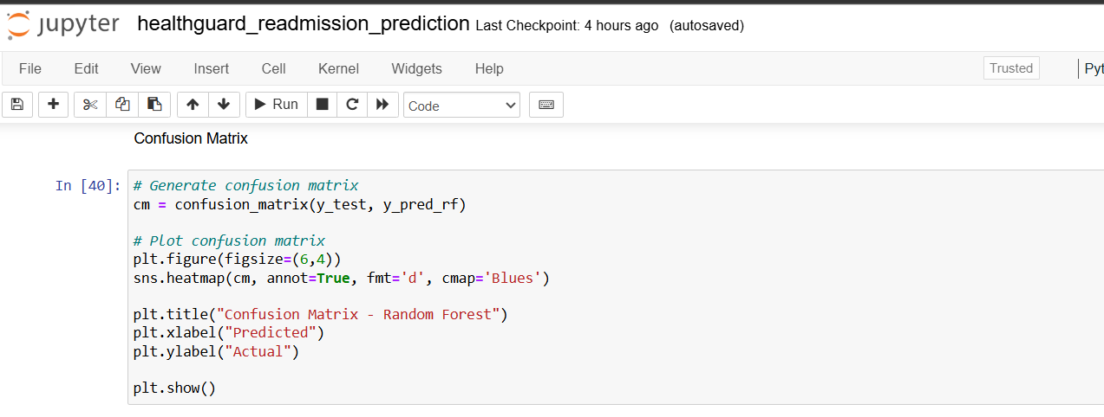
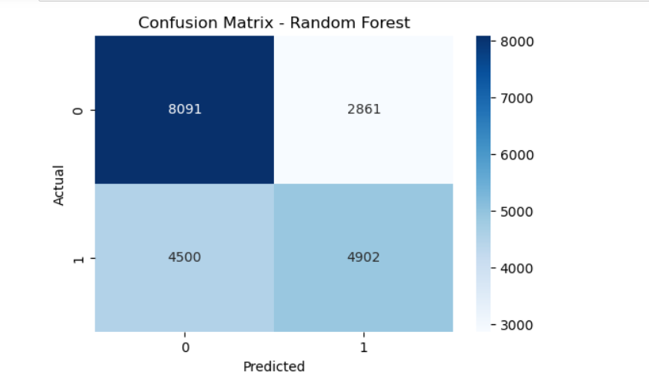
Model Evaluation Metrics
Precision
Recall
F1-score
Confusion Matrix
ROC Curve

Slide 12
Key Findings
Random Forest performed best
Accuracy ≈ 64%
Important patient factors identified
(Insert screenshot: feature_importance)

Slide 13
Conclusion
ML helps analyse healthcare data
Predicts high-risk patients
Supports better hospital decision-making
Can reduce readmission rates

