Slide 1

ATHENA
A
Athena
A seamless and secure healthcare monitoring system to improve patient communication, physician education, and health care performance providing highest quality patient care

Slide 2
Problem Statement
"Women and girls can be particularly vulnerable to human rights abuses and suffer poor health outcomes as a result”
In most societies, women have lower social status than men, producing unequal power relations. Arguably, women need special attention when framing an agenda for global health due to the fact that women are biologically different from men and therefore have different needs throughout their lifespan. The importance of a good record cannot be undermined. Privacy and security is of utmost importance when it comes to generation, processing or preserving Electronic Health Record (EHR) of a particular patient and it is important to have a standard, which various hospitals, diagnostic centers and other medical institutions can use, as a central repository of EHR of patients. Thus, the rise of preserving medical history as an electronic version has posed significant concerns about the protection of confidentiality. Various hospitals and diagnostic centers have started to generate medical reports and host them online form where the user can download them with seemingly easy to know information like the bill number, the name, and so on. It is also to be seen that most of these websites, which may or may not be directly under the hospital or the diagnostic center, provide no or little authentication for the patient while hosting and/or serving the reports. Thus, it is evident that access to healthcare becomes restricted is EHR confidentiality is not enforced. The patient’s fear that the personal data may be disclosed diminishes their candor and may result in a compromise with the quality of care. Thus, it is of utmost importance to implement a secure record maintenance system.

Slide 3
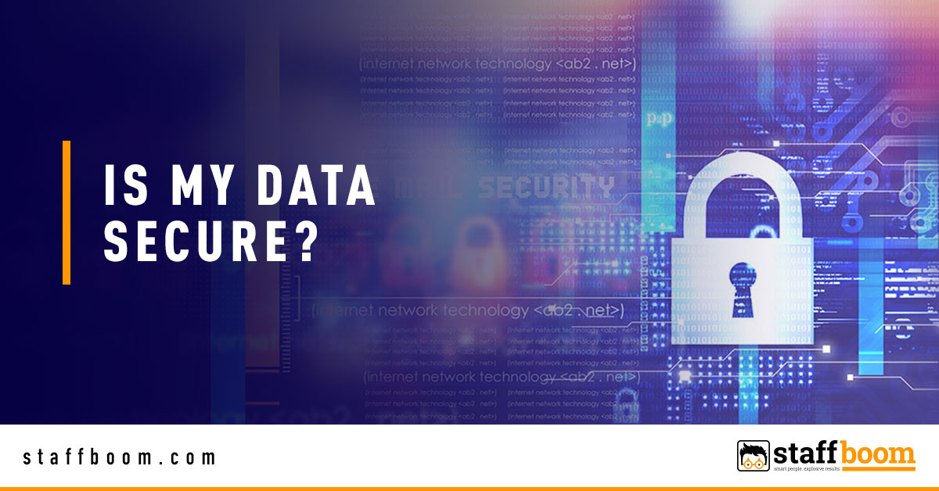
3. As the popularity of electronic health record storage grows, a special concern arises for the privacy and security of patient data. Various hospitals and diagnostic centers have started to generate medical reports and host them online form where the user can download them with seemingly easy to know information like the bill number, the name, and so on.
4. It is also to be seen that most of these websites, which may or may not be directly under the hospital or the diagnostic center, provide no or little authentication for the patient while hosting and/or serving the reports. Thus, it is evident that access to healthcare becomes restricted is EHR confidentiality is not enforced
5. A study comparing the completeness of captured data and the level of agreement between the three different data collection methods: manual collection, administrative collection from EHR and inpatient medical record reveals all data is not securely stored

Slide 4
How do we overcome this problem?
Addressing this problem, we introduce Athena , where we implement FIDO2 compatible smart medical card for healthcare information system. Services of the standard adhere to regulations provides by the government and assures privacy to the information of the patient or the end-user. This incorporates multiple layers of security on cloud computing model to ensure secrecy of the said data. Further, the experimental results prove that the proposed implementation achieves the same level of performance when compared to the conventional healthcare information systems.
The objective is to provide an effective, easy-to-use, standardized solution to safeguard people’s right to privacy. This has been achieved using Fast Identity Online (FIDO) specifications, use of symmetric cryptography with the help of a Fernet library, proper use of cloud-based resources, and encrypting important data in transit. FIDO2 helps implement seamless password less authentication with the help of smart cards and/or security keys. This technology leverages trusted computing and device attestation for user authentication. It also reduces the problem associated with managing and protecting credentials. It ensures that the processing of personal health data revealing a person’s uniquely identifying information like genetic data, biometric data and other data about a person’s life would be prohibited in this standard .

Slide 5
Tech stack:
Cloud platform: Microsoft Azure
Deployment on: Virtual Machine. (Ubuntu 18.04. 4GB ram. 2 vCPU).
Smart card authentication: FIDO2 Specifications.
All user images and data: Encrypted at rest with AES256. Stored in Azure Blob Storage.
Transaction history: SQL Database with Cryptographic Ledger.

Slide 6

How will it help women and create massive impact in the society ?
Most women, especially from Asia and Africa encounter barriers to health care that include concerns about confidentiality and disclosure, discriminatory attitudes and treatment, limits access to health care and health insurance, and often a limits understanding as to what their health risks may be.
Because most women fall prey to death during childbirth, a storage of health information such as blood group, medical history, etc. can result in saving time re-doing these examinations each time women are admitted. Such an implementation resulting in saving time during emergencies can result in massive development in societyBecause most women fall prey to death during childbirth, a storage of health information such as blood group, medical history, etc. can result in saving time re-doing these examinations each time women are admitted. Such an implementation resulting in saving time during emergencies can result in massive development in society.

Slide 7
How our idea is unique?
With this unique idea, we solve all concerns about privacy and security that relate to patient information .
Athena, a web-based framework enables FIDO2 via simple API calls across all supported browsers and platforms on billions of devices consumers use every day. FIDO2 cryptographic login credentials are unique across every website, biometrics or other secrets like passwords never leave the user’s device and are never stored on a server.
This security model eliminates the risks of phishing, all forms of password theft, and replay attacks. Because FIDO keys are unique for each Internet site and each user, they cannot be used to track you across sites hence ensuring the highest level of privacy.​ Hence there is no way an attacker can remotely access the account without physically accessing the card.​
In addition, the implementation is extremely seamless. Patients can easily generate temporary NFC tags for patients via the online portal. Moreover, the platform provides a centralized system for medical record maintenance for everyone. It guarantees easy record maintenance and hence the patients will not have to go about the hospital with an entire medical file.

Slide 8
FIDO2 Smart Card proves to be a bon for uplifting status of women healthcare to unimaginable bounds!
FIDO2, a recently evolved technology by FIDO Alliance is on its way to prove itself to be instrumental in Password less authentication frameworks.
This project proposes a centralized system for medical record maintenance of womenfolk guaranteeing complete security a . We aim to have a partnership with various hospitals. It guarantees easy record maintenance and hence the patients will not have to go about the hospitals with an entire medical file.
People from marginalized group are more prone to obesity, tobacco use, and alcohol use along with increased risk of cardiovascular disease, cancer, and sexually transmitted infections (STIs). Hence, special help should be provided while accessing care along with maintaining privacy. Understanding the health care needs and experiences of women is important for addressing barriers and facilitating access to care and coverage and for that a good secure medical record maintaining system should be present.

Slide 9
The website will have two versions:
1. User version: This has the option to view records, add records, register and remove temporary
tokens and register new FIDO2 keys.
2. Hospital version: This has only the options to view and add records. The hospital will not be
authorized to manage tokens and keys. It is to be noted that the hospital can login only with
temporary tokens.
3. For medical equipments: We provide an API endpoint with which medical devices and softwares
will be able to directly upload the report against a user. It is to be noted that the medical
equipments should preferably be interfaced with an NFC reader as the API endpoint authenticates
the device with it only. API Documentation

Slide 10
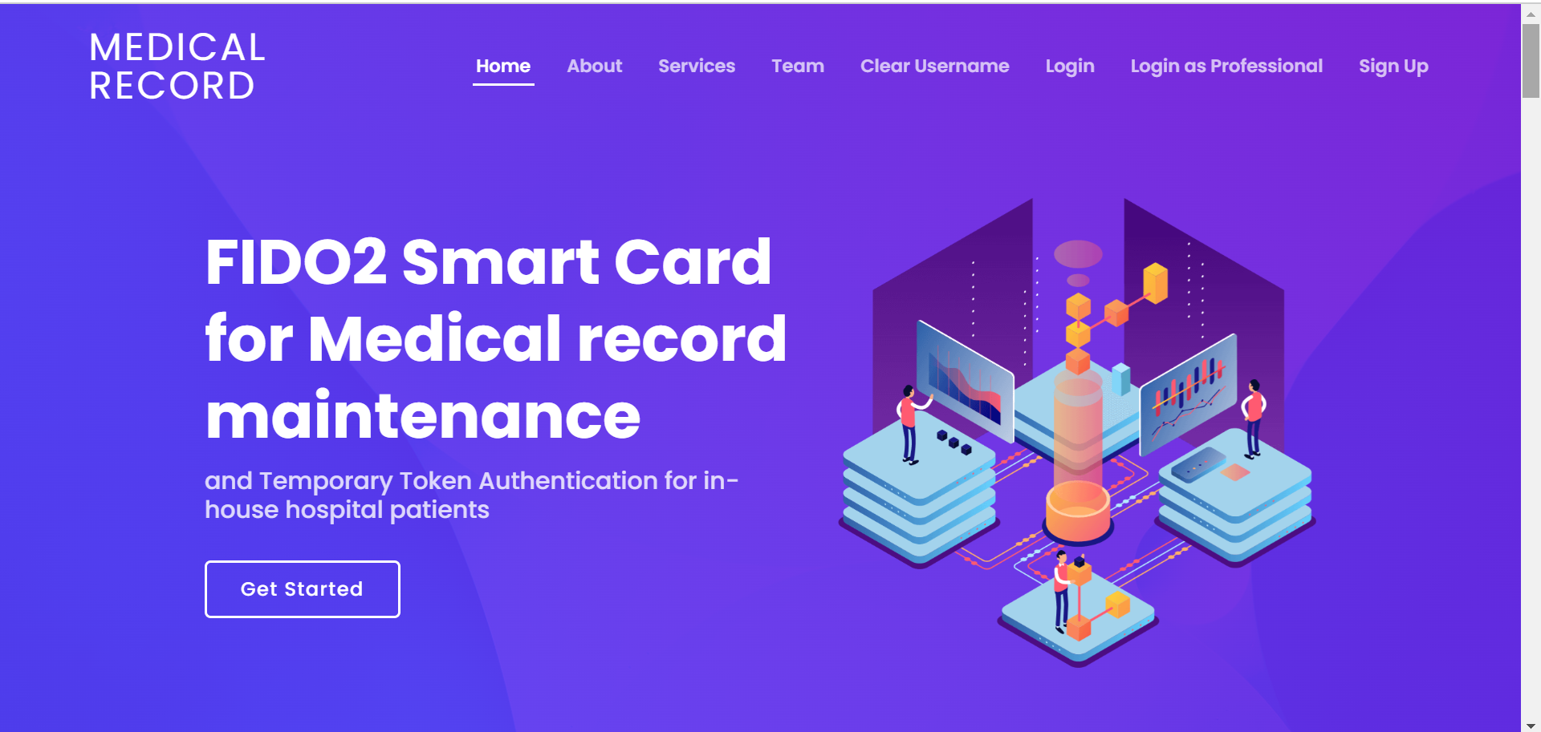
User Experience

Slide 11
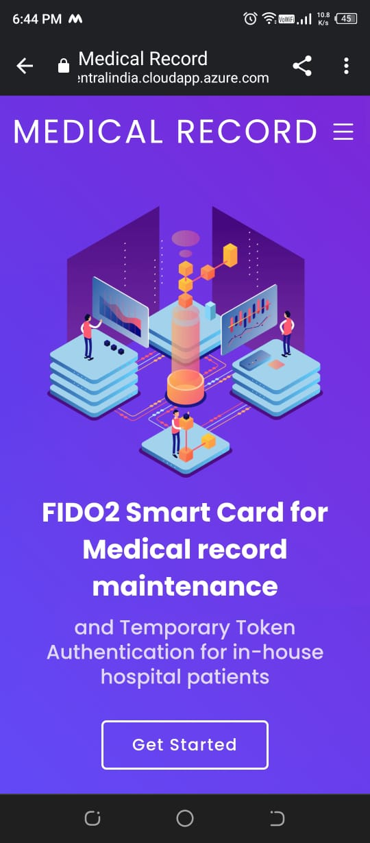
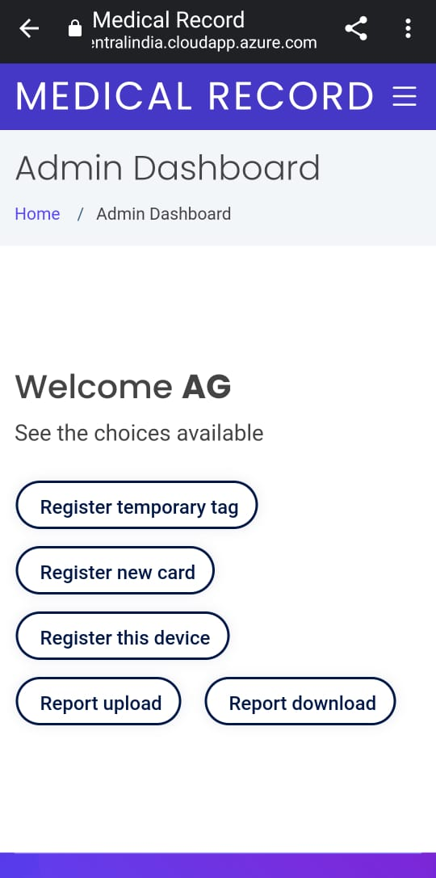

Slide 12
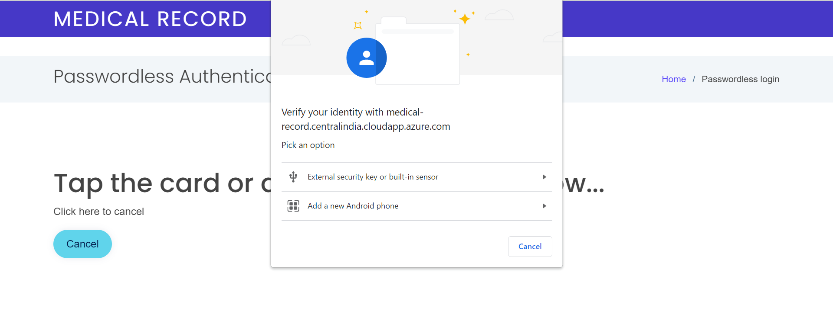
Authentication for password less and secure login

Slide 13
Prior work on this idea/current status
Analysis of Electronic Health Records have proven beneficial for detecting and predicting a patient’s illness comprehensively in less time . There have been studies proposing newer models testing the individual, security and privacy factors affection Electronic Medical Record (EMR) acceptance and role of trust as a mediator . In attempts to protect the privacy of Electronic Health Record (EHR), various studies have come up with different procedures. Some of them implement the storing the health record data on distributed ledger system on Blockchain. In such cases, the compliance with HIPAA, GDPR and other government regulations is necessary. Further, it is to be noted that it is not only the users or the humans who upload the EHR files. Medical Equipment in the age of Internet of Medical Things (IoMT) are equally capable of uploading reports Clearly, the use of EHR can reform the way traditional medical reports look at the scenario of a patient. Moreover, it is used as medico-legal evidence and hence maintaining the integrity is necessary . There has been various attempts to make the cloud infrastructure more secure in the healthcare sector . However, it is seen that most diagnostic centers hosting the patient data on private cloud is extremely insecure. There have been various cases where the diagnostic centers or hospitals have not followed the cloud security practices when using a public or hybrid cloud system to hold EHR data. For faster access and to ensure availability of bigger files of EHR, even fog computing has been used in some cases

Slide 14
How do we stand out?
We propose an idea which implements FIDO based secure authentication and separate models for authorizing a particular medical to facility to access patient data. The FIDO (Fast Identity Online) Alliance proposed a set of standards for changing the nature, procedure and security of online authentication. By now, it has drawn specifications in the standard . The proposed idea is more seamless as it implements device attestation for authentication, which is a passwordless model . It is proven to be secure against most common attacks and care has been taken to patch common vulnerabilities. Device attestation changes the authentication model to ‘something the user has’ instead of ‘something the user knows. The proposed study highlights the drawbacks of existing systems and to implement a novel framework for security . The loss of confidentiality of health records may lead to a serious affect in the patient’s life and care has been taken to ensure such incidents do not occur. Moreover, a central repository for all patient data would be instrumental in quicker access to the medical history of an individual and help in better healthcare . Further, the best cloud security practices for providing confidentiality and integrity to the health records . We propose a standard for storing and retrieving EHR while securing the patient’s privacy. The proposed system uses cloud model and has enhanced authentication and integrity measures .

Slide 15
Future scope
Athena can be used in a large scale for individual record maintenance.This will be useful where one doesn’t need to stand behind long queues for repeated tests over the years and hustle of collecting records of various ailments especially for women .
In future, this can be improvised as a standard health record maintenance system by partnered groups of hospitals, diagnostic centers and other medical institutions or directly by the government. In the proposed idea, security and confidentiality is achieved by employing multiple security practices and keeping all sensitive data encrypted both at rest and at transit until it is necessary to decrypt them, that is only when the user downloads the electronic health records This paper presents a standard that follows the regulations specified by the government and allows the user to securely store and retrieve health records
This enables users’ confidentiality over their personal health data and protects various known attacks. This ensures that the health data is available when needed and the information is not used, disclosed, accessed, altered, or deleted inappropriately while being stored, retrieved or transmitted. Further, it is ensured that for any party other than the owner of the information (the patient himself) to access the data, the owner needs to authorize them for the same. From the results and tests, it is confirmed that the proposed idea brings in utmost security and performance.
Further, Athena has been tested against common cyber attacks like Denial of Service, DNS Hijack, Cookie/ Session hijack and so on. It has been seen that Athena is resilient against most cyber attacks or personal data loss.
Athena provides a great amount of security for women to keep a track of their heath history in a secure manner.
Care has been taken to keep the User Experience (UX) seamless.

