Slide 1

REAL TIME BIOMETRIC SURVEILLANCE WITH GAIT RECOGNITION
Authors:
Subasish Mohapatra
Anisha Swain Manaswini Das
Presented By-
Anisha Swain
College of Engineering and Technology,
Biju Patnaik University of Technology, Odisha.

Slide 2
outline
Introduction
Problem statement
Benefits of the system
Literature survey
Drawbacks
Proposed model
DATA ACQUISITION
FEATURES
DATA MINING
IMPLEMENTATION
RESULTS
CONCLUSION AND FUTURE WORK

Slide 3
INTRODUCTION
Gait is a unique behavioural characteristic of every human being which is hard to imitate.
Gait analysis is the systematic study of animal locomotion, more specifically the study of human motion.
Gait recognition is A biometric technology that is mostly used to monitor motion of people in the scenarios where user cooperation is not highly expected.

Slide 4
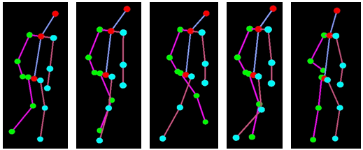
GAIT ANALYSIS
Fig.1 Gait Analysis from Skeleton Data
Source: ee.oulu.fi

Slide 5




EXISTING SURVEILIANCE SYSTEM
AUTHENTICATION SYSTEM
Fig.2 Existing surveillance systems

Slide 6
PROBLEM DEFINITION
REAL TIME IMPLEMENTATION
DATA UPDATATION
HUGE SUBJECT INTERACTION
DATA SEGREGATION
DATA SECURITY & CONFIDENTIALITY

Slide 7
BENIFITS
REAL TIME
UN-INTRUSIVE SYSTEM
LESS IMITATION
LESS SUBJECT INTERACTION
ONE TIME DATA UPDATATION
MAKER FREE SYSTEM

Slide 8
LITERATURE SURVEY
SL. No. | AUTHOR NAME | YEAR | DRAWBACKS
1. | Ricardo M. Araujo,Gustavo Graña,Virginia Andersson | 2014
2. | Davrondzho Gafurov | 2007
3. | Dr. Dayanand G Savakar, Danesh Telsang | 2016
4. | Aniruddha Sinha Kingshuk Chakravarty Brojeshwar Bhowmick | 2010
5. | Ke Yang, Yong Dou, Shaohe Lv, Fei Zhang, Qi Lv | 2015
Table.1

Slide 9
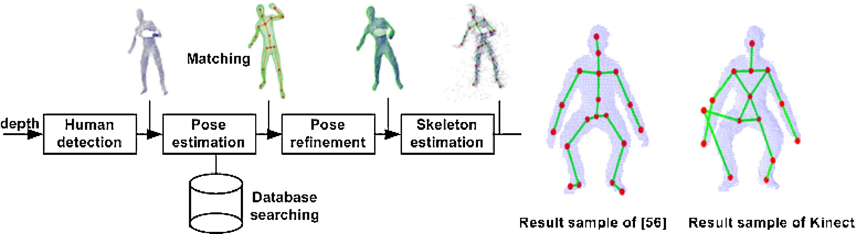
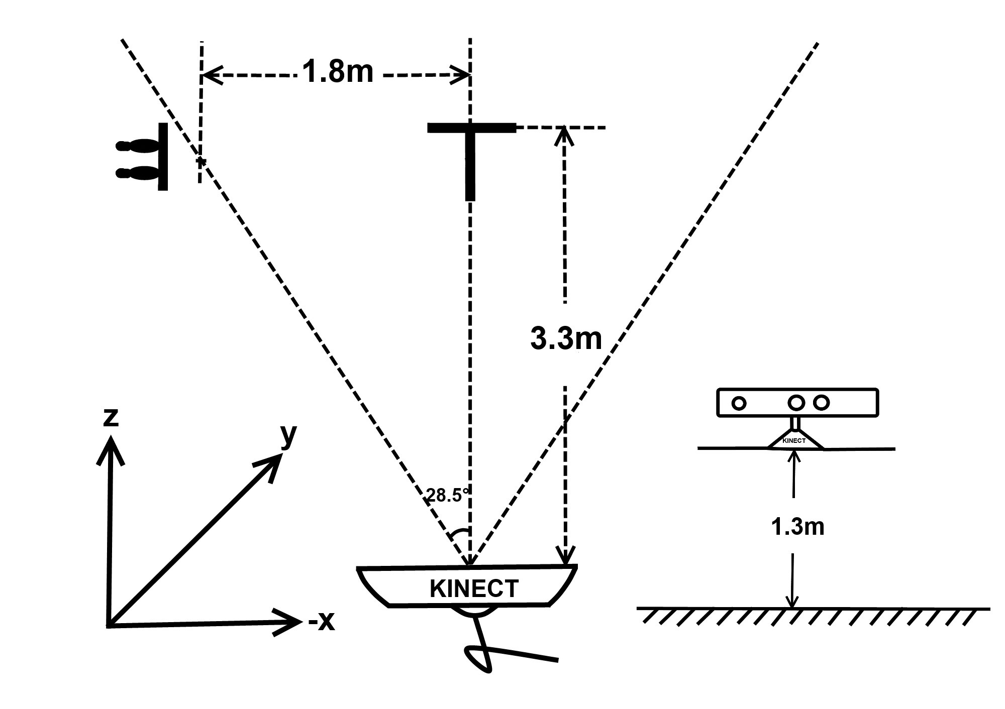
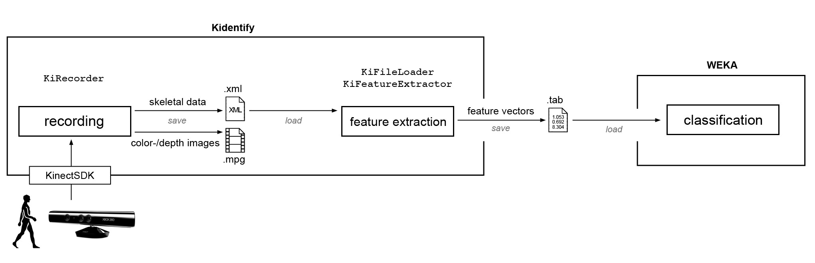
EXISTING MODELS
Fig.3 Basic processing pipeline of algorithms by Jungong Han
Fig.4 Experimental Setup by Shuming Jiang
Fig.5 schematic of prototypic gait implementation by Johannes Preis

Slide 10
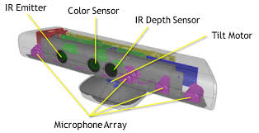
OUR MODEL
Kinect is Microsoft’s motion sensor add-on for the Xbox 360 gaming console. The device provides a natural user interface (NUI) that allows users to interact intuitively and without any intermediary device, such as a controller.
Skeleton Data Acquisition
Feature Extraction
Dataset Creation
Training & Recognition
Fig.6 Construction of Kinect

Slide 11
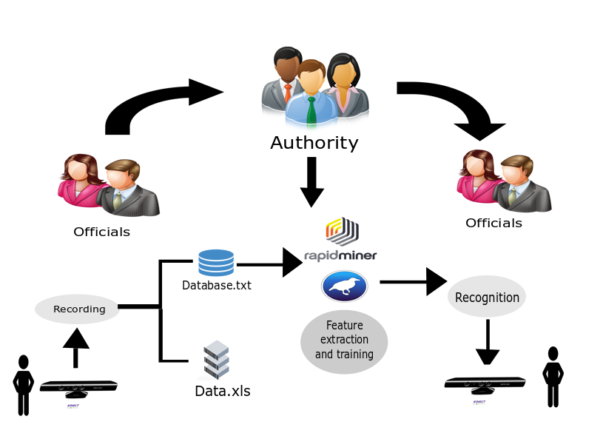
PROPOSED MODEL
Fig.7 briefly summarizes our proposed model

Slide 12
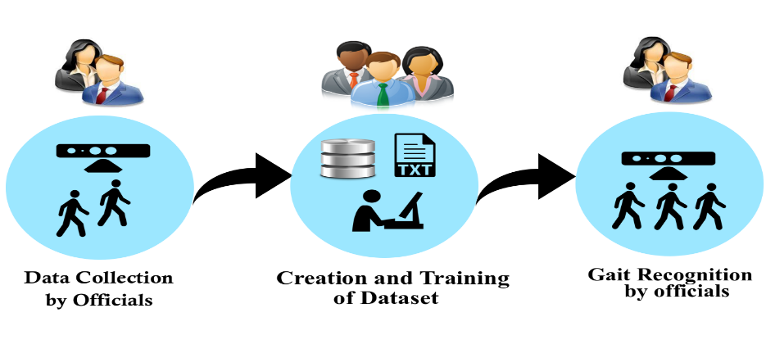
TEST BED
Fig.8 The Test Bed configuration

Slide 13
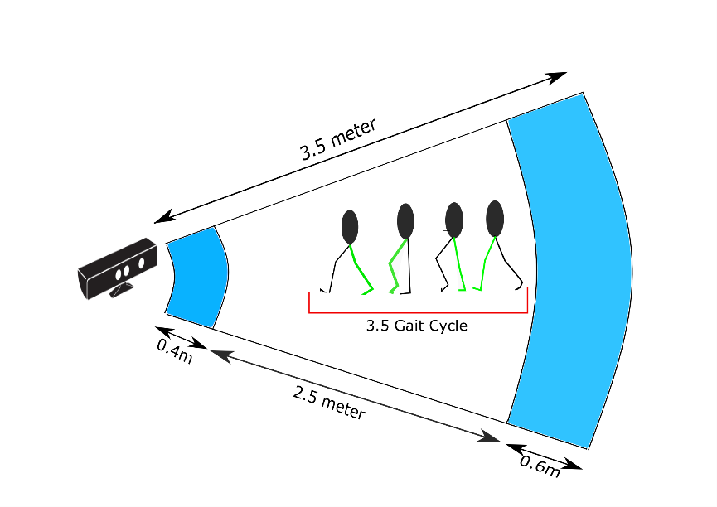
EXPERIMENT ENVIRONMENT
Fig.9 The Experiment Environment

Slide 14
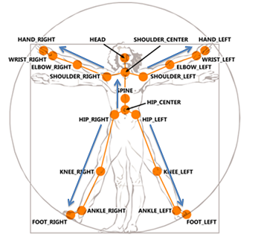
SKELETON DATA EXTRACTION
Joint Position Extraction
Joint Distance Extraction
Joint Angle Extraction
Velocity of a Joint
Fig.10 20 Skeleton Joints provided by kinect

Slide 15
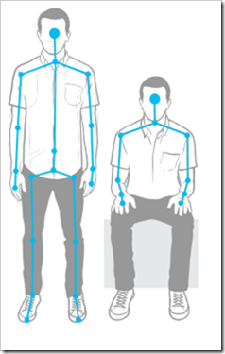
JOINT POSITION EXTRACTION
20 joint Points
Extracted as 3D co-ordinate having X, Y, Z axis
Fig.11 Joint Structure of Human

Slide 16
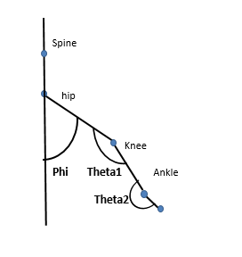
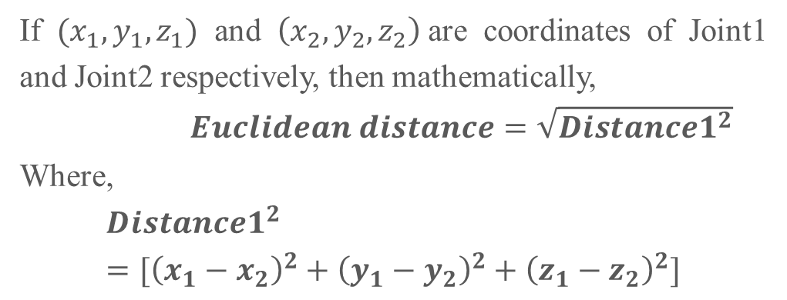
JOINT DISTANCE EXTRACTION
Euclidean Distance
3D Joint Vectors
If $(x_{1},y_{1},z_{1})$ and $\left(x_{2},y_{2},z_{2}\right)$are coordinates of Joint1 and Joint2 respectively, then mathematically,
$Euclidean distance=\sqrt{{Distance1}^{2}}$
Where,
$${Distance1}^{2}=[{\left(x_{1}−x_{2}\right)}^{2}+{\left(y_{1}−y_{2}\right)}^{2}+{\left(z_{1}−z_{2}\right)}^{2}]$$
(x1, y1, z1)
(x2, y2, z2)
Fig.12 Right leg Joint Positions

Slide 17
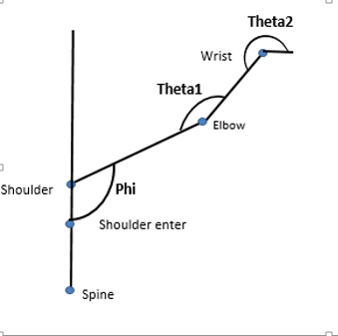
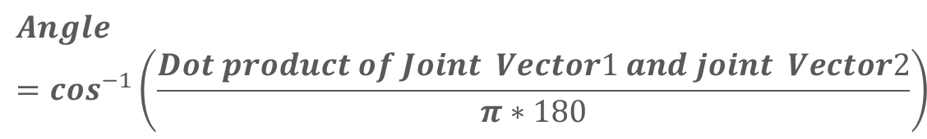
JOINT ANGLE EXTRACTION
Inverse cosine of dot product of the two Joint Vectors
$$Angle=\cos^{−1}\left(\frac{Dot product of Joint Vector1 and joint Vector2}{π∗180}\right)$$
Fig.13 Joint Position of Right Hand

Slide 18
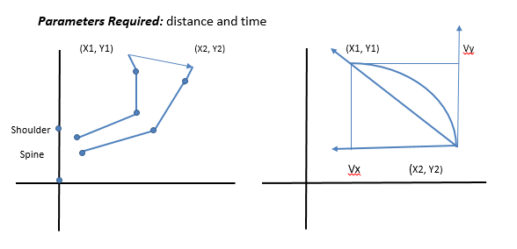
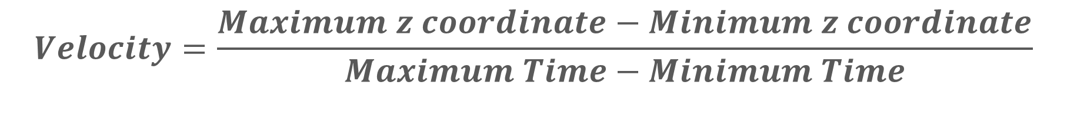
JOINT VELOCITY EXTRACTION
Fig.14 Velocity Calculation methods
$$Velocity=\frac{Maximum z coordinate−Minimum z coordinate}{Maximum Time−Minimum Time}$$

Slide 19
FEATURE EXTRACTION
32 FEATURES
17 DYNAMIC
15 STATIC

Slide 20
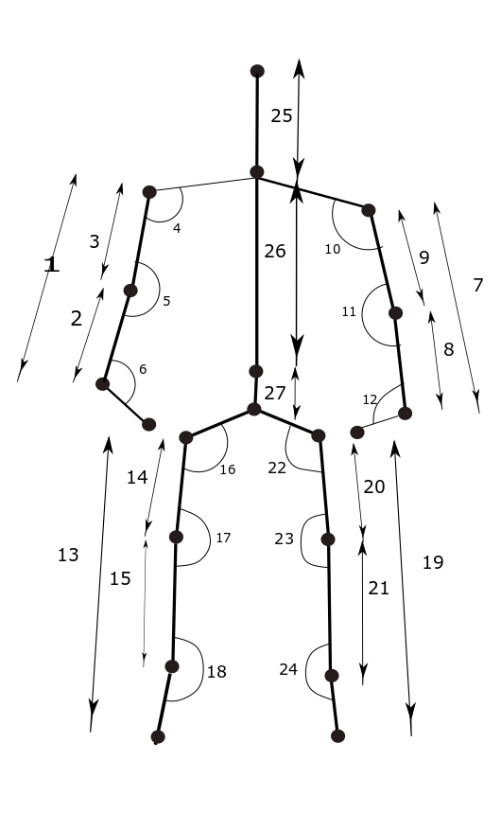
Right Hand Length
Right Hand to Elbow Length
Right Elbow to Shoulder Length
Right Hand Angle
Right Elbow Angle (Theta-1)
Right Wrist Angle (Theta-2)
Left Hand Length
Left Wrist to Elbow Length
Left Elbow to Shoulder Length
Left Hand Angle (Phi)
Left Elbow Angle (Theta-1)
Left Wrist Angle (Theta-2)
Right Leg Length
Right Hip to Knee Length
Right Knee to Ankle Length
Right Leg Angle
Right Knee Angle
Right Ankle Angle
Left Leg Length
Left hip to knee Length
Left Knee to Ankle Length
Left Leg Angle
Left Knee Angle
Left ankle Angle
Head to Shoulder Centre Length
Shoulder Centre to Spine Length
Spine to Hip Length
Body Velocity
Right-Hand Velocity
Right Leg Velocity
Left- hand Velocity
Left- Leg Velocity
Fig.15 Features extracted from skeleton structure

Slide 21



DATASET CREATION
20 PEOPLE
10 FEMALE
10 MALE

Slide 22


TRAINING AND RECOGNITION
Fig.16 RapidMiner Logo
Fig.17 Weka Logo

Slide 23
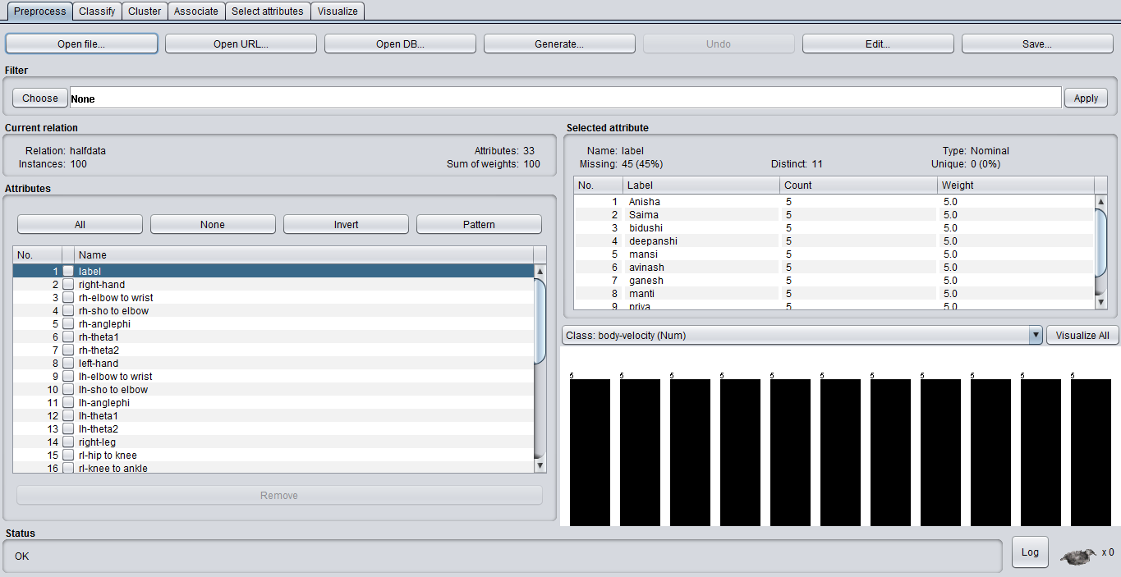
TRAINING ENVIRONMENT 1
Fig.18 Weka Environment

Slide 24
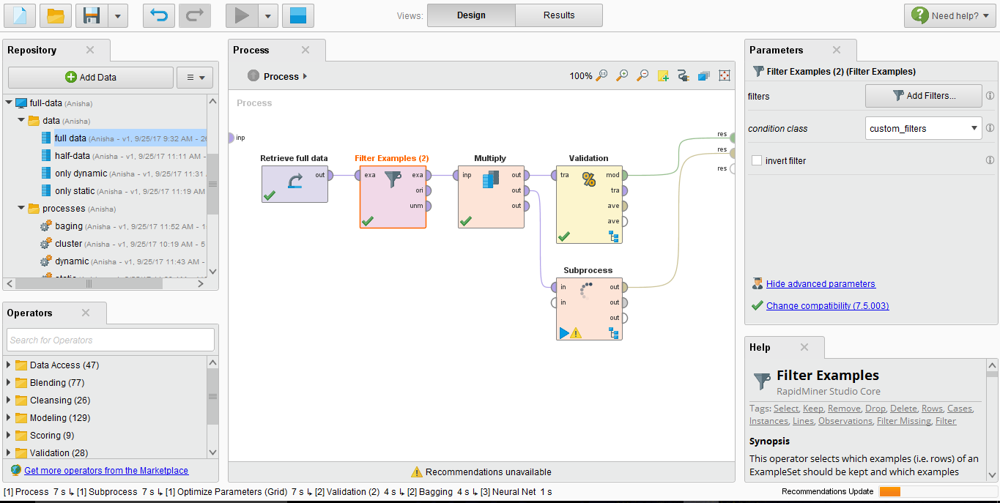
TRAINING ENVIRONMENT 2
Fig.18 RapidMiner Environment

Slide 25
ALGORITHMS
RapidMiner | Weka
Naïve Bayes (Kernel) K- Nearest Neighbor Neural Networks Gradient Boosted Tree Bagging of Neural networks and KNN Bagging of Naïve Bayes and KNN | Naive Bayes Bayes Net Multilayer Perceptron Random Forest Bagging with Bayes Net
Table.2 Used Algorithms

Slide 26
RESULTS
RapidMiner |  | Weka
Algorithms | Percentage Of Accuracy | Algorithms | Percentage Of Accuracy
Naïve Bayes (Kernel) | 96.67% | Naive Bayes | 78%
K- Nearest Neighbor | 82% | Bayes Net | 85%
Neural Networks | 86% | Multilayer Perceptron | 85.45%
Gradient Boosted Tree | 75% | Random Forest | 83%
Bagging of Neural networks and KNN | 87.8% | Bagging with Bayes Net | 81%

Slide 27
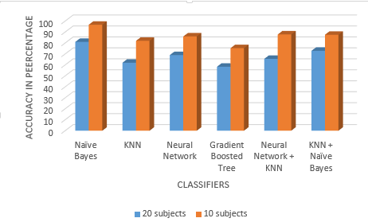
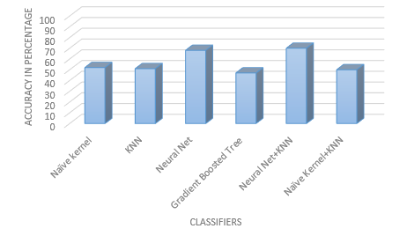
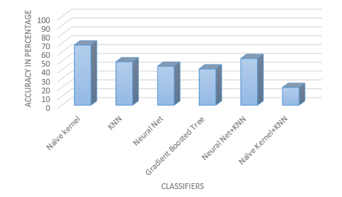
Fig.19 Comparision made with RapidMiner Environment

Slide 28
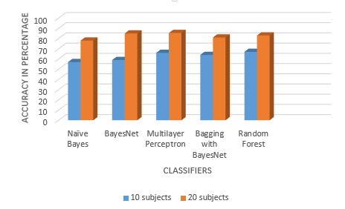
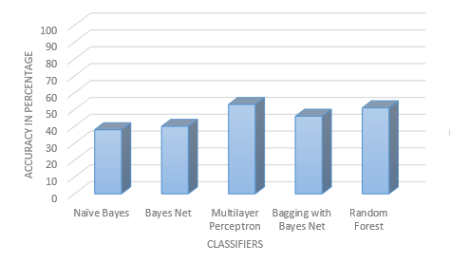
Fig.19 Comparision made with Weka Environment

Slide 29
CONCLUSION
We conclude that Gait recognition is better and more reliable as compared to Fingerprint, Iris and DNA authentication for its unintrusive and maker free approach. We achieved a significant recognition accuracy of 96.67% with 10 subjects by applying Naïve Bayes classifier. From the above calculations and comparisons using both RapidMiner and WEKA toolkits, we deduced that accuracy is better with static features rather than with dynamic features and hybrid model with both static and dynamic features yields improved accuracy.

Slide 30
FUTURE WORLK
We aim to achieve a complete biometric system by integrating face and speech recognition along with gait recognition. The fields of this system’s implementation can be enlarged to make it more functional.

Slide 31
THANK YOU

