Slide 1
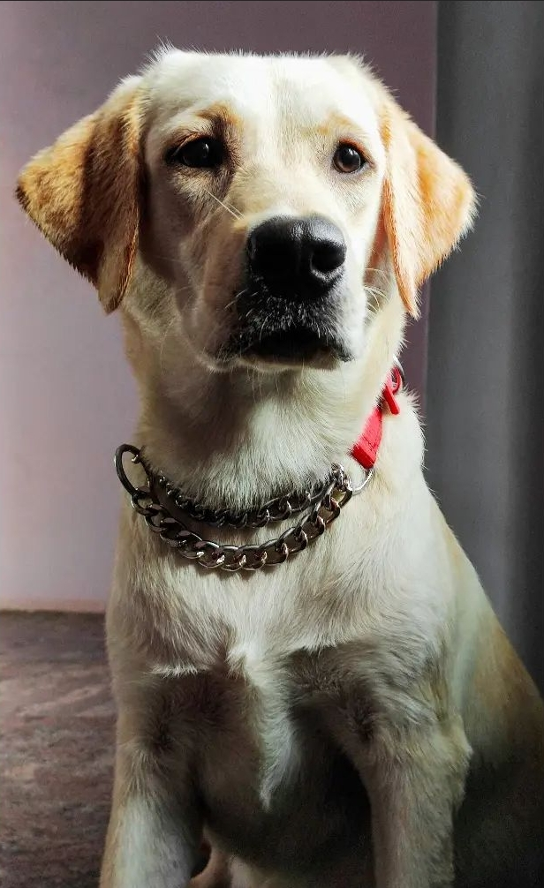
CASE STUDY ON DOGaholics
Anisha J
2211630
CDB22DW022

Slide 2
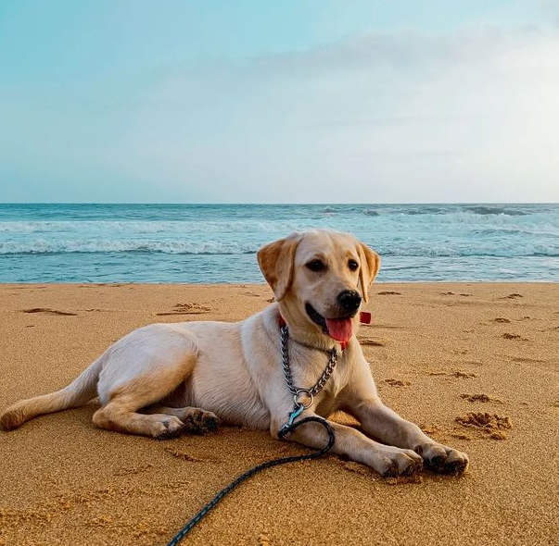
CONTENTS
Introduction
About DOGaholics
Target Population
Data Collection
Services Offered by DOGaholics
Plans to Measure User Engagement
Working Model of DOGaholics
Predictive and Prescriptive Analytics
Churn Analysis for Retaining Users
Monetization Ideas

Slide 3
Introduction
As a data scientist/machine learning engineer, I am tasked to build a niche social network platform for a particular segment of Indian population. For that, I would like to build a dog care app. I named this platform as "DOGaholics". Despite being human’s greatest pals for thousands of years, dogs are now the sole company for some individuals. The only living thing that loves us more than it loves itself is a dog. So, I thought of building a niche social network for a segment of people who loves dog and in need of providing proper care training to them.
Already there are some existing app for dogs, but those apps miss some necessary information and tools. So, I would like to build a platform which fulfils all the necessities of dog owners for the well-being of their pets.

Slide 4

About DOGaholics
It is the most complete digital pet-care platform. It offers everything you might need to better care for your pets including reminders for all care tasks, medical history and data sharing.
Now, lets have a detailed vision about this platform.​

Slide 5
Target Population
All dog owners, pet lovers and caregivers will be the most important target audience.
People who are having pets for a long years will also be targeted so that they will share the experience in their point of view.
People who are interested to research about pets, especially dogs.
People who are interested to buy a pet but have no idea on how to look after them.
Lonely people who are turning to pets for friendship.
Pet doctors to share their thoughts and to provide proper guidelines to the users.

Slide 6
Data Collection
Each type of user will be asked to provide basic personal information such as name, address, contact information, date of birth and number of members in family. The authentic users will be verified by important government records.
All details of the veterinarian users will also get updated and verified.
Users should update all details of their pets starting from its from its origin, scientific breed of the pet, genealogy, weight, height, color, age, gender etc.
Users should update the name of the vaccines injected to their pets.
Users should update about the food habits followed till now for their pets.
Users should update whether they have a single pet or multiple pets in their home.
User preference data will also get collected frequently.
Users should give feedback on daily/weekly basis for the service provided in the app.

Slide 7
Services Offered by DOGaholics
Provides enough details
The app should make sure that users can access all the information they need from the platform itself. The information which is collected to have information on breed, height, weight, news, and ideal weather for the pet, among other things will results in tailoring to the needs of users. This application will be updated to include their lifetime, prevalent health issues, and feeding needs. By Before getting a pet, users may uncover important facts that pet owners should be aware of.
Pet health information centralized
The collected medical history data makes it simpler to identify current health concerns and takes necessary action. Additionally, it is simple to maintain track of a pet's most recent shots or clinic visits. This app keeps a record of all past shots, illnesses, medicines, and appointments with the vet.

Slide 8
Fixing an appointment.
The DOGaholics app allows users to set up appointments for medical and grooming services. They are also alerted through text message on their phones when veterinarian immunizations and grooming appointments are approaching.
Vet Finder
This platform helps in seeking for nearby vets and animal clinics by pet owners from their home itself so that Pet owners save time and effort by not having to look for a welcoming vet or animal hospital. The app also suggest consumers to verified veterinarians based on user reviews and veterinary expertise.
Online store incorporation
Integrating niche platform with e-commerce has several advantages. For instance, making it easier for pet owners to purchase everything they require for their animals under one roof.

Slide 9
Keep track of your pet's growth
Pet owners are often concerned about their animals' health. Users will be able to track their development and make milestone notes as a result. The tool enables pet owners to receive monthly updates that illustrate how much their pet has grown and what it requires for optimum growth, as well as regular information on how their pet's physical development.
Wearable activity trackers and pet monitors
Wearable trackers will be provided to the users to tracks and monitor their pets. The use of wearable technology may be a great way to allay any worries when owners are not there. When a wearable tracker is fastened to the collar, keeping track of their pet is easy. If a pet manages to get out of the safety net, the gadget will promptly alert the pet's owner.
Monitoring of feed
This tool gives dog owners a diet plan and calorie tables so they can simply keep tabs on the wellbeing of their dogs.

Slide 10
Training and counselling
Owners of pets must exercise a great deal of patience while grooming and teaching their animals. Lessons on how to train animals might be quite beneficial. Users may look for problems and find quick fixes, which may involve anything relating to their pets.
Pet-friendly hotel reservations
Another distinctive function of this app is it helps in finding pet-friendly lodging and organizing pet-friendly travel. It aids customers in booking the hotel with the greatest pet accommodations.
Services for emergencies
When a pet is injured in an accident, the emergency feature of this app is useful. For instance, if a pet is hurt, the app links the user with a local vet, animal hospital.

Slide 11
Reminders
The pet owner will get reminders by receiving timely updates about immunizations and doctor's visits.
Discussion with the Doctor
Through the app, pet owners should be able to get in touch with their animal's veterinarians
Electronic Notes
Notes are useful for keeping track of a pet's routine, including its nutrition, medication schedule, and exercise regimen.
Text and Image Connection
Pet owners ought to be able to communicate with one another by exchanging texts and pictures of their pets.

Slide 12
Plans to Measure User Engagement
Data Visualization
The admin will be able to see all essential data and info about pet owners, pet sitters, vets, and other data.
E-mail marketing
E-mail marketing is essential for admin in order to promote the app.
Cloud-based Storage
Cloud storage helps in accessing the data from anywhere at any time. It is a safe and secure environment for storing data.
Performance Statistics
The admin or app owner will be able to check the app performance for taking better business decisions.
Ratings and Feedback
Admin should receive all the ratings and feedbacks by the user to make improvisation in the app.

Slide 13
Working model of DOGaholics
DOGaholics serves various needs of pet owners and caregivers in a single place. Let us understand how the pet care app works.
The pet parents need to install the app on their devices.
Next, they must enter the login or signup details, such as name, e-mail, and phone number.
There will be option for a relevant subscription to use the app and their services. Choosing a subscription plan will help to avail of unique features offered by the app.
Include details about the pet in the application for personalized recommendations.
Choose the product or pet care service they are interested in.
After selecting and paying for the products or services, wait for further commands.

Slide 14
Predictive and Prescriptive Analytics
Based on what kind of services a user likes, the user will be provided with similar kind of notification for such services.
Based on a user’s engagement with different product and services, similar thing will be forwarded to the user.
Based on the ratings and reviews of the users regarding the app, it will be noticed for further preference and recommendations to users which will be based on these rankings. The rankings may be regarding different aspects like cost, hospitality, services offered, products delivered, errors in management and so on.

Slide 15
Churn Analysis for Retaining Users
Setting realistic expectations from the get-go
The most common reason why customers leave a platform – they fail to deliver to the tunes of the promises they made. It is a common practice across industries to over promise and under deliver. Setting a realistic expectation will helps to go with the flow.
Nail the first five minutes
The most reliable way to reduce customer churn and earn the loyalty of a customer is to deliver remarkable customer service. It essentially starts with the first impression your business creates in the minds of the customer

Slide 16
Collecting feedback from customers
This is the easiest, yet the most powerful way to keep your customers from churning. Collecting feedback from the customers and reviewing those feedbacks, providing proper solution to dissatisfied uses will helps to reduce customers from churning.
Building useful resources for customers
A customer who understands the product and its benefits well is an educated customer and educated customers do not abandon you. Building a useful resources for the customers will always keep them within the premise of the app

Slide 17
Monetization Ideas
Merchandise
Under this revenue model, the business developing pet marketplace app can design and sell company-themed merchandise. It can include dog collars, shirts, and other pet-related products on which the company’s brand gets tagged.
Advertisements
The advertisement revenue model targets two birds with one stone. The app charges businesses who want to place ads in the app, thus making revenue from them. Also, the app users can purchase a premium version for ad-free experience in the app.
Integrating eCommerce
A pet care app can sell diverse pet products like harnesses, supplies, food, etc. Integrating with e-commerce giants like Amazon can increase the sales.
Commission
Under this revenue model, the application brings pet sellers and owners together and charges both of them a percentage to use the app and its features.

Slide 18

“Dogs do speak, but only to those who know how to listen.”– Orhan Pamuk

Slide 19
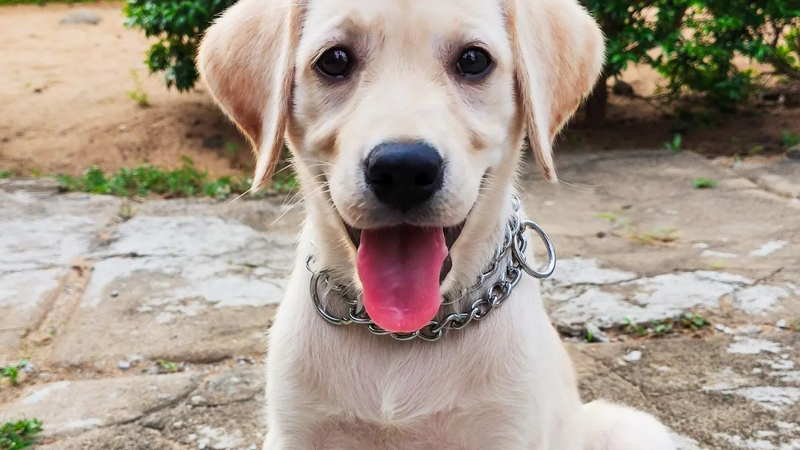
THANK YOU

