Slide 1

RnD Grants Management Portal CP301 Development Engineering Project(AY 2023-24) Team T16 - Under the guidance of Dr. Puneet Goyal
Shruti: 2020csb1127
Sreya:2020csb1087
Vishnu:2020csb1097
Lashyanth:2020csb1083
https://rndgrantst16.onrender.com

Slide 2
Idea Description
Project Topic: RnD Grants Management Portal
The project aims to develop a web-based platform for managing and tracking research and development grants.
The current system relies on manually updating Excel spreadsheets stored on local office computers, which becomes increasingly challenging as the number of projects and files grow.
The lack of a centralized system also makes it hard for faculty members and academic office members to access the latest information on specific grants, and generating reports is a time-consuming and complex process.
The new system will streamline grant management by providing a user-friendly interface for tracking and reporting grant information in real-time.

Slide 3




Tech stack or Technologies used
FRONTEND
React JS
React Bootstrap
Material UI
Sheet JS
BACKEND
Node JS
Express
Google oAuth
DEPLOYMENT
1.Render
2.Server
Nginx, PM2, PostgreSQL
DATABASE
PostgreSQL

Slide 4
Previous Work done by Team Y2
Backend API routes are secured using JWT so as to prevent unauthorized API calls to the backend server. Supports secured Google oAuth2 based login. Authorization of users as professors or Admins.
Admin
Only admin can add/delete the project, expense, new funds and new users.
He can download the excel file of the data.
Professor
Professor can view his projects, project related expense
can download the excel sheet of the data.
Professor does not have access to delete or add any expense or project or funds.
When professor wants to talk to admin he can mention it in comment and the expense row will turn green for both admin and professor.
Searching capabilities on project lists by different attributes to reduce the manual efforts.
Automated summary table generation and updating dynamically.

Slide 5
CRUD operation support on expense rows.
Appropriate checks are imposed so as to avoid erroneous inputs(such as expenditure exceeding the sanctioned amount, DOS exceeding DOC)
Implemented functionalities to incorporate the conversion of committed expenses to possibly different actual expenses.
Exporting the contents of expenditure and summary table as an excel file.
Importing the contents of the funds from an excel file.
Division of funds and expenses into 2 major heads of Recurring and Non-Recurring with focus on different subheads as well.
The total balance of a project may temporarily be negative as long as the expenditure does not exceed the sanctioned amount.
Database design implemented keeping efficiency of CRUD operation in mind ( For ex : A separate table for each professor’s projects ) .

Slide 6
Work we have done before Mid-Sem
Downloaded the dependencies required for running the application.
Database, google oAuth, and backend server details have been expired so we created a new database and added ourselves as admin and connected to our google oAuth link.
After all the change, the applications perfectly running on our local systems and changes are reflecting in our database.
While checking the application we found some bugs and some features missing. We removed the bugs and added some new functionality and some are yet to be added.
We deployed the application on render.
Bugs Corrected
When a use with Email_id starting with numbers is added, the view projects is not working as PostgreSQL does not allow creating a table name starting with digits. So the application is not working for the users like 2020csb1087@iitrpr.ac.in

Slide 7
New features added
import projects
There is no option for importing the excel file for adding projects and filling the data automatically. We can only download the data. So we added import option to added projects.
Pop-up message when same user is added.
Pop up message when same project id is entered
Pop-up message when unknown user id is entered .
Fellowship page
There is no role for the fellows in this application. So added a role for the fellows like professors. And fellow have separate page like professors and they can interact with each other.
Professor and admin has authority to add or remove fellow from the project.
Fellow can see the expenses ,project details, comment to the professor and see their co fellows in the project.
Professor or admin can add a fellow to the project only when the fellow is a user.
New fellow insertion and deletion in a particular project.

Slide 8
Work we have done After Mid-Sem

Slide 9
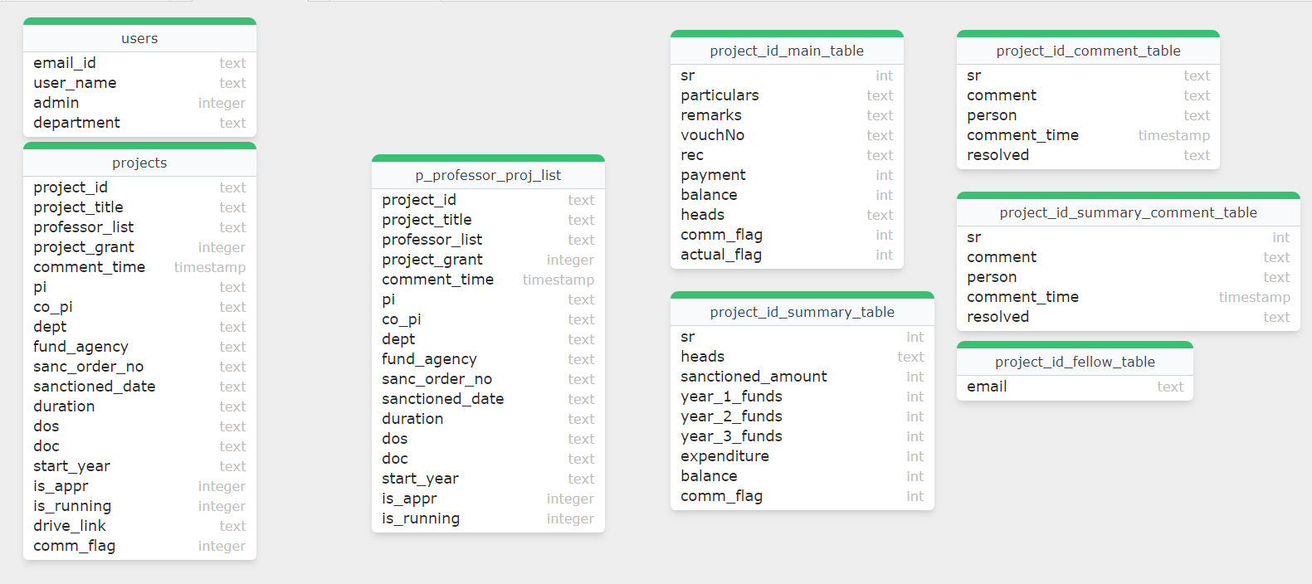
Database Change

Slide 10
New features added
Added many feature to manage users
Search users by emailed and department.
Added department to the users details.
Added option for import users.
Added a sample import for the import from excel.
Changed the frontend.

Slide 11
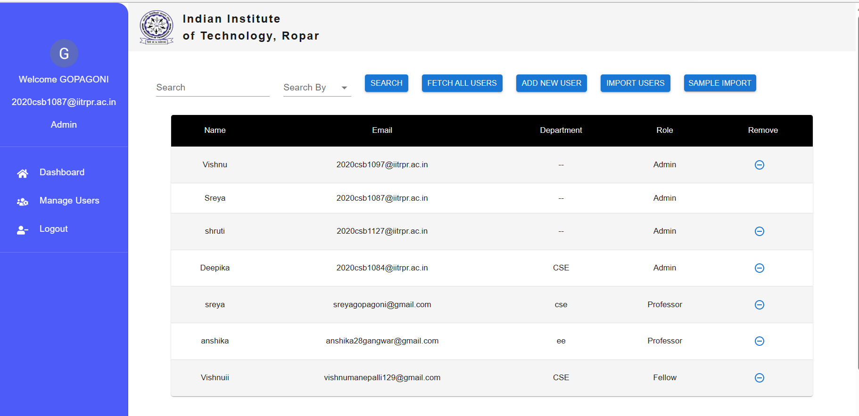
Only Admin has manage users page Which includes features
. Search
. Fetch all users to view all the user details
. Add new user manually using form.
. Import users from excel file
. sample import excel file which you can download for reference

Slide 12
Added many feature to projects Table
Added a update project status button where you can change status of the project from running to completed and completed to running. both admin and professor can update the project status.
Add a view file button where you can see the uploaded sanctioned file when a professor request for a new project and approve the project accordingly.
Added a request table and option to request project for professor and admin can approve the project.
Added a sample import file for import projects
Added form validation.

Slide 13
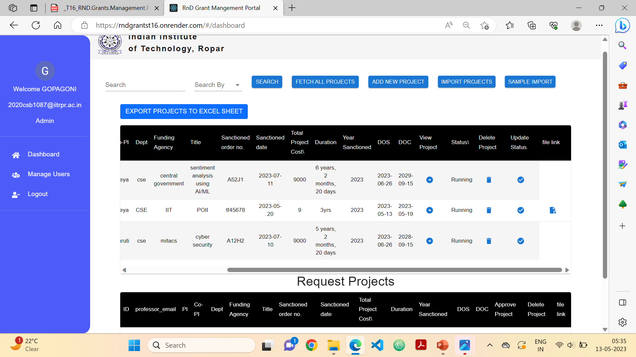
Export all projects in an excel file
View the details of the particular project
View the pdf of the sanctioned project details if provided.
Update the status of the project complete to running
or running to complete
Only Admin can delete the project

Slide 14
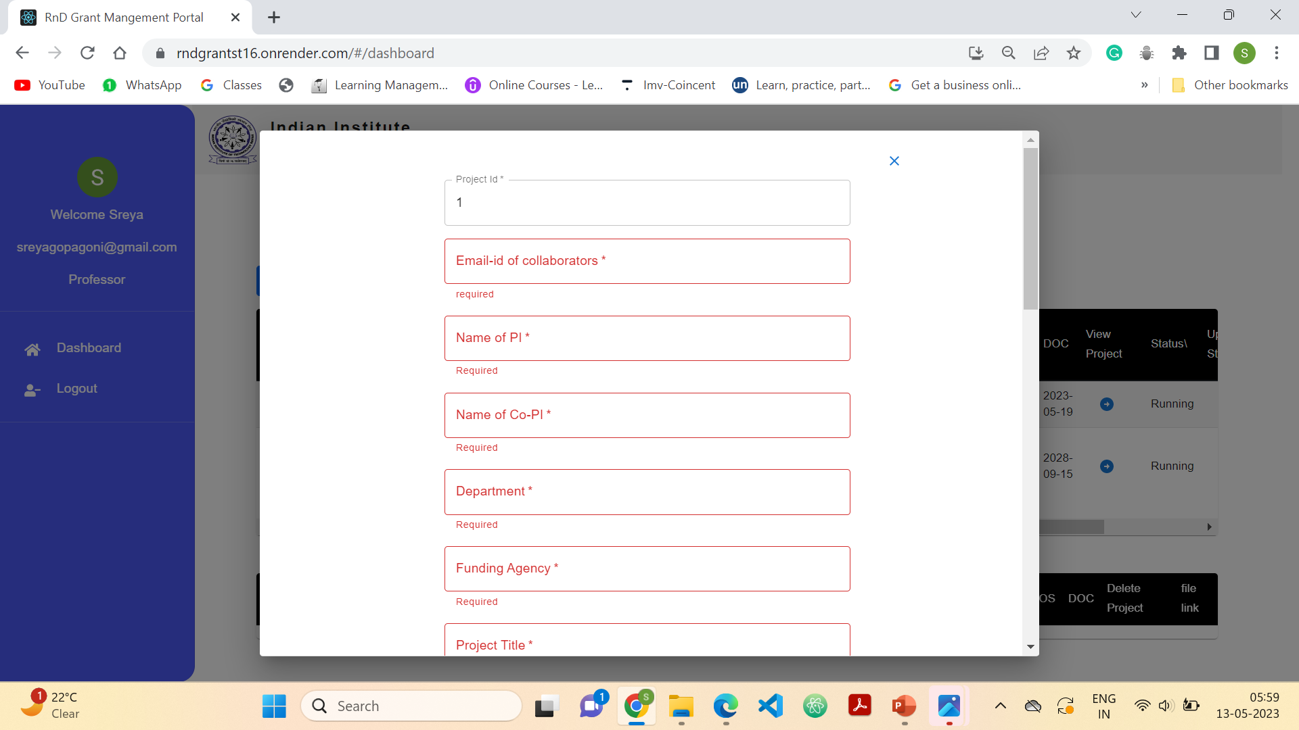

upload the excel file which contain details of all the projects. If needed see the sample impot file by clicking the sample import button
Manually add projects using form
Also implement form validation and checks

Slide 15
Added a resolve comment button which when clicked resolves the green color that seen shown when professor or fellow comments in the summary table to main table.
Added role to the details of users that is displayed on the side bar.
Tried to find solutions to google login in the server. Tried ti implement email OTP login but due to continue usage the email is getting block, so dropped that idea.
Met stakeholders and took feedback from them, improve the website based on the feedback.

Slide 16
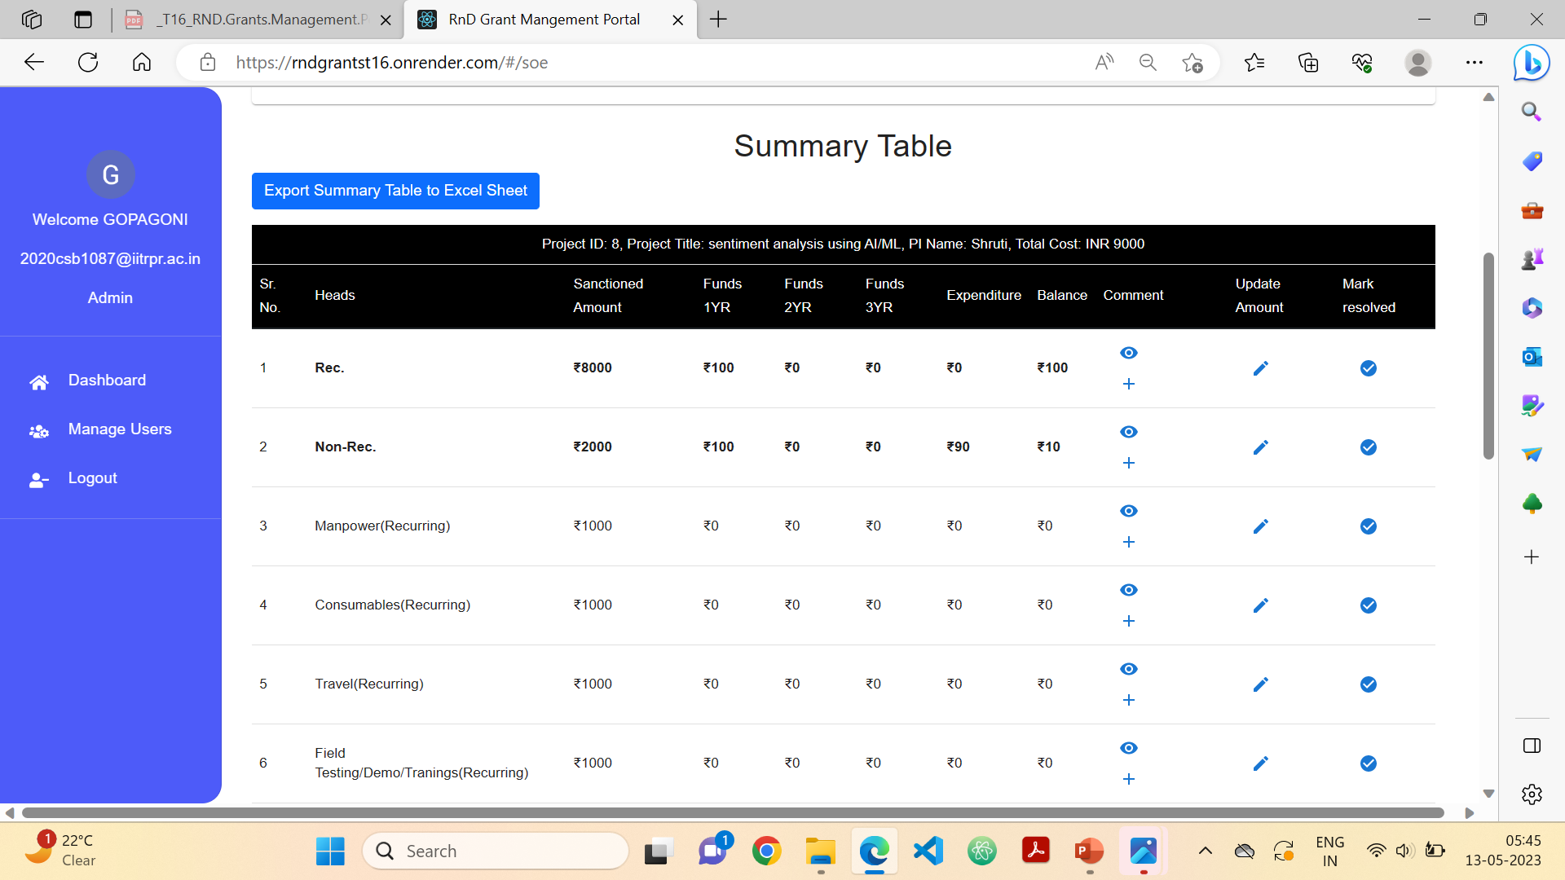
role
Edit the sanctioned amount
When seen the comment and want to resolve the comment
View or add comment

Slide 17
Deployment status
ON SERVER
We successfully deployed our website on the IIT Ropar server.
To deploy our application on a server, we utilized a combination of various technologies, including GitHub for version control, nginx as a web server, PM2 for process management, and PostgreSQL as our database management system.
Our website uses google authentication to login so, we have put a request to the IT section for a Domain Name for proper functioning of the website.
The deployed application is live and can be used with the link below.
http://172.30.8.212/

Slide 18
Team Contributions
Everybody has equally contributed to the work till now.
But to be specific :
Sreya: backend, deployment, New features
Lashyanth: Login and backend, Resolve bugs
Shruti: deployment, frontend, Resolve bugs
Vishnu: new features, frontend, Backend

Slide 19
Acknowledgement
We would like to take this opportunity to express our sincere gratitude to all those who have supported us in the completion of this project.
First and foremost, we would like to thank my supervisor, Dr. Puneet Goyal for his invaluable guidance throughout the project. His expertise and insights have been instrumental in shaping the direction of this work.
we would like to express our gratitude to our seniors Vishwam Datta, Ayush Verma, Anshu Kumar, Himanshu Yadav whose project we extended.
Further we would also like to thank our stakeholders Rnd management section who helped us with continues and valuable feedbacks.
Thank you all for your motivation throughout the course of this project.

Slide 20
Thank you

