Slide 1

R & D Grants Management
System
Mentor:
Puneet Goyal
Presented by:
T16

Slide 2
Tech Stack Used
Frontend:
●TypeScript + JavaScript
●React.js
●MUI & TailwindCSS (styling, tables)
●React-router (client-side routing)
Backend:
●TypeScript
●Nest.js
●Express.js
●ExcelJS
●Node-pg
PostgreSQL

Slide 3
How to run code?
Server side:
●Open a new terminal and go into backend directory.
●cd backend
●Install all dependencies
●npm install
●Run the server in development mode
●npm start
●If we get a console message 'Listening’
●We can verify the same by going into browser and running http://localhost:5000, we should receive a 'Hello World'
Client side:
●Open a new terminal and go into the frontend directory
●cd frontend
●Install all dependencies
●npm install
●Running the frontend
●npm start
●Now our website is live on http://localhost:3000/

Slide 4
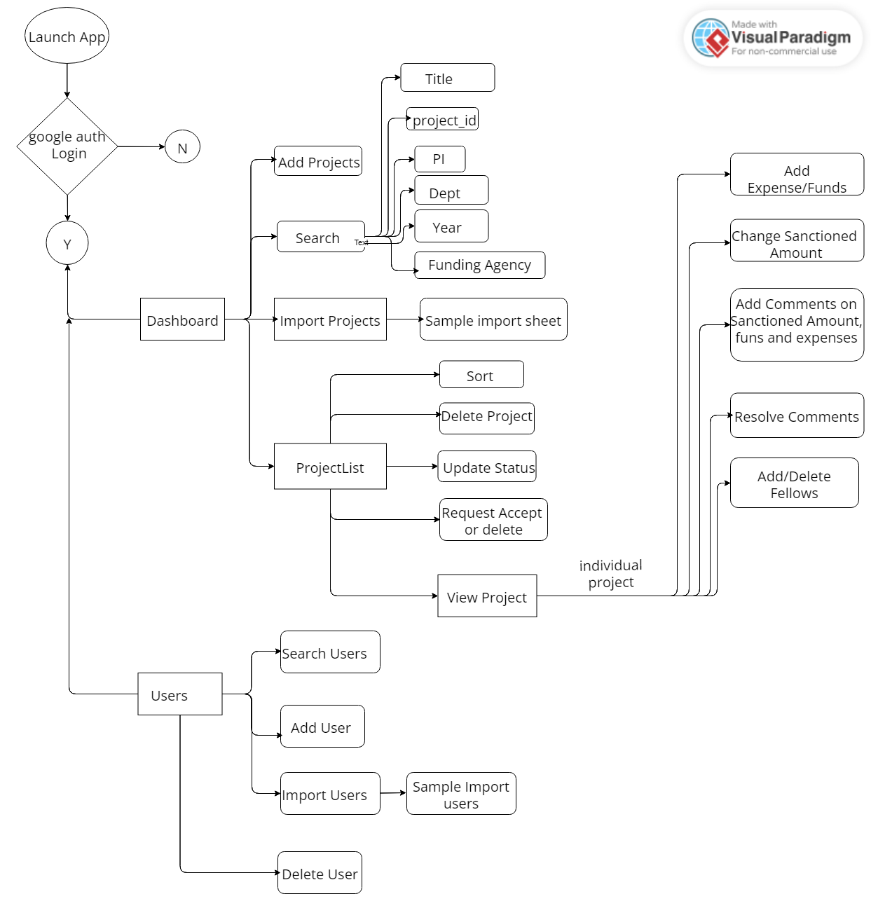

Slide 5
/backend
components
backend
node modules
Backend queries.sql
index.js
package-lock.json
package.json

Slide 6
/backend/components
components
addComment
createProject
addFund
db
addFellow
delFellow
addSummaryComment
delProject
addUser
delrow
apprProject
delUser

Slide 7
/frontend
node modules
frontend
public
src
package.json
package-lock.json

Slide 8
components
editFellow
editSanctioned
getUser
getComment
listofProjects
InsertMainTable
getmainTable
showProject
updatedAddfund
getMarkread
specificProject
updateStatus
getProjectcolor
specificUser
upload_users_file
getSummaryComment
ToActual
editSanctioned
userEXIST
userType

Slide 9
Deployment
We are excited to announce that our R&D Grants Management project has been fully deployed and is now accessible on Render, as well as on the server. The site is now available for use by stakeholders, providing them with easy access to the necessary functionality for ongoing work.
RnD Grant Mangement Portal (rndgrantst16.onrender.com)

Slide 10
Team Members-
Gopagoni Sreya (2020csb1087)
Vishnu (2020csb1097)
Lashyanth (2020csb1083)
Shruti Gangwar (2020csb1127)

