Slide 1

IMPROVING MARKETING STRATEGIES USING MACHINE LEARNING
ANISHA & TU

Slide 2
Introduction
Purposes
Understand how customer characteristics affect their response to marketing campaigns
Predict customer response based on customer characteristic and purchase history
About the dataset
Kaggle dataset: https://www.kaggle.com/datasets/imakash3011/customer-personality-analysis
Purchasing history (number of products bought in each category, date joined, recency, response history to previous campaigns)
Customer characteristics (marital status, have children or not, education, income, etc)

Slide 3
How we approach?
Data Processing
Remove NA, check for outliers and distributions of variables.
Resampling
Unequal observations for the target outcome.
Feature selection
Check correlations + Examine feature importances from RF and XGBoost to select most important features
Evaluation
Fit the model and convert coefficients to odds ratio
Logistic Regression
Predictive models
Hyperparameter tuning
Interpret odds ratio and check for performances

Slide 4
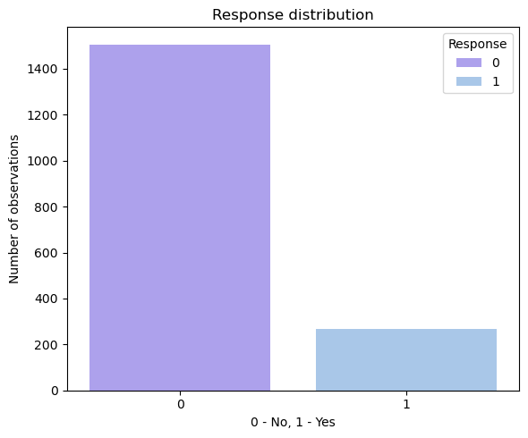
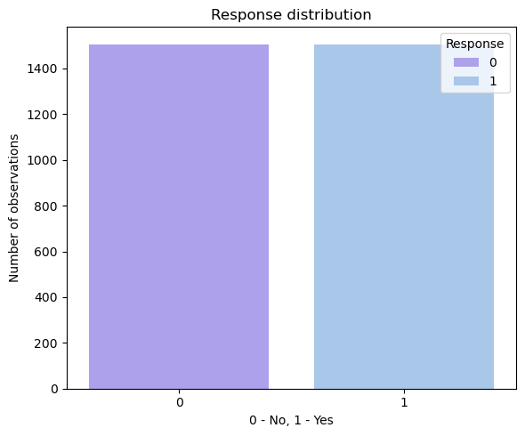
Resampling
Before
After

Slide 5
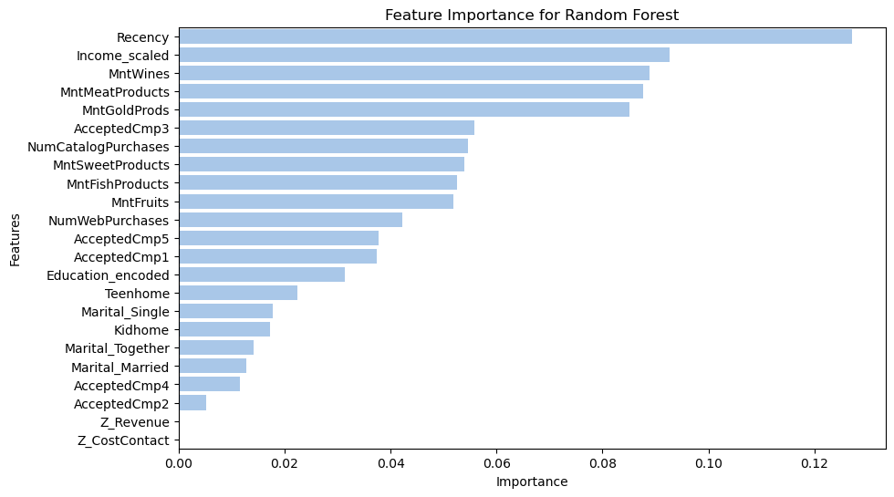
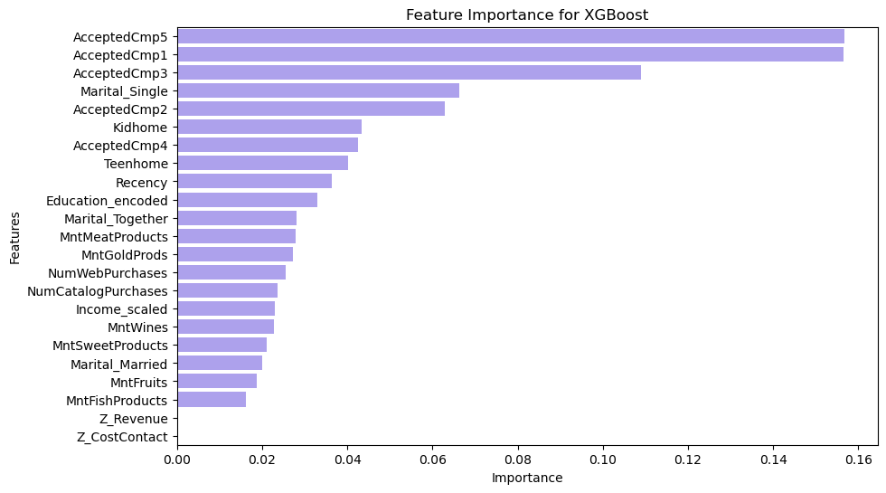
Feature Importance
After checking feature importance from both models, we narrow down to 13 features to run logistic regression. This helps understand how each feature explain for customer response.

Slide 6
Model performance
Model | Accuracy | Precision | Recall | F1 score
Random Forest | 0.882883 | 0.682927 | 0.417910 | 0.518519
XGBoost | 0.867117 | 0.564516 | 0.522388 | 0.542636

Slide 7
Logistic Regression
Logistic Regression
Models the relationship between a binary outcome and predictors.
Features Selected
Recency: # of days since customer's last purchase
MntWines: Amt spent on wine in last 2 years
MntMeatProducts: Amt spent on meat in last 2yrs
MntGoldProds: Amt spent on gold in last 2yrs
Income: Customer's yearly household income
Marital_Single: Customer's marital status
Kidhome: # of children in customer's household
Teenhome: # of teenagers in customer's household
AcceptedCmp1/2/3/4/5: 1 if customer accepted the offer in the nth campaign, 0 otherwise
Based on the most important features from each model, we carry out the Logistic Regression Model
Main Goal from model: Interpret the relation between the features to each other. Understand the customer characteristics so that firms can use it for their marketing strategies.
Odds Ratio: Quantify the strength (from magnitude) and direction of the association (<1 or >1) between a predictor variable and an outcome variable.

Slide 8
Result from regression
 | Features | Coefficients | Odds Ratio
1 | Teen home
2 | Income scaled
3 | Recency
4 | Amt Wines
5 | Amt Meat Products
6 | Amt Gold Products
 | Features | Coefficients | Odds Ratio
7 | Kidhome
8 | Marital_Single
9 | AcceptedCmp4
10 | AcceptedCmp5
11 | AcceptedCmp1
12 | AcceptedCmp2
13 | AcceptedCmp3
-0.34876 | 0.705564
-0.25724 | 0.773182
-0.0273 | 0.973069
0.001295 | 1.001296
0.001885 | 1.001886
0.003237 | 1.003243
0.784293 | 2.190857
0.947255 | 2.578621
0.985352 | 2.678754
0.988378 | 2.686873
1.066014 | 2.903783
1.157739 | 3.182729
2.238834 | 9.382383
Odds Ratio is calculated by taking exponential of the coefficients from the regression.
p-value < 0.05 for all features - statistically significant odds ratio.

Slide 9
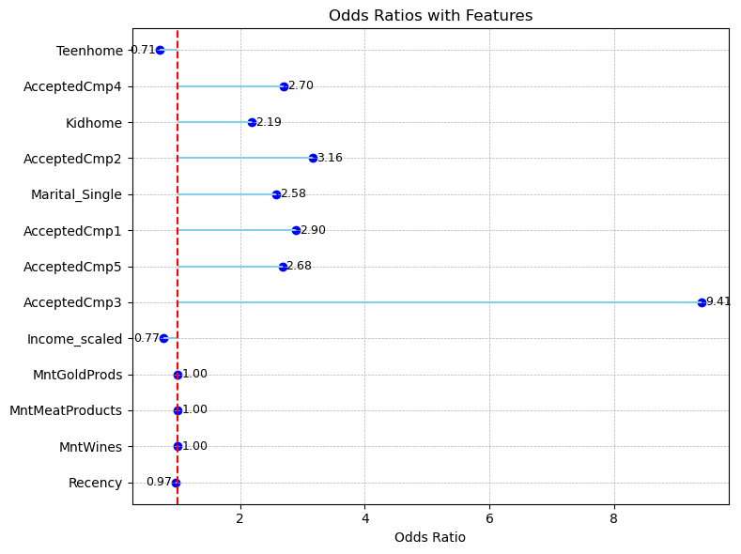
Findings 1
Past campaign acceptance is the strongest predictor of accepting the most current campaign (especially AcceptedCmp3).
AcceptedCmp3: 9.4 -> If accepted 3rd campaign → more than 8x more likely to accept again.
Teenhome: -0.71 means every additional teenager in the household reduces the odds of accepting the offer by about 29%
All were statistically significant odd ratios

Slide 10
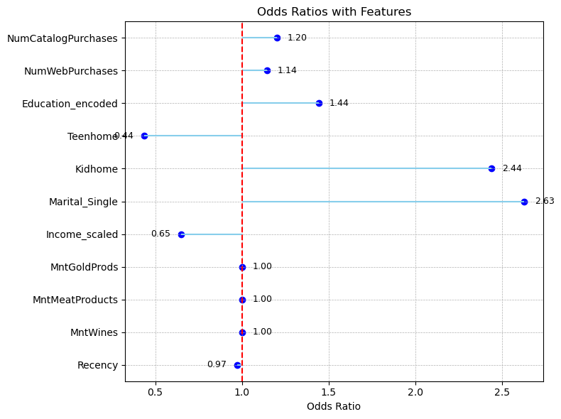
Findings 2
Marital Status - single customers are 1.6 times more likely to accept the most current campaign.
Having kids (Kidhome) also strongly increase the odds of responding to their campaigns - almost 1.5 times more than person without kid.
Customers with higher level of education tend to response to this campaign.
Teenagers (Teenhome) and income reduce the odds of responding.
Spending habits (Wine, Meat, Gold), and longer time since last purchase (Recency) have very small effects in
p<.05 for all variables

Slide 11
THANK YOU
before
Conclusion
From the findings, we can see that both purchasing history and customer characteristics are important in understanding how customers react to certain campaigns.
Future Extension:
By focusing on interpreting features that increase/decrease the likelihood of responding to the most current campaign, the firm can
Evaluate the effectiveness in their campaign on whether it reached their initial target audience.
Adjust target audience for upcoming campaigns based on current customer interests.
Next Steps before Final Poster:
Improve model performance in predicting outcome.
Organize the features for logistic regression

