Slide 1
Publish-Subscribe Messaging with QoS 0 and QoS 1 over TCP
Performance under emulated message loss
BCSE308P Computer Networks Lab | Fall Semester 2026-27
Student Name 1 (Reg. No. 1), Student Name 2 (Reg. No. 2)
Publisher
Broker
Subscriber
Notes:
Introduce the project in one breath: we built a publish-subscribe messaging system from scratch on TCP, then broke the network on purpose to see what a delivery guarantee costs. Say who did which part here.

Slide 2
Problem and motivation
1
One source, many consumers
Problem statement
A sensor may feed a display, a logger and an alarm. Direct links make every new consumer a code change.
When messages are lost, how much latency, extra traffic and duplicate delivery does at-least-once delivery cost?
2
A broker decouples them
Publishers send to a topic. The broker forwards to every subscriber whose filter matches.
3
Reliability has a price
Acknowledgements make delivery safer, but cost time and traffic. How much?
Notes:
TCP is reliable for bytes, but messaging systems still lose messages when a connection drops or a message is never processed. The question for the project is the price of the stronger guarantee.

Slide 3
Existing approach and its gap
Baseline: QoS 0 (best effort)
63.8%
delivered at 20% loss. The other messages vanish without any signal.
Send once, never check. This is the behaviour of MQTT QoS 0 [1]. A message must survive two hops, so it arrives with probability (1 - p) squared.
The gap
Loss is silent and cannot be repaired.
Related work
The MQTT standard [1] and the Mosquitto broker [6] define and implement the QoS levels. Surveys and comparisons [2, 4, 5] describe or compare protocols. We wanted a readable implementation, measured under controlled loss.
Notes:
QoS 0 is the baseline. It is the cheapest behaviour, and under loss the delivery ratio is one minus the loss rate, squared. The related work describes or compares protocols. We did not read each paper in full, only the abstracts, so keep claims about them modest.

Slide 4
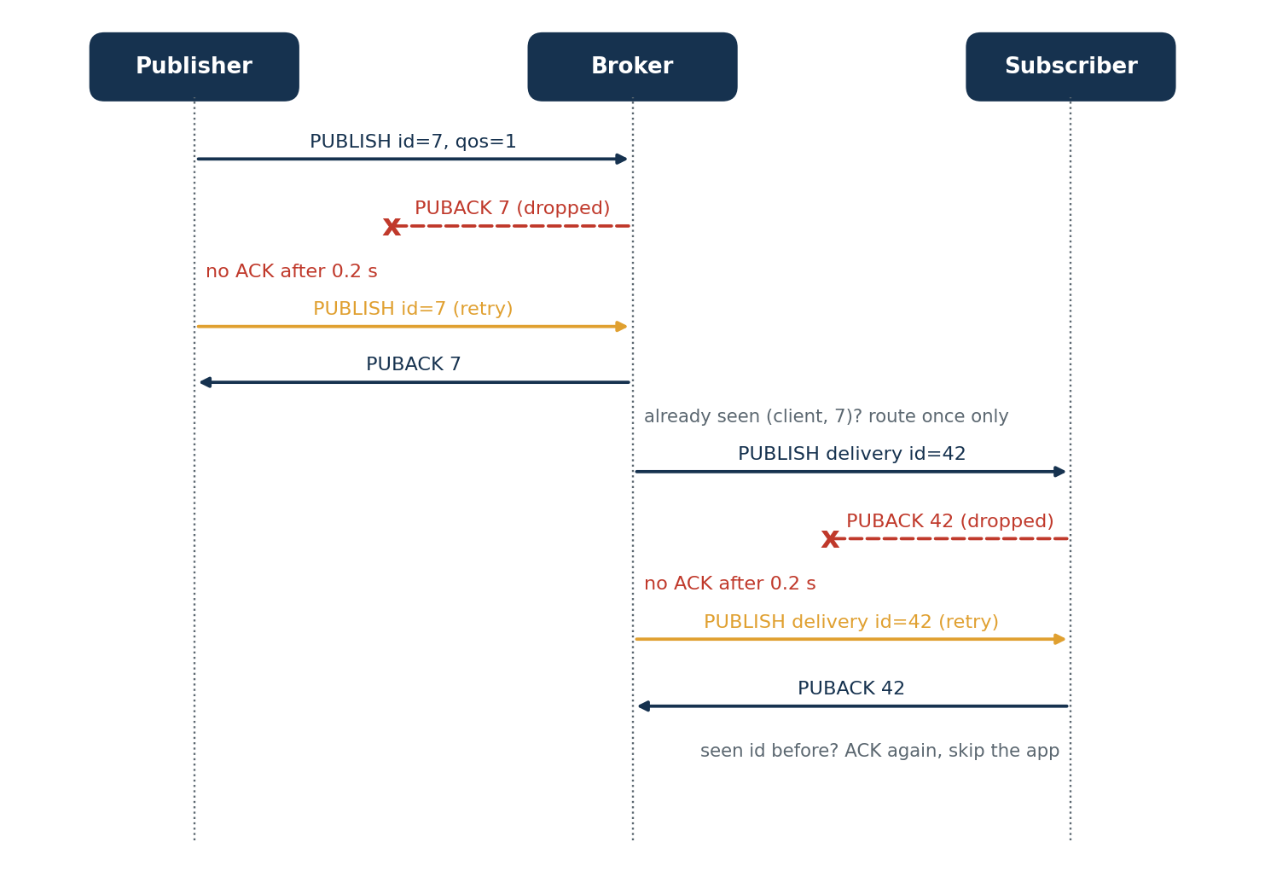
Proposed mechanism: QoS 1
1
Each hop has its own ACK and 0.2 s retry timer
2
The broker gives every delivery its own id
3
ACKs are idempotent: a repeat is re-ACKed but routed once
4
One asyncio task per delivery, so no subscriber blocks another
5
Duplicates are caught and counted at the subscriber
A lost PUBACK on each hop causes a retry
Not a new protocol: the contribution is the design, testbed and measurements.
Notes:
The mechanism follows MQTT QoS 1. What we did is implement it from scratch with a per-hop design, and measure it. A lost acknowledgement looks the same as a lost message to the sender, so the sender resends, and the receiver must recognise the repeat.

Slide 5
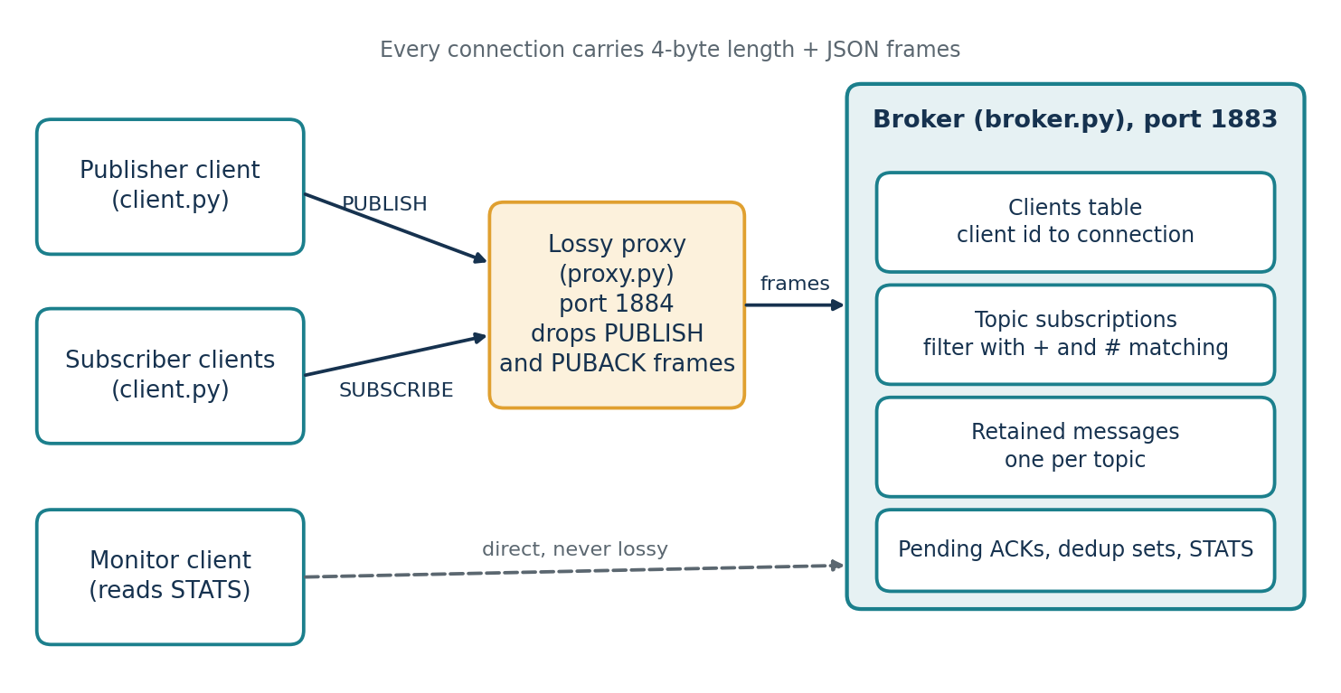
Architecture and algorithm
1
Publisher: send, wait 0.2 s for PUBACK, retry up to 5 times.
2
Broker: always ACK, route each (client, id) once, deliver with its own id.
3
Subscriber: ACK every copy, give the app each delivery id once.
Notes:
Clients talk to the broker directly on 1883 or through the lossy proxy on 1884. The proxy drops whole PUBLISH and PUBACK frames. The three numbered steps are the whole QoS 1 algorithm. The full pseudocode and flowcharts are in chapter 3 of the report.

Slide 6
Implementation setup
Environment
Code
Item | Details
Language | Python 3.12, asyncio
Platform | Windows 11
Processor | Core i7-1360P, 16 threads
Memory | 15.7 GB
Network | Loopback only
File | Role
broker.py | Routing, retained, QoS
client.py | Client library and CLI
proxy.py | Lossy proxy
benchmark.py | Runs experiments
tests/ | Unit and end-to-end
A fresh broker is started for every run. Each setting is run 3 times with 300 messages, sent in batches of 20.
Notes:
Everything runs on one laptop over the loopback interface, as separate processes. A fresh broker for each run means counters and subscriptions cannot carry over. About 700 lines of Python in total.

Slide 7
Scenarios and metrics
Scenarios
Metrics
Scenario | Loss | Subscribers | Payload
S0 no loss | 0% | 1 | 64 B
S1 low | 5% | 1 | 64 B
S2 medium | 10% | 1 | 64 B
S3 high | 20% | 1 | 64 B
Scalability | 0% | 10, 50, 100 | 64 B
Payload | 0% | 1 | 64 B, 1 KB, 16 KB
Delivery ratio
messages that arrive
Mean latency
receive time minus send time
Throughput
messages per second
Retransmissions
extra frames sent
Duplicates
repeat copies seen
S0 to S3 run QoS 0 (baseline) and QoS 1 (proposed). The other two run QoS 1.
Notes:
In the loss scenarios QoS 0 is the baseline and QoS 1 is the proposed mechanism. Latency counts from the first send, so retry delay is included. Throughput under loss mostly reflects our batching and the 0.2 second timer.

Slide 8
Results: baseline against proposed
Mean ± SD of 3 runs
Loss | Delivery % QoS 0 | Delivery % QoS 1 | Latency ms QoS 0 | Latency ms QoS 1
0% | 100.0 ± 0.0 | 100.0 ± 0.0 | 0.9 ± 0.3 | 2.0 ± 0.3
5% | 89.4 ± 1.9 | 100.0 ± 0.0 | 2.5 ± 0.6 | 24.4 ± 5.5
10% | 82.6 ± 2.2 | 100.0 ± 0.0 | 4.3 ± 2.5 | 48.9 ± 6.4
20% | 63.8 ± 1.0 | 100.0 ± 0.0 | 2.3 ± 0.9 | 104.7 ± 6.1
QoS 1 delivered 100% at every loss rate. The price at 20% loss: latency rose from 2.0 ms to 104.7 ms.
Notes:
Left: delivery against loss. QoS 0 falls with loss, QoS 1 stays at 100 percent. Right: the table has the means and standard deviations. The latency of QoS 0 looks low because only surviving messages are timed. The full set of graphs and tables is in chapter 5 of the report.

Slide 9
Analysis and limitations
Model against measurement, 20% loss
Quantity | Model | Measured
Publisher retries | 169 | 155 ± 12
Broker retransmits | 169 | 159 ± 16
Subscriber duplicates | 75 | 70 ± 10
QoS 1 latency (ms) | 100 | 105 ± 6
Limitations
Loss is emulated above TCP
One laptop, 3 runs, loss above 20% untested
With no loss at all, one run needed 1,049 retransmissions. The fixed 0.2 s timer likely fired on a busy broker.
Notes:
The model is simple: each hop needs one over (one minus p) squared attempts, and duplicates arise when an acknowledgement is lost. The measured values agree within about one and a half standard deviations. The chart on the right is a real weakness we found: with a hundred subscribers and no loss, one of three runs saw about a thousand spurious retransmissions. Our explanation is that the single event loop was busy, but we did not investigate further.

Slide 10
Conclusion and future work
Conclusion
Future work
At 20% loss QoS 0 delivered 63.8%, QoS 1 delivered 100%
QoS 1 latency rose about 52 times, with 314 retransmissions
Measurements matched a simple loss model
Adaptive timeout with backoff
QoS 2, keep-alive, last-will
TLS and binary encoding
Two machines, real loss with netem
[1] OASIS, MQTT 3.1.1, 2014. [2] Eugster et al., ACM Comput. Surv., 2003. [3] Hunkeler et al., COMSWARE, 2008. [4] Thangavel et al., IEEE ISSNIP, 2014. [5] Naik, IEEE ISSE, 2017. [6] Light, J. Open Source Softw., 2017.
Notes:
Close on the trade-off: reliability costs latency, traffic and duplicates, and now we have measured numbers for each. The first future item follows directly from the weakness on the previous slide. Full references in IEEE style are in chapter 7 of the report. Then take questions.

