Slide 1

B.Tech – BCSE497J – Project-I
Confidence Calibration and Hallucination Reduction in Small Language Models
Team members:
Anisha Dhoot (Reg. No: ________)
Nataliya Singh (Reg. No: ________)
Yash Hirani (Reg. No: ________)
Faculty guide:
Prof. Swathi J N

Slide 2

Approval Mail From Guide
Get the approval for the following points from your guide through mail before 21-10-2026.(sample attached below)
All the above aspects are addressed and updated by the project team.

Slide 3
Aim
To study whether a controlled share of explicit "I don't know" examples in parameter-efficient fine-tuning makes a small language model (Phi-3-mini, 3.8 B) better calibrated and less likely to hallucinate on institution-specific questions.
Compare three systems on one test set: Base, Normal FT (answerable data only) and IDK FT (15% abstention data).
Measure the benefit (hallucination rate, ECE, Brier, AUROC) and the cost (false refusals, answerable accuracy).
Run everything on a single 4 GB laptop GPU with QLoRA.

Slide 4
Abstract
SLMs are cheap to deploy but often wrong with high confidence; a confident wrong answer about credits or courses is worse than "I don't know".
Phi-3-mini fine-tuned with QLoRA on 2,984 VIT question-answer pairs (15% unanswerable); 449-query test set (370 answerable, 79 unanswerable).
Normal fine-tuning doubled answerable accuracy (0.227 → 0.451) but answered all 79 unanswerable questions (hallucination rate 1.000; base 0.506).
15% abstention data: hallucination rate 0.139, IDK F1 0.840; ECE 0.622 → 0.408 → 0.304; AUROC 0.557 → 0.764 → 0.810.
Cost: 15 false refusals of 370 answerable queries (4.1%), −4.3 points answerable accuracy. Abstention must be supervised explicitly.

Slide 5


Literature Review
Paper | Objective | Methodology | Pros / Cons | Findings
Zhang et al., R-Tuning, NAACL 2024 [48] | Teach LLMs to say "I don't know" for questions beyond their knowledge | Find questions the model gets wrong, build refusal-aware data, fine-tune | Pro: refusal ability transfers to new tasks. Con: large models; abstention share set by data | Refusal behaviour can be learned and generalises
Cheng et al., ICML 2024 [5] | Can assistants know what they do not know? | Model-specific IDK datasets; compare SFT and preference optimisation | Pro: systematic comparison of training styles. Con: 7B+ models, server hardware | Assistants can be trained to recognise knowledge limits
Guo et al., ICML 2017 [14] | Measure calibration of modern neural networks | ECE and reliability diagrams; temperature scaling | Pro: standard metrics and a simple fix. Con: classifiers, not free-form generation | Modern networks are miscalibrated
Jiang et al., TACL 2021 [20] | Calibration of language models on QA | Evaluate T5, BART and GPT-2 confidences, fine-tuning and post-hoc calibration | Pro: early QA calibration study. Con: older models | Models are poorly calibrated; fine-tuning and post-hoc fixes help little
Kapoor et al., NeurIPS 2024 [25] | Teach LLMs to know what they don't know | Fine-tune on a small graded set, including LoRA | Pro: training beats prompting for calibration. Con: needs graded examples | Small fine-tuning sets give better-calibrated uncertainty
Gekhman et al., EMNLP 2024 [12] | Does fine-tuning on new knowledge cause hallucination? | Controlled fine-tuning with known and unknown facts | Pro: explains why domain fine-tuning is risky. Con: does not give a mitigation | New facts are learned slowly and raise hallucination
Hu et al., arXiv 2026 [17] | Effect of PEFT on hallucination detection | Apply confidence and entropy detectors to PEFT models | Pro: links PEFT and detectability. Con: no abstention training | PEFT raises AUROC of unsupervised detectors

Slide 6
Research Gap
Abstention work (R-Tuning, Cheng et al.) targets 7B–70B models on server GPUs; sub-4B models on a 4 GB consumer GPU are not studied.
Abstention share is set by how much data exists, not controlled as a variable.
Calibration and hallucination are studied separately; here both use one refusal-aware correctness definition.
Over-abstention is a named open problem but rarely quantified; here false refusal rate is reported.
Effect of plain domain fine-tuning on abstention is rarely measured against base and abstention-aware models.

Slide 7


Objectives
Measure how domain fine-tuning changes calibration and hallucination (Base vs Normal FT).
Test whether 15% abstention data reduces hallucination (Normal FT vs IDK FT).
Test whether it also improves calibration (ECE, Brier) and discrimination (AUROC) without temperature scaling.
Quantify the cost: false refusals and answerable accuracy.
Package code, data and results so every number is reproducible on a 4 GB GPU.
Identified SDGs: SDG 4 – Quality Education (reliable, honest campus assistants); SDG 9 – Industry, Innovation and Infrastructure (efficient on-device AI).
Technology readiness: TRL 4 – technology validated in the lab (research prototype with a demo chatbot).
Outcomes: conference paper (Springer LNCS format); reproducible code, data and results package; demo web chatbot.

Slide 8
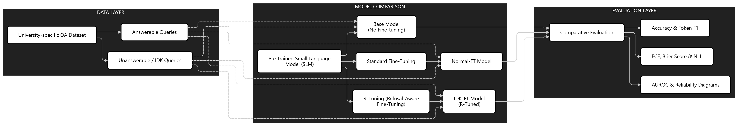
Framework/Architecture/Block Diagram
Data layer: VIT QA corpus split into answerable (2,537) and abstention (792) pools; controlled mix ρ = 0 or 0.15.
Training layer: Phi-3-mini 4-bit + LoRA → Normal FT (0% IDK) and IDK FT (15% IDK); Base has no adapter.
Inference layer: greedy answer + length-normalised token-probability confidence, or an "I don't know" response.
Evaluation layer: refusal metrics, ECE, Brier, NLL, AUROC, reliability diagrams.

Slide 9
Functional Requirements
FR1 Build train/valid/test files for a chosen abstention ratio; normalise refusals to one canonical string.
FR2 Verify no train/test leakage and canonical refusal labels.
FR3 Train a LoRA adapter within 4 GB VRAM.
FR4 Generate a greedy answer and a sequence-level confidence for each query.
FR5 Compute hallucination rate, IDK precision/recall/F1, false refusals, answerable accuracy.
FR6 Compute ECE, Brier, NLL, AUROC; export per-example confidence and correctness.
FR7 Plot reliability diagrams, ROC curves, confidence histograms, refusal and error charts.
FR8 Demo chatbot that shows answer, confidence and an explicit abstention.

Slide 10
Modules
Module | What it does | Files
1 Data curation | Public VIT QA rows; source inventory; non-public rows removed | final_qa_dataset.csv, combined_qa_finetuning.csv, VIT_QA_Resource_Breakdown.xlsx
2 Data preparation | Controlled-ratio splits (70/15/15, seed 42); leakage and label checks | prepare_expc_data.py, verify_dataset.py
3 Fine-tuning | QLoRA training of Normal FT and IDK FT adapters | train_lora.py, exp_c_train.py
4 Evaluation | Answers, confidence, refusal and calibration metrics | eval_compare_fixed.py, compare_idk_stats.py
5 Analysis and figures | Reliability, ROC, histograms, refusal and error charts | calibration_eval_utils.py, run_calibration_utils.py, make_figures.py
6 Demo chatbot | Flask UI: answer + confidence + abstention | chatbot_site/

Slide 11
Experiments and Results (1/5): Dataset and Setup
Dataset: 2,349 core QA pairs from public VIT documents (82% curriculum) + 980 supplementary pairs; 5 unanswerable categories.
Pools: 2,537 answerable, 792 abstention (one canonical refusal string); mix ρ = 0 (Normal FT) and ρ = 0.15 (IDK FT).
Phi-3-mini-4k-instruct, 4-bit NF4, LoRA r = 8, α = 16; 3 epochs, lr 2e-4, batch 1×8, seed 42; RTX 3050 Ti, 4 GB.
All systems tested on the IDK-15 test split: 449 queries (370 answerable, 79 unanswerable); greedy decoding.
Mixture | ρ (target) | Total | Train | Validation | Test
IDK-0 | 0.00 | 2537 | 1775 (0) | 380 (0) | 382 (0)
IDK-15 | 0.15 | 2984 | 2088 (312) | 447 (56) | 449 (79)
Table: partition sizes; abstention examples in parentheses. Metrics: HR, IDK P/R/F1, false refusals, token F1, ECE, Brier, NLL, AUROC.

Slide 12
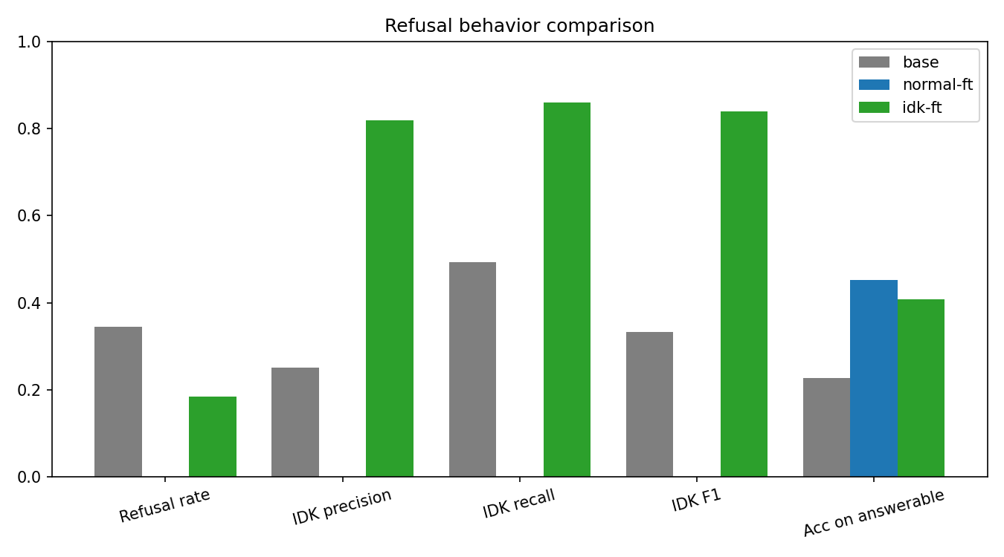
Experiments and Results (2/5): Hallucination Reduction
System | Refusal rate | IDK precision | IDK recall | IDK F1 | HR | Missed abst. (FN) | False refusals (FP) | Answerable acc.
Base | 0.345 | 0.252 | 0.494 | 0.333 | 0.506 | 40 | 116 | 0.227
Normal FT | 0.000 | 0.000 | 0.000 | 0.000 | 1.000 | 79 | 0 | 0.451
IDK FT | 0.185 | 0.819 | 0.861 | 0.840 | 0.139 | 11 | 15 | 0.408
• Base refuses half of the unanswerable questions (HR 0.506), but 116 of its 155 refusals are on answerable questions.
• Normal FT refuses nothing: all 79 unanswerable questions answered (HR 1.000).
• IDK FT: HR 0.139 (86% lower than Normal FT, 73% lower than Base), IDK F1 0.840, 15 false refusals (4.1%).

Slide 13
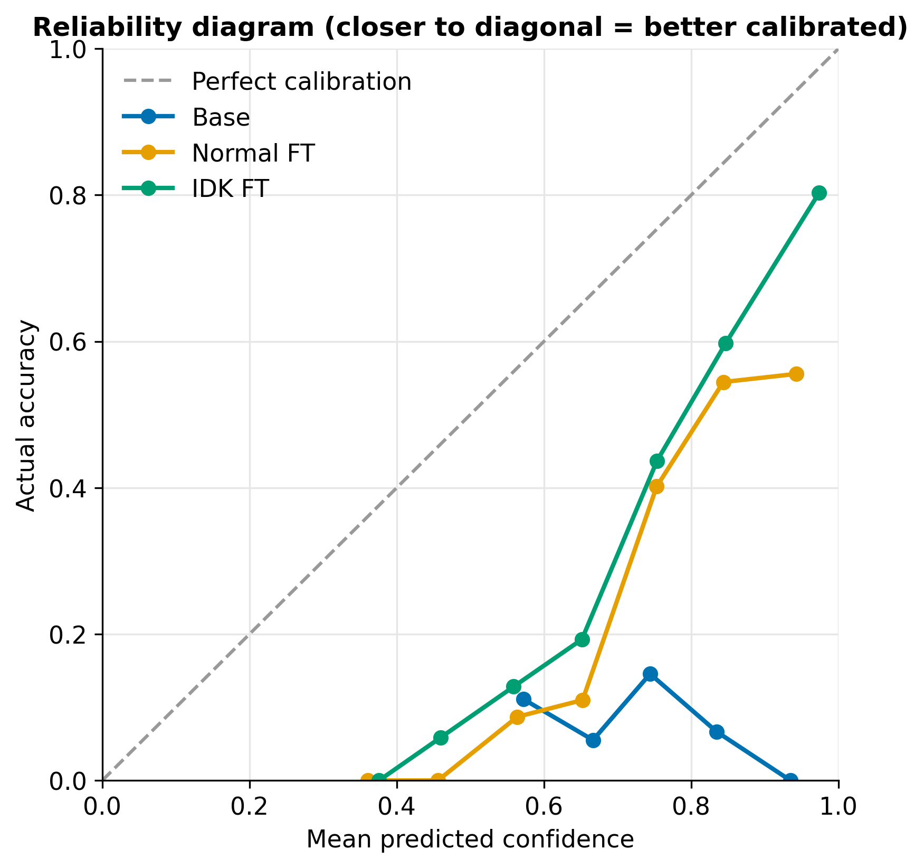
Experiments and Results (3/5): Calibration
Metric | Base | Normal FT | IDK FT
Accuracy (refusal-aware) | 0.100 | 0.327 | 0.477
Exact match | 0.000 | 0.051 | 0.189
Token F1 | 0.168 | 0.391 | 0.515
ECE | 0.622 | 0.408 | 0.304
Brier score | 0.480 | 0.351 | 0.285
Reference NLL | 2.405 | 1.663 | 0.965
AUROC | 0.557 | 0.764 | 0.810
• ECE falls 51% from Base to IDK FT (25% of it from abstention data); Brier and AUROC follow.
• All three curves sit below the diagonal: every system is still over-confident (IDK FT is right only 19% of the time at confidence ≈ 0.65).
• Part of the gain is confident repetition of the fixed refusal sentence.

Slide 14
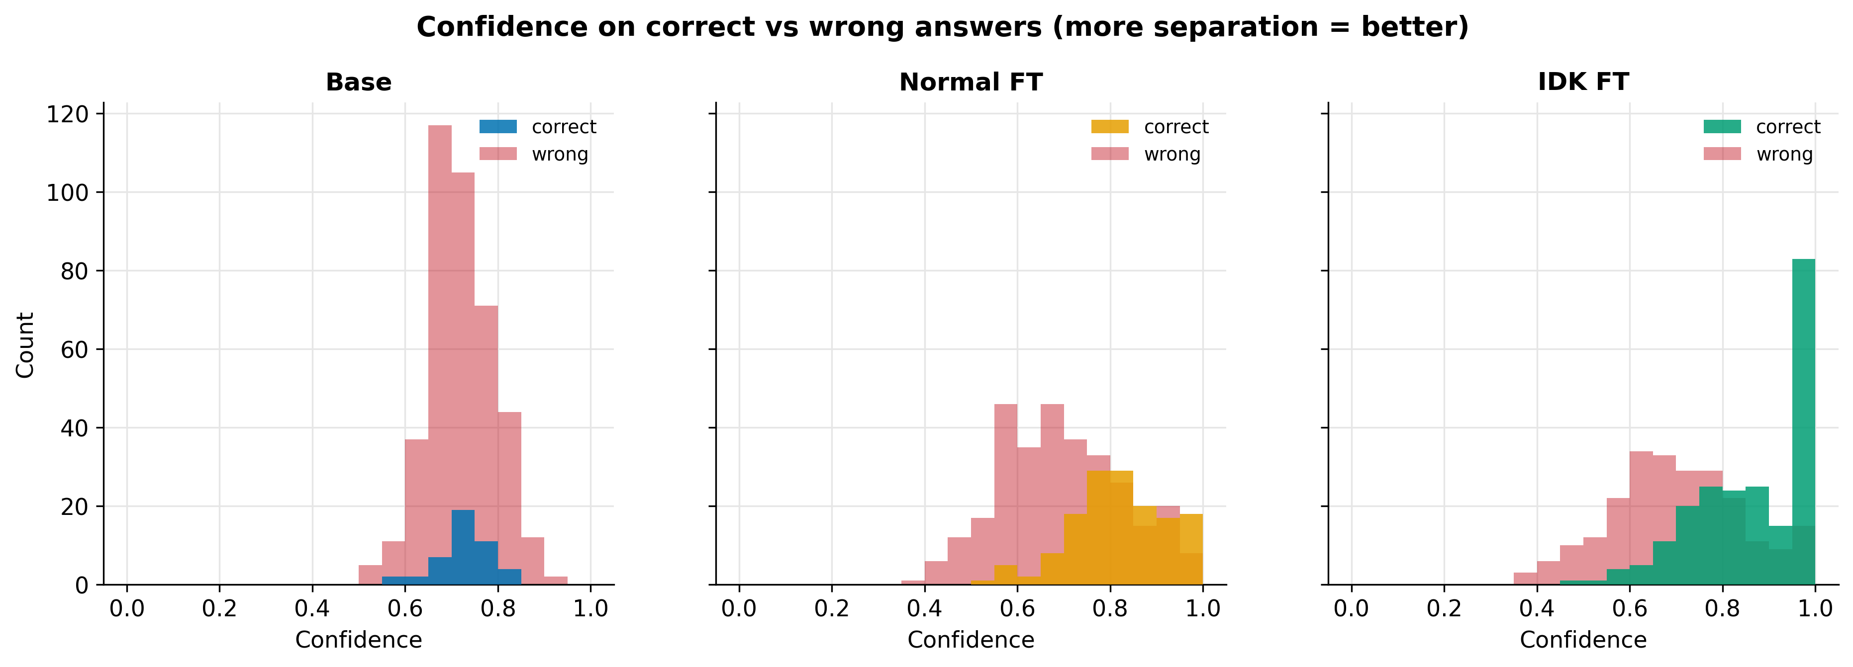
Experiments and Results (4/5): Confidence and Cost
• Base: correct and wrong answers overlap (AUROC 0.557). Normal FT 0.764. IDK FT 0.810, with a peak of correct answers at 0.95–1.0, mostly canonical refusals.
• At a false-positive rate of 0.1 IDK FT keeps about 43% of its correct answers (Normal FT 25%); the gain is in the high-confidence region.
• Cost: 15 false refusals of 370 (4.1%), accuracy 0.451 → 0.408 (167 → 151 correct) to avoid 68 hallucinations – about four per correct answer lost.

Slide 15
Experiments and Results (5/5): Ablation, Errors and Limits
Metric | Domain adaptation (Base → Normal FT) | Abstention data (Normal FT → IDK FT)
Hallucination rate | +0.494 (0.506 → 1.000) | −0.861 (1.000 → 0.139)
IDK F1 | −0.333 | +0.840
False refusal rate | −0.314 | +0.041
Answerable accuracy | +0.224 | −0.043
Token F1 | +0.223 | +0.124
ECE | −0.214 | −0.104
Brier | −0.129 | −0.066
AUROC | +0.207 | +0.046
Error analysis (IDK FT)
• 11 missed abstentions: plausible fake course codes and details absent from the documents.
• 15 false refusals: questions worded like refusal examples; confidence above 0.95.
• Most errors: wrong numbers on answerable questions (limited memory of a 3.8 B model).
Limitations
• One model, one ratio (15%), one seed, one institution; HR 95% interval ≈ 0.08–0.23.
• Phrase-list refusal detection; token-overlap correctness; no temperature scaling; no retrieval.
Domain adaptation brings knowledge and most of the calibration gain but removes abstention; abstention data restores it at a small cost.

Slide 16
Conclusion and Future Work
Conclusion
Domain fine-tuning alone is not enough: it doubled answerable accuracy but removed abstention (HR 0.506 → 1.000).
15% controlled abstention data cut HR to 0.139 (IDK F1 0.840) and improved ECE (0.304), Brier (0.285) and AUROC (0.810).
Price: 4.1% false refusals; all systems remain over-confident; results are for one model, ratio, seed and institution.
Future work
Abstention-ratio sweep (10% and 20% splits already prepared) with several seeds; varied, context-dependent refusals.
Temperature scaling and a confidence threshold; sampling-based and verbalised confidence.
Better correctness checks (course codes, credits, NLI); combine with retrieval; other SLMs and institutions.

Slide 17
Outcome Achieved
Conference paper: manuscript completed in Springer LNCS format ("Confidence Calibration and Hallucination Reduction in Small Language Models"). Status: [update – submitted / accepted / published] with proof.
Others: reproducible code, datasets, results and figures package; demo web chatbot.
Outcome-achieved proof to be uploaded on or before 27 Oct 2026 in the given link.

Slide 18
References
[48] H. Zhang et al., "R-Tuning: Instructing large language models to say 'I don't know'," in Proc. NAACL, 2024.
[5] Q. Cheng et al., "Can AI assistants know what they don't know?" in Proc. ICML, 2024.
[25] S. Kapoor et al., "Large language models must be taught to know what they don't know," in Proc. NeurIPS, 2024.
[12] Z. Gekhman et al., "Does fine-tuning LLMs on new knowledge encourage hallucinations?" in Proc. EMNLP, 2024.
[17] X. Hu et al., "Small updates, big doubts: Does parameter-efficient fine-tuning enhance hallucination detection?" arXiv:2602.11166, 2026.
[42] B. Wen et al., "Know your limits: A survey of abstention in large language models," Trans. Assoc. Comput. Linguist., 2025.
[14] C. Guo, G. Pleiss, Y. Sun and K. Q. Weinberger, "On calibration of modern neural networks," in Proc. ICML, PMLR vol. 70, pp. 1321-1330, 2017.
[20] Z. Jiang, J. Araki, H. Ding and G. Neubig, "How can we know when language models know? On the calibration of language models for question answering," Trans. Assoc. Comput. Linguist., vol. 9, pp. 962-977, 2021.
[8] T. Dettmers, A. Pagnoni, A. Holtzman and L. Zettlemoyer, "QLoRA: Efficient finetuning of quantized LLMs," in Proc. NeurIPS, 2023.
[16] E. J. Hu et al., "LoRA: Low-rank adaptation of large language models," in Proc. ICLR, 2022.
[1] M. Abdin et al., "Phi-3 technical report: A highly capable language model locally on your phone," arXiv:2404.14219, 2024.
[31] A. Malinin and M. Gales, "Uncertainty estimation in autoregressive structured prediction," in Proc. ICLR, 2021.

