Slide 1
Churn Analysis
Analysis using Logistic Regression

Slide 2
Problem Statement
We have a data of customers of a telecom service provider with their mobile service plan, usage, charges and contractual details.
The situation is that, we need to find that things which influences a customer to cancel the contract with the company and to build a model to predict the customers who are likely to churn in the future.

Slide 3
Data Summary
Variable | Data Type | Description
Churn | factor | 1 – Yes, 0 – No
AccountWeeks | int | Contract Period (in weeks)
ContractRenewal | factor | Recent contract renewal (1 – Yes, 0 – No)
DataPlan | factor | 1 – Yes, 0 – No
DataUsage | num | gb/month
CustServCalls | int | Number of calls to customer service
DayMins | int | Average call time (minutes/month)
DayCalls | int | Average call count (calls/month)
MonthlyCharge | num | Average monthly bill amount
OverageFee | num | largest over usage fee in last 12 months
RoamMins | num | average number of roaming minutes

Slide 4
Data Summary (cont..)
Dimension:
 | Count
Rows | 3333
Columns | 11
Churn | Account Weeks | Contract Renewal | Data Plan | Data Usage | Cust Serv Calls | Day Mins | Day Calls | Monthly Charge | Overage Fee | Roam Mins
0 | 128 | 1 | 1 | 2.7 | 1 | 265.1 | 110 | 89 | 9.87 | 10
0 | 107 | 1 | 1 | 3.7 | 1 | 161.6 | 123 | 82 | 9.78 | 13.7
0 | 137 | 1 | 0 | 0 | 0 | 243.4 | 114 | 52 | 6.06 | 12.2
0 | 84 | 0 | 0 | 0 | 2 | 299.4 | 71 | 57 | 3.1 | 6.6
0 | 75 | 0 | 0 | 0 | 3 | 166.7 | 113 | 41 | 7.42 | 10.1
0 | 118 | 0 | 0 | 0 | 0 | 223.4 | 98 | 57 | 11.03 | 6.3

Slide 5
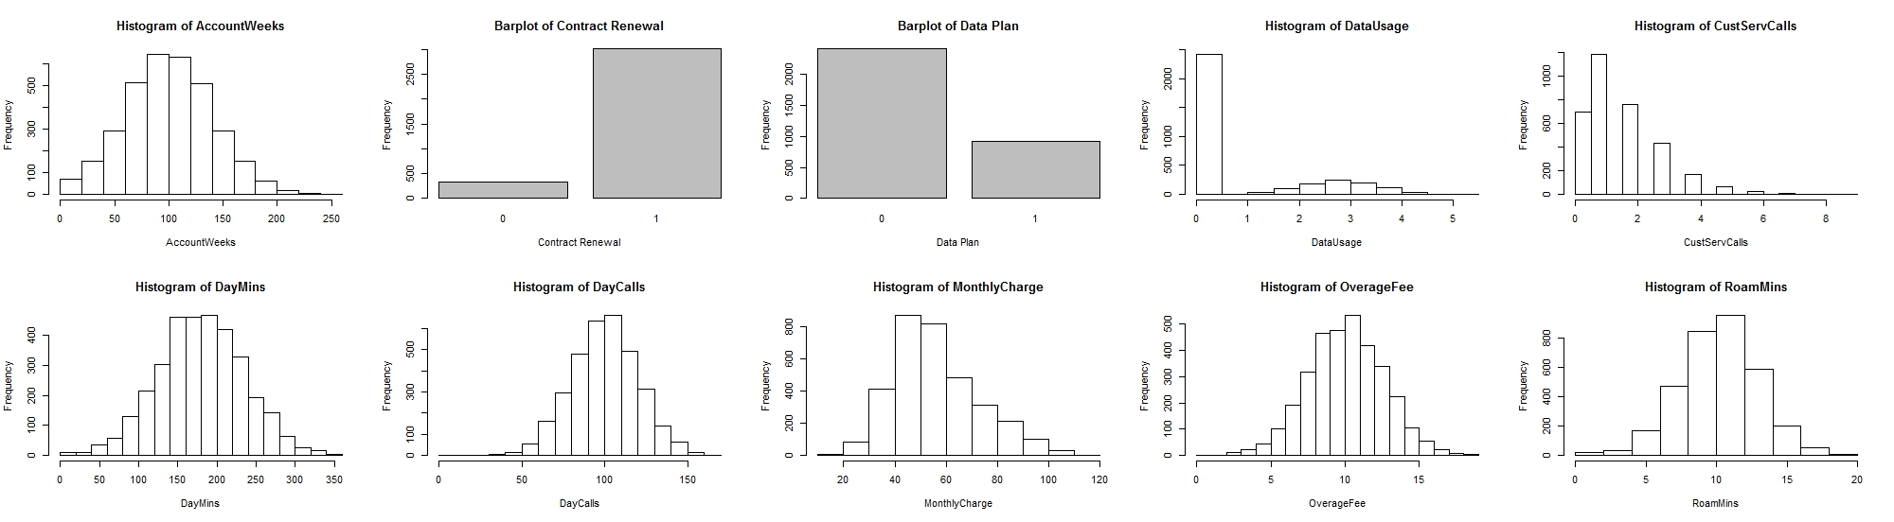
Exploratory Data Analysis (Univariate)
Findings:
The data shows that there has been recent renewal of contract
Majority of the customers did not opt for a data subscription, this is also matching with the data usage graph as most of the customers have zero data usage
Less number of customer service calls are being made by customers

Slide 6
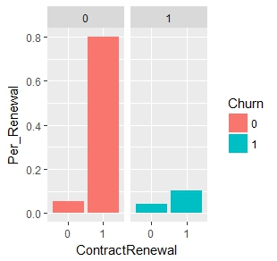
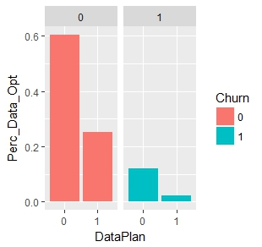
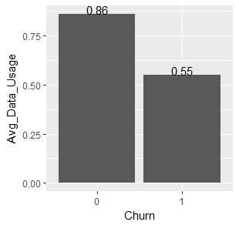
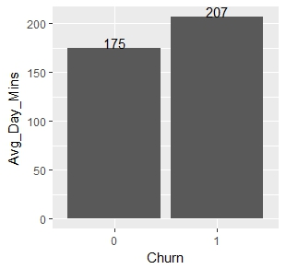
Exploratory Data Analysis (Bivariate)
Insights:
Customers who have recently renewed the subscription have lesser propensity to churn
Propensity to churn is high among customers who have not subscribed for data plan
Out of the active data plan users, low data usage indicates that the customer has high probability to churn
Customers who have more day call min per month are more likely to churn this could be due to weak network forcing them to talk for more min in order to convey a message

Slide 7
Hypothesis Testing & IOV
Calculation Weight of evidence for the categorical variables indicates:
Based on t-test on the continuous variables we notice that only few variables have a significant difference between group mean across the churn value of 0 & 1
Data Usage
Average call time (minutes/month)
Average monthly bill amount
Largest over usage fee in last 12 months
Average number of roaming minutes
Number of calls to customer service
Variable | IV
Contract Renewal | 37.9
Data Plan | 9.7

Slide 8
Data Sampling
The data is split into Development & Holdout sample using SRS
Development – 70%
Holdout – 30%
Churn percentage in each sample is as follows
Sample | 0 | 1
Complete Data | 86% | 14%
Development Sample | 87% | 13%
Testing Sample | 83% | 17%

Slide 9
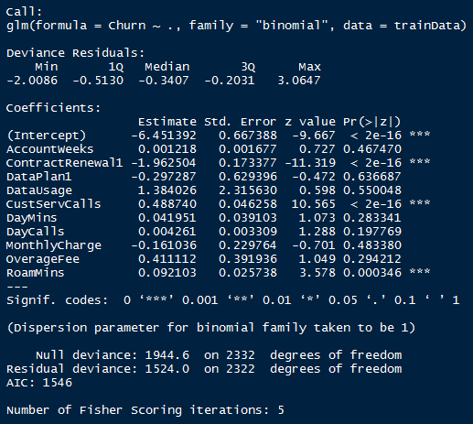
Model Building (Model1)
Model1 is built using all the independent variables
Insights:
Most of the variables are in-significant (high p-value)
Significant variables are
Contract Renewal
Customer Service Calls
Roaming minutes
AIC Value : 1546

Slide 10
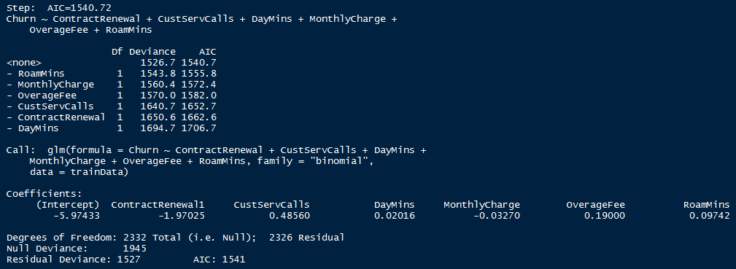
Stepwise
Performing stepwise model selection by AIC

Slide 11
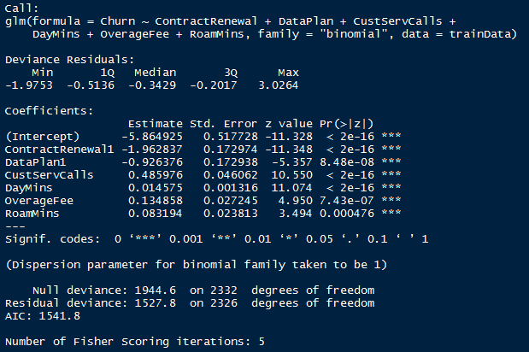
Model 2
Model2 is built using all independent variables suggested by the stepwise output
Insights:
Null Deviance:
Shows how well the response variable is predicted
by a model that includes only the intercept
Value : 1843.2 on 2332 degrees of freedom
Residual Deviance:
Shows how well the response variable is predicted
by a model that includes independent variable
Value : 1477.9 on 2326 degrees of freedom
AIC Value : 1542

Slide 12
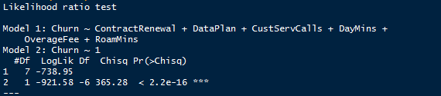
Model Statistics
Pseudo R2: (McFadden R2)
20% of uncertainty produced by intercept model has been calibrated/explained by full model
Maximum Likelihood Estimator:
Model 1 using the independent variables fits better than intercept model

Slide 13
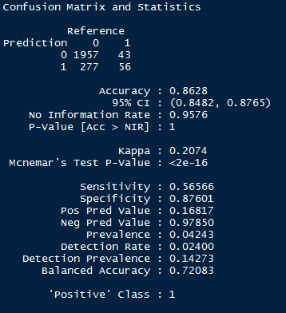
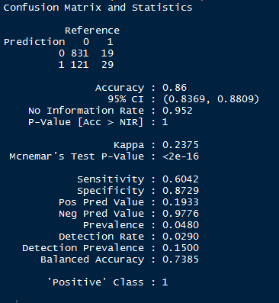
Confusion Matrix
Development:
Hold Out:

Slide 14
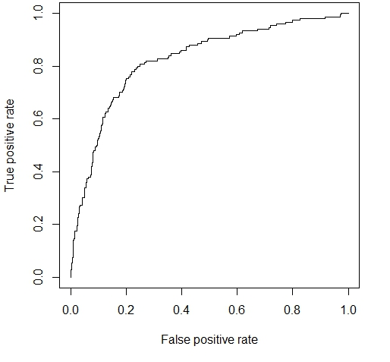

ROC & AUC
Development:
AUC : 0.8129
Hold Out:
AUC : 0.8245

Slide 15
Rank Order Chart
Development:
i | Cnt | Cnt_Resp | Cnt_Non_Resp | Resp_Rate | Cum_Resp | Cum_Non_Resp | Cum_Rel_Resp | Cum_Rel_Non_Resp | KS
1 | 234 | 1 | 233 | 0.4273504 | 1 | 233 | 0.003003003 | 0.1165 | 0.113497
2 | 233 | 12 | 221 | 5.1502146 | 13 | 454 | 0.039039039 | 0.227 | 0.187961
3 | 233 | 4 | 229 | 1.7167382 | 17 | 683 | 0.051051051 | 0.3415 | 0.2904489
4 | 233 | 13 | 220 | 5.5793991 | 30 | 903 | 0.09009009 | 0.4515 | 0.3614099
5 | 233 | 14 | 219 | 6.0085837 | 44 | 1122 | 0.132132132 | 0.561 | 0.4288679
6 | 234 | 20 | 214 | 8.5470085 | 64 | 1336 | 0.192192192 | 0.668 | 0.4758078
7 | 233 | 21 | 212 | 9.0128755 | 85 | 1548 | 0.255255255 | 0.774 | 0.5187447
8 | 233 | 54 | 179 | 23.1759657 | 139 | 1727 | 0.417417417 | 0.8635 | 0.4460826
9 | 233 | 87 | 146 | 37.3390558 | 226 | 1873 | 0.678678679 | 0.9365 | 0.2578213
10 | 234 | 107 | 127 | 45.7264957 | 333 | 2000 | 1 | 1 | 0

Slide 16
Rank Order Chart
Holdout Sample:
i | Cnt | Cnt_Resp | Cnt_Non_Resp | Resp_Rate | Cum_Non_Resp | Cum_Rel_Non_Resp | Cum_Resp | Cum_Rel_Resp | KS
1 | 100 | 3 | 97 | 3 | 97 | 0.114118 | 3 | 0.02 | 0.094118
2 | 100 | 3 | 97 | 3 | 194 | 0.228235 | 6 | 0.04 | 0.188235
3 | 100 | 4 | 96 | 4 | 290 | 0.341177 | 10 | 0.066667 | 0.27451
4 | 100 | 4 | 96 | 4 | 386 | 0.454118 | 14 | 0.093333 | 0.360784
5 | 100 | 4 | 96 | 4 | 482 | 0.567059 | 18 | 0.12 | 0.447059
6 | 100 | 8 | 92 | 8 | 574 | 0.675294 | 26 | 0.173333 | 0.501961
7 | 100 | 9 | 91 | 9 | 665 | 0.782353 | 35 | 0.233333 | 0.54902
8 | 100 | 22 | 78 | 22 | 743 | 0.874118 | 57 | 0.38 | 0.494118
9 | 100 | 41 | 59 | 41 | 802 | 0.943529 | 98 | 0.653333 | 0.290196
10 | 100 | 52 | 48 | 52 | 850 | 1 | 150 | 1 | 0

Slide 17
ODDS Ratio
Variable | Odds Ratio | Remark
Contract Renewal | 0.16 | Odds of becoming a Churn customer increases by 0.16 times when customer renews the contract
Data Plan | 0.35 | Odds of becoming a Churn customer increases by 0.35 times when customer subscribes for the data plan
Customer Service Calls | 1.69 | Odds of becoming a Churn customer increases by 1.69 times when customer calls Customer care one more time
Average call time | 1.01 | Odds of becoming a Churn customer increases by 1.01 times when average customer call time per month increases by a minute
Over Usage Fee | 1.15 | Odds of becoming a Churn customer increases by 1.15 times when highest over usage fee increase by one unit
Roaming Minutes | 1.07 | Odds of becoming a Churn customer increases by 1.01 times when average roaming call time per month increases by a minute

