Slide 1
Churn Analysis
Analysis using Logistic Regression

Slide 2
Problem Statement
We have a data of customers of a telecom service provider with their mobile service plan, usage, charges and contractual details.
The situation is that, we need to find that things which influences a customer to cancel the contract with the company and to build a model to predict the customers who are likely to churn in the future.

Slide 3
Data Summary
Variable | Data Type | Description
Churn | factor | 1 – Yes, 0 – No
AccountWeeks | int | Contract Period (in weeks)
ContractRenewal | factor | Recent contract renewal (1 – Yes, 0 – No)
DataPlan | factor | 1 – Yes, 0 – No
DataUsage | num | gb/month
CustServCalls | factor | Number of calls to customer service (Levels: 0,1,2,3,4,5,6,7,8,9)
DayMins | int | Average call time (minutes/month)
DayCalls | int | Average call count (calls/month)
MonthlyCharge | num | Average monthly bill amount
OverageFee | num | largest overage fee in last 12 months
RoamMins | num | average number of roaming minutes

Slide 4
Data Summary (cont..)
Dimension:
 | Count
Rows | 3333
Columns | 11
Churn | AccountWeeks | ContractRenewal | DataPlan | DataUsage | CustServCalls | DayMins | DayCalls | MonthlyCharge | OverageFee | RoamMins
0 | 128 | 1 | 1 | 2.7 | 1 | 265.1 | 110 | 89 | 9.87 | 10
0 | 107 | 1 | 1 | 3.7 | 1 | 161.6 | 123 | 82 | 9.78 | 13.7
0 | 137 | 1 | 0 | 0 | 0 | 243.4 | 114 | 52 | 6.06 | 12.2
0 | 84 | 0 | 0 | 0 | 2 | 299.4 | 71 | 57 | 3.1 | 6.6
0 | 75 | 0 | 0 | 0 | 3 | 166.7 | 113 | 41 | 7.42 | 10.1
0 | 118 | 0 | 0 | 0 | 0 | 223.4 | 98 | 57 | 11.03 | 6.3

Slide 5
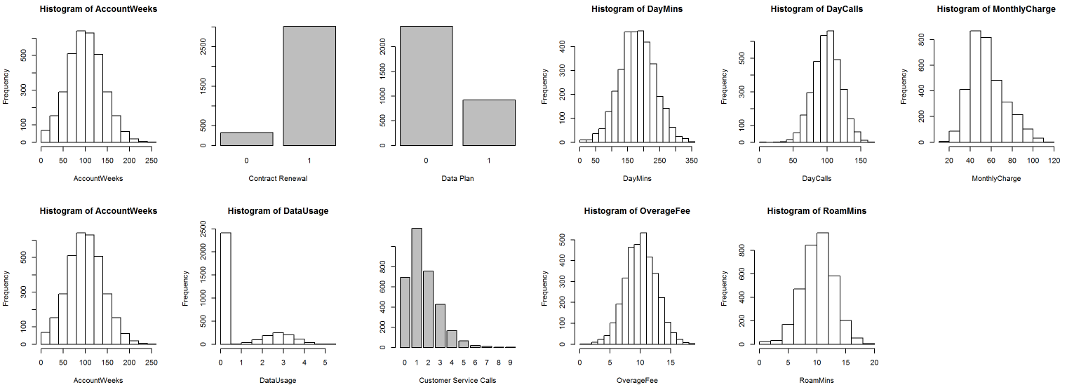
Exploratory Data Analysis

