Slide 1
Churn Analysis
Analysis using Logistic Regression

Slide 2
Problem Statement
We have a data of customers of a telecom service provider with their mobile service plan, usage, charges and contractual details.
The situation is that, we need to find that things which influences a customer to cancel the contract with the company and to build a model to predict the customers who are likely to churn in the future.

Slide 3
Data Summary
Variable | Data Type | Description
Churn | factor | 1 – Yes, 0 – No
AccountWeeks | int | Contract Period (in weeks)
ContractRenewal | factor | Recent contract renewal (1 – Yes, 0 – No)
DataPlan | factor | 1 – Yes, 0 – No
DataUsage | num | gb/month
CustServCalls | int | Number of calls to customer service
DayMins | int | Average call time (minutes/month)
DayCalls | int | Average call count (calls/month)
MonthlyCharge | num | Average monthly bill amount
OverageFee | num | largest over usage fee in last 12 months
RoamMins | num | average number of roaming minutes

Slide 4
Data Summary (cont..)
Dimension:
 | Count
Rows | 3333
Columns | 11
Churn | Account Weeks | Contract Renewal | Data Plan | Data Usage | Cust Serv Calls | Day Mins | Day Calls | Monthly Charge | Overage Fee | Roam Mins
0 | 128 | 1 | 1 | 2.7 | 1 | 265.1 | 110 | 89 | 9.87 | 10
0 | 107 | 1 | 1 | 3.7 | 1 | 161.6 | 123 | 82 | 9.78 | 13.7
0 | 137 | 1 | 0 | 0 | 0 | 243.4 | 114 | 52 | 6.06 | 12.2
0 | 84 | 0 | 0 | 0 | 2 | 299.4 | 71 | 57 | 3.1 | 6.6
0 | 75 | 0 | 0 | 0 | 3 | 166.7 | 113 | 41 | 7.42 | 10.1
0 | 118 | 0 | 0 | 0 | 0 | 223.4 | 98 | 57 | 11.03 | 6.3

Slide 5
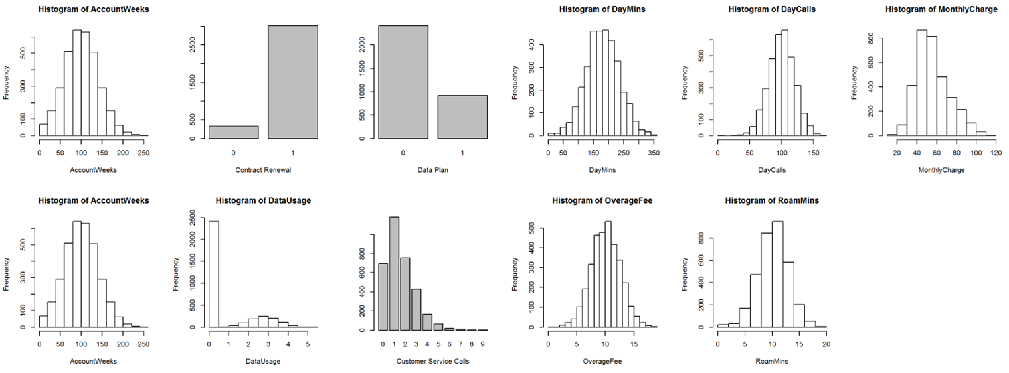
Exploratory Data Analysis
Findings:
The data shows that there has been recent renewal of contract
Majority of the customers did not opt for a data subscription, this is also matching with the data usage graph as most of the customers have zero data usage
Less number of customer service calls are being made by customers

Slide 6
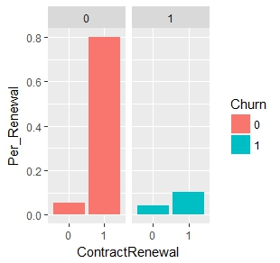
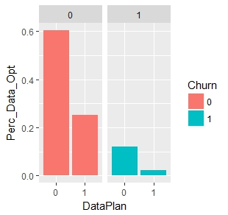
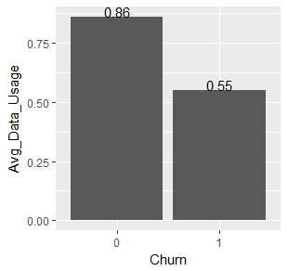
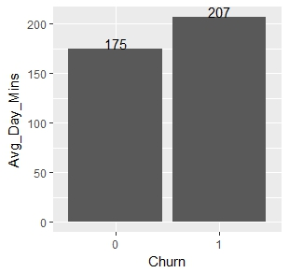
Bi-variate Analysis
Insights:
Customers who have recently renewed the subscription have lesser propensity to churn
Propensity to churn is high among customers who have not subscribed for data plan
Out of the active data plan users, low data usage indicates that the customer has high probability to churn
Customers who have more day call min per month are more likely to churn this could be due to weak network forcing them to talk for more min in order to convey a message

Slide 7
Bi-Variate Analysis
Insights:
Customers who have recently renewed the subscription have lesser propensity to churn
Propensity to churn is high among customers who have not subscribed for data plan
Out of the active data plan users, low data usage indicates that the customer has high probability to churn
Customers who have more day call min per month are more likely to churn this could be due to weak network forcing them to talk for more min in order to convey a message

Slide 8
Hypothesis Testing & IOV
Calculation Weight of evidence for the categorical variables indicates:
Based on t-test on the continuous variables we notice that only few variables have a significant difference between group mean across the churn value of 0 & 1
Data Usage
Average call time (minutes/month)
Average monthly bill amount
largest over usage fee in last 12 months
average number of roaming minutes
Number of calls to customer service
Variable Name | IV
Contract Renewal | 37.9
Data Plan | 9.7

Slide 9
Data Sampling
The data is split into Development and Hold out sample by using SRS at 70-30 split
The churn percentage in each sample is as follows
Sample | 0 | 1
Complete Data | 86% | 14%
Development Sample | 87% | 13%
Testing Sample | 83% | 17%

Slide 10
Model Building
A logistic model needs to build to solve this classification problem
We start with the model building process by including all the variables and then using the stepwise removal
Insights:
All the variables are significant
Variable | Estimates
(Intercept) | -5.50789
ContractRenewal1 | -1.95892
DataPlan1 | -1.04312
CustServCalls | 0.497345
DayMins | 0.011923
OverageFee | 0.130107

Slide 11
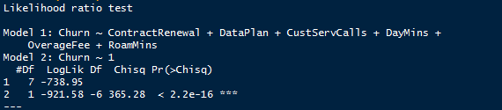
Model Statistics
Null Deviance – Shows how well the response variable is predicted by a model that includes only the intercept (grand mean)
Value : 1843.2 on 2332 degrees of freedom
Residual Deviance – Shows how well the response variable is predicted by a model that includes independent variable
Value : 1477.9 on 2326 degrees of freedom
Pseudo R2 – 20% of uncertainty produced by intercept model has been calibrated/explained by full model
Maximum Likelihood Estimator - Model 1 fairs better than intercept model

Slide 12
Model Evaluation
Confusion Matrix
Train
Test

Slide 15
Confusion matrix
Mle
Pr2
Odds & interpretation

