Slide 1

AgentShield AI Autonomous Multi-Agent Framework for Multi-Cloud Infrastructure-as-Code Security Under the Guidance of Dr. Vishal Reddy
Team members:
Anisha Paturi
Ch Parinamika Bhanu
Ch Venkata Vahini
Sravani Janak

Slide 2
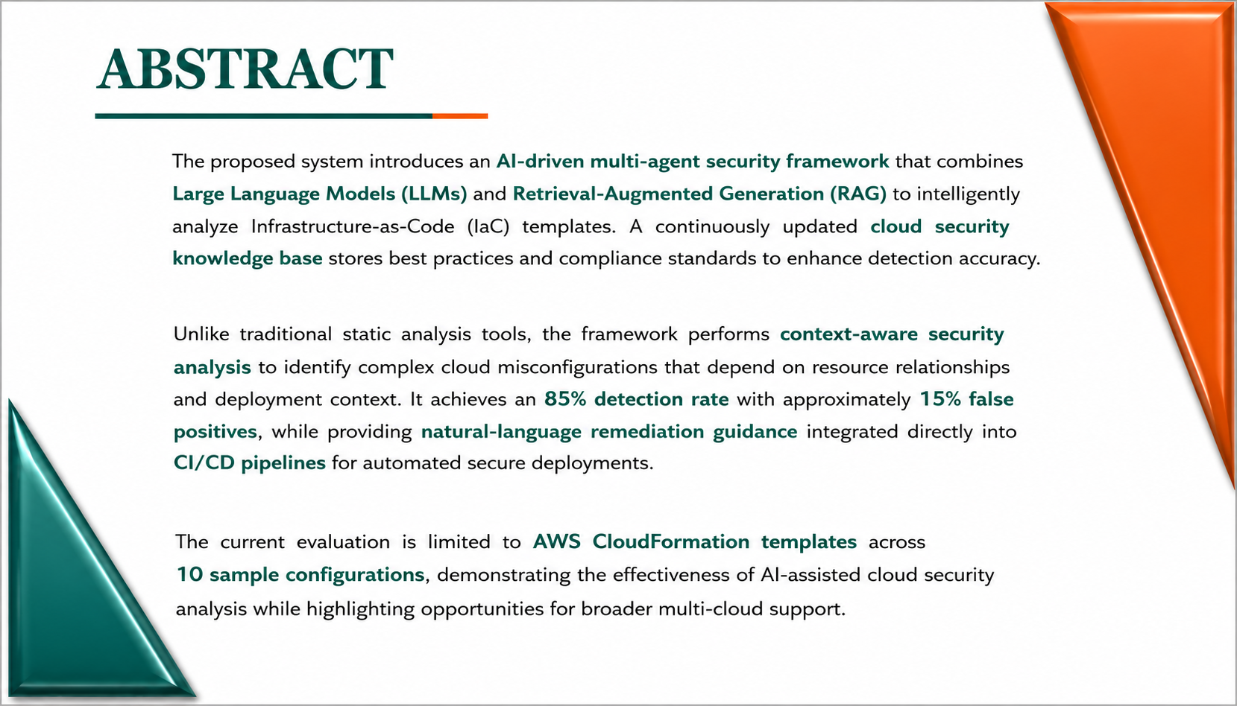

Slide 3
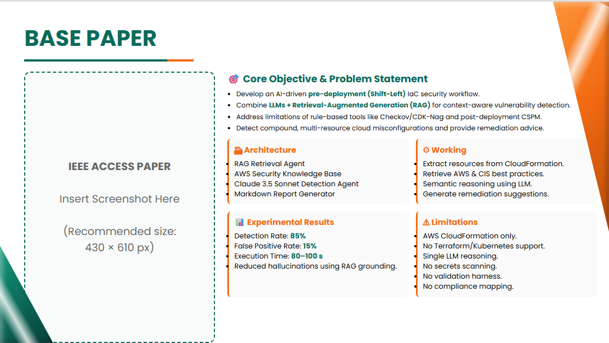
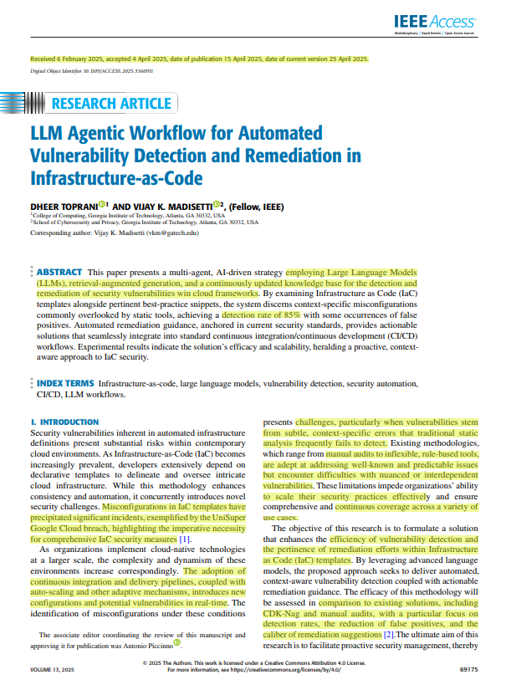

Slide 4
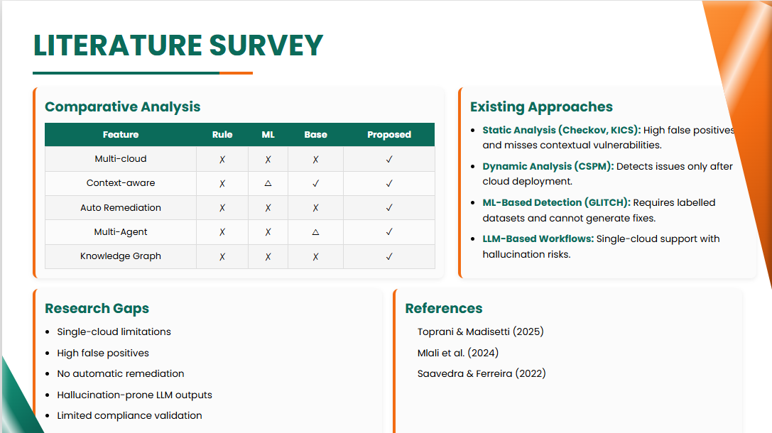

Slide 5
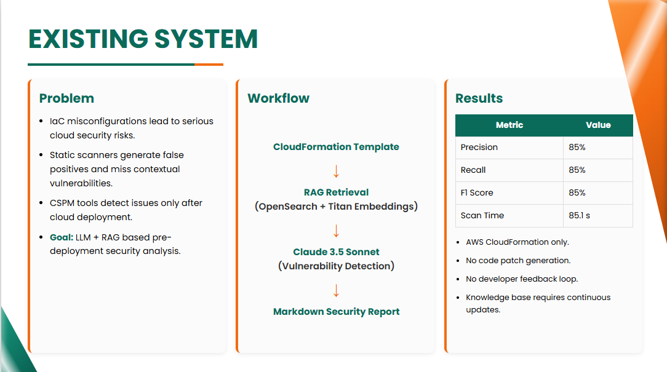

Slide 6
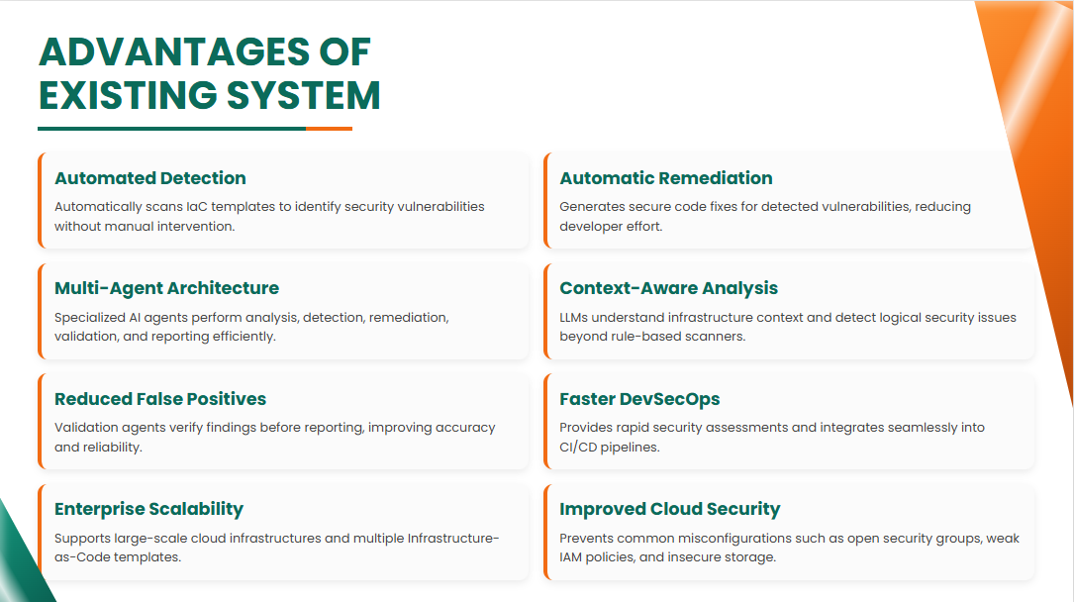

Slide 7
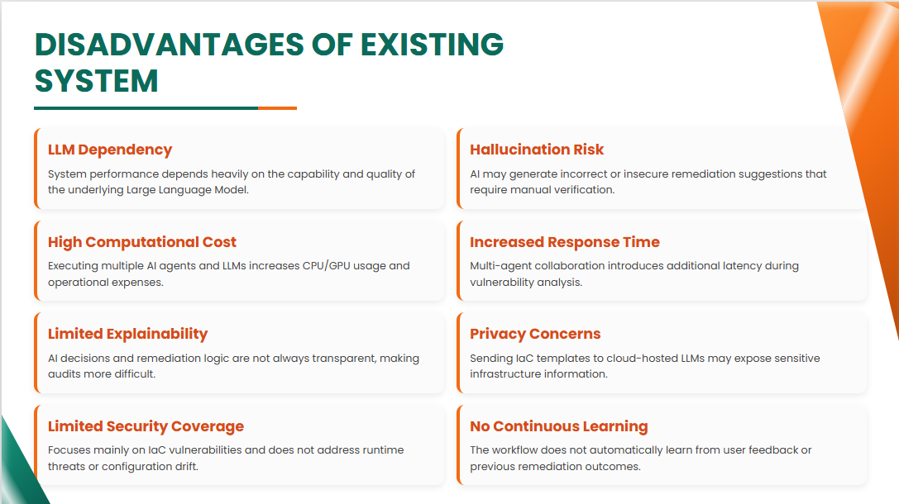

Slide 8
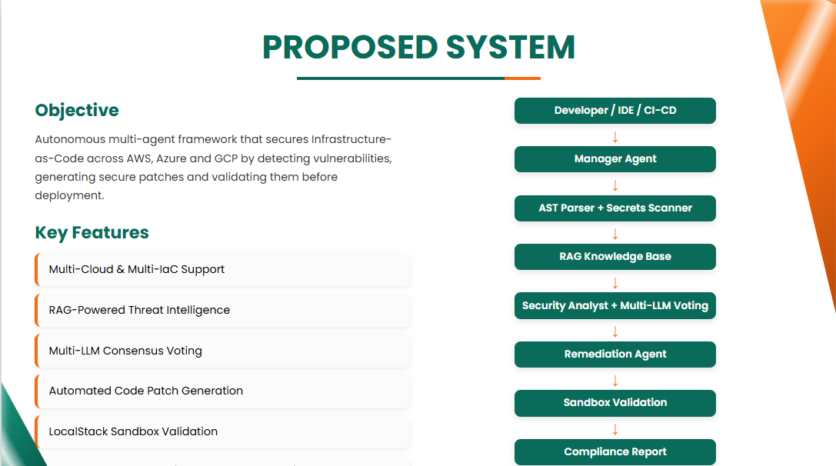

Slide 9
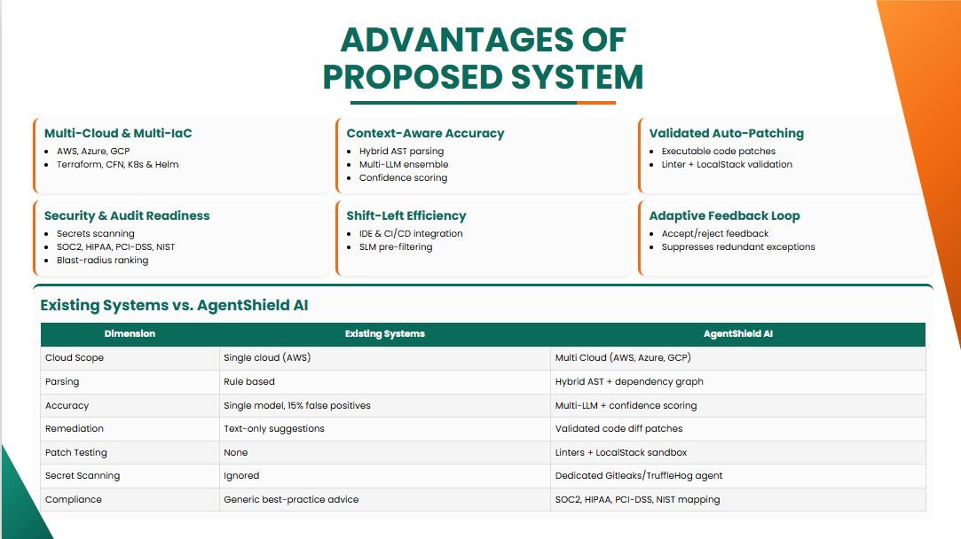

Slide 10
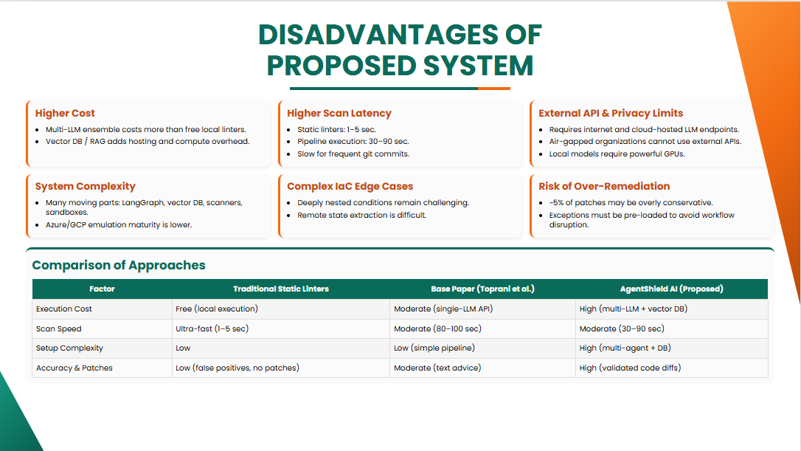

Slide 11
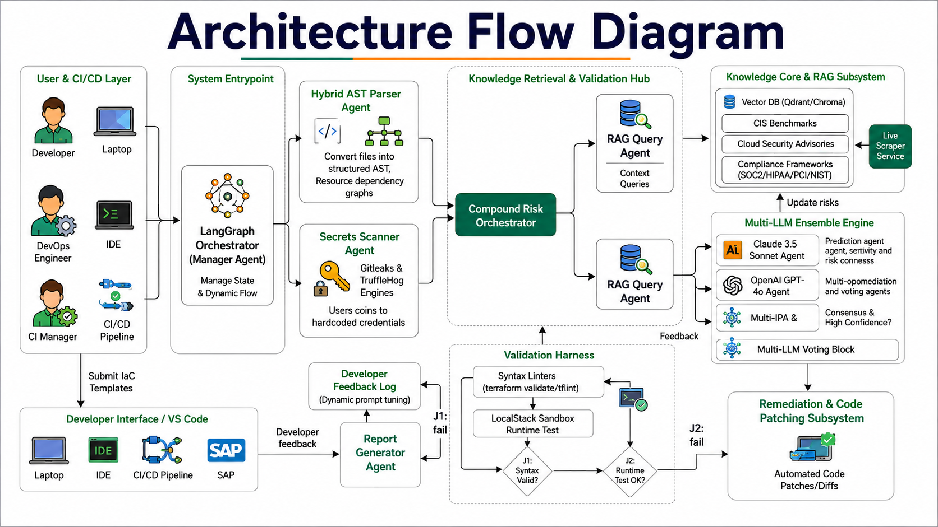

Slide 12
