Slide 1

AgentShield AI
Autonomous Multi-Agent Framework for Multi-Cloud Infrastructure-as-Code Security
Under the Guidance of
Dr. Vishal Reddy
Team members:
Anisha Paturi
Ch Parinamika Bhanu
Ch Venkata Vahini
Sravani Janak

Slide 2
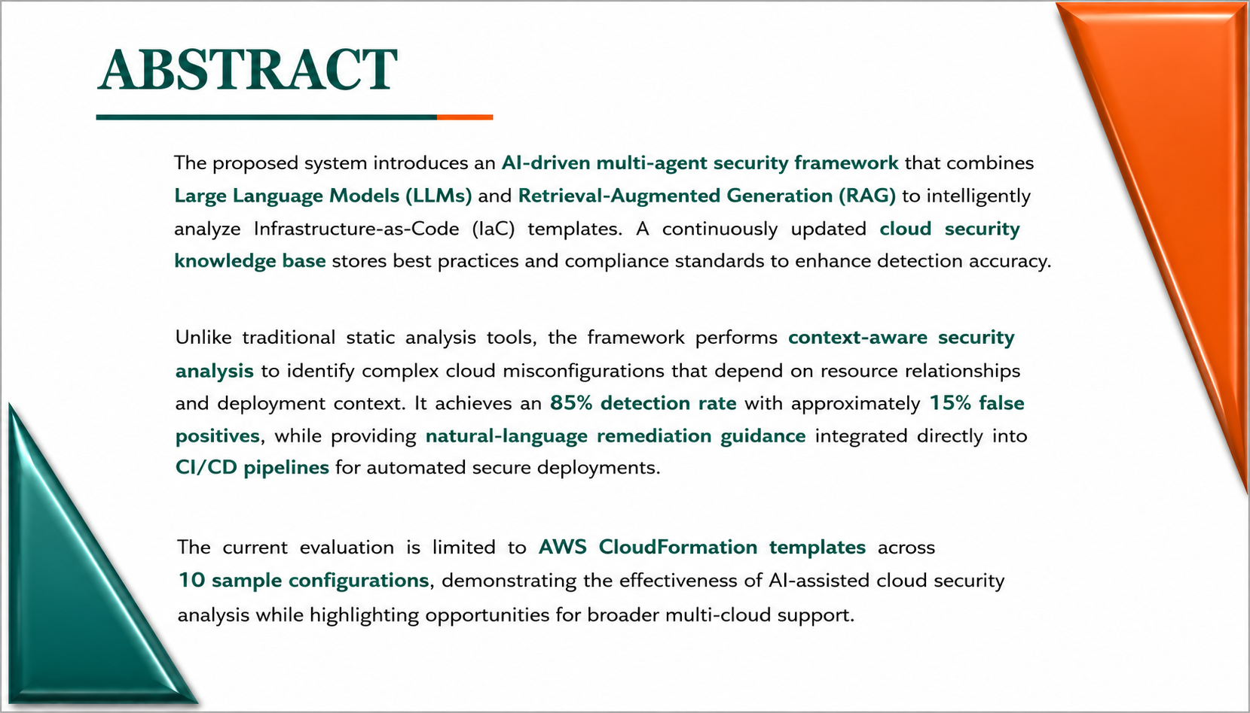

Slide 3
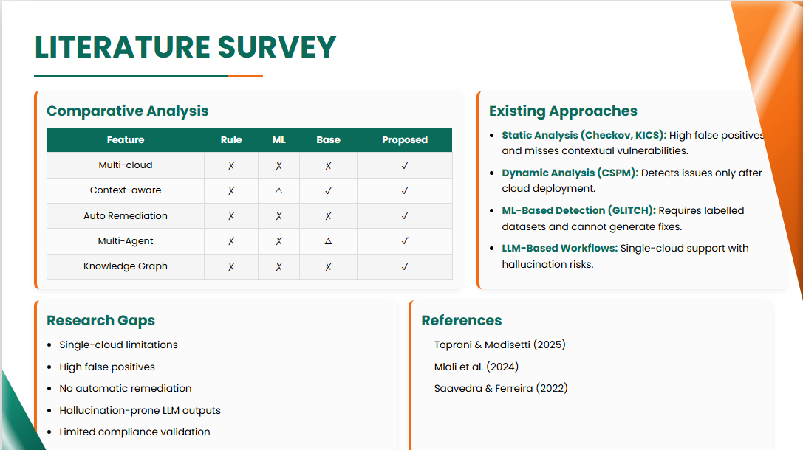

Slide 4
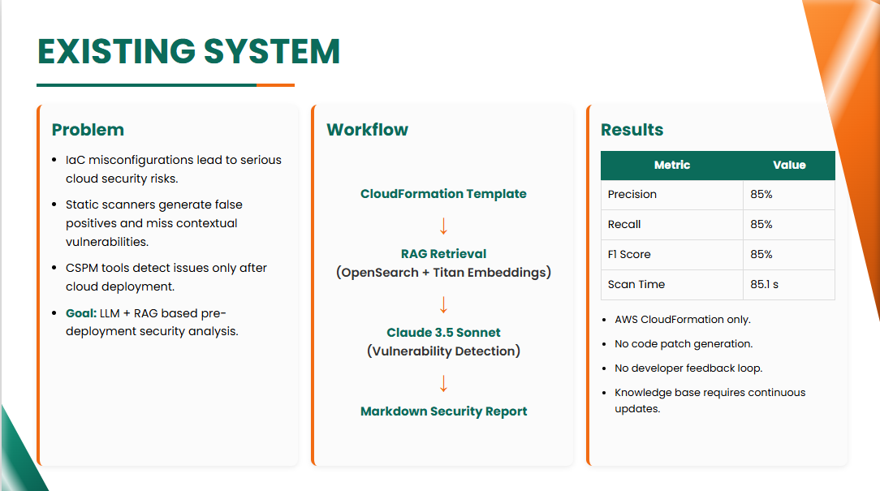

Slide 5
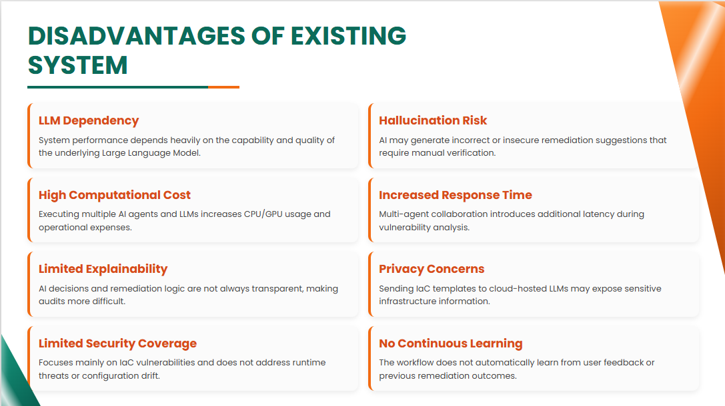

Slide 6
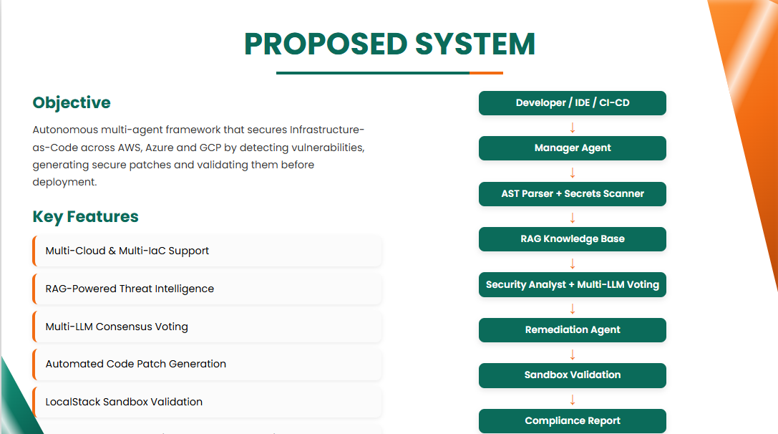

Slide 7
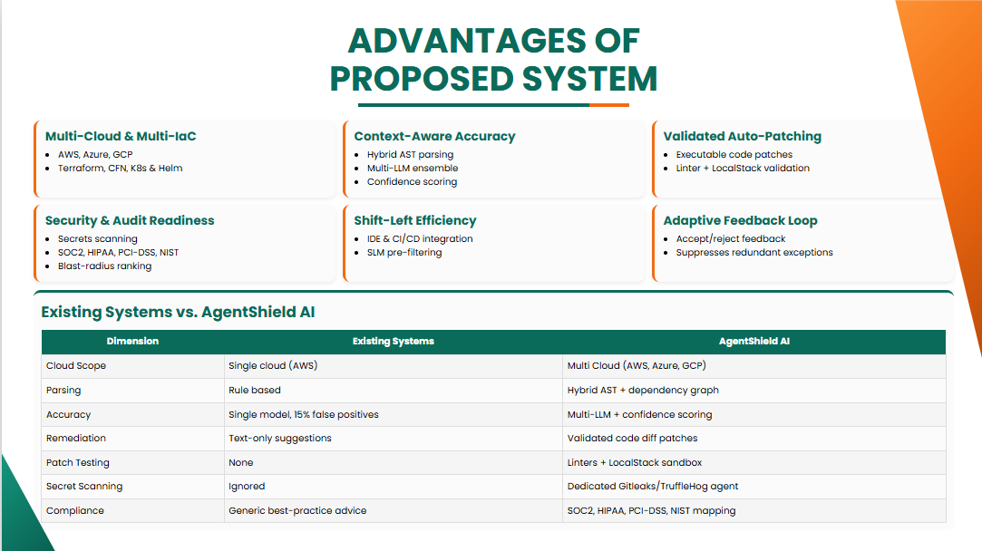

Slide 8
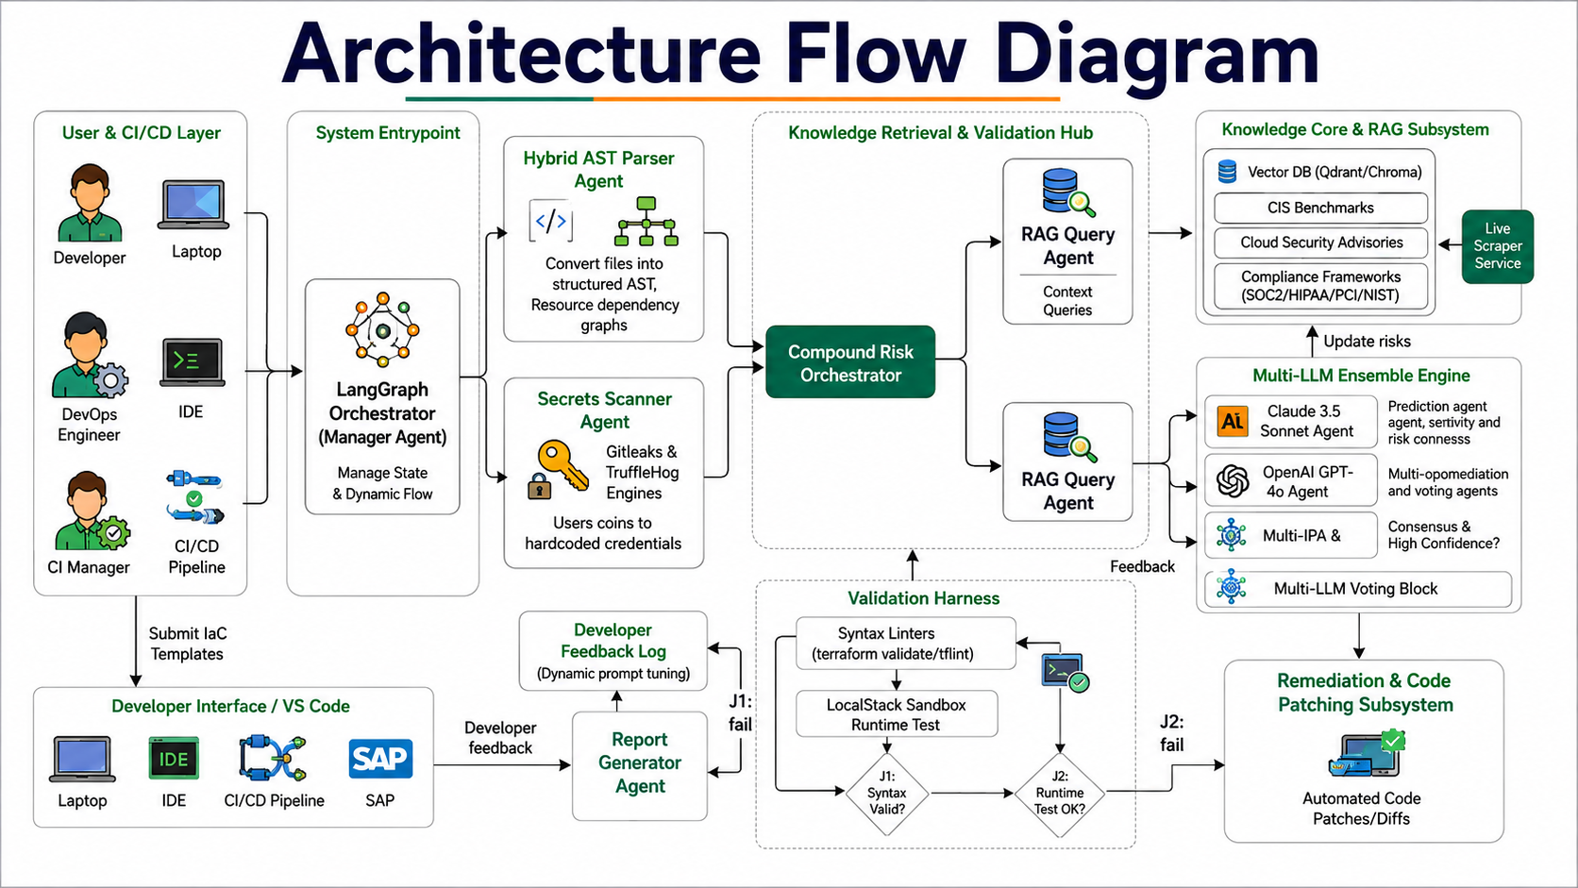

Slide 9
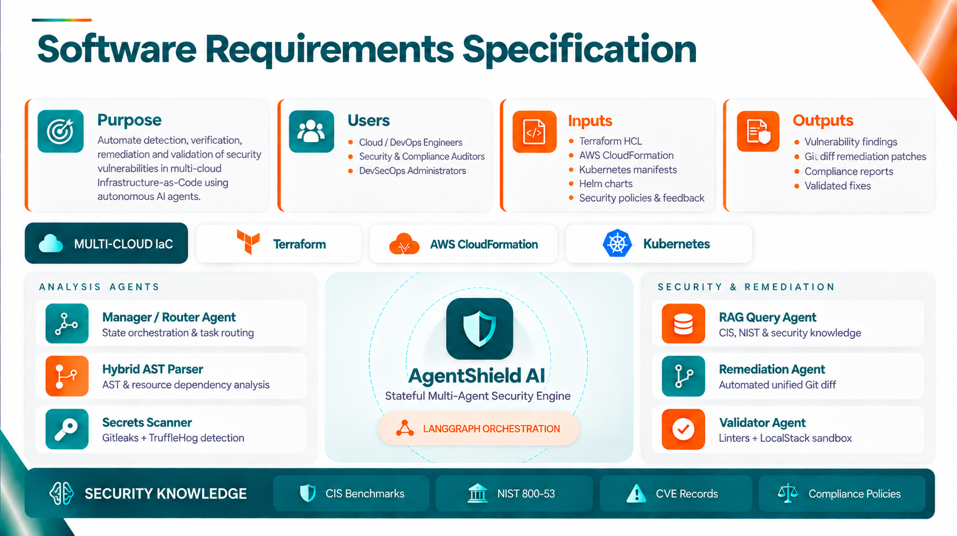

Slide 10
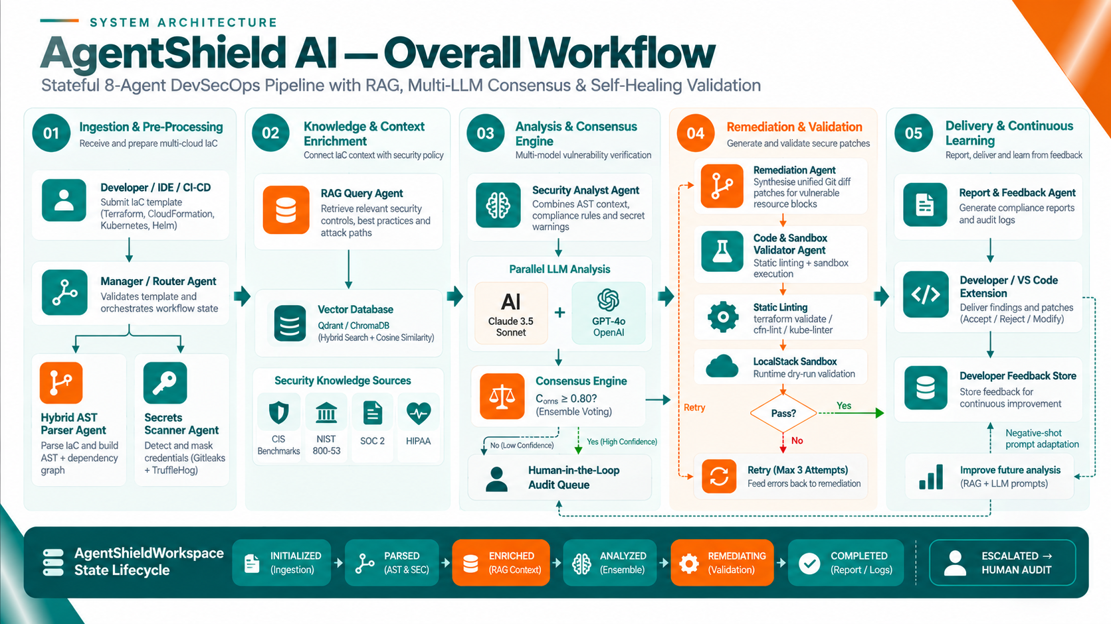

Slide 11
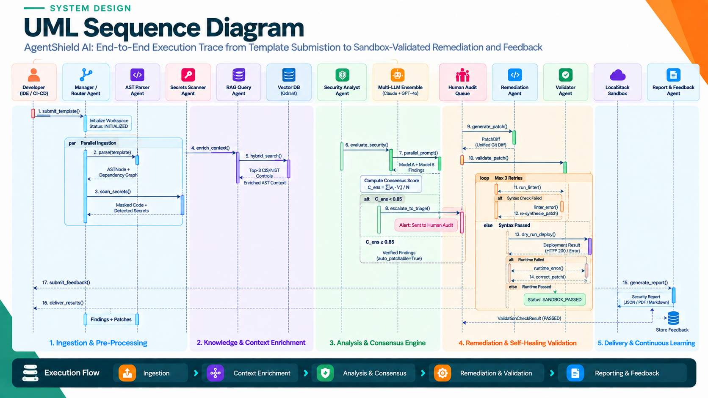

Slide 12
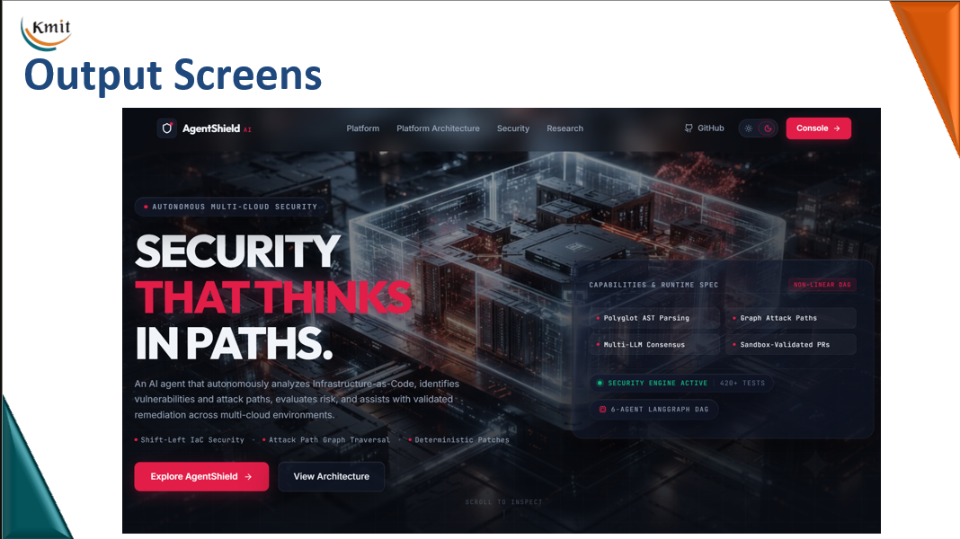

Slide 13
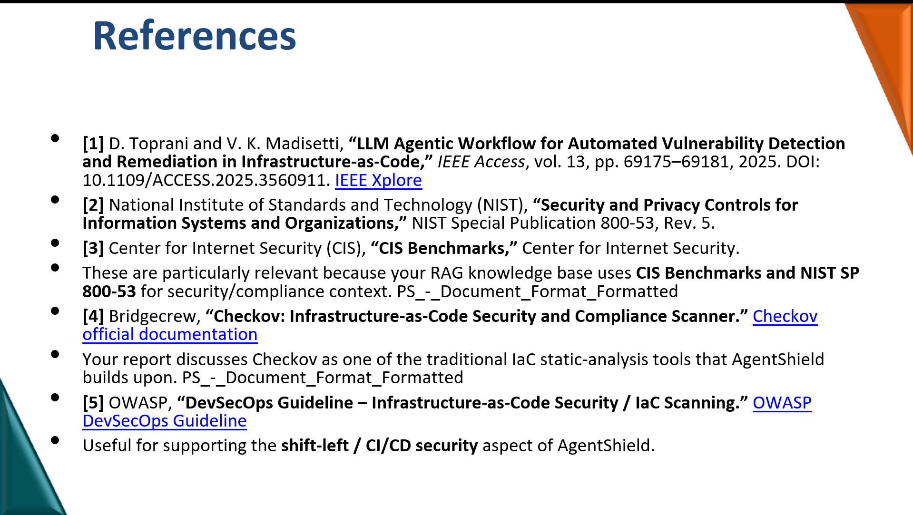

Slide 14


