Slide 1







College Connect
Night Owls
9.Open innovation

Slide 2

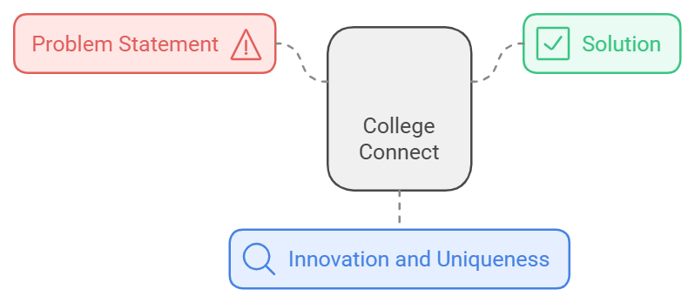

Students struggle with staying informed about campus updates, long canteen queues, inefficient event registration, limited academic collaboration, and ineffective feedback systems, leading to a less streamlined campus experience.
College Connect is a dynamic web platform that keeps students informed and connected through personalized login access. It provides class and campus-wide news and features a dedicated section for companies visiting for placements and internships, enhancing career readiness.
Holistic Campus Management
Canteen Pre-Order System
Peer Help Portal
Real-Time Notifications
User-Centric Design
Scalable for Future Enhancement

Slide 3
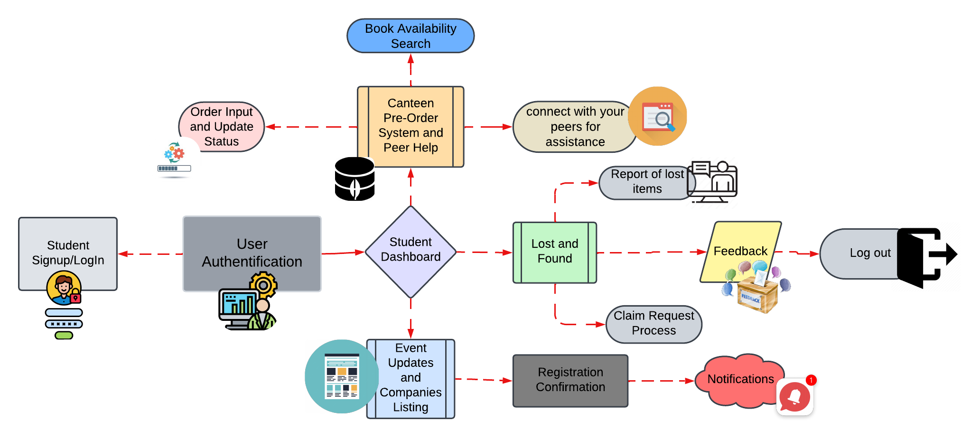

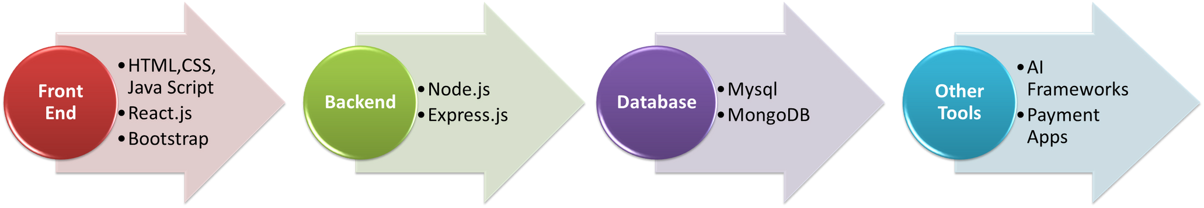

Slide 4
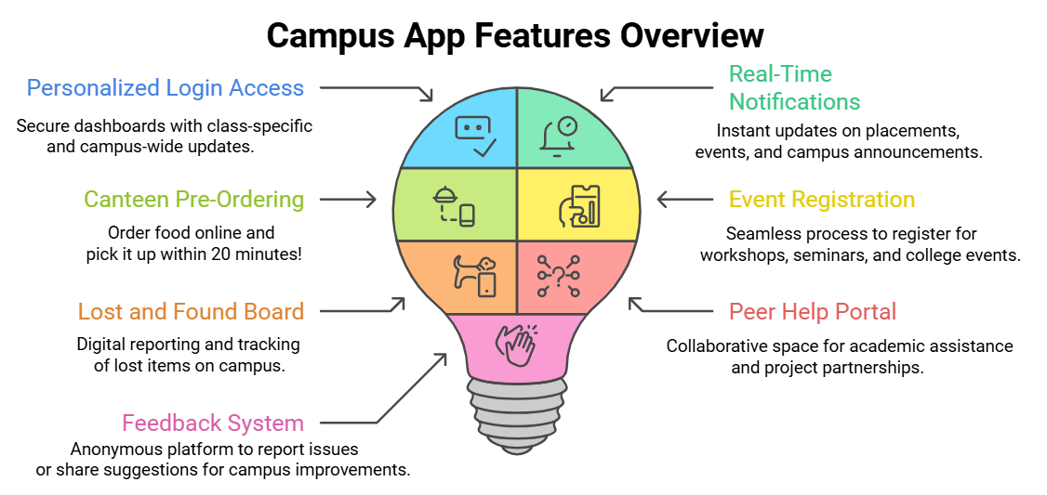

Potential Impact on Target Audience
For Students:
2.For Faculty and Staff:
3.For College Administrators
Enhanced Efficiency
Improved Communication
Collaborative Opportunities
Stress Reduction
Better Engagement
Event Organization Simplified
Streamlined Operations
Data Insights
Enhanced Reputation
Higher Student Satisfaction

Slide 5
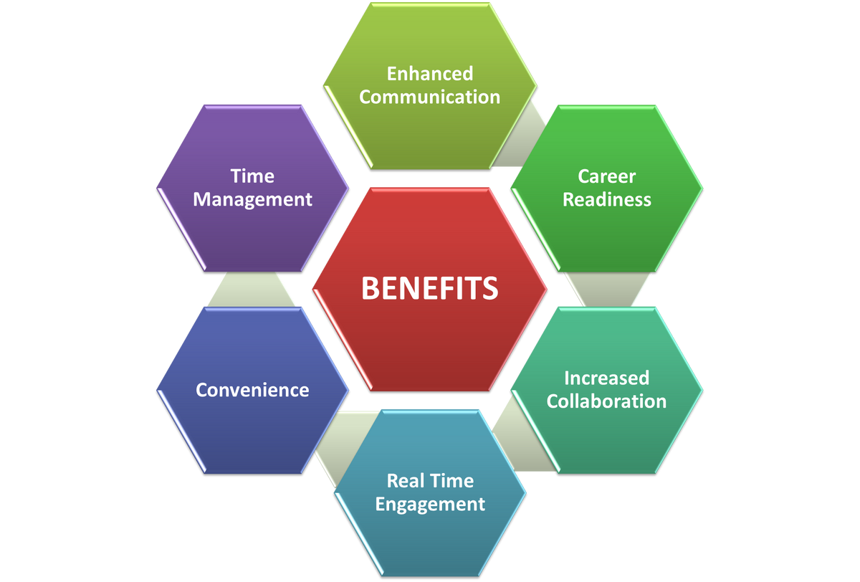
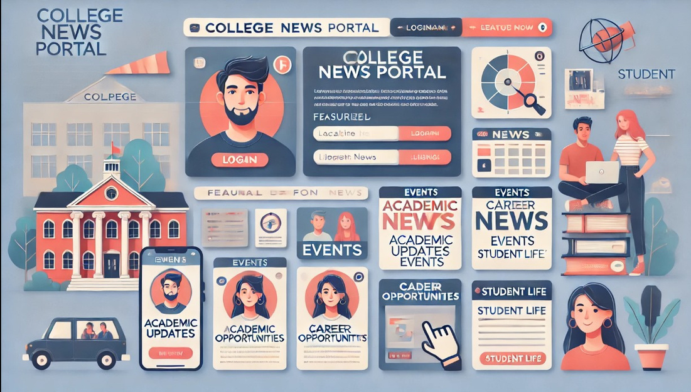
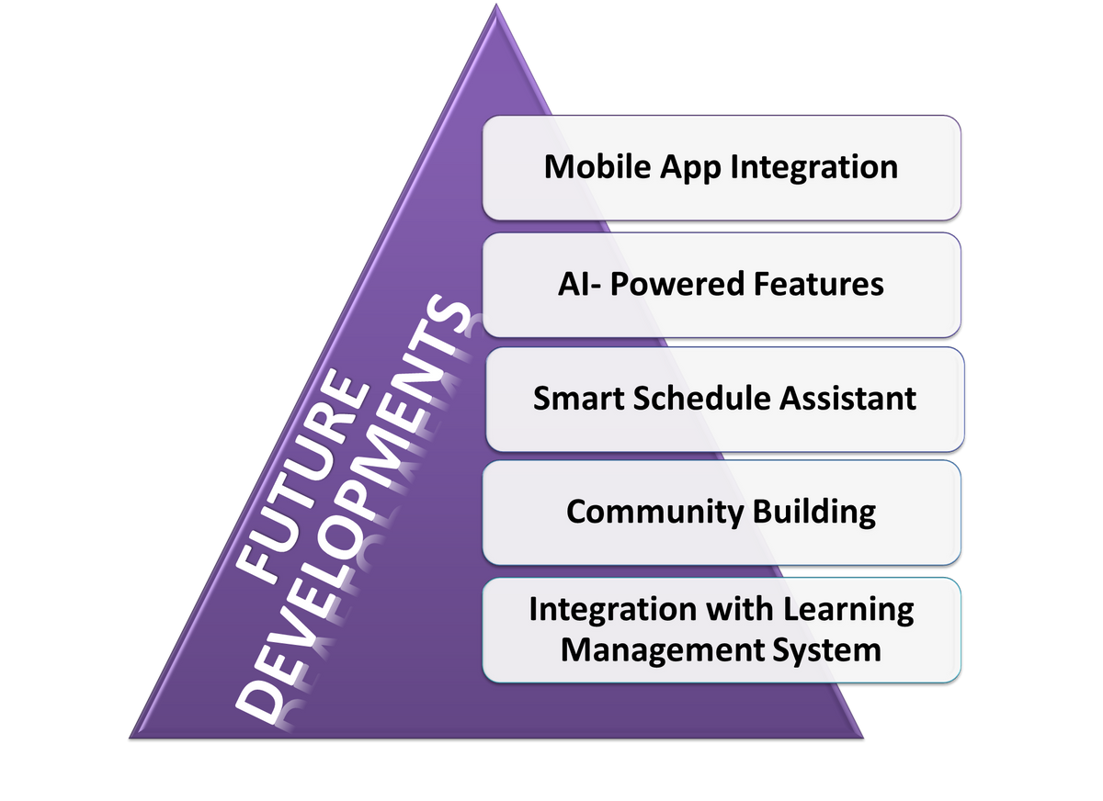
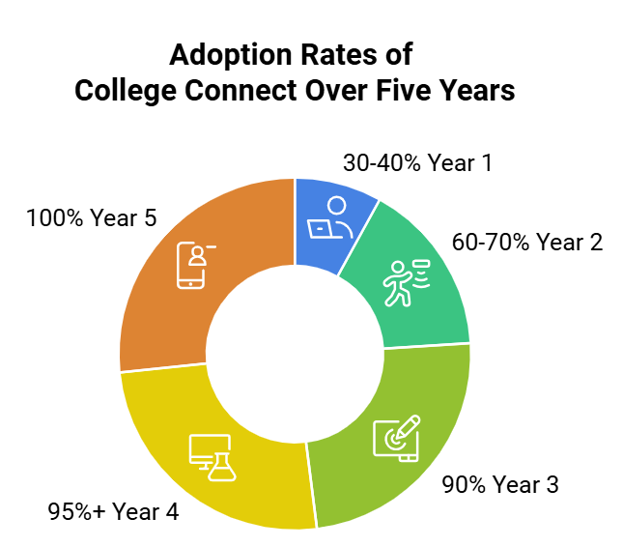


Slide 6
THANK YOU

